Slide 1
Maximizing Retention
JORDAN T. YELINEK
Assistant Grand Secretary
Emily M. Limon
Chief Communications Officer
Lodge Leadership Retreat 2025
Administration and Membership Tracks

Slide 2
Why This Matters
Retention keeps our fraternity alive.
Use available systems and services to support members.
Notes:
Prompt: Think about someone who went NPD in your lodge. What might have changed that outcome?

Slide 3
Systems and Services for Your Lodge

Slide 4
Restoration Campaign Snapshot
Over 20% of contacted members restored to good standing.
Average of $11,000 in dues/restoration per lodge.
Participation growing across California.
Notes:
Include QR code to campaign resources.

Slide 5
How It Works: Restoration Campaign
$100 flat fee restores membership.
Lodge adopts resolution and submits list.
Grand Lodge performs outreach and processing.
Notes:
Include QR code to sample resolution form.

Slide 6
Dues Invoicing Program
30+ touchpoints: letters, emails, reminders.
90% retention rate for participating lodges.
Compared to 80% for self-managed lodges.
Notes:
Include QR to sign-up or FAQs.

Slide 7
How It Works: Dues Invoicing
Lodge opts in to invoicing.
Grand Lodge manages outreach and payment collection.
Secretaries receive regular updates.

Slide 8
Retention Campaign: What We Learned
We reached out to 100 Masons marked as Notice of Intent to Suspend in 2024
Personal outreach doubled retention rates
Text messaging was the most effective method
Half of those contacted beyond the certified letter remained in good standing
Human connection matters more than policy

Slide 9
Who We Heard From
Quiet loyalty - No response, but paid
Appreciation matters - Thanked us, then paid
No relationship beyond dues - Disconnected EAs/FCs
Needed assistance, not silence - Financially burdened

Slide 10
Masonic Assistance Snapshot
CARE MANAGEMENT
FINANCIAL ASSISTANCE
SENIOR HOUSING
EMERGENCY ASSISTANCE
AGE-APPROPRIATE PROGRAMS
(888) 466-3642

Slide 11
Communication Tricks and Tips

Slide 12
Talk Like a Human
Lead with care, not consequences.
“We miss you” vs. “Pay or be suspended.”

Slide 13
Tone Sets the Outcome
Gentle honesty > rigid formality.
Let members feel seen—not scolded.
Notes:
Prompt: What’s one thing your lodge does well in member communication?

Slide 14
Frequency Builds Familiarity
Reach out before dues season.
Year-round check-ins matter.

Slide 15
Best Practices

Slide 16
Your Turn: Share What Works
Turn to someone near you and share:
One thing you’d like to try this year.
One thing your lodge does to retain members.

Slide 17
What Did You Learn?
How was that conversation for you?
What’s one thing you’ll take back to your lodge?

Slide 18
Key Takeaways
Use Grand Lodge services —they work.
Talk to your members before it’s too late.
Retention is about relationships, not just procedures.

Slide 19
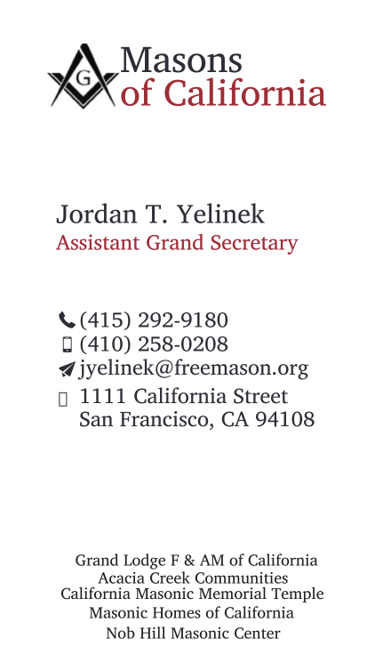
Let's Stay Connected
Jordan T. Yelinek
Emily M. Limón
Assistant Grand Secretary
Chief Communications Officer
(415) 292-9180
(415) 292-9180
jyelinek@freemason.org
elimon@freemason.org
1111 California Street San Francisco, CA 94108
1111 California Street San Francisco, CA 94108

