Slide 1
The Secretary as a Leader Influencing lodge culture and success
Allan L. Casalou
Grand Secretary
Lodge Leadership Retreat 2025
Administration Track

Slide 2
More Than a Recorder
You were not elected to take notes. You were called to lead.
The secretary is the cultural and emotional center of the lodge.
Notes:
Prompt: What made you say 'yes' to this role?
This session is about redefining what it means to be a secretary in Freemasonry.

Slide 3
Lodge Culture Starts at the Desk
Culture is shaped by what we honor and what we overlook.
You set the tone more than you realize.

Slide 4
Collaboration Over Command
Work with the Master, be his first follower.
A good Secretary can work with any Master

Slide 5
Seeing the Big Picture
A good secretary knows the bylaws.
A great secretary knows the people.

Slide 6
You Are Not Alone
There is a large community of Secretaries – lean in
Member Services is always here for you
Notes:
Prompt: What’s one piece of advice you’d give a brand-new secretary?

Slide 7
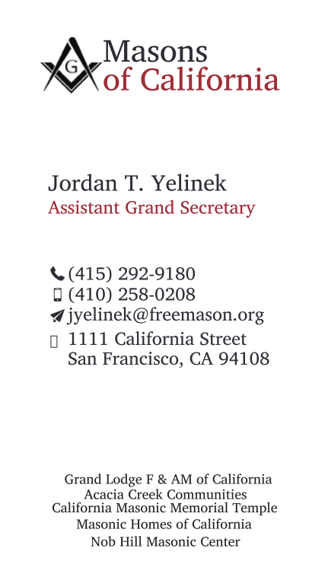
Let's stay connected
Allan L. Casalou
Grand Secretary
(415) 292-9140
acasalou@freemason.org
1111 California Street San Francisco, CA 94108

