Slide 1
Welcoming New Members
Secrets of an Engaging Onboarding Process
MICHAEL ROBERTS
Manager of membership and lodge development
Lodge Leadership Retreat 2025
Administration Track

Slide 2
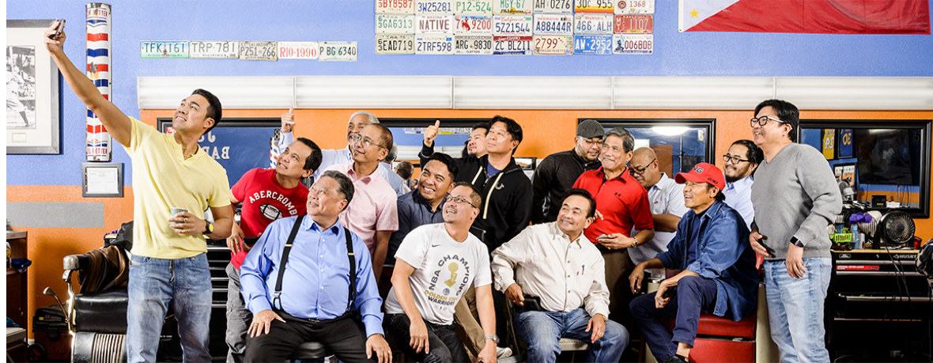
We will cover three key areas:
Creating effective Welcome Kits
Tracking progress through degrees
Integrating members into lodge life with mentorship

Slide 3





How Do You Feel About Your Engaging Onboarding Process?
Emoji | Description
1 | Excited & Confident “I love onboarding and feel great about it!”
2 | Curious & Open to Learning “I think I’m doing okay, but I want to improve.”
3 | Overwhelmed & Uncertain “I’m not sure if my onboarding process is working.”
4 | Skeptical or Uninterested “Does onboarding really matter that much?”
5 | Frustrated & Struggling “Onboarding feels chaotic – I need help!”

Slide 4

Open Discussion
Lodge Welcome Kits
“First Impressions Matter”

Slide 5
Welcome Kit
Lodge Welcome Kits
“First impressions matter”
Who here currently uses a Welcome Kit for new prospects?
Why do first impressions matter so much? What happens when a new member feels lost?
What’s one item your lodge includes – or should include – that makes a difference?

Slide 6
What should be included in a Well-Structured Welcome Kit
Personalized welcome letter
Lodge informational brochure
Trestleboard
Opening the Door to Freemasonry
Invitation to attend an event

Slide 7

Sample Welcome Kit
Notes:
By a show of hands, how many of your lodges have a Welcome Kit?

Slide 8
Welcome Letter

Slide 9
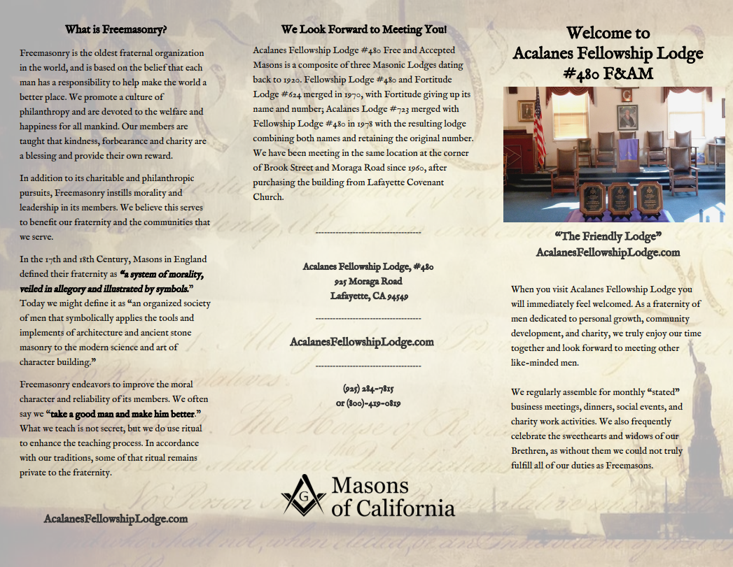
Lodge Informational Brochure

Slide 10
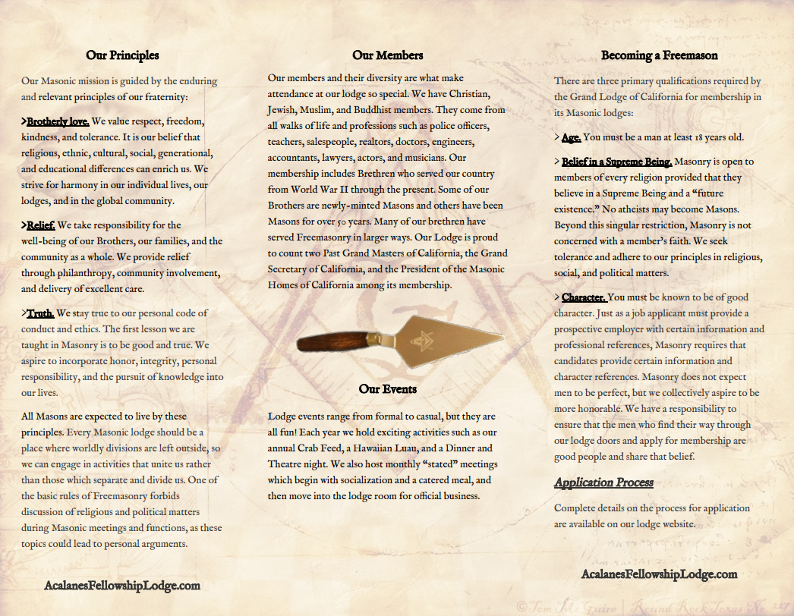
Lodge Informational Brochure

Slide 11
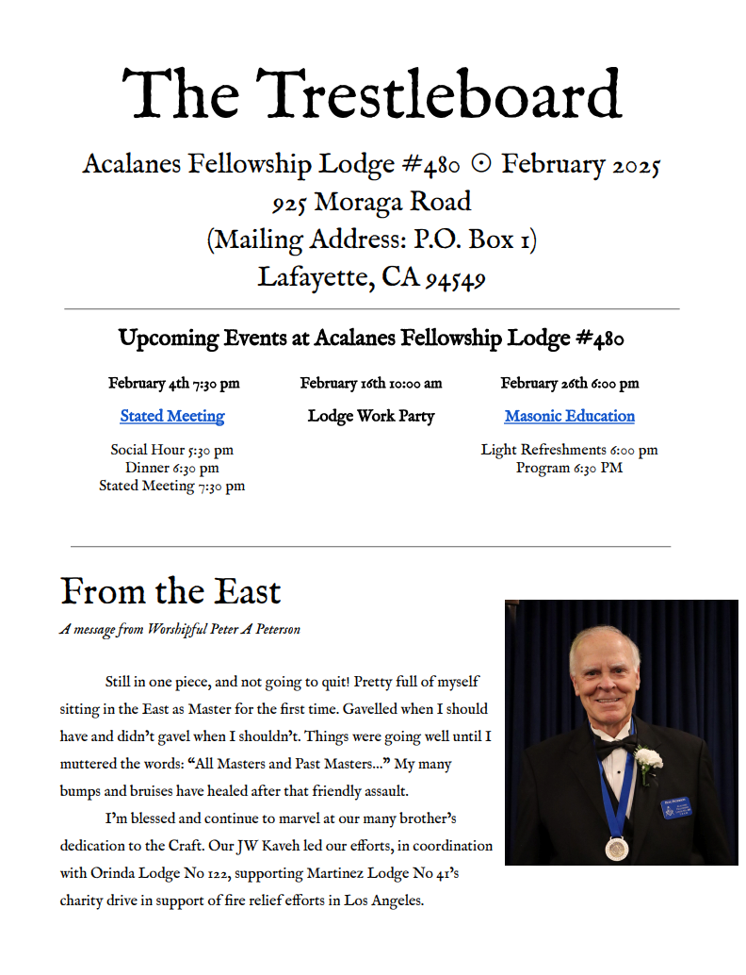
The Trestleboard

Slide 12
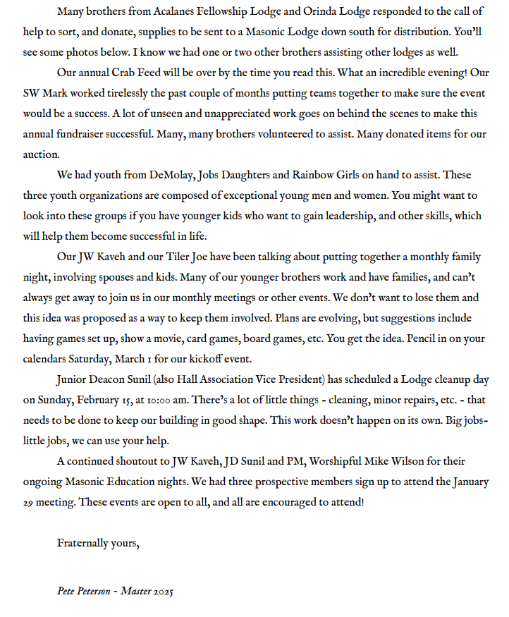
The Trestleboard

Slide 13
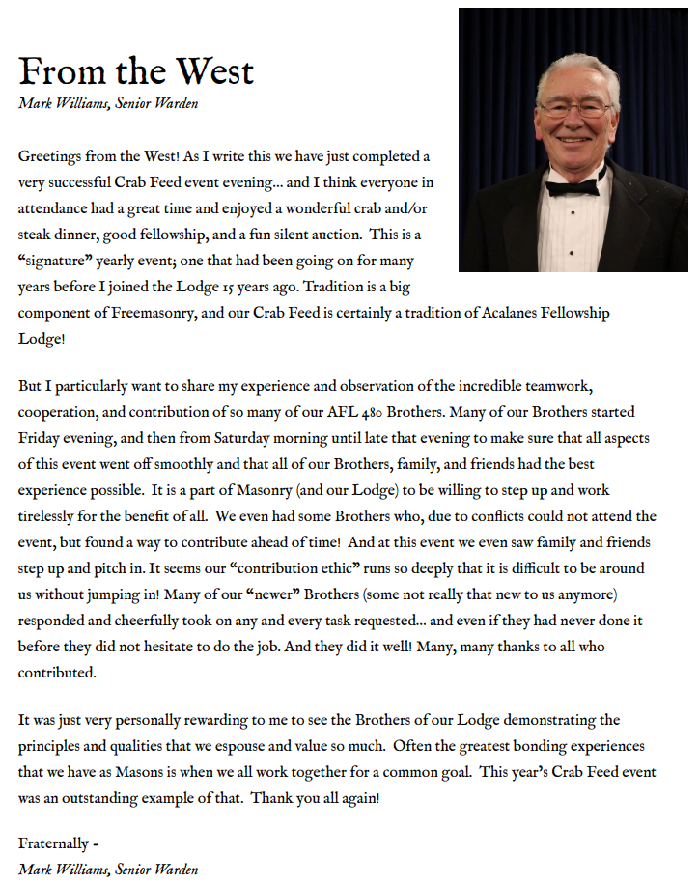
The Trestleboard

Slide 14
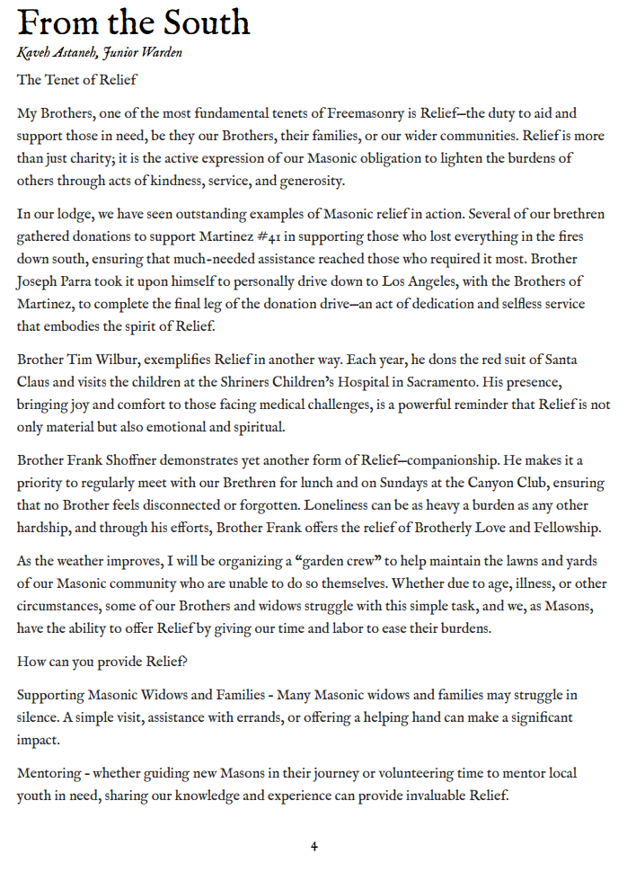
The Trestleboard

Slide 15
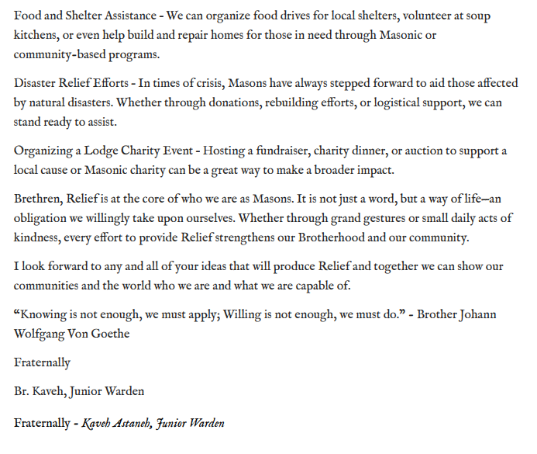
The Trestleboard

Slide 16
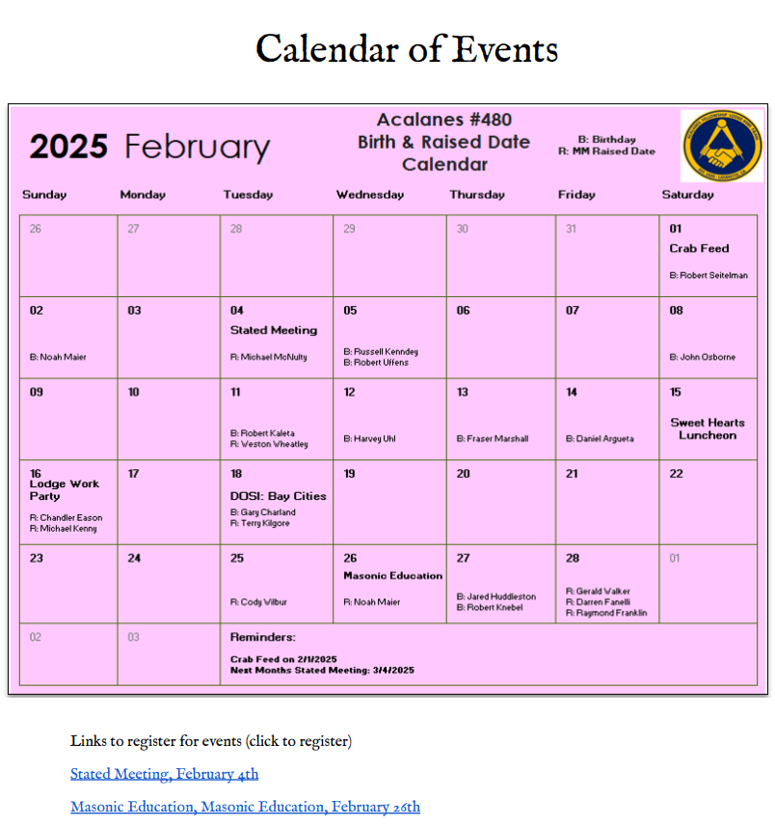
The Trestleboard

Slide 17
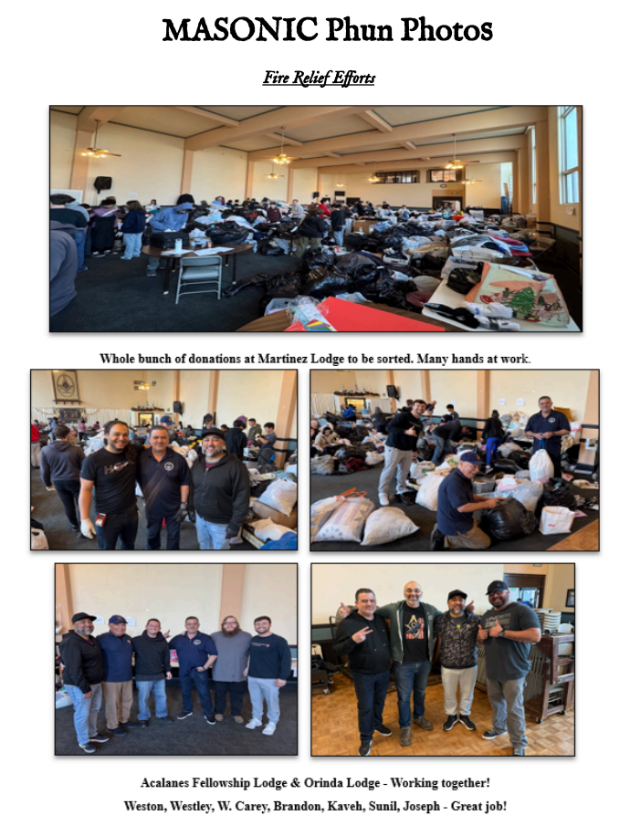
The Trestleboard

Slide 18
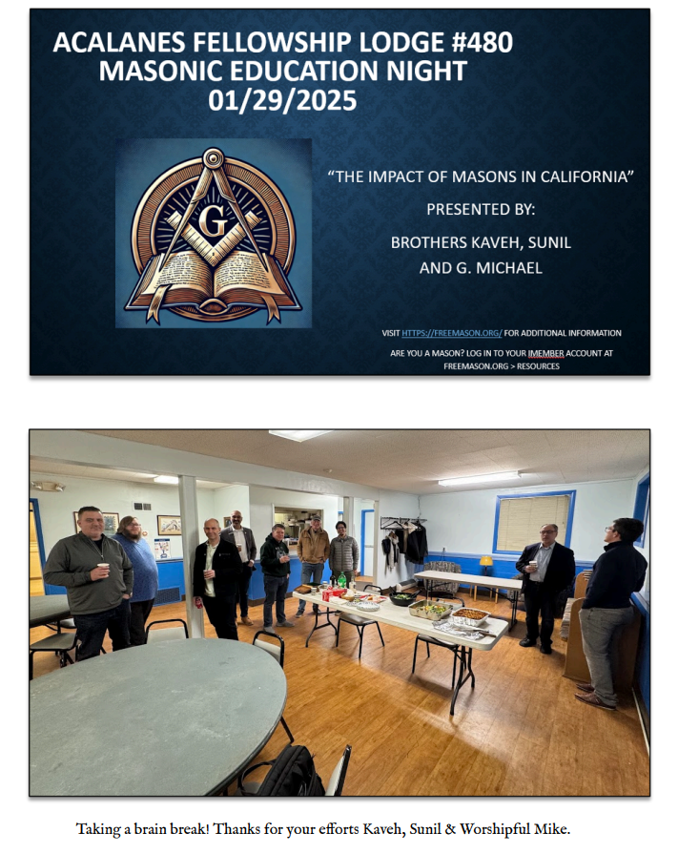
The Trestleboard

Slide 19
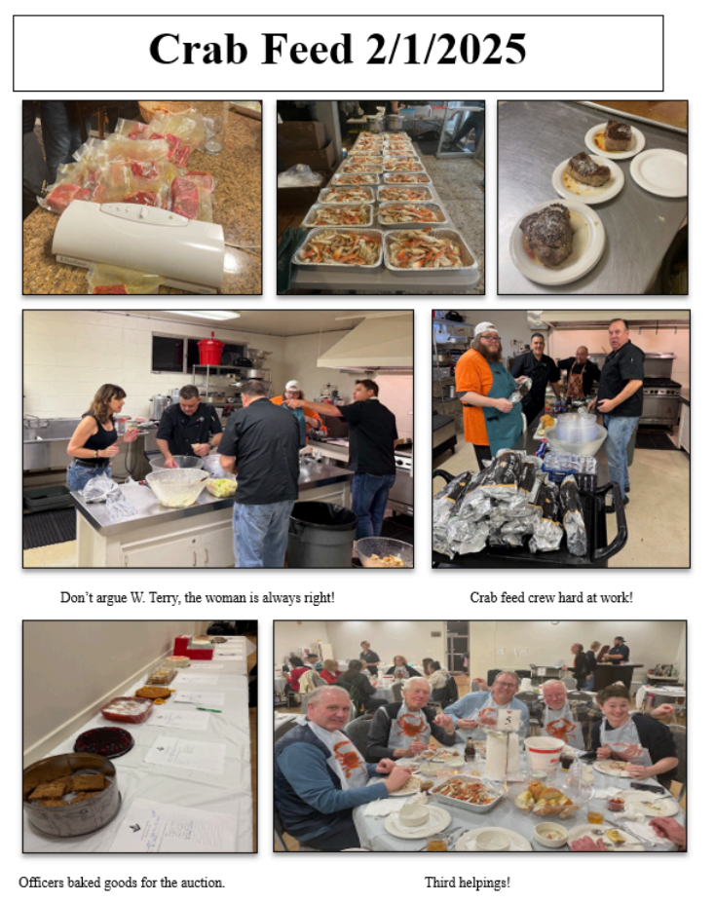
The Trestleboard

Slide 20
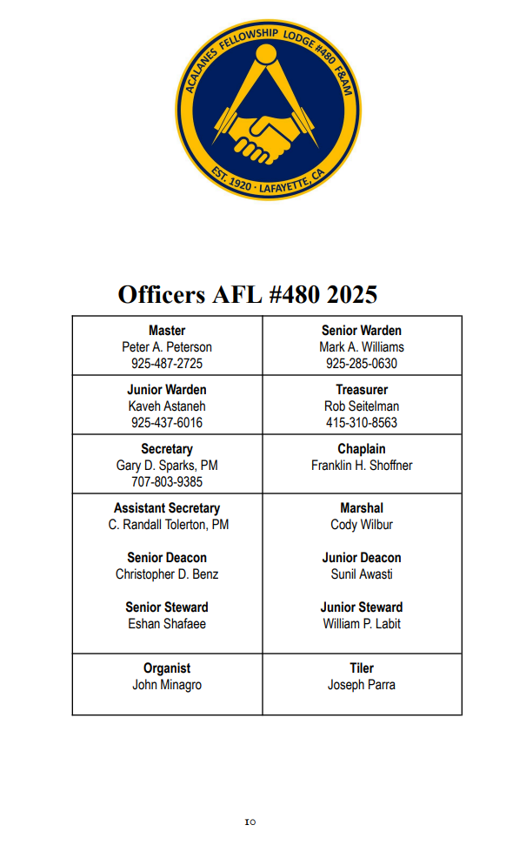
The Trestleboard

Slide 21
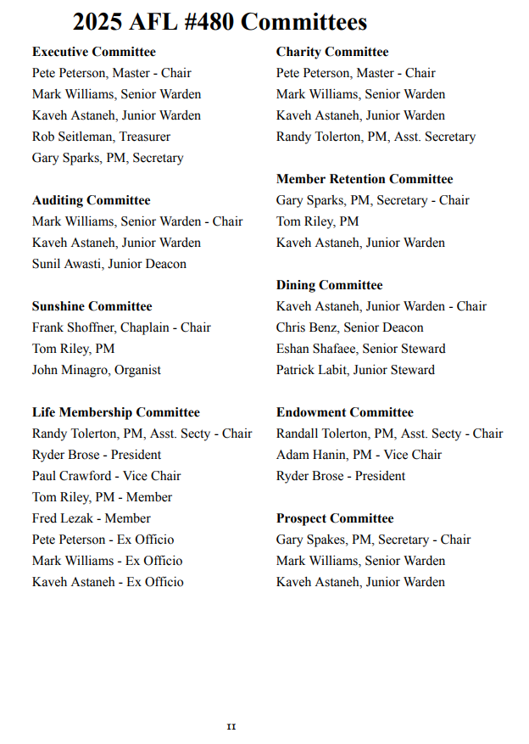
The Trestleboard

Slide 22
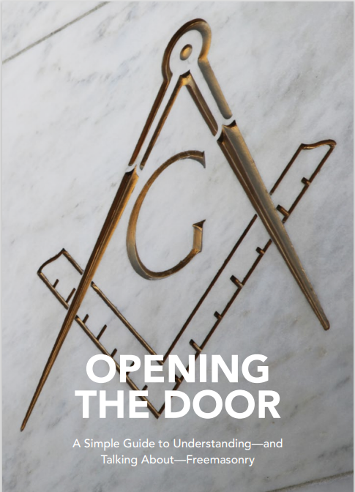
Simple Guide to Understanding-and Talking About-Freemasonry
https://freemason.org/openingthedoor/
Available for free download:
English
Spanish
French

Slide 23
OPENING THE DOOR
A Simple Guide to Understanding and Talking About-Freemasonry
Supply Order Form LAFSCO
Los Angeles Fraternal Supply Company
(310) 537-7663
https://www.lafsco.com/100-opening-the-door-package-p-1485.html
GL-100 Opening The Door
Package of 50 - $4.00

Slide 24
Invitation to Attend an Event

Slide 25
Open Discussion
Tracking member progress
Notes:
By a show of hands, how many of your lodges actively integrate new members into lodge life?

Slide 26
Open Discussion
Tracking member progress
Who here tracks members’ progress in iMember?
Why do members disengage? What happens when there’s no clear path forward?
How does your lodge currently track progress through degrees in iMember – and what’s working (or not)?
Notes:
By a show of hands, how many of your lodges actively integrate new members into lodge life?

Slide 27
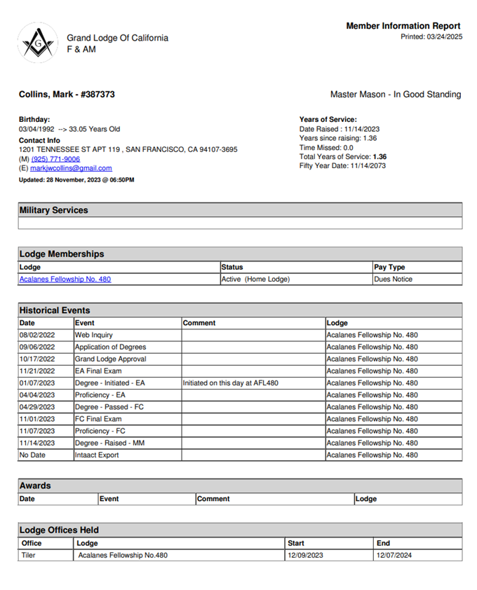
Member Information Report
Notes:
By a show of hands, how many of your lodges actively integrate new members into lodge life?

Slide 28
Open Discussion
Integrating members into lodge life with mentorship

Slide 29
Open Discussion
Integrating members into lodge life with mentorship
Who here has a defined process in place for new member integration?
Why does new member integration and mentorship matter?
What is one thing your lodge does (or could do) to collaborate with officers to create mentorship opportunities that foster connection and growth?

Slide 30
Integrating new members into lodge life
Structured Mentorship Program
  Assign a mentor (seasoned Mason) to each new member to help them understand traditions, expectations, and the significance of degrees.
  Set up regular check-ins to answer questions and discuss Masonic education.
  Encourage informal meetups, such as coffee chats or lodge dinners, to build rapport.

Slide 31
Integrating new members into lodge life
Social & Community Engagement
  Plan casual social events (BBQs, game nights, sports outings) to help new members bond with the brethren.
  Encourage participation in community service projects, giving them a sense of purpose and active involvement.
  Invite them to lodge-sponsored family events to help integrate their families into the Masonic community.

Slide 32
Integrating new members into lodge life
Educational Opportunities
Offer a Masonic study group or discussion sessions on key teachings, history, and symbols.
Provide digital access to online resources like podcasts, videos, and reading materials for deeper learning.
Organize a Q&A session where Past Masters share their experiences and insights.

Slide 33
Integrating new members into lodge life
Active Involvement in Lodge Operations
Encourage participation in degree teams, so they feel engaged in the ritual process.
Give them small responsibilities (helping with events, setting up for meetings, greeting guests) to foster a sense of contribution.
Invite them to serve on a lodge committee (charity, membership, social, etc.) based on their interests.

Slide 34
Integrating new members into lodge life
Leveraging Technology for Engagement
Use iMember Database to track their progress, send reminders, and provide access to Masonic materials.
Create a private lodge chat group (WhatsApp, Discord, etc.) for informal discussions and support.
Send a monthly email or newsletter with lodge updates, member spotlights, and upcoming events.

Slide 35
Integrating new members into lodge life
Recognition & Encouragement
Publicly acknowledge their progress in degrees during meetings or events.
Offer certificates or small tokens for completing their Entered Apprentice and Fellowcraft degrees.
Celebrate their first year with a "New Mason Anniversary" event, where they share their experiences and future aspirations.

Slide 36

Integrating new members into lodge life
Mentorship is the bridge between initiation and true belonging. Without it, new members struggle to find their place. With it, they thrive!

Slide 37
In Closing
We’ve talked about why onboarding matters and how to do it effectively
We explored three key elements:
Creating meaningful welcome kits
Tracking progress through degrees
Integrating members into lodge life through mentorship

Slide 38
In Closing: “A Call To Action”
If you could only do ONE thing to improve onboarding in your lodge, what would it be?
Commit to One Action
Write It down
Share with a neighbor (2 minutes)

Slide 39
Questions
Answers

Slide 40
Let’s keep in touch
Michael Roberts
✉️ mroberts@@freemason.org
📞 (415) 292-9135

