Slide 1
Modern Tools for Lodge Management
JORDAN T. YELINEK
ASSISTANT Grand Secretary
Lodge Leadership Retreat 2025
Administration Track

Slide 2
Why This Matters
Your role is more than admin—it's connection.
The right tools make communication consistent and simple.
Notes:
Prompt: Raise your hand if you’ve ever felt like you’re managing more than your fair share of lodge communication.
This is about improving communication—not just simplifying tasks.

Slide 3
iMember Is More Than Dues
It’s your member engagement dashboard.
All-in-one hub for events, messages, records.
Notes:
This sets up that iMember is the core platform for secretaries.
They may know how to pay dues, but not how to use the communication tools.

Slide 4
Four Tools to Make Life Easier
Newsletter announcements
Surveys
File vault
Events

Slide 5
Newsletter Announcement

Slide 6
Create a Newsletter Post
Use the built-in content editor.
Send targeted messages to your members.
Notes:
Include screenshot of newsletter tool.
Mention examples: monthly update, lodge announcements.

Slide 7
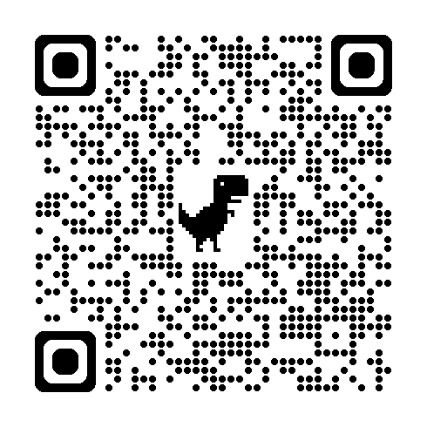
How to Create a Newsletter Announcement
1
Navigate to
http://member.freemason.or
g
Scan to download a step by step guide

Slide 8
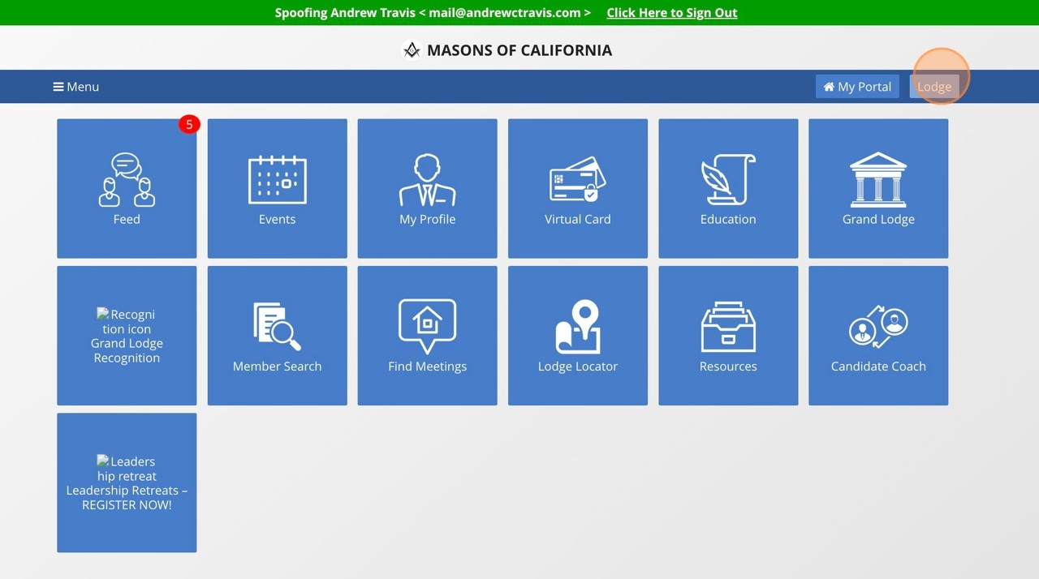
How to Create a Newsletter Announcement
2
Navigate to the Lodge dashboard by clicking "Lodge"
Scan to download a step by step guide

Slide 9
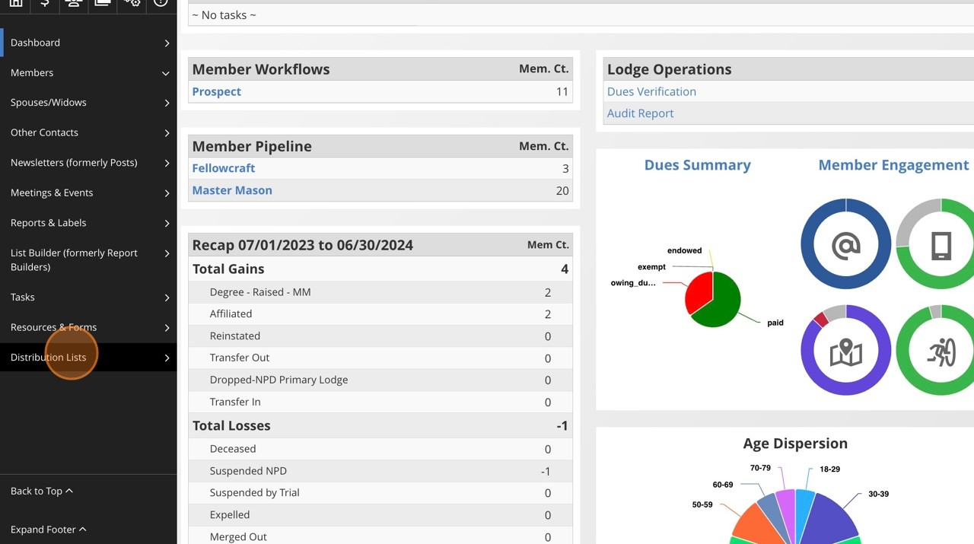
How to Create a Newsletter Announcement
3
Before setting up the newsletter announcement, review your distribution lists by
clicking "Distribution Lists"
Scan to download a step by step guide

Slide 10
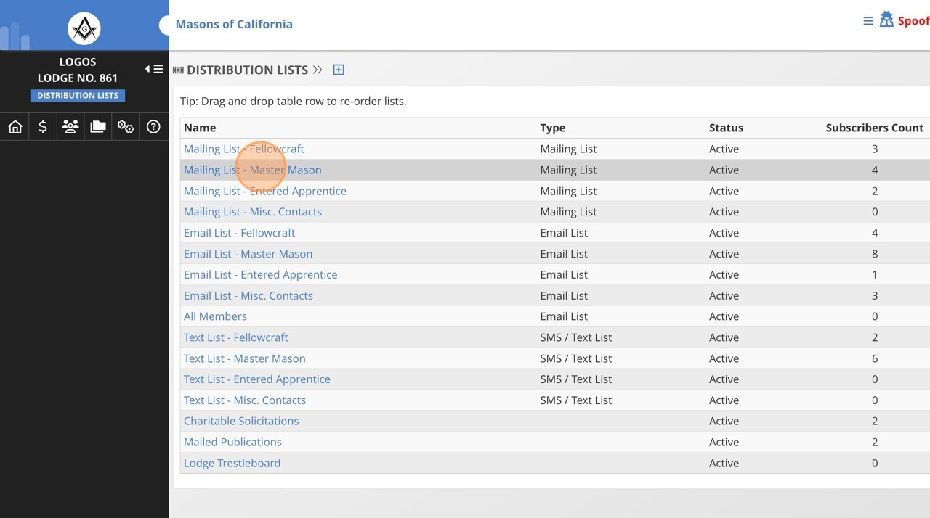
How to Create a Newsletter Announcement
4
Choose the list you wish to review.
Scan to download a step by step guide

Slide 11
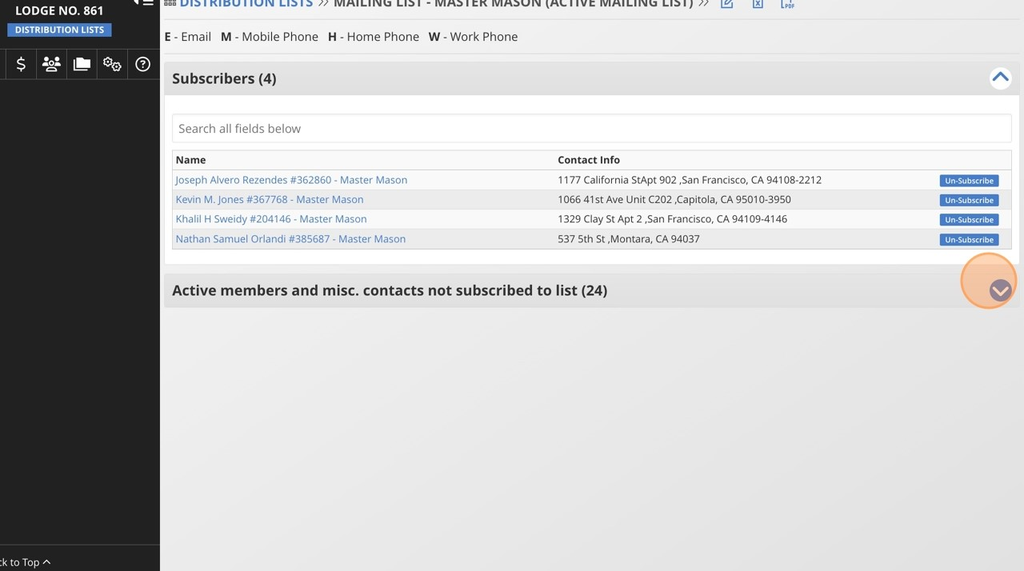
How to Create a Newsletter Announcement
5
Review the subscribers, and if you wish to add other people to the list, click the
down arrow next to "Active members and misc. contacts not subscribed to list"
Scan to download a step by step guide

Slide 12
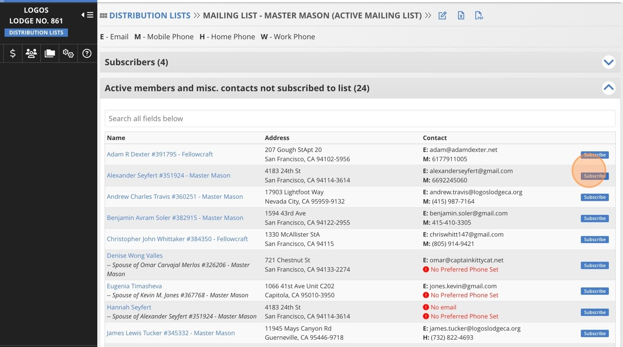
How to Create a Newsletter Announcement
6
For any contact you wish to add, click "Subscribe" next to their name
Scan to download a step by step guide

Slide 13
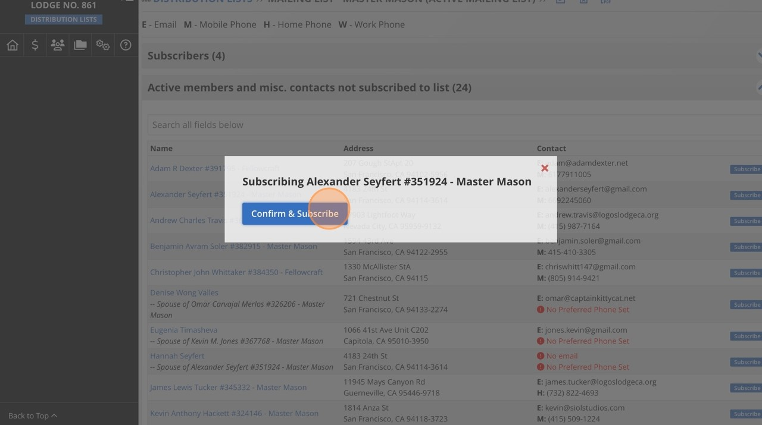
How to Create a Newsletter Announcement
7
Click the "Confirm & Subscribe" button for that individual.
Scan to download a step by step guide

Slide 14
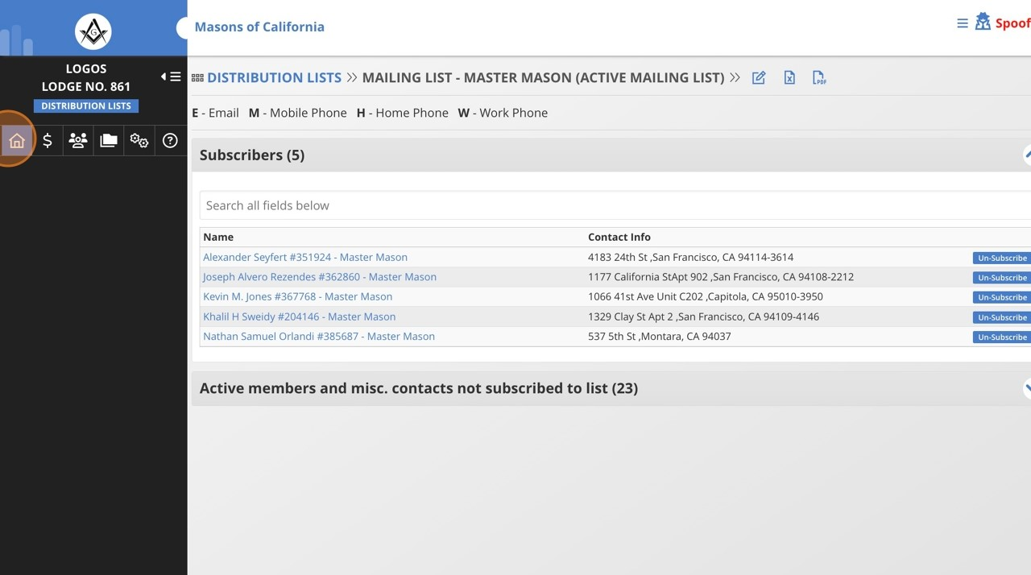
How to Create a Newsletter Announcement
8
When you are done subscribing contacts to your distribution list, Click the house
icon to return to your Lodge dashboard.
Scan to download a step by step guide

Slide 15
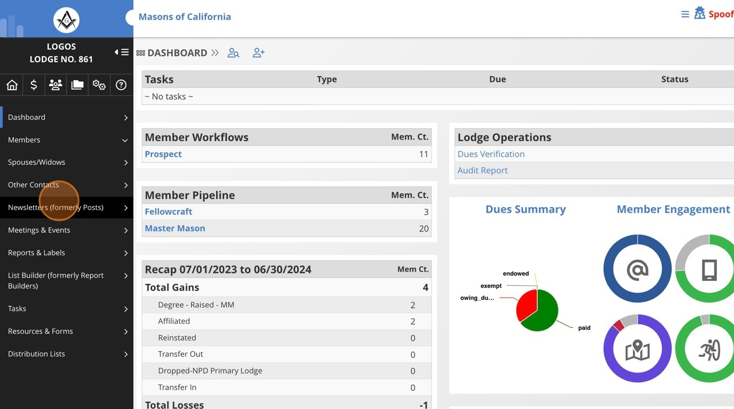
How to Create a Newsletter Announcement
9
Click "Newsletters (formerly Posts)"
Scan to download a step by step guide

Slide 16
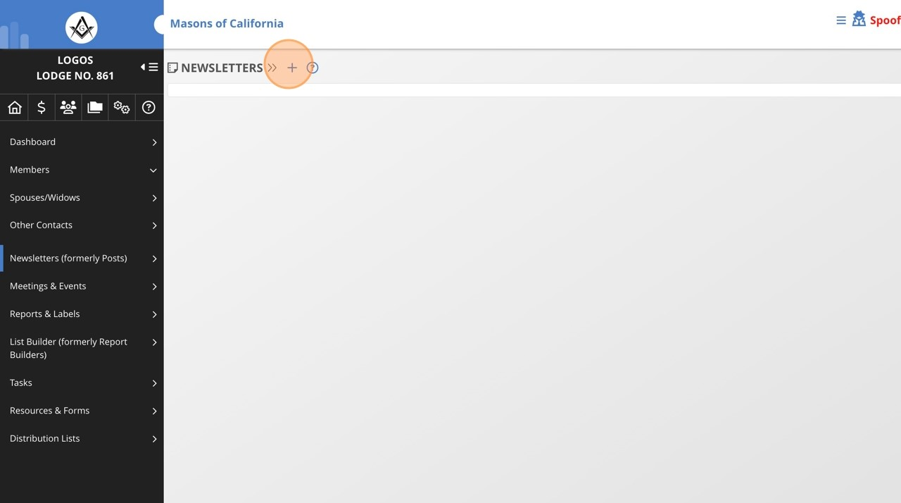
How to create a Newsletter Announcement
10
Click here.
Scan to download a step by step guide

Slide 17
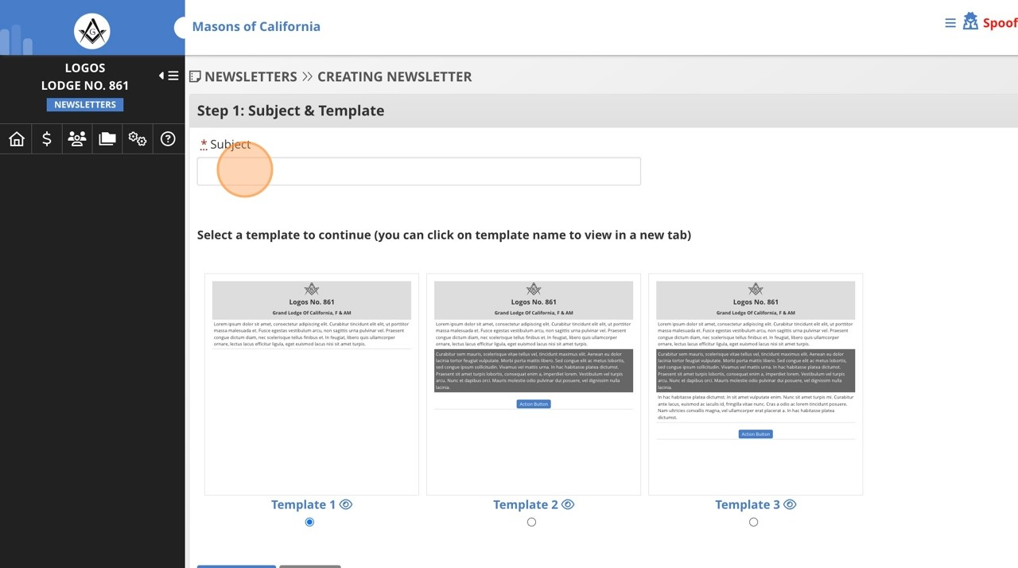
How to create a Newsletter Announcement
11
Enter the subject for the newsletter
Scan to download a step by step guide

Slide 18
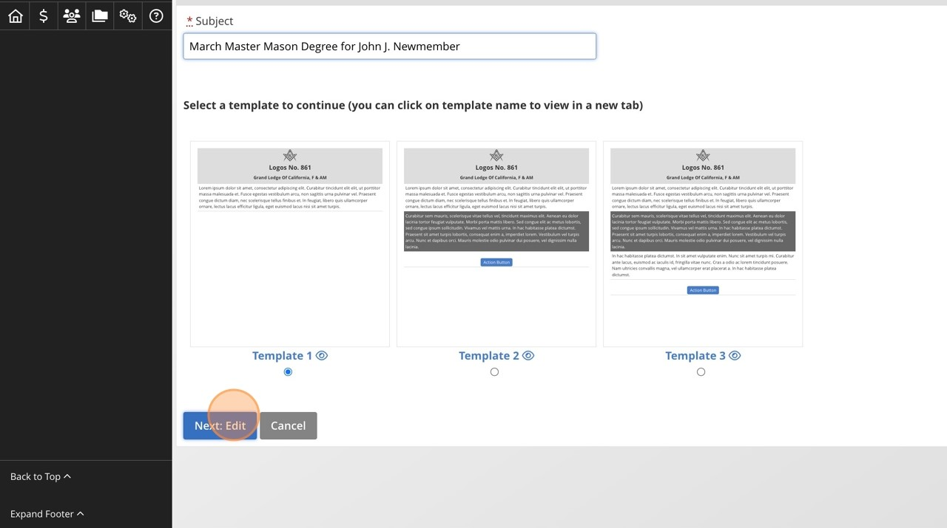
How to create a Newsletter Announcement
12
Select the template for the email, and click the "Next: Edit" button
Scan to download a step by step guide

Slide 19
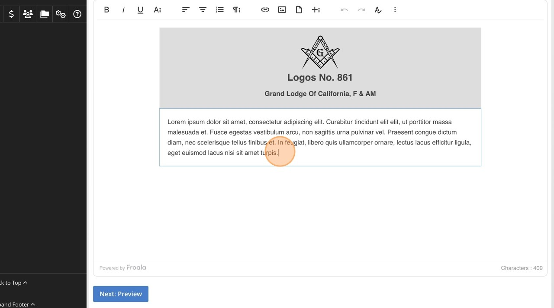
How to create a Newsletter Announcement
13
Enter the text of your message in this box.
Scan to download a step by step guide

Slide 20
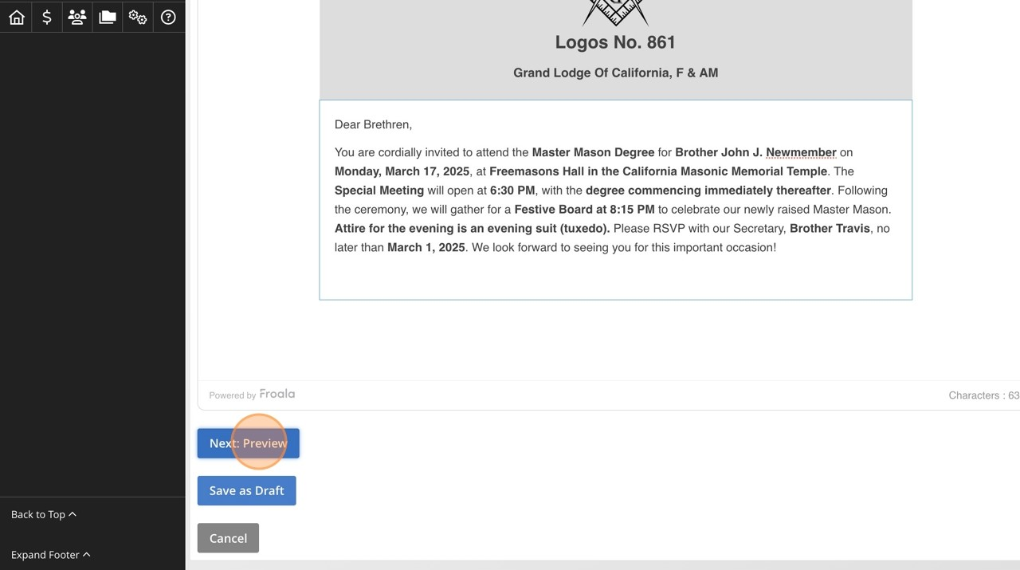
How to create a Newsletter Announcement
14
Click the "Next: Preview" button.
Scan to download a step by step guide

Slide 21
How to create a Newsletter Announcement
15
This is what the post and email will look like. If you want to modify it, click the
"Back to Edit" button, otherwise click "Next: Publish"
Scan to download a step by step guide

Slide 22
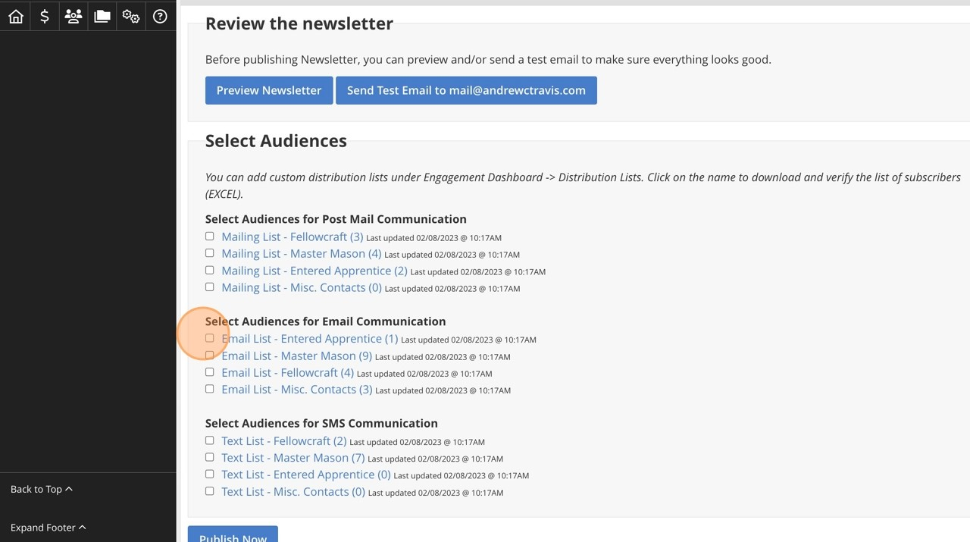
How to create a Newsletter Announcement
16
Choose your audience for the communication.
Scan to download a step by step guide

Slide 23
How to create a Newsletter Announcement
Scan to download a step by step guide

Slide 24
Build and share a survey

Slide 25
Build and Share a Survey
Quick pulse checks
Event interest
Member needs
Notes:
Include screenshot of survey creation tool.
Tip: Keep it short and simple for better response rates.

Slide 26
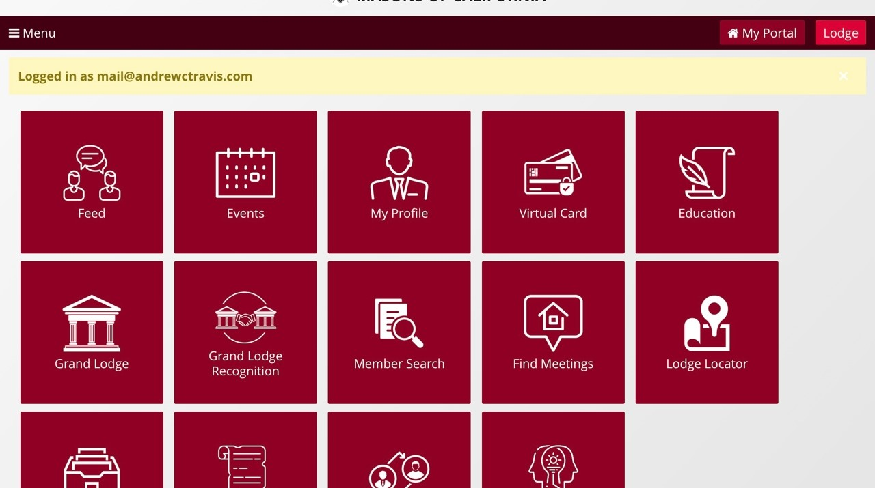
Build and share a Survey
1
16
Navigate to
http://member.freemason.org
and login.
Choose your audience for the communication.
Scan to download a step by step guide

Slide 27
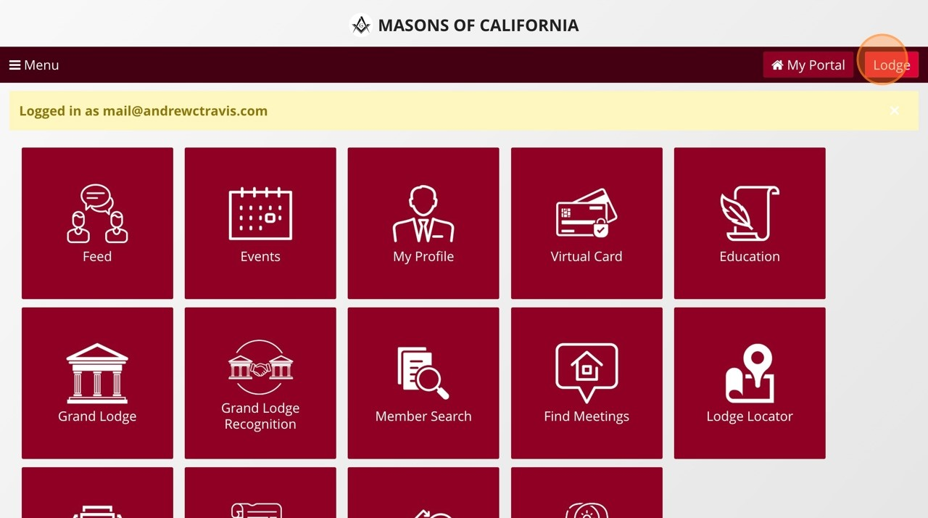
Build and share a Survey
2
16
To navigate to your lodge dashboard, click "Lodge"
Choose your audience for the communication.
Scan to download a step by step guide

Slide 28
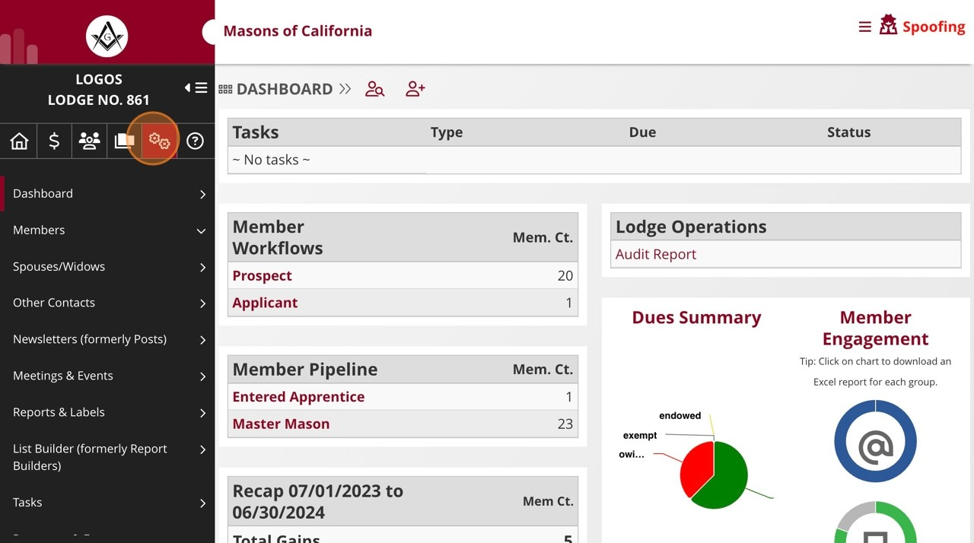
Build and share a Survey
16
3
Choose your audience for the communication.
Click on the gears icon
Scan to download a step by step guide

Slide 29
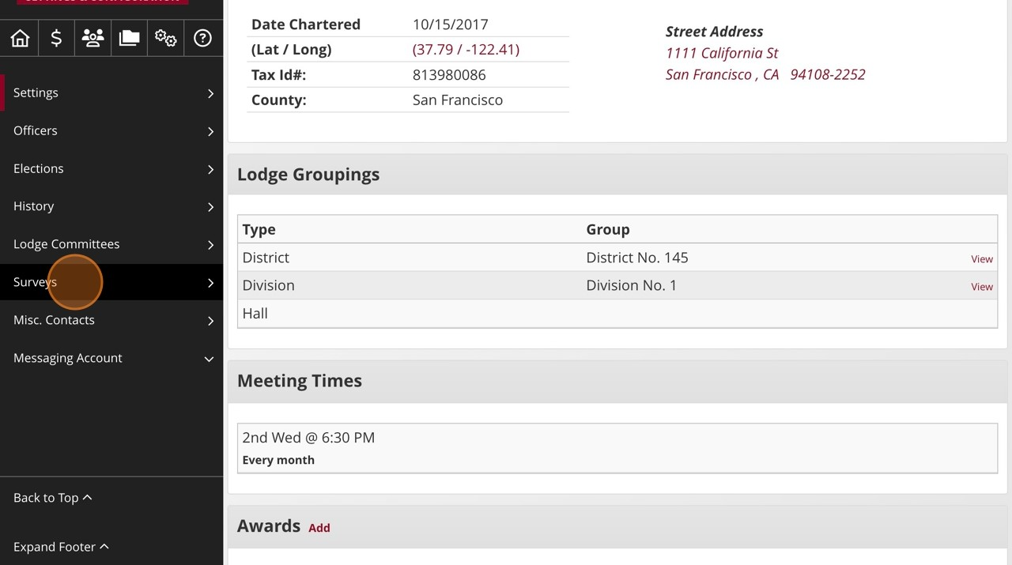
Build and share a Survey
4
Click "Surveys"
16
Choose your audience for the communication.
Scan to download a step by step guide

Slide 30
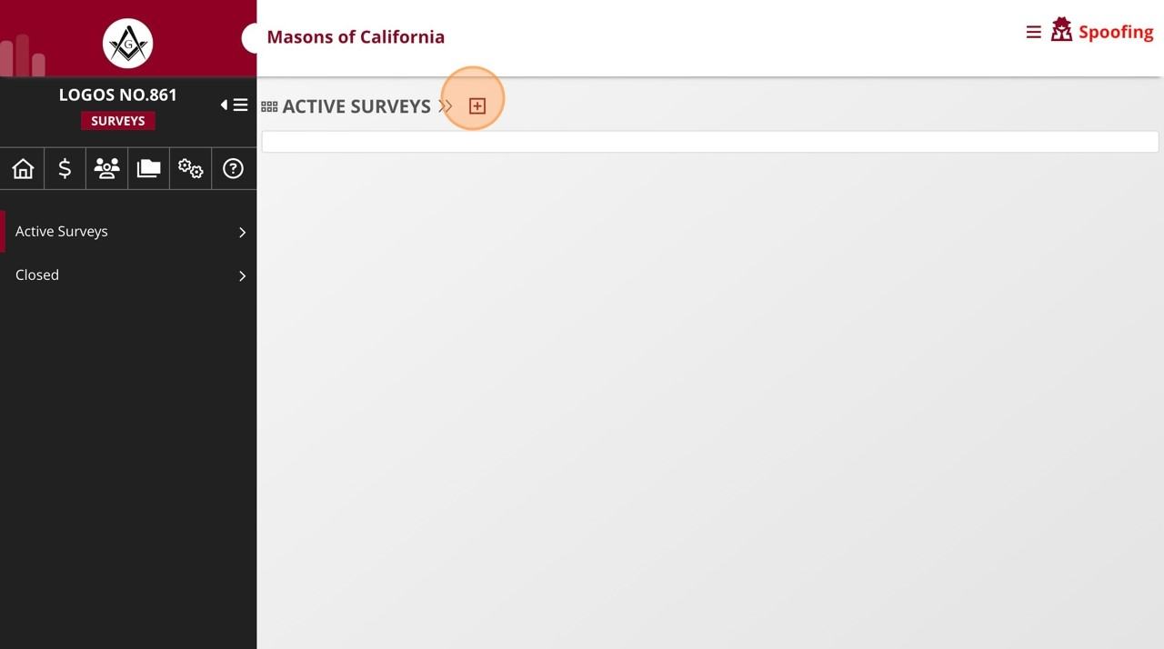
Build and share a Survey
5
16
Click the plus icon to create a new survey.
Choose your audience for the communication.
Scan to download a step by step guide

Slide 31
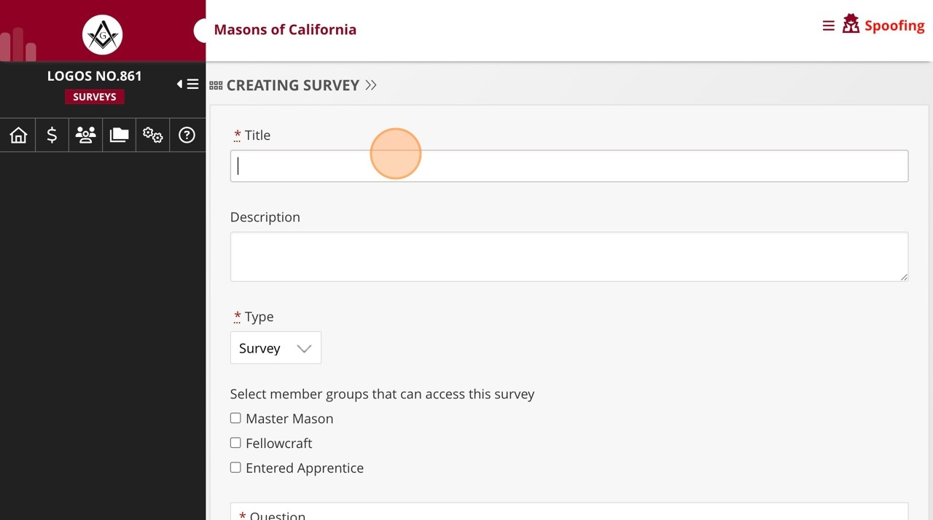
Build and share a Survey
6
Enter the survey title in the "* Title" field.
16
Choose your audience for the communication.
Scan to download a step by step guide

Slide 32
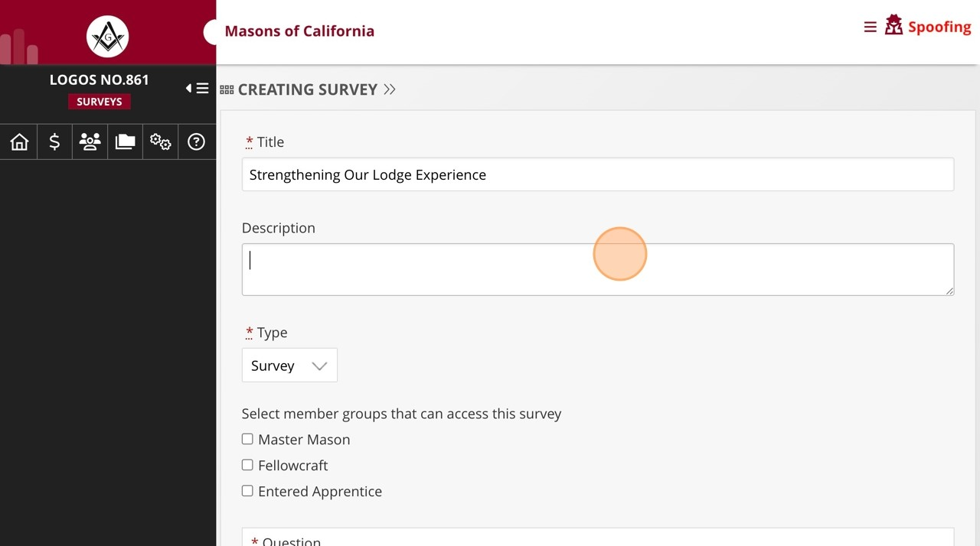
Build and share a Survey
7
16
Enter the description of the survey in the "Description" field.
Choose your audience for the communication.
Scan to download a step by step guide

Slide 33
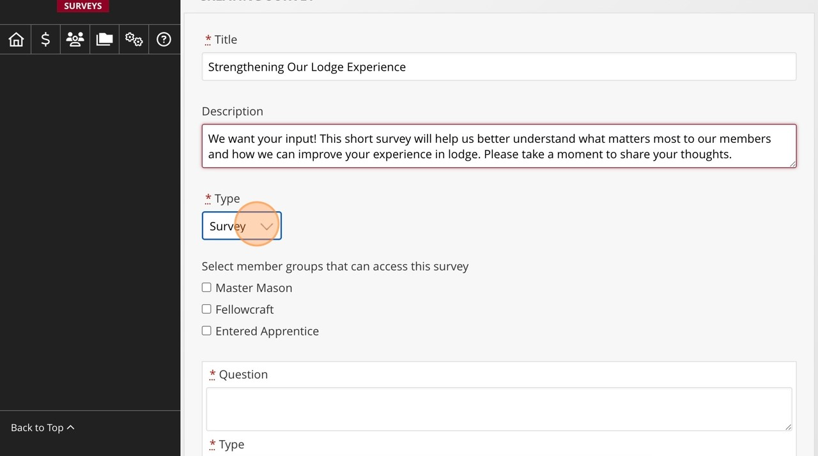
Build and share a Survey
16
Click this dropdown to choose the type of survey (the options are survey, election
8
Choose your audience for the communication.
and ballot).
Scan to download a step by step guide

Slide 34
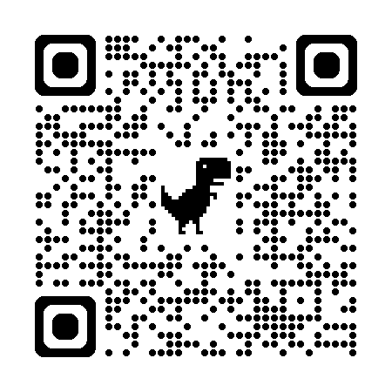
Build and share a Survey
Scan to download a step by step guide

Slide 35
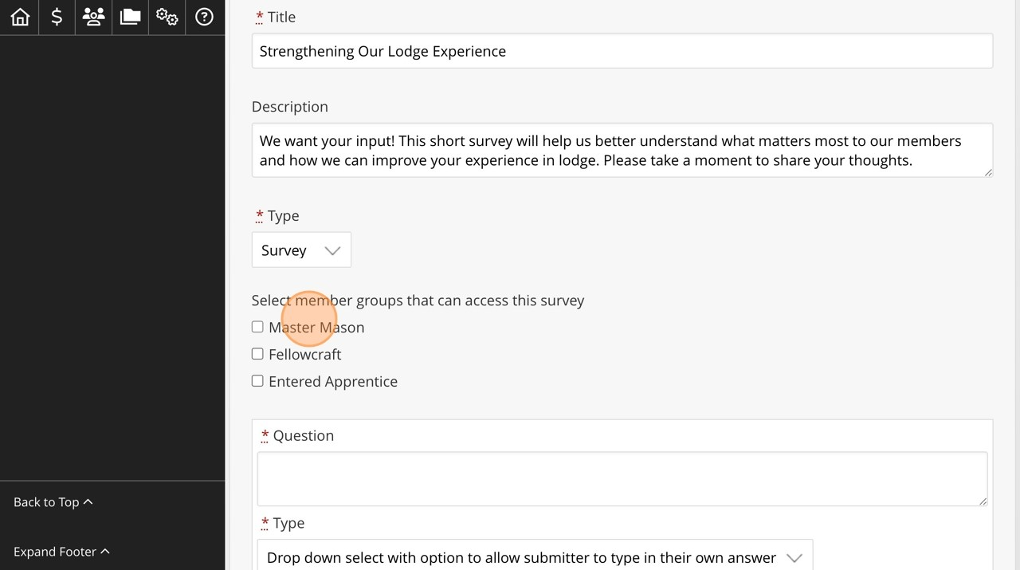
Build and share a Survey
9
Select the member groups for which the survey is intended.
16
Choose your audience for the communication.
Scan to download a step by step guide

Slide 36
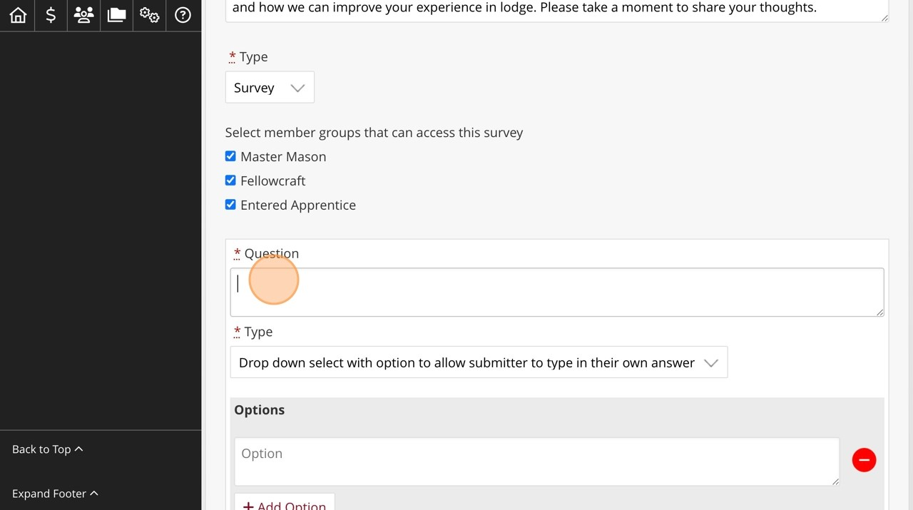
Build and share a Survey
10
16
Enter the question in the "* Question" field.
Choose your audience for the communication.
Scan to download a step by step guide

Slide 37
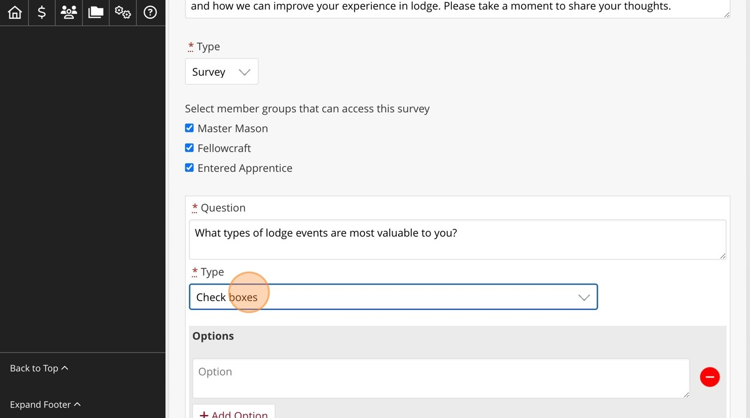
Build and share a Survey
11
Select the question type from this drop down (the options are drop down select
16
Choose your audience for the communication.
with option to allow submitter to type in their own answer, regular drop down
select, radio buttons, and check boxes)
Scan to download a step by step guide

Slide 38
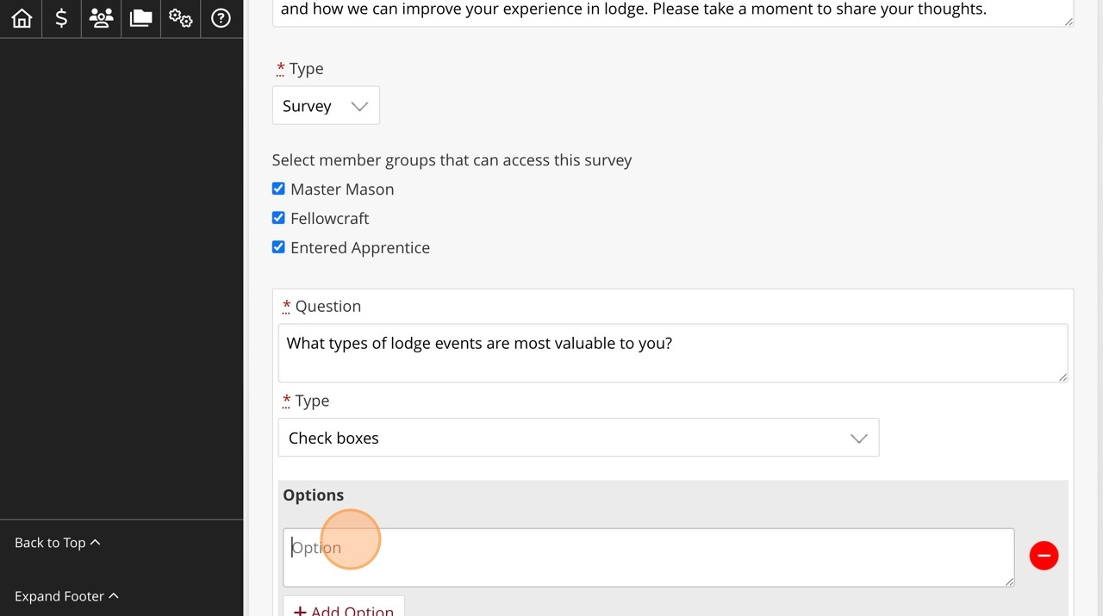
Build and share a Survey
12
16
Enter any response options in the "Option" field.
Choose your audience for the communication.
Scan to download a step by step guide

Slide 39
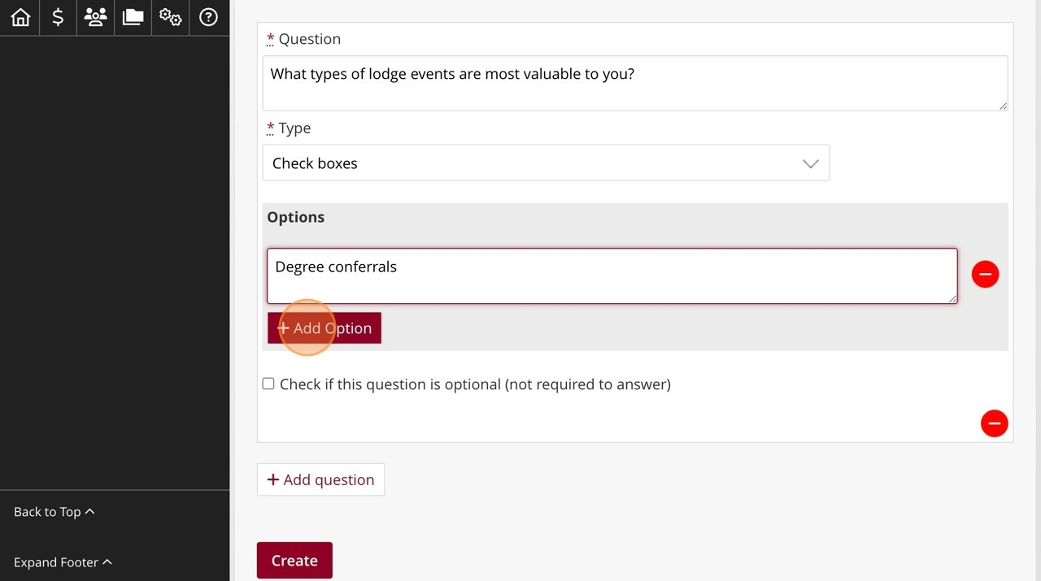
Build and share a Survey
13
Click "Add Option" to add on any other response options. Repeat as many times as
16
Choose your audience for the communication.
you need for the options available.
Scan to download a step by step guide

Slide 40
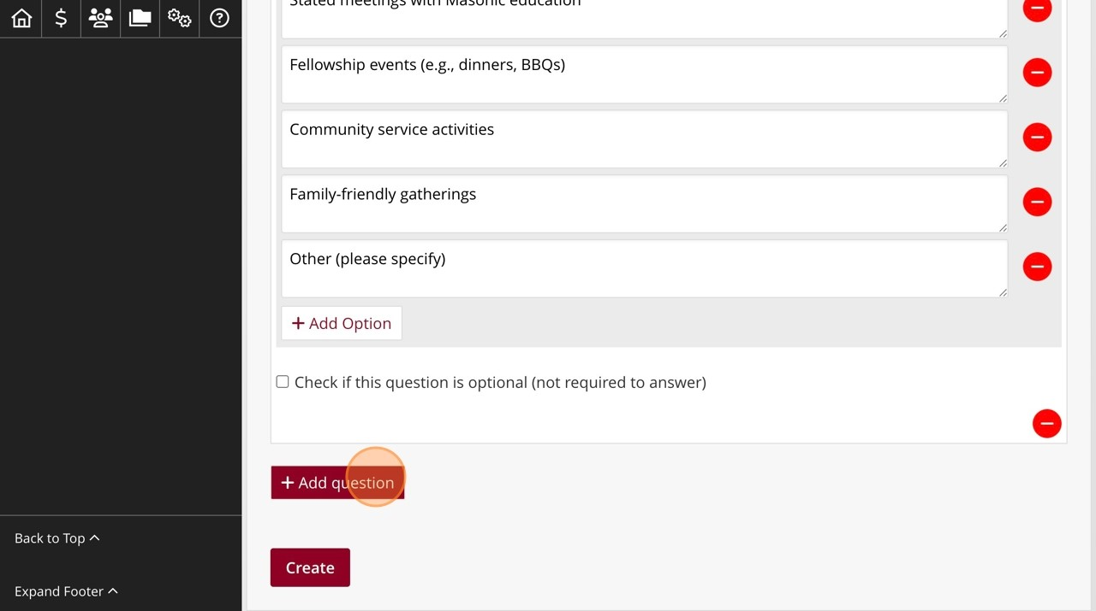
Build and share a Survey
14
Click "Add question" to add a new question. Repeat as many times, adding options
16
Choose your audience for the communication.
for response, for as many questions as needed.
Scan to download a step by step guide

Slide 41
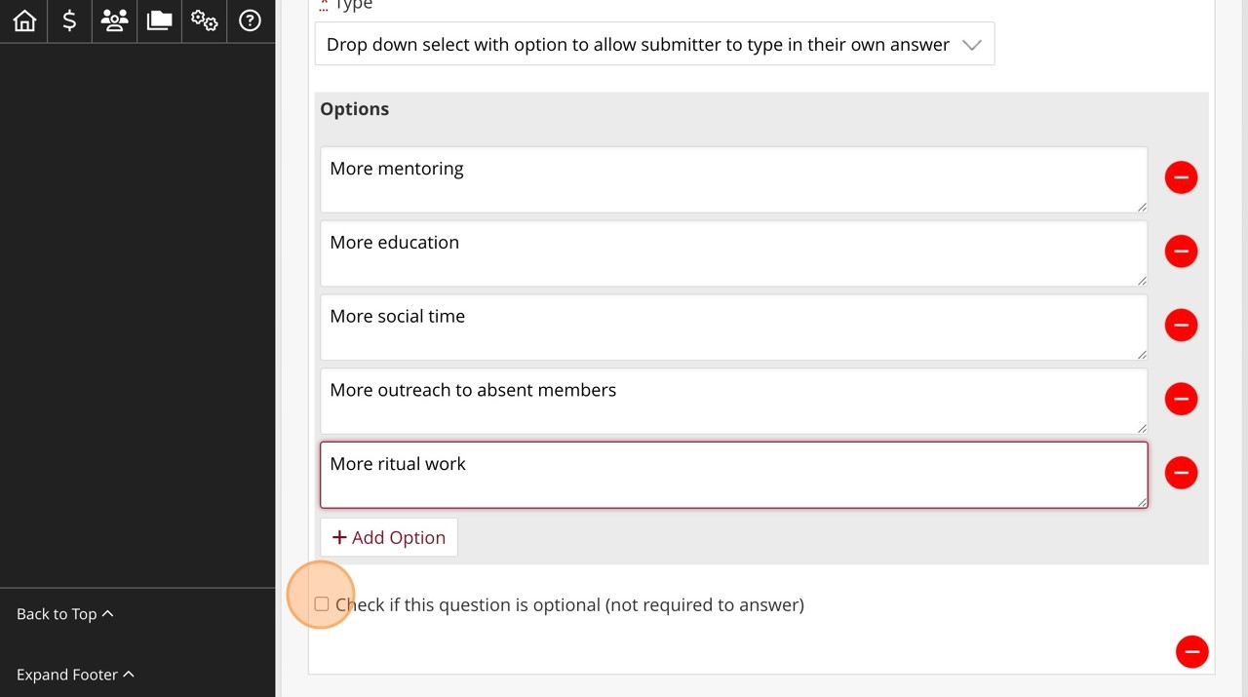
Build and share a Survey
15
Click the "Check if this question is optional (not required to answer)" field. for any
16
Choose your audience for the communication.
non-required questions.
Scan to download a step by step guide

Slide 42
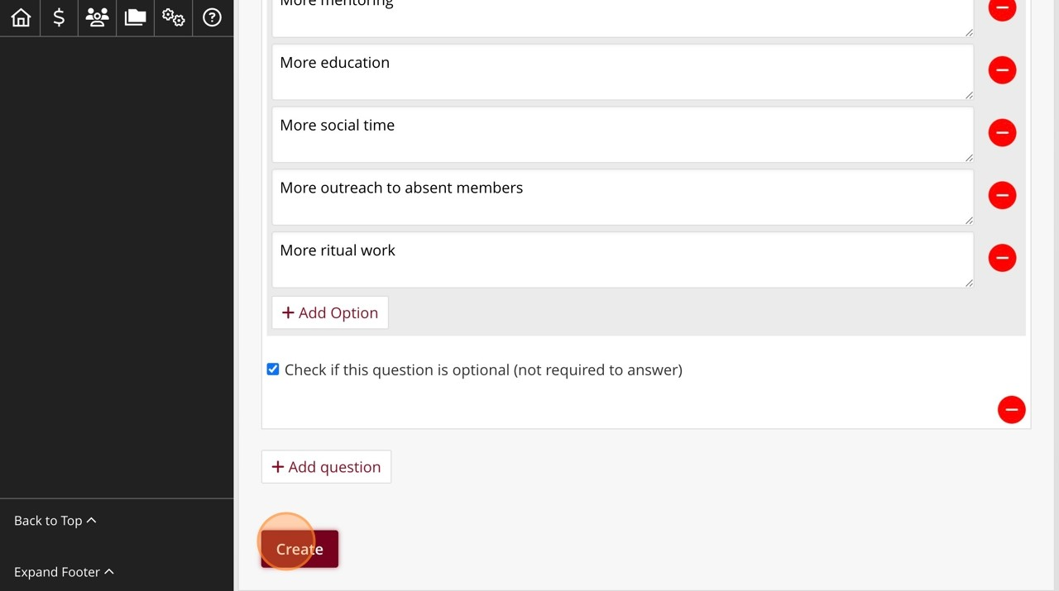
Build and share a Survey
16
16
Click the "Create" to create the survey.
Choose your audience for the communication.
Scan to download a step by step guide

Slide 43
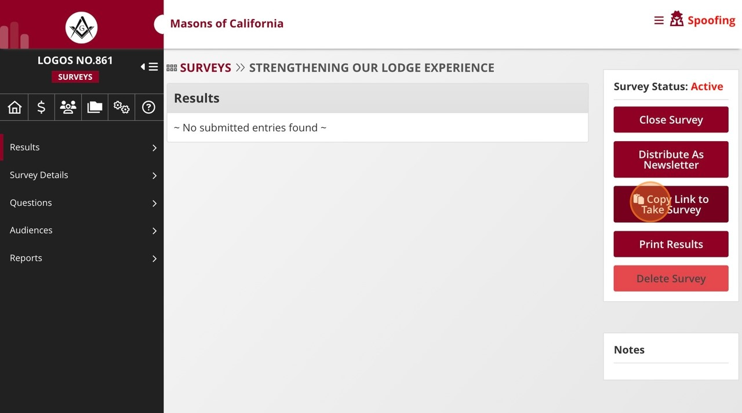
Build and share a Survey
17
Click "Copy Link to Take Survey" to get a sharable URL which you can give to
16
Choose your audience for the communication.
members.
Scan to download a step by step guide

Slide 44
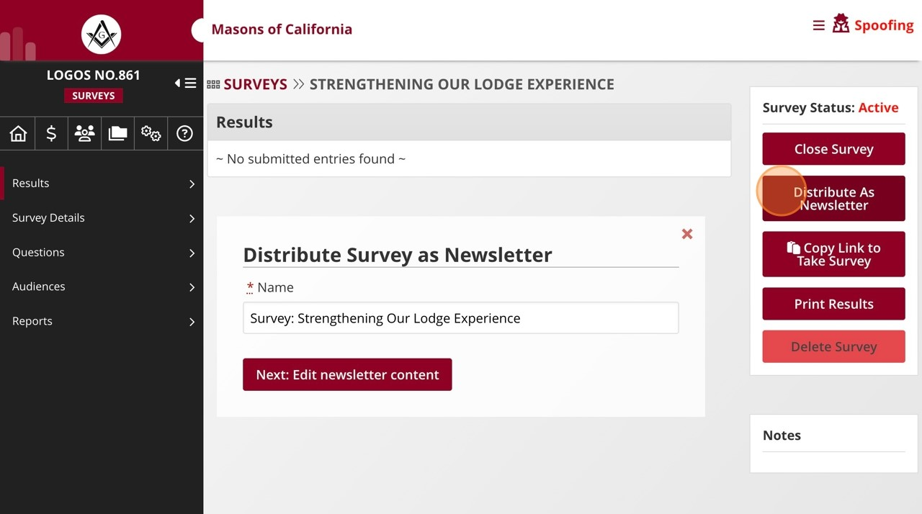
Build and share a Survey
18
16
Click "Distribute As Newsletter" to send the survey out via email.
Choose your audience for the communication.
Scan to download a step by step guide

Slide 45
Build and share a Survey
FOLLOW INSTRUCTIONS FOR POSTING A NEWSLETTER ANNOUNCEMENT
Scan to download a step by step guide

Slide 46
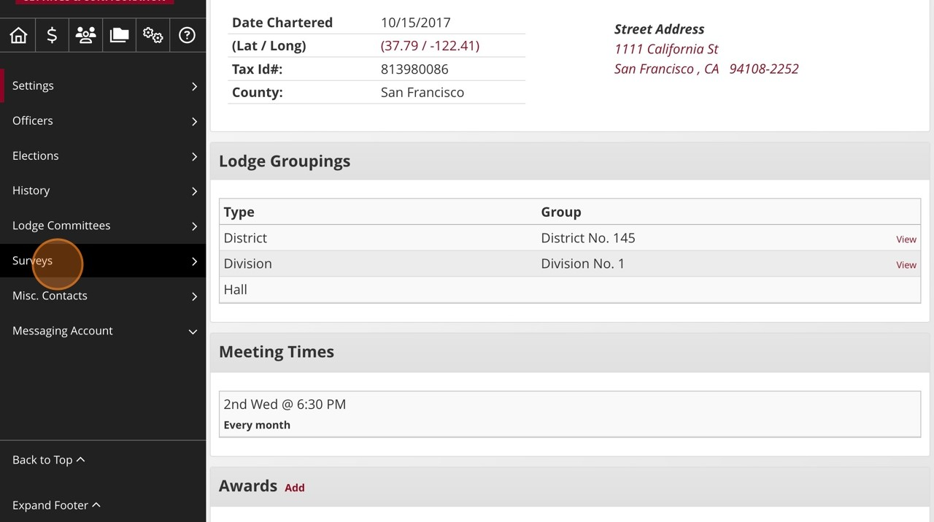
Build and share a Survey
25
Click "Surveys"
16
Choose your audience for the communication.
Scan to download a step by step guide

Slide 47
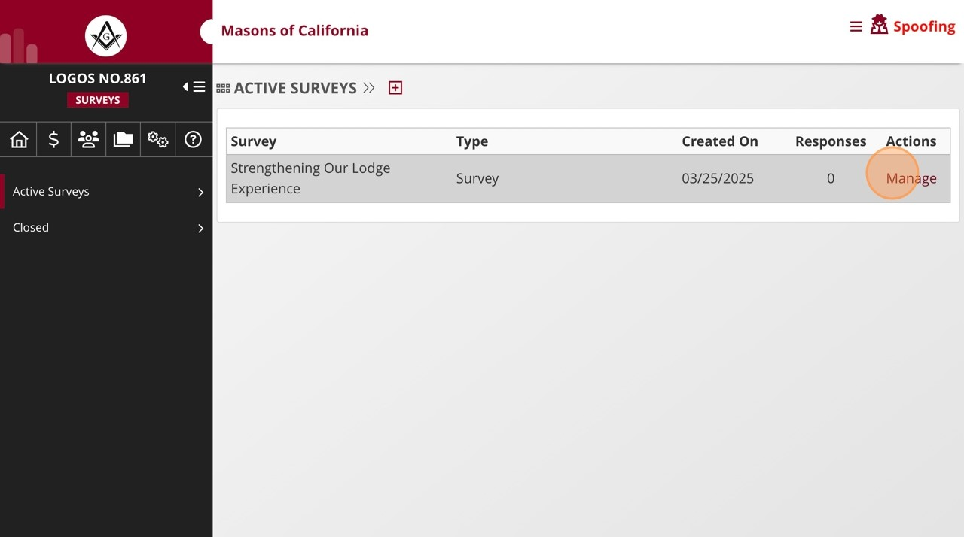
Build and share a Survey
26
16
Click "Manage" next to the survey you wish to manage.
Choose your audience for the communication.
Scan to download a step by step guide

Slide 48
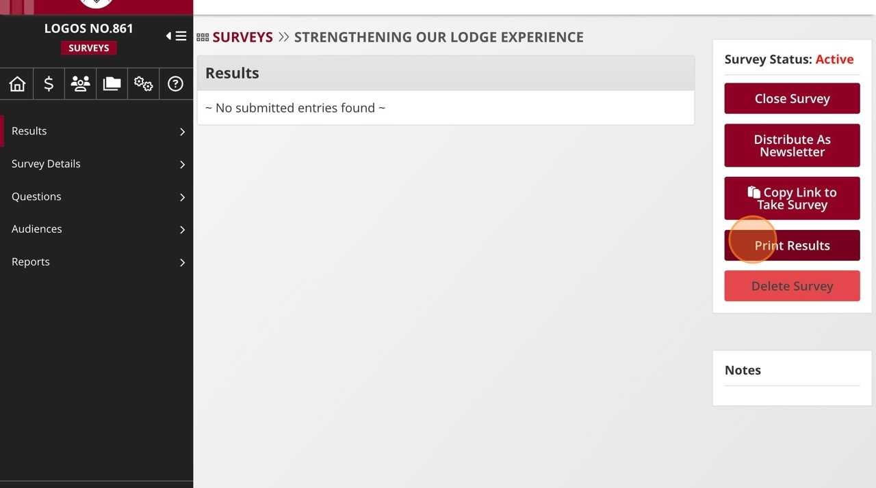
Build and share a Survey
27
Click "Print Results" will download a PDF of the results to your computer. Note that
16
Choose your audience for the communication.
in this example the survey had not yet run, but otherwise results would show in
the results area of the page.
Scan to download a step by step guide

Slide 49
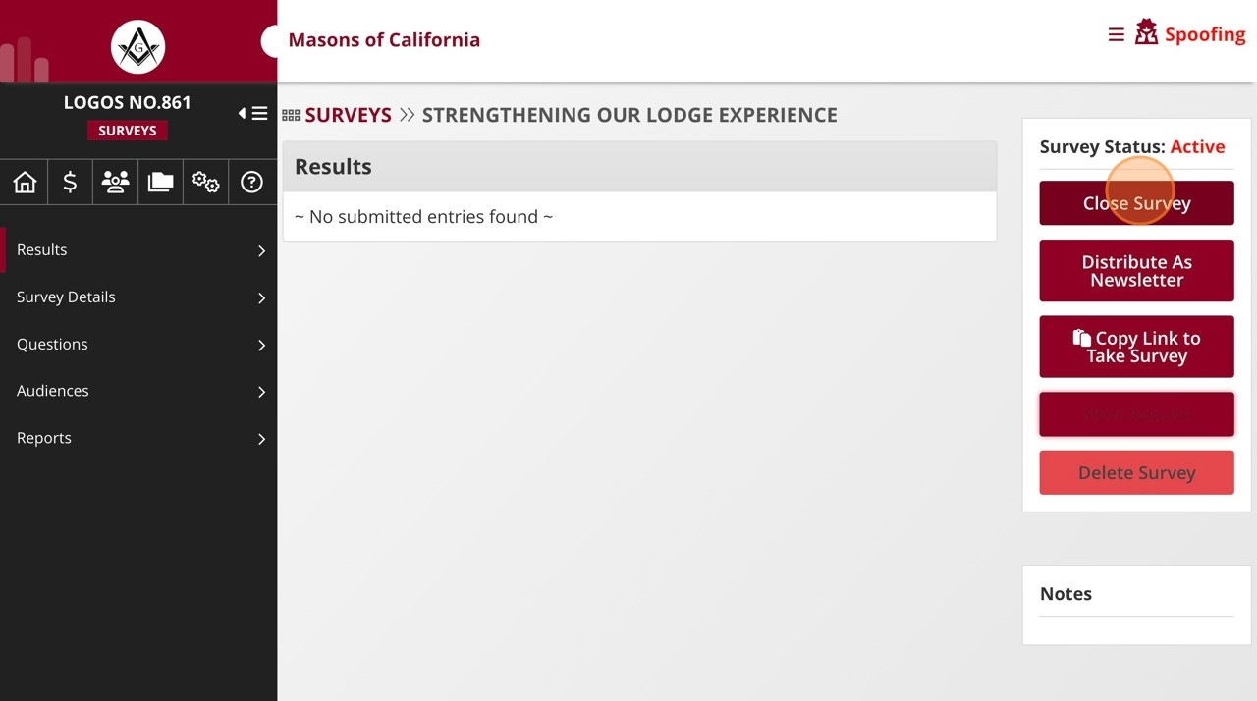
Build and share a Survey
28
Click "Close Survey" when you are ready to close the survey from accepting new
16
Choose your audience for the communication.
responses.
Scan to download a step by step guide

Slide 50
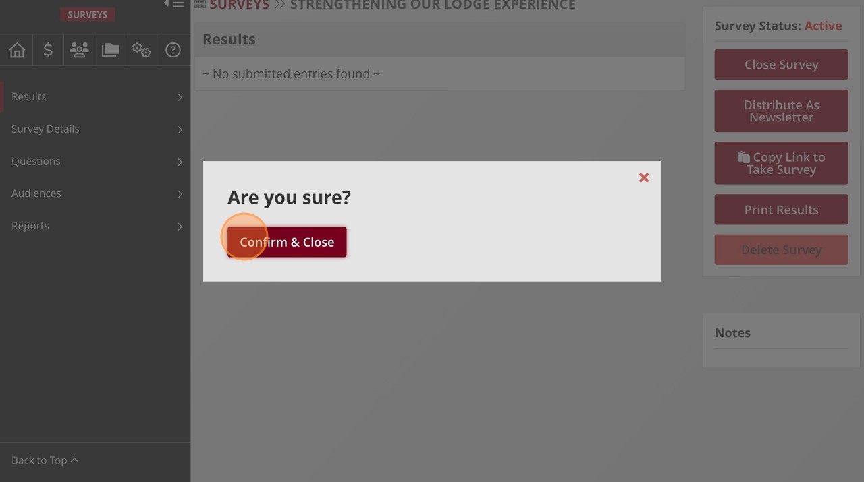
Build and share a Survey
29
Click this button.
16
Choose your audience for the communication.
Scan to download a step by step guide

Slide 51
Store and share files in the Vault

Slide 52
Store and Share Files in the Vault
Bylaws, minutes, resolutions.
Safe, accessible, and organized.
Notes:
Show where the Vault is in iMember.
Highlight that it’s searchable and shared with officers.

Slide 53
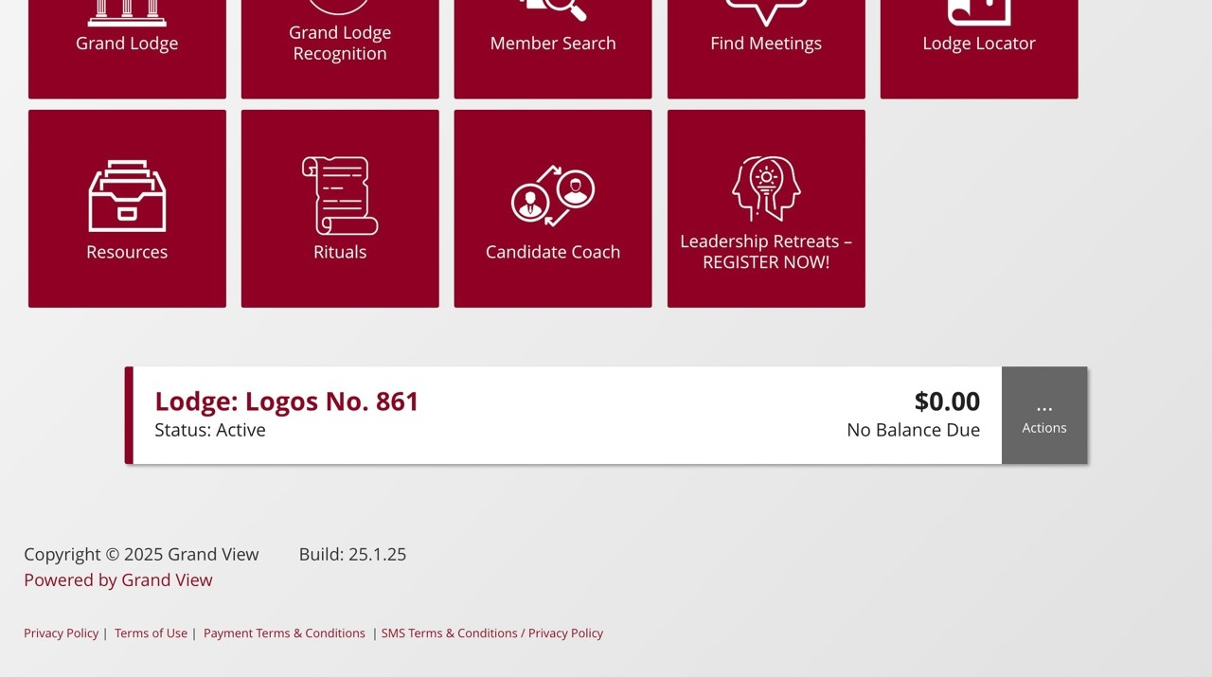
Store and Share Files in the Vault
1
16
Navigate to
http://member.freemason.org
Choose your audience for the communication.
and login.
Scan to download a step by step guide

Slide 54
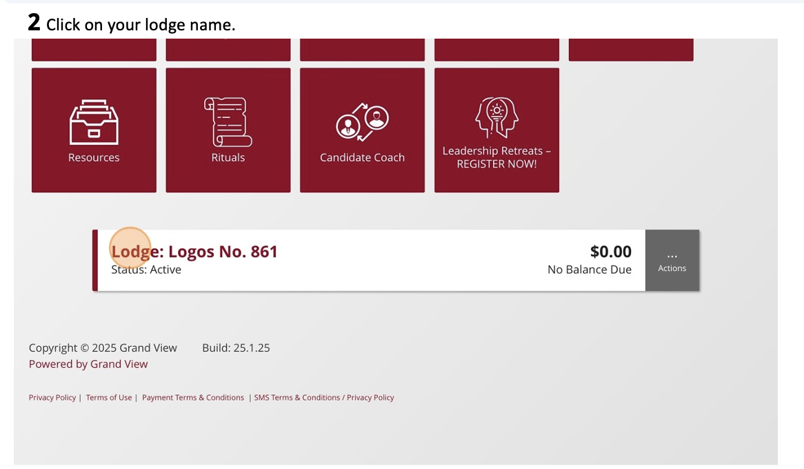
Store and Share Files in the Vault
Scan to download a step by step guide

Slide 55
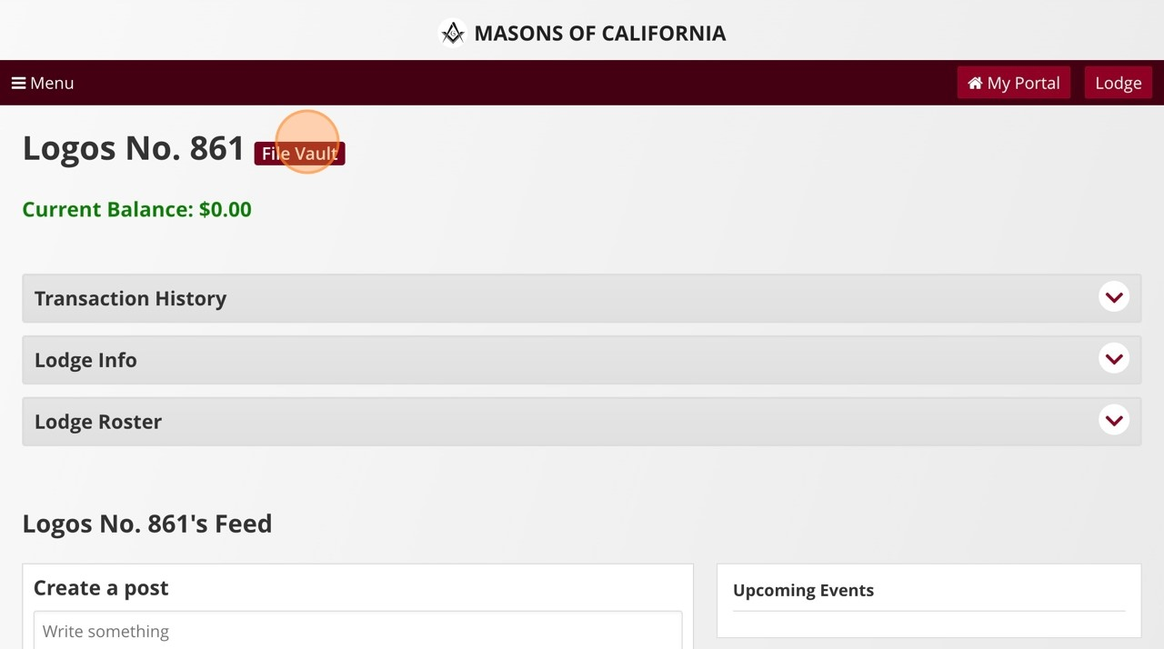
Store and Share Files in the Vault
3
Click "File Vault." This is how members who do not have lodge dashboard access
16
Choose your audience for the communication.
can see the files in their lodge's vault.
Scan to download a step by step guide

Slide 56
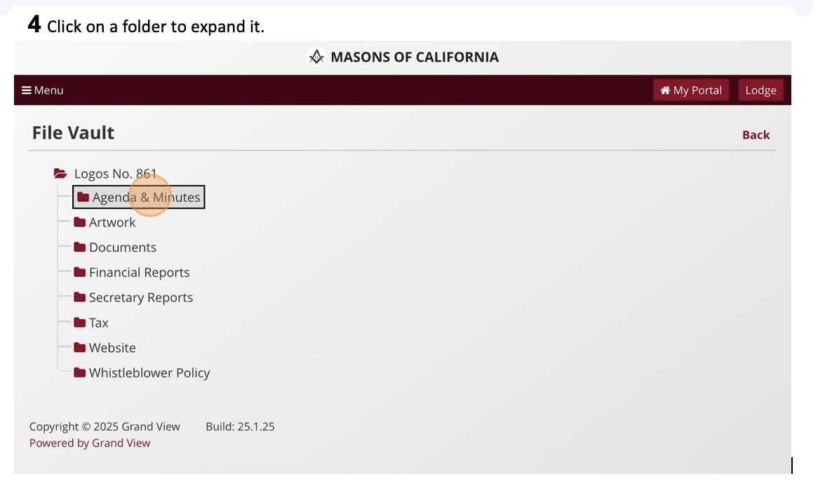
Store and Share Files in the Vault
Scan to download a step by step guide

Slide 57
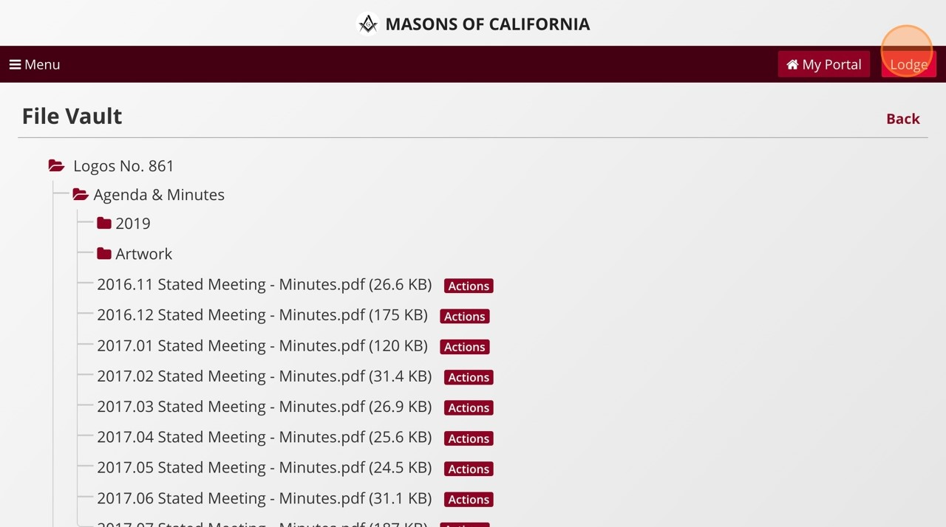
Store and Share Files in the Vault
5
Click on a file name to download it.
16
Choose your audience for the communication.
For members wish lodge dashboard access, click the "Lodge" button.
Scan to download a step by step guide

Slide 58
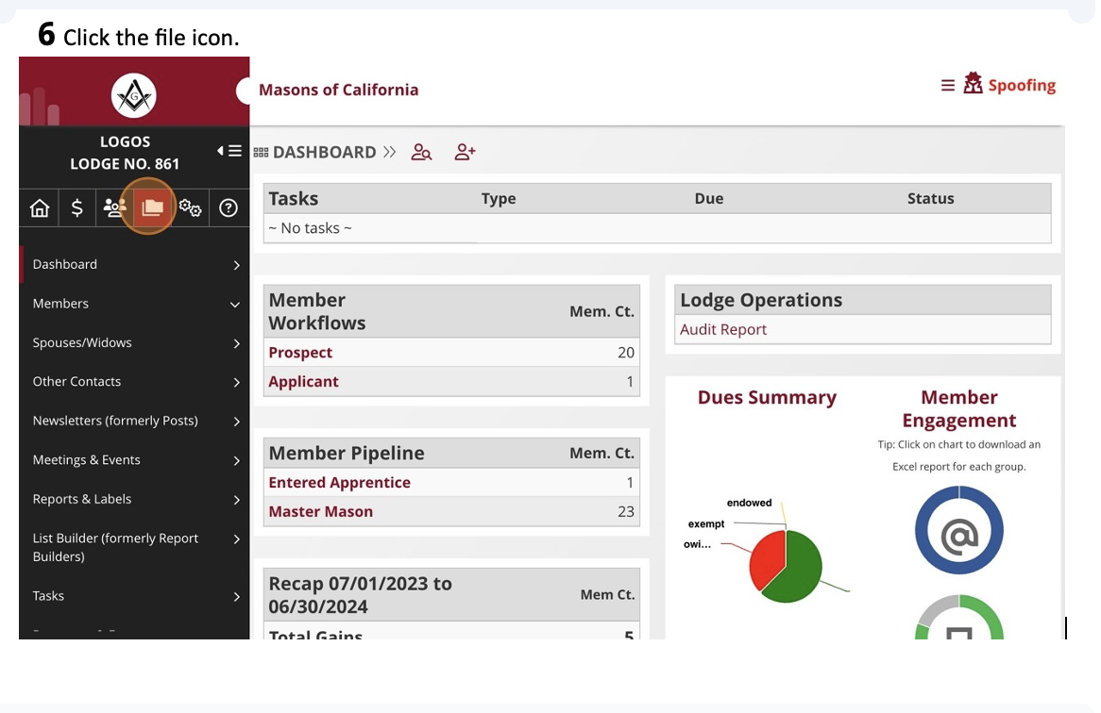
Store and Share Files in the Vault
16
Choose your audience for the communication.
Scan to download a step by step guide

Slide 59
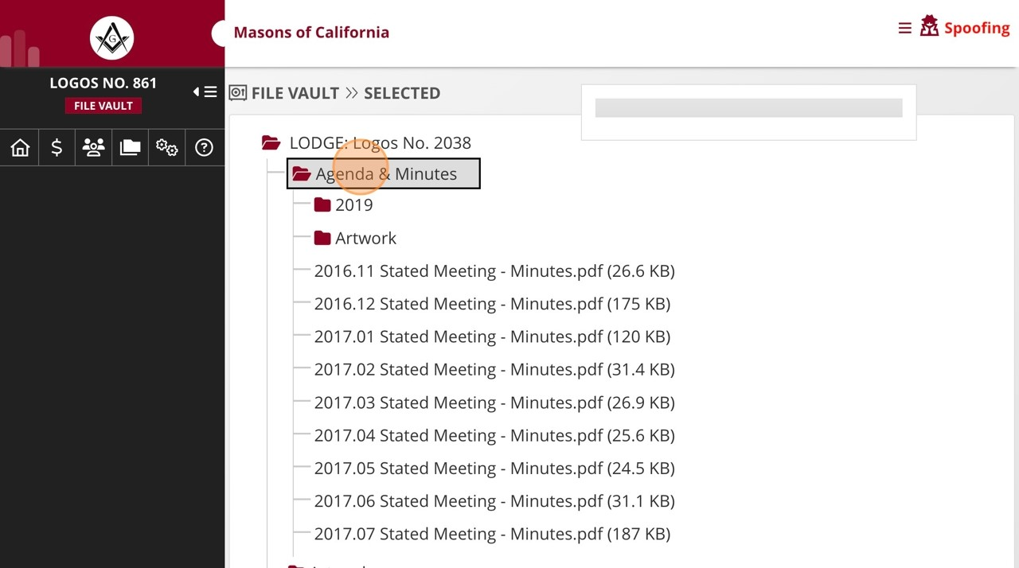
Store and Share Files in the Vault
7
16
Click on a folder to expand it.
Choose your audience for the communication.
Scan to download a step by step guide

Slide 60
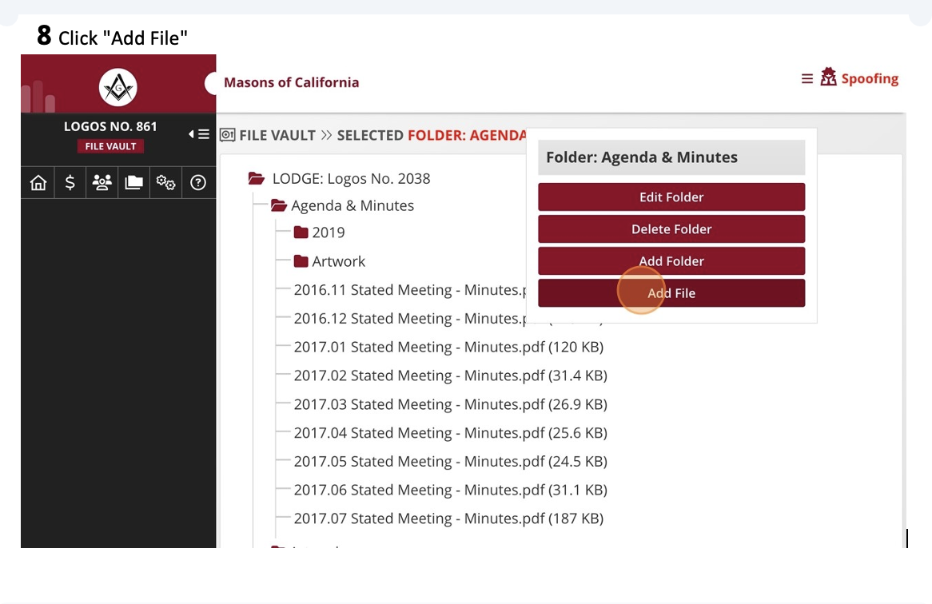
Store and Share Files in the Vault
16
Choose your audience for the communication.
Scan to download a step by step guide

Slide 61
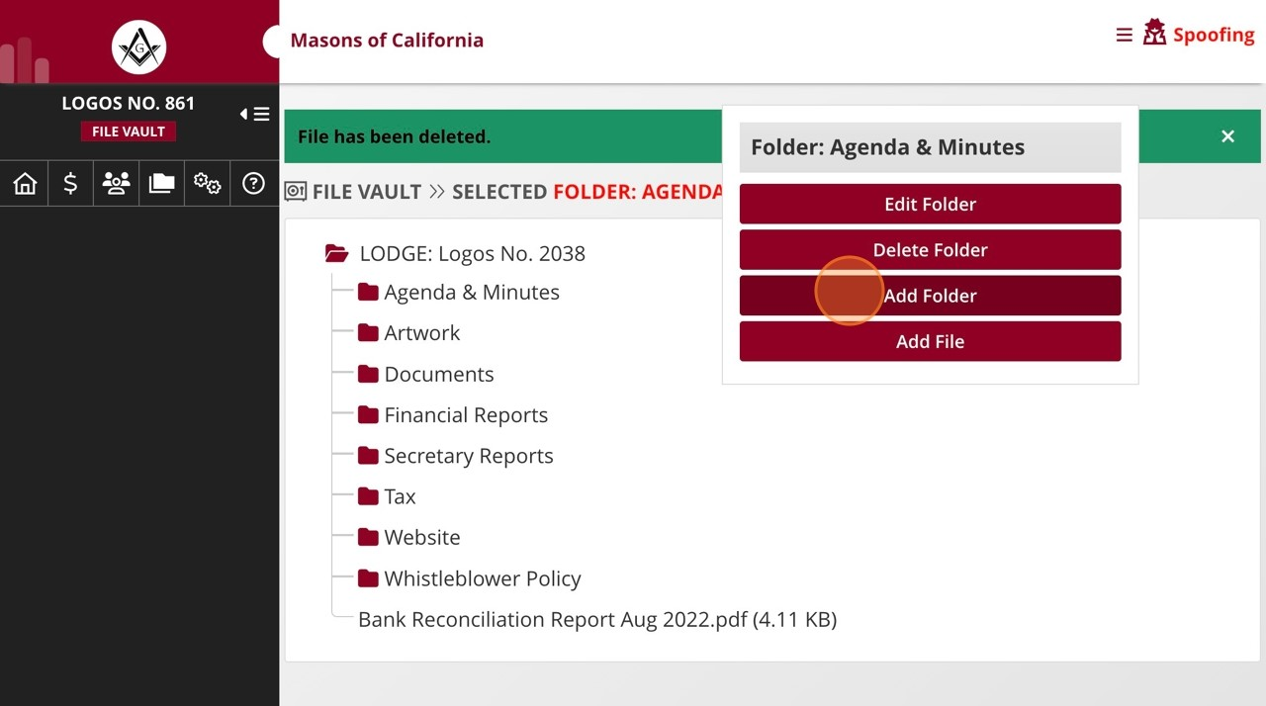
Store and Share Files in the Vault
9
16
Click "Add Folder" to create a new folder.
Choose your audience for the communication.
Scan to download a step by step guide

Slide 62
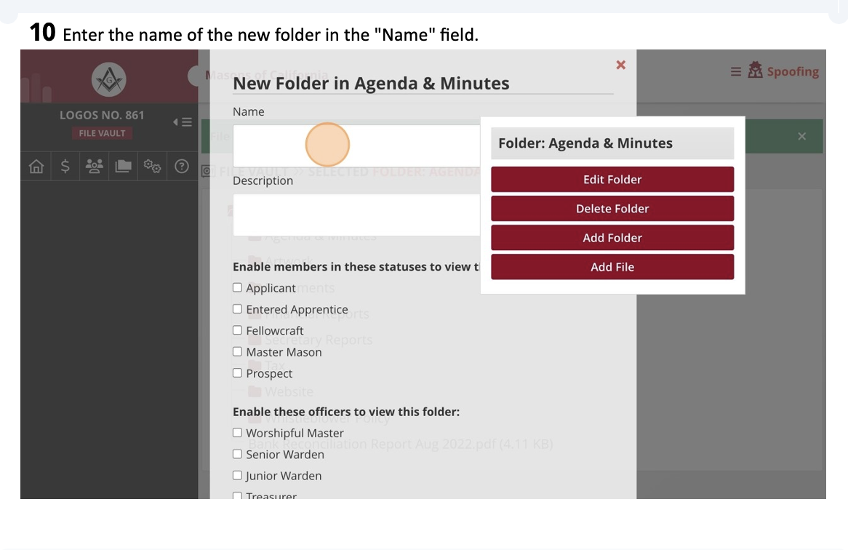
Store and Share Files in the Vault
16
Choose your audience for the communication.
Scan to download a step by step guide

Slide 63
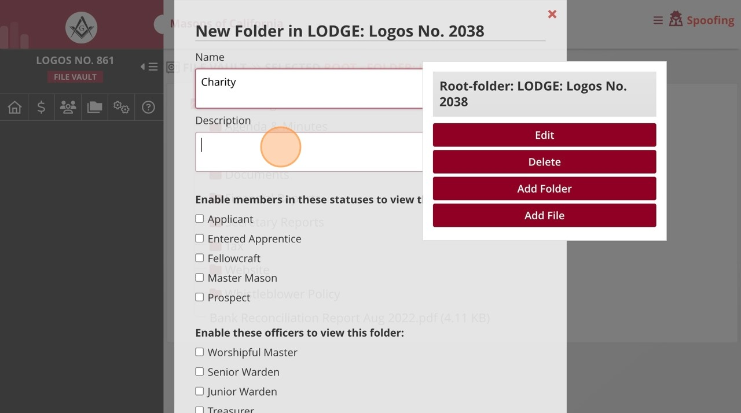
Store and Share Files in the Vault
11
16
Enter the description of the folder in the "Description" field.
Choose your audience for the communication.
Scan to download a step by step guide

Slide 64
Store and Share Files in the Vault
16
Choose your audience for the communication.
Scan to download a step by step guide

Slide 65
Store and Share Files in the Vault
Scan to download a step by step guide

Slide 66
Plan and promote events

Slide 67
Plan and Promote Events
Add events with RSVP options.
Auto reminders and calendar integration.
Notes:
Show screenshot of event creation.
Discuss typical events: Stated Meetings, Degrees, Dinners.

Slide 68
Plan and Promote Events
1
16
Navigate to
and login.
http://member.freemason.org
Choose your audience for the communication.
Scan to download a step by step guide

Slide 69
Plan and Promote Events
2
16
To navigate to your lodge dashboard, click "Lodge"
Choose your audience for the communication.
Scan to download a step by step guide

Slide 70
Plan and Promote Events
3
16
Click "Meetings & Events"
Choose your audience for the communication.
Scan to download a step by step guide

Slide 71
Plan and Promote Events
4
16
Click the plus icon to create a new event.
Choose your audience for the communication.
Scan to download a step by step guide

Slide 72
Plan and Promote Events
5
16
Select the type of event from this menu of options.
Choose your audience for the communication.
Scan to download a step by step guide

Slide 73
Plan and Promote Events
6
16
Enter the event name in the "* Event Name" field.
Choose your audience for the communication.
Scan to download a step by step guide

Slide 74
Plan and Promote Events
7
16
Enter the event date and time
Choose your audience for the communication.
Scan to download a step by step guide

Slide 75
Plan and Promote Events
8
Enter an event description.
16
Choose your audience for the communication.
Scan to download a step by step guide

Slide 76
Plan and Promote Events
9
16
Edit fields such as hosted by, location and cost.
Choose your audience for the communication.
Scan to download a step by step guide

Slide 77
Plan and Promote Events
10
Edit reservation information such as reservation cut off date, registration cap
16
Choose your audience for the communication.
(
maximum attendance) and additional instructions for registration.
Scan to download a step by step guide

Slide 78
Plan and Promote Events
11
16
Provide lodging information, if applicable.
Choose your audience for the communication.
Scan to download a step by step guide

Slide 79
Plan and Promote Events
16
12
Choose your audience for the communication.
Edit the event contact and event options fields.
Scan to download a step by step guide

Slide 80
Plan and Promote Events
13
16
Click the "Create Event" button to create the event.
Choose your audience for the communication.
Scan to download a step by step guide

Slide 81
Plan and Promote Events
14
16
Click "Admin Tools"
Choose your audience for the communication.
Scan to download a step by step guide

Slide 82
Plan and Promote Events
15
16
Click "Register a Member" to register a member on their behalf.
Choose your audience for the communication.
Scan to download a step by step guide

Slide 83
Plan and Promote Events
16
16
Begin typing the members name in this box
Choose your audience for the communication.
Scan to download a step by step guide

Slide 84
Plan and Promote Events
17
16
Click the member’s name.
Choose your audience for the communication.
Scan to download a step by step guide

Slide 85
Plan and Promote Events
18
16
Click the "Continue" button to register the member for the event.
Choose your audience for the communication.
Scan to download a step by step guide

Slide 86
Plan and Promote Events
19
16
Click "Communications" to schedule a broadcast for the event.
Choose your audience for the communication.
Scan to download a step by step guide

Slide 87
Plan and Promote Events
20
Click "Manage Audiences" to determine whom you would like to broadcast the
16
Choose your audience for the communication.
event to.
Scan to download a step by step guide

Slide 88
Plan and Promote Events
16
21
Choose your audience for the communication.
Select your intended audience from this window.
Scan to download a step by step guide

Slide 89
Plan and Promote Events
22
Click the "Update Audiences" button to save your selection.
16
Choose your audience for the communication.
Scan to download a step by step guide

Slide 90
Plan and Promote Events
23
16
Click "Communications"
Choose your audience for the communication.
Scan to download a step by step guide

Slide 91
Plan and Promote Events
24
16
Click "Schedule Broadcast"
Choose your audience for the communication.
Scan to download a step by step guide

Slide 92
Plan and Promote Events
25
16
Enter the date and time of your scheduled broadcast.
Choose your audience for the communication.
Scan to download a step by step guide

Slide 93
Plan and Promote Events
26
16
Select if you wish the broadcast to go by text message, email, or both.
Choose your audience for the communication.
Scan to download a step by step guide

Slide 94
Plan and Promote Events
27
16
Click the "Schedule Broadcast" button.
Choose your audience for the communication.
Scan to download a step by step guide

Slide 95
Plan and Promote Events
Scan to download a step by step guide

Slide 96
Plan and Promote Events
28
16
Click "Quick Check In" to help register members at the event.
Choose your audience for the communication.
Scan to download a step by step guide

Slide 97
Communication tips

Slide 98
Communication Tips
Use subject lines that make sense.
Stick to plain language.
Schedule regular touchpoints.
Notes:
Give examples of good vs vague subject lines.
Talk about setting monthly or quarterly routines.

Slide 99
Be the Friendly Voice of the Lodge
Communicate like a person, not a policy.
Pair digital tools with warmth.
Notes:
Share a sample message that balances friendliness with clarity.
Talk about how tone creates trust.

Slide 100
Questions to Ask Your Members
What’s your favorite memory from lodge?
What keeps you from coming more often?
What do you wish we did more of?
Notes:
Prompt audience to turn to someone nearby and ask one question.
Mention these questions work great in surveys or check-ins.

Slide 101
Support Options
MEMBER SERVICES
415-292-9180
memberservices@freemason.org
SECRETARY’S ASSOCIATION MEETINGS
Notes:
Reassure them that help is always available.
Highlight contact info and training calendar.

Slide 102
2025 Secretary Associations Meetings
FEBRUARY 25, 2025 6:00 p.m. Membership Reporting Per Capita Suspension for Non-Payment of Dues Secretary’s Semi-Annual Report Top three requests to Member Services this quarter Secretary requested training | MAY 25 | 6:00 p.m. Membership Reporting Per Capita Remissions Suspension for Non-Payment of Dues Secretary’s Semi-Annual Report
AUGUST 26, 2025 6:00 p.m. Review of Legislation Dues Invoicing Records Retention Top three requests to Member Services this quarter Secretary requested training | NOVEMBER 4, 2025 6:00 p.m. Remissions Elections Installations Impact of Legislation Top three requests to Member Services this quarter Secretary requested training

Slide 103
Register now!

Slide 104
Today’s handouts and more

Slide 120
Q&A

Slide 121
Q&A
What tool are you most excited to try?
Notes:
Encourage 2-3 audience shares if time allows.
Affirm all contributions.

Slide 122
Let's stay connected
Jordan T. Yelinek
Assistant Grand Secretary
(415) 292-9180
jyelinek@freemason.org
1111 California Street San Francisco, CA 94108
Scan for my contact information

