Slide 1
From Records to Relationships
Building a Connected Lodge
Allan L. Casalou
Grand Secretary
Lodge Leadership Retreat 2025
Administration Track

Slide 2
From Clerk to Connector
Traditional view
New vision
Connection
Secretary as a record keeper
Secretary as a hub of engagement
Starts with leadership

Slide 3

Leadership
The secretary is an important leader in the lodge – but he is also a part of a team.

Slide 4
Organization
Where are your duties listed?
  California Masonic Code
    §805.230
    Other §§ throughout Part 8
    Important to note: §813.040B
  The ritual
    “To observe the will and pleasure….”
  Customs of the lodge

Slide 5
Three Main Areas of Responsibility
Admin
Communication
Finances

Slide 6
Poll
Out of my 3 main functions I feel strongest in… (choose one)
Administration
Communications
Finance

Slide 7
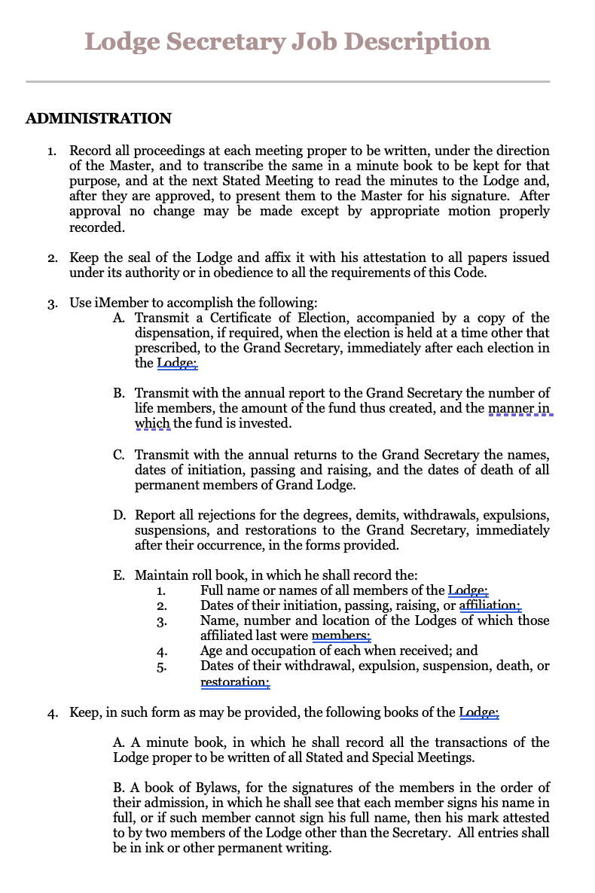
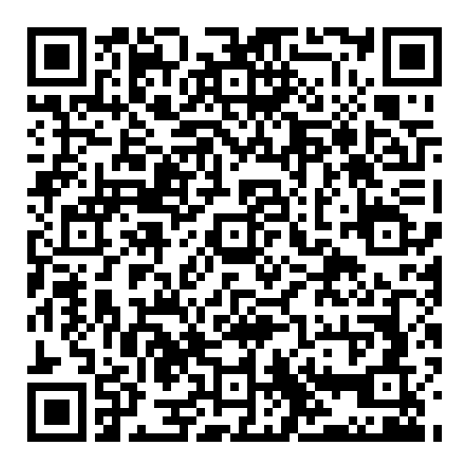
Secretary’s Job Description
Scan to download the file
On lodge dashboard under
Resources & Forms

Slide 8
Administration
Governance
Membership transactions
Reporting
Awards and recognition
Supplies

Slide 9
Poll
The minutes template I use for stated meetings is (choose one):
Past lodge template
Another lodges template
I don’t use a template but would appreciate having one.

Slide 10
Communication
The secretary is often the conduit for lodge communication.
Constituents
  Members
  Widows
  Sojourning Masons
  Officers
  Inspector and grand lodge leadership
  Public

Slide 11
Communication
Communication tools
  Personal conversations
  Social media
  Email
  Letters and mailings
  Website
  Trestleboard
  Telephone calls

Slide 12
Finance
Accurate record of receipts
How is money “paid” to the treasurer?
Approved expenditures recorded in the minutes
February and August Annual and Semi-Annual reports

Slide 13
Poll
I keep track the finances of the lodge with (choose one)
Intacct
Quickbooks or other app program
Spreadsheet / Excel

Slide 14
Managing the Workload
Use iMember
Appoint an assistant secretary
Establish a regular “work” schedule
Work in “real time”

Slide 15
Poll
I’m proactive in working with and training my assistant secretary (choose one)
True
False
An assistant secretary would be welcome

Slide 16
Poll
I am an active member of our executive committee/board (choose one)
Yes
No
We don’t have an executive committee/board

Slide 17
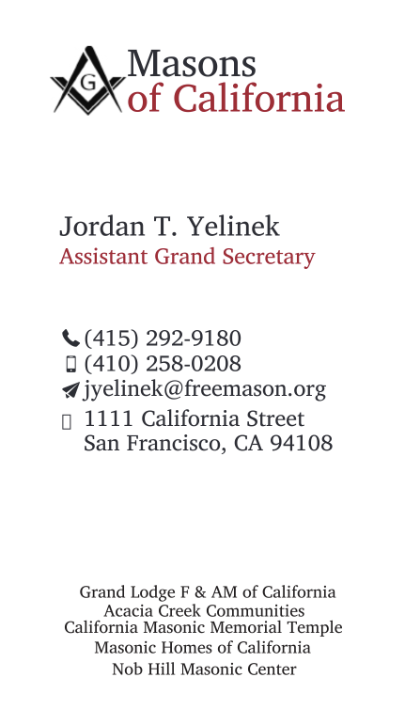
Let's stay connected
Allan L. Casalou
Grand Secretary
(415) 292-9140
acasalou@freemason.org
1111 California Street
San Francisco, CA 94108

