Slide 1
Very Worshipful Allan Casalou, PM Grand Secretary

Slide 2
BUILDING A LODGE TOGETHER
WHAT HAPPENS NEXT?

Slide 3
How has Freemasonry been transmitted, unimpaired, from generation to generation?
How will we do it now?

Slide 4
A
YOU
NAME, TITLE
CORE FUCTION
MEANINGFUL ROLE

Slide 5
B
OTHER
OFFICER
NAME, TITLE
BENEFIT

Slide 6
NAME
WHY?
C
SUCCESSOR

Slide 7
B
OTHER
OFFICER
A
YOU
C
SUCCESSOR

Slide 8
BEEHIVE IMPERATIVES
CONSISTENCY
Show up!
Prioritize!
Culture
Effectiveness
Succession
Be the example!
CLARITY
CARE

Slide 9
1
EDUCATION
Senior Warden
Candidates - Coaches
Programming – Junior
Deacon
Review this tool with all officers
Have a conversation with your successor
Learn and grow.
MEMBERSHIP
Junior Warden
Welcome Committee - Marshal
Prospects – Senior Deacon
Member Engagement - Chaplain
RITUAL
Officer’s Coach
Degrees & Ceremonies
Officer Qualifications
Regalia/Paraphernalia - Tiler
Music - Organist
EXECUTIVE
Master
Oversight
Planning & Delegation
Charity – w/Wardens
Hall Association – w/Senior Warden
SOCIAL
Stewards
Dinners and Parties
Outings & Gatherings
Family Engagement
FINANCE
Treasurer
Financial Accounts
Budget/Forecasting
Insurance
ADMINISTRATION
Secretary
Records/Documents
Required Filings
Minutes/Bylaws
Dues

Slide 10
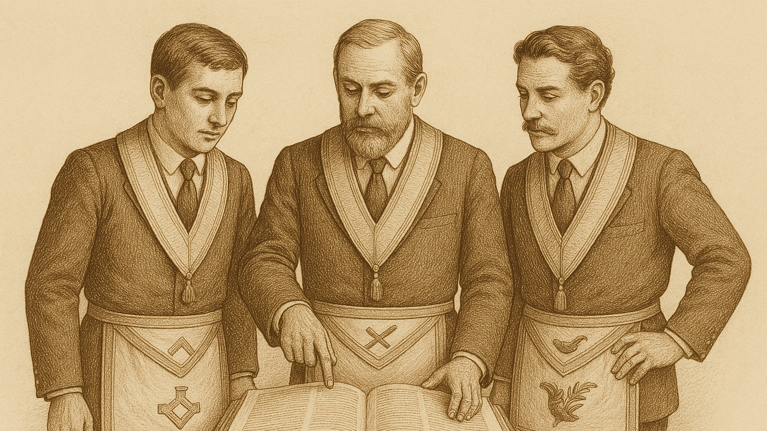

Slide 11
LODGE OFFICERS
BUILDING A LODGE TOGETHER

Slide 12
Your Opinion Matters Fraternal Updates & Reflecting on Strengths from Numbers
Please complete a 5-Question Survey. This should take less than 3 minutes to complete.
Survey Link: https://forms.gle/3Sd3kWzBjmYs5xJQ9

