Slide 2
Right Worshipful Garrett S. Chan, PM
Deputy Grand Master

Slide 3
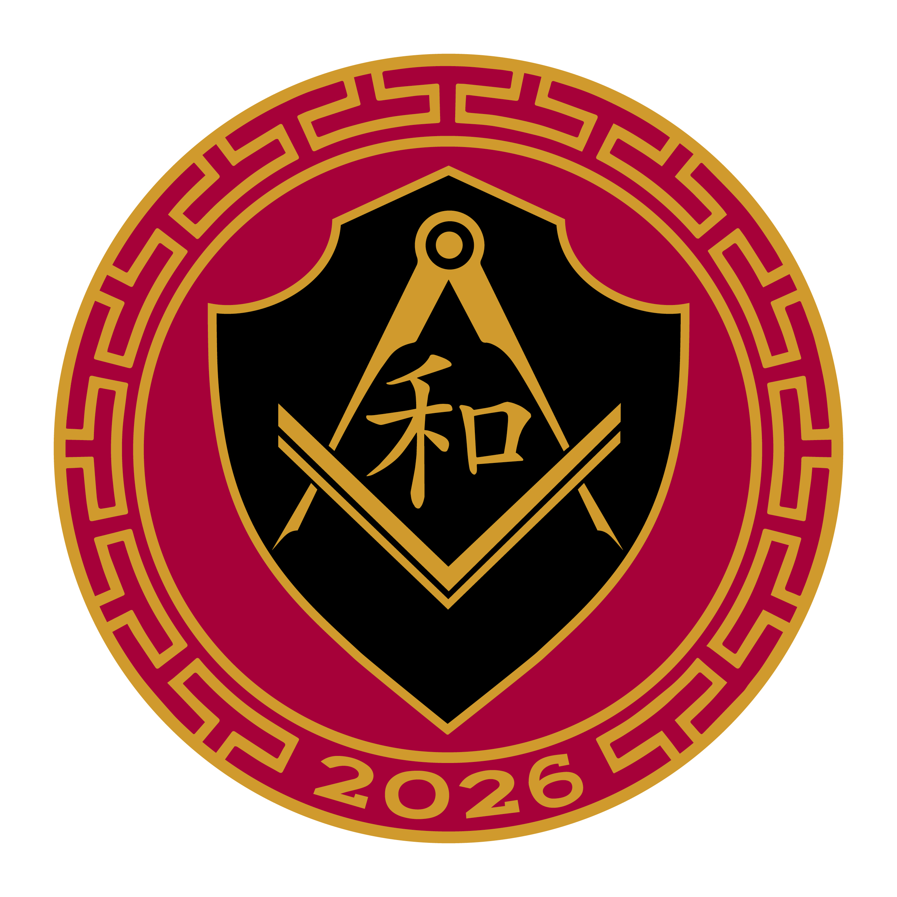

Slide 4
Pin Design:
The pattern symbolizes infinity, eternity, unity and interconnectedness of things, winding paths of life.
Red: Good Fortune, Happiness and Energy.
Gold: symbolizes wealth, prosperity and fortune.
Shield: reminder to be faithful to the vows I have taken as a DeMolay.
The Chinese Character: Harmony, which is integral to next year’s theme.
The Square and Compass: It’s meant to be all-inclusive

Slide 5
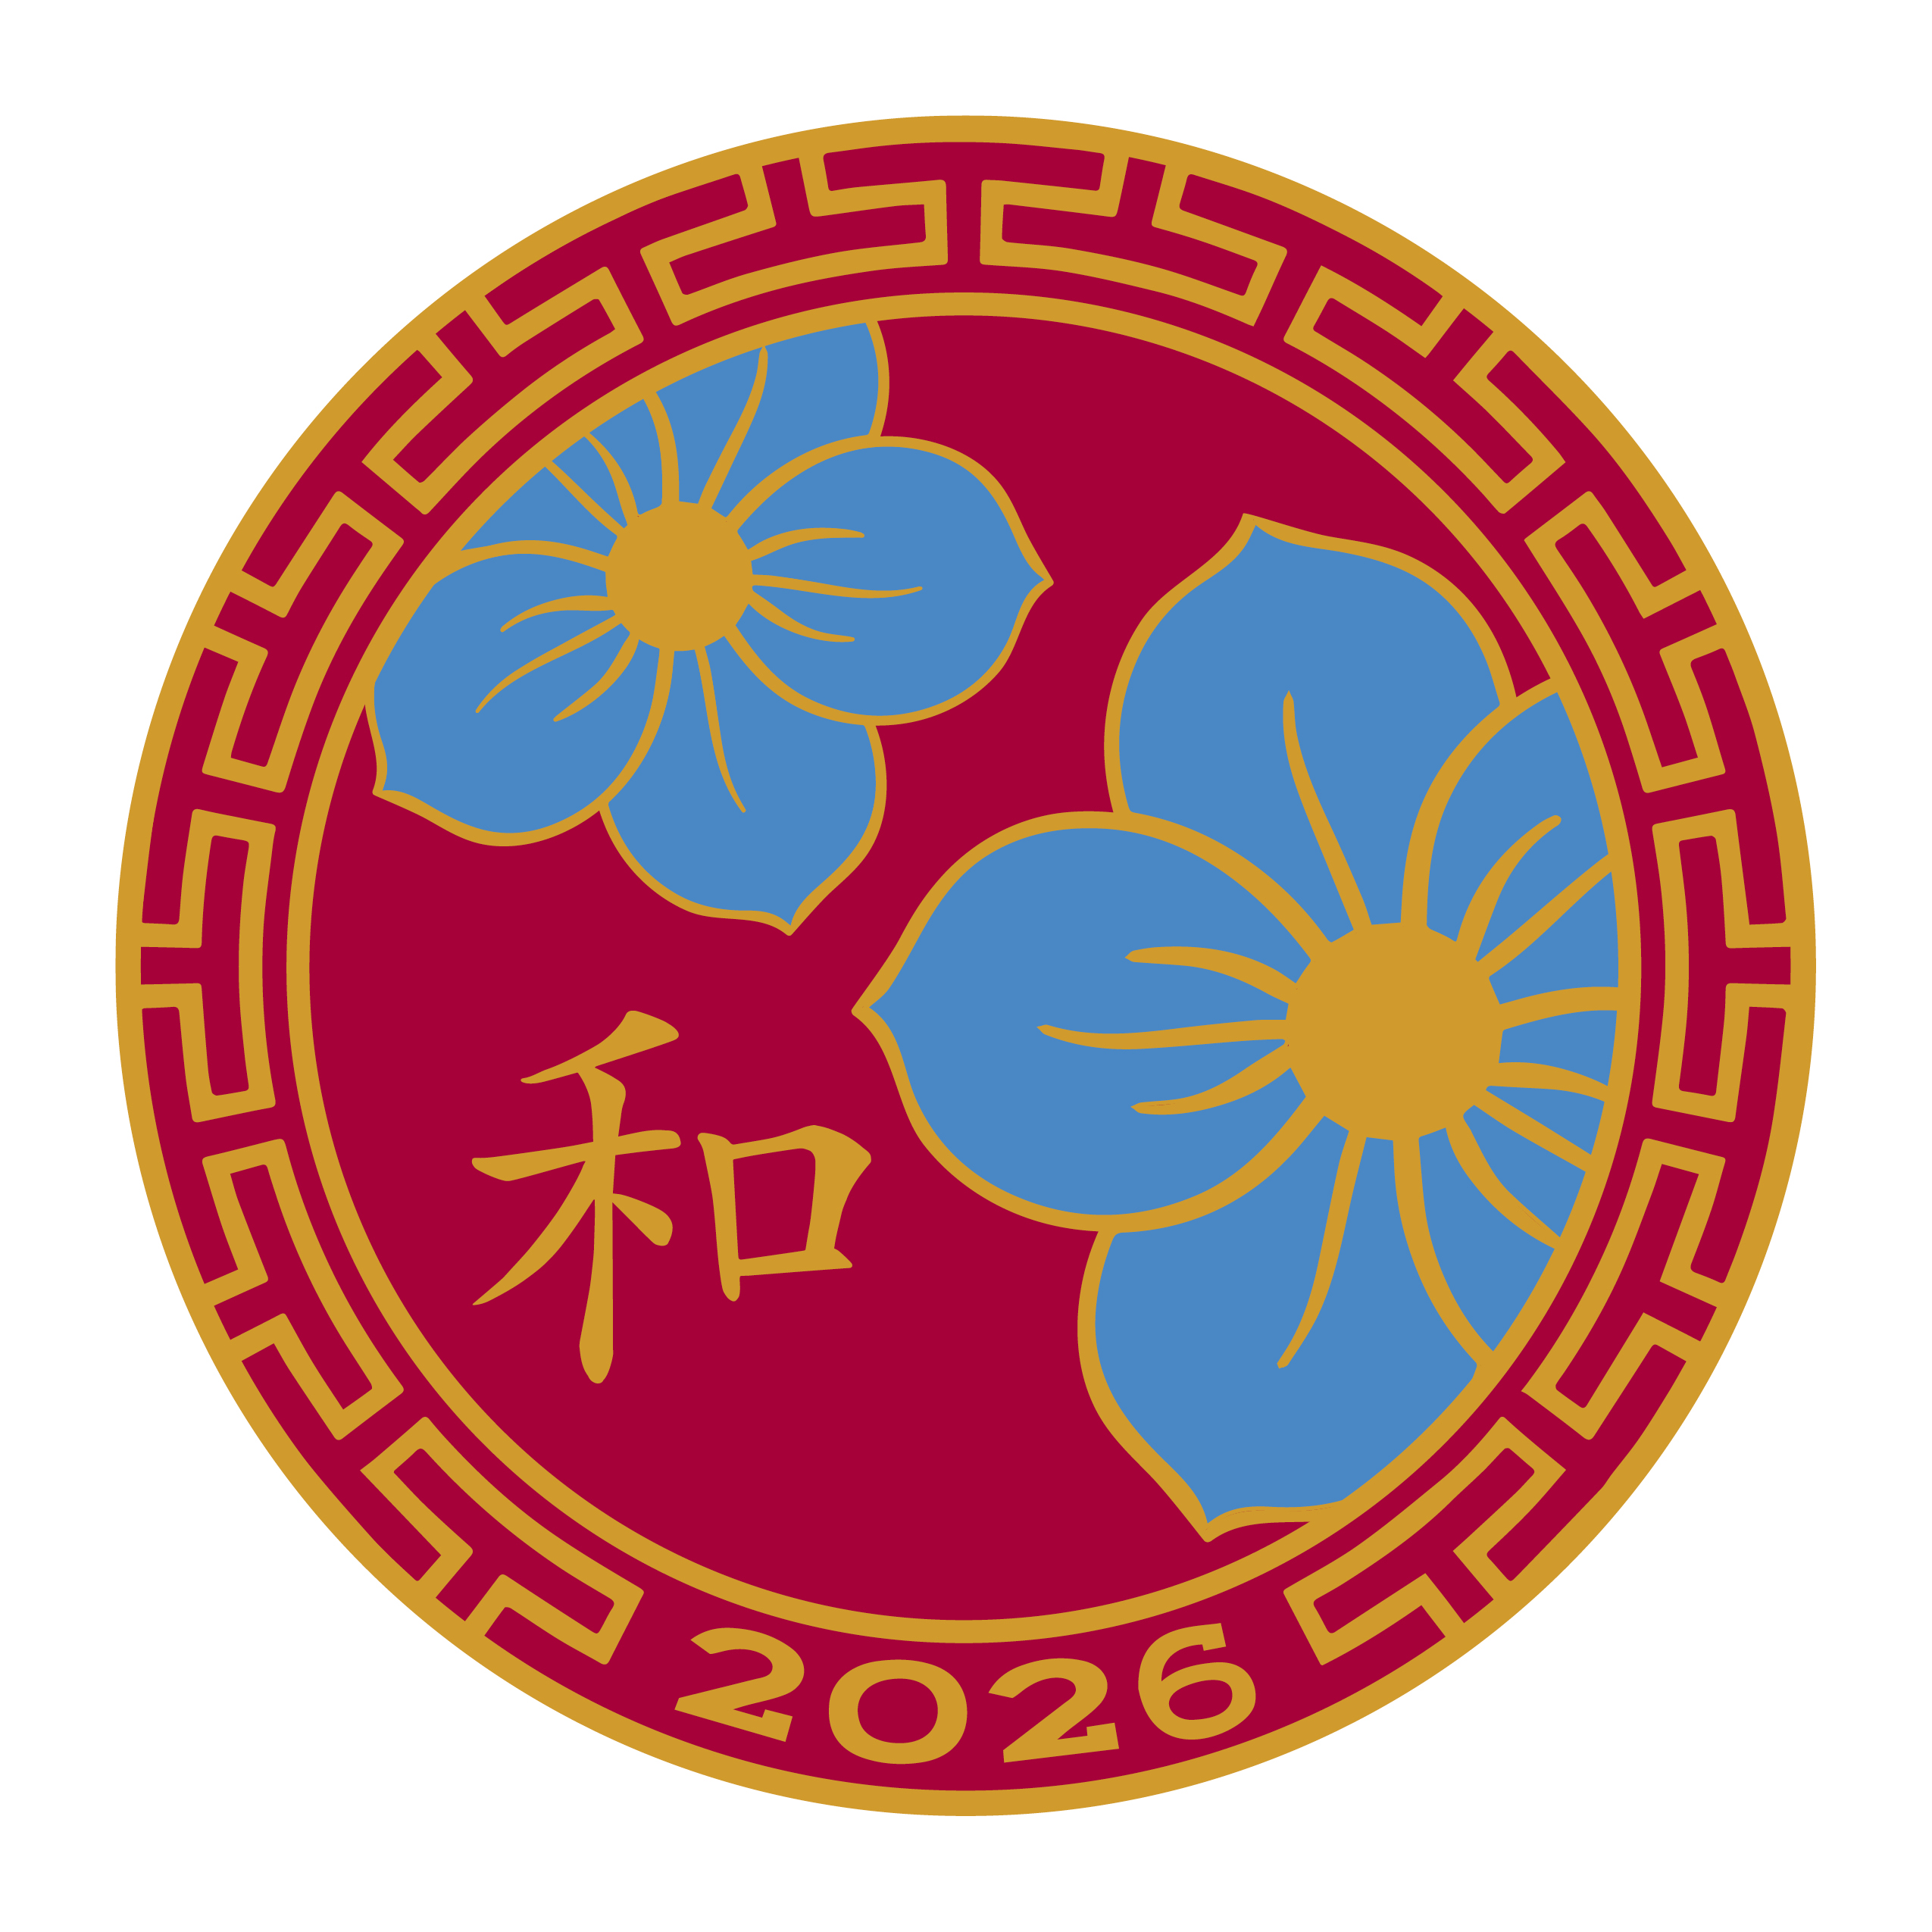

Slide 6
Pin design:
Perimeter design and colors are used for the same meanings.
Forget me not: one representing the mason and the other our treasured ladies.

Slide 7
