Slide 2
Terry Quigley
CEO, Masonic Homes of California & Acacia Creek

Slide 3
Masonic Relief 2025
Terry Quigley
President and CEO of Masonic Homes of California and Acacia Creek
Notes:
Keystone Initiative; Celebrate some of the ways we do that

Slide 4
True compassion means not only feeling another’s pain, but also being moved to help relieve it.
Daniel Goleman
Distressed Worthy Brother Relief Program
Notes:
Bumps in the road (unpaved) Cardinal events; DWB Born; 2020 250k; 2024 318k; + referrals – yay; + acuity and risk of homelessness
Car accident –back to caring for his family; Health condition and meds- standing with him

Slide 5
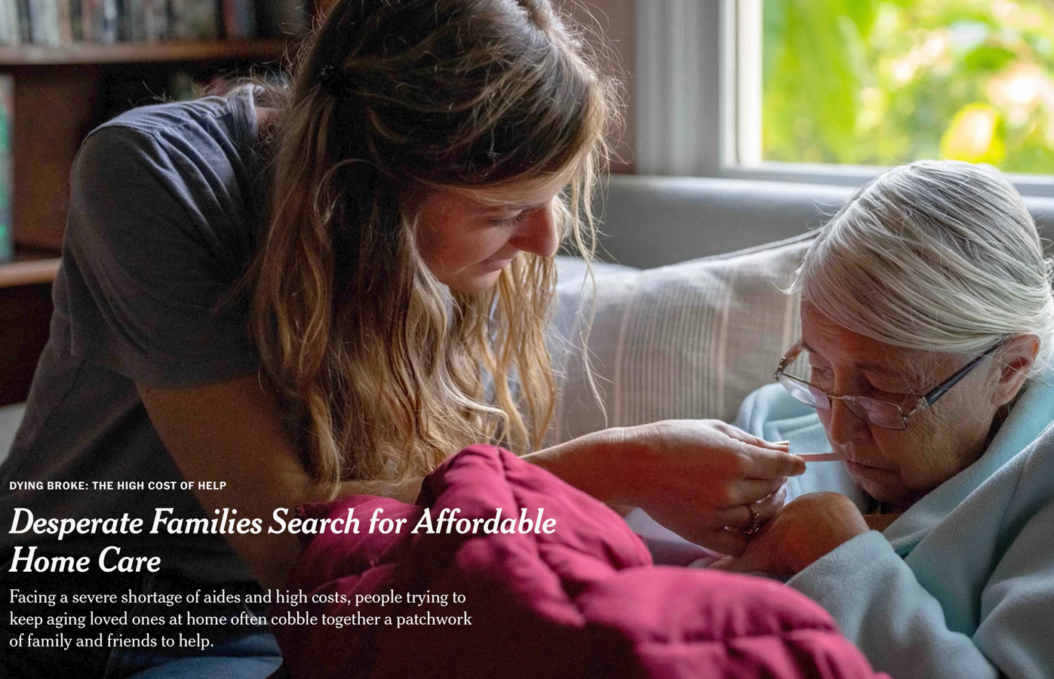
Senior housing and health care becoming a societal crisis.
Masonic Homes is part of the solution.
Notes:
If housing & Health increasing crisis for others + for seniors; throw numbers at you $4k; 3500; $29/hr/ 7000/mo 250kyear MHC part of solution

Slide 6
RETIREMENT COMMUNITIES
Independent Living, Assisted Living, Memory Care, Skilled Nursing, Shared Housing
Covina Campus
Union City Campus
Notes:
IL/AL/MC/SN (Yay first floor full); Shared Housing – talk about a bit more in a minute

Slide 7
Senior Living Looks Different Today
Notes:
Not old people homes anymore

Slide 8
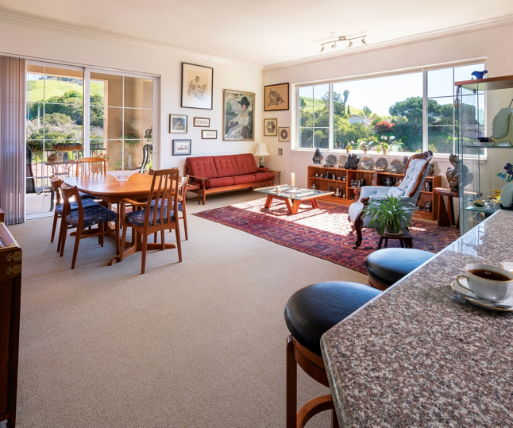
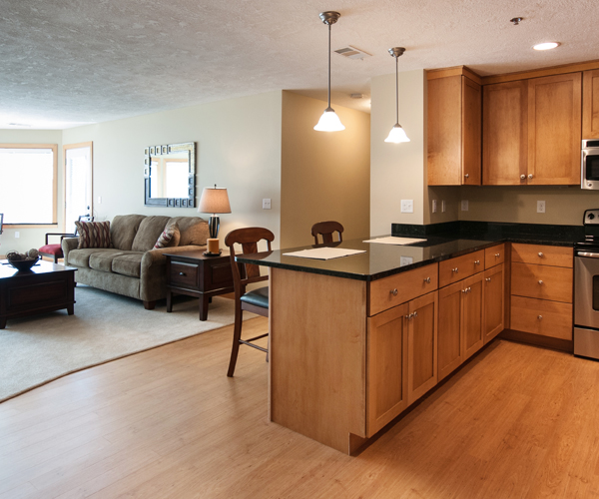
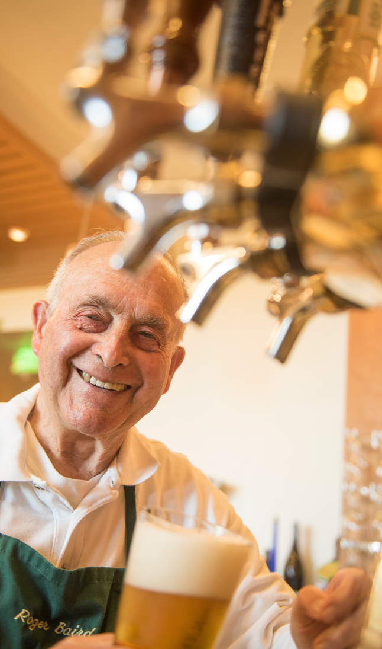
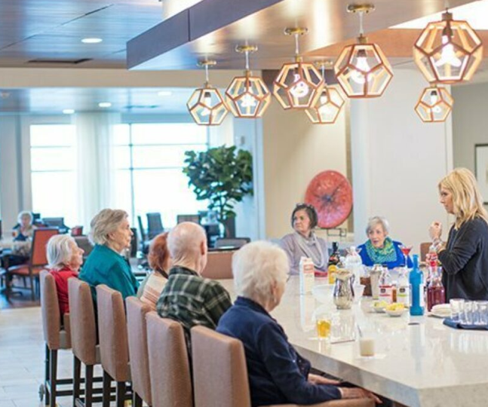

Slide 9
The Masonic Homes and Acacia Creek are now serving more Masons and their families
Notes:
Once only Masons, wives and widow….Now includes parents and inlaws

Slide 10
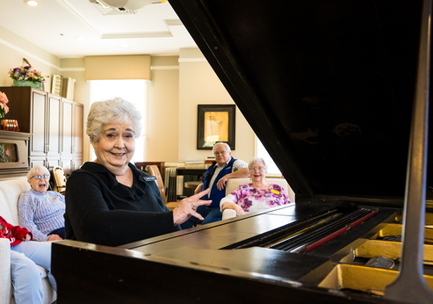
Who Can Live at the Masonic Homes and Acacia Creek and How Do They Pay?
Masons: Partial Assignment of Assets or Pay As You Go
Eligible Masons, Spouses and Surviving Spouses, Parents and Parents-in-law can take advantage of our charitable funds, or pay as they go.
Non-Masons or Other Family: Pay As You Go
Pay for services on a monthly basis.

Slide 11
Masonic Outreach Services
Masons, their spouses, surviving spouses, parents and parents-in-law are eligible
Personalized care management
Help accessing services and benefits (VA benefits, transportation)
Senior home placement services
Financial support for qualified Masons
Shared, affordable housing
Help connecting Masons to local lodges
Notes:
So much- Calif a big state, did you know if you don’t live near Home, we can help you find a place? Shared Housing Less than $700 w/utilities
Show and tell – eligibility card; Magnet – everyone needs a lifeline- put it on your refrig, tell your family

Slide 12
Masonic Center for Youth and Families
Therapy services for all ages
Family counseling
Sliding scale fee
Locations in Union City and Covina,
and serving everywhere else via telehealth
Notes:
Bumps aren’t just financial. We provide relief for the emotional bumps as well. All Masons and families- throughout CA, regardless of ability to pay

Slide 13
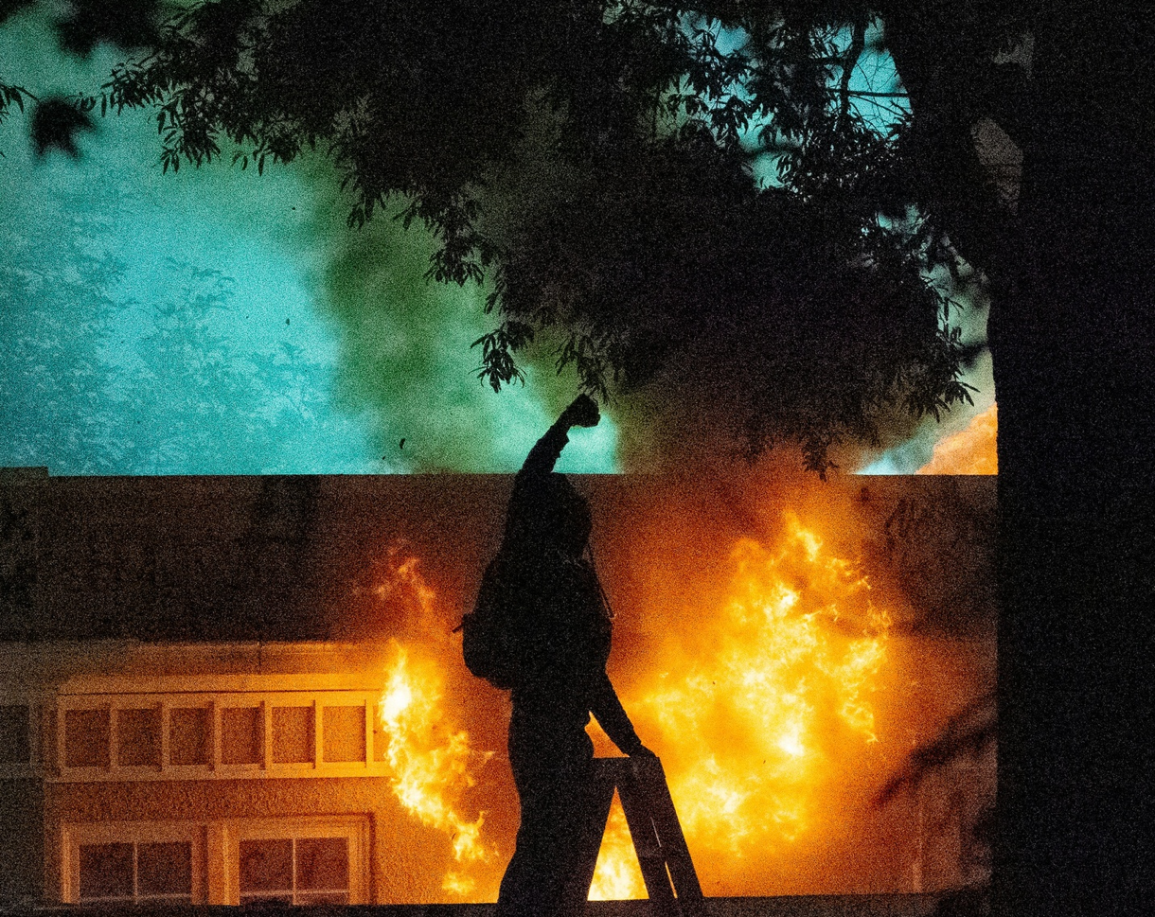
FIRE
RELIEF
Notes:
Imagine walking out to work…what do you take? Come home, gone. Pp Assistance for evacuated . Damaged or lost- lodging, $, shoulder. So many stories

Slide 14
This is Relief
Th is Masonry

