Slide 1
HOW DOES OUR MANIFESTO COME TO LIFE?
Talking About Freemasonry:
Part III
Emily Limón Chief Communications Officer

Slide 2
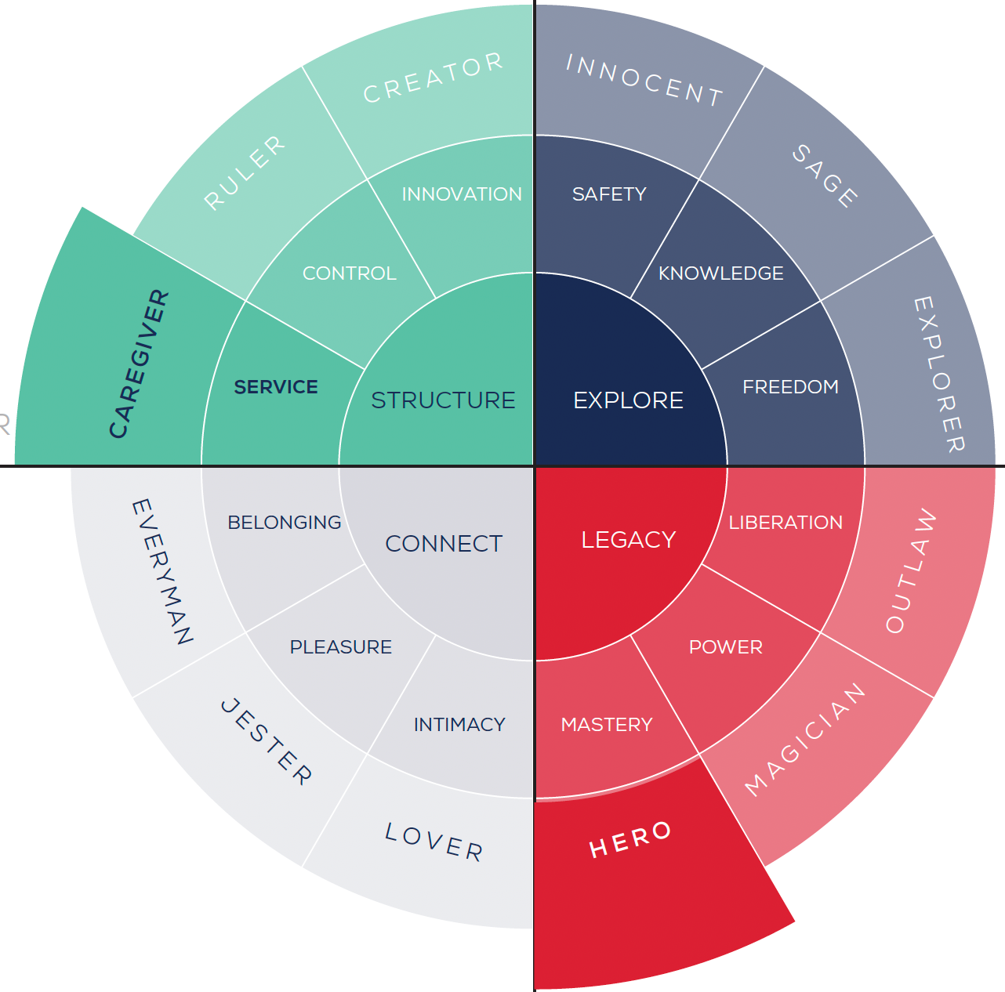
The Caregiver/Hero
"Be the change you want to see in the world."
Brand Message
There's no greater satisfaction than helping someone. Together we can improve our world and make a difference.
Brand Voice
Caring, Inclusive, Bold, Ambitious
Drivers
Service, Stability, Inspiration, Growth
Fears
Selfishness, Neglect, Weakness, Incompetence

Slide 3
Masons are builders.
Where once we built magnificent structures, today we build character. Steeped in tradition and ceremony, our values are based on a bedrock of friendship and philanthropy.
We believe that harmony between diverse individuals is a powerful force for good.
And just as ancient stonemasons perfected their craft, we employ timeless lessons that create meaningful change in ourselves, stronger communities around us, and a better world for all.

Slide 4
HOW DOES OUR BRAND
MESSAGE COME TO LIFE?
For You?
For Your Members?
In Your Lodge's Ritual Practice?
In Your Stated Meetings?
In Your Community Service?

Slide 5
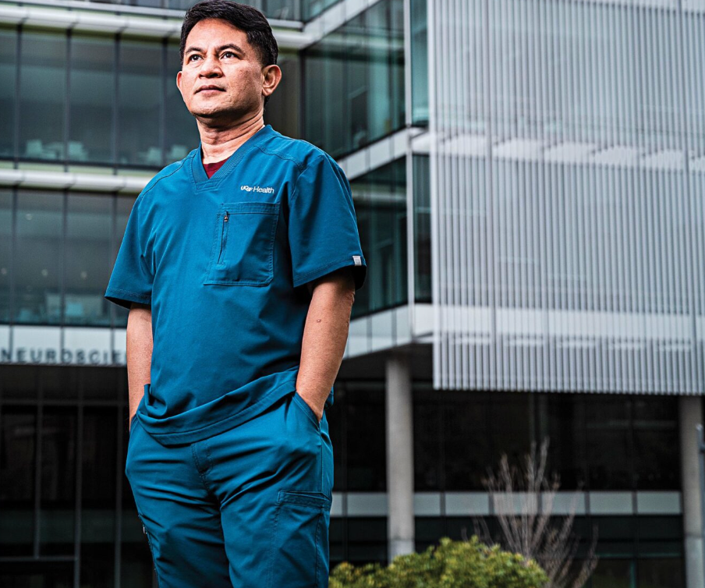
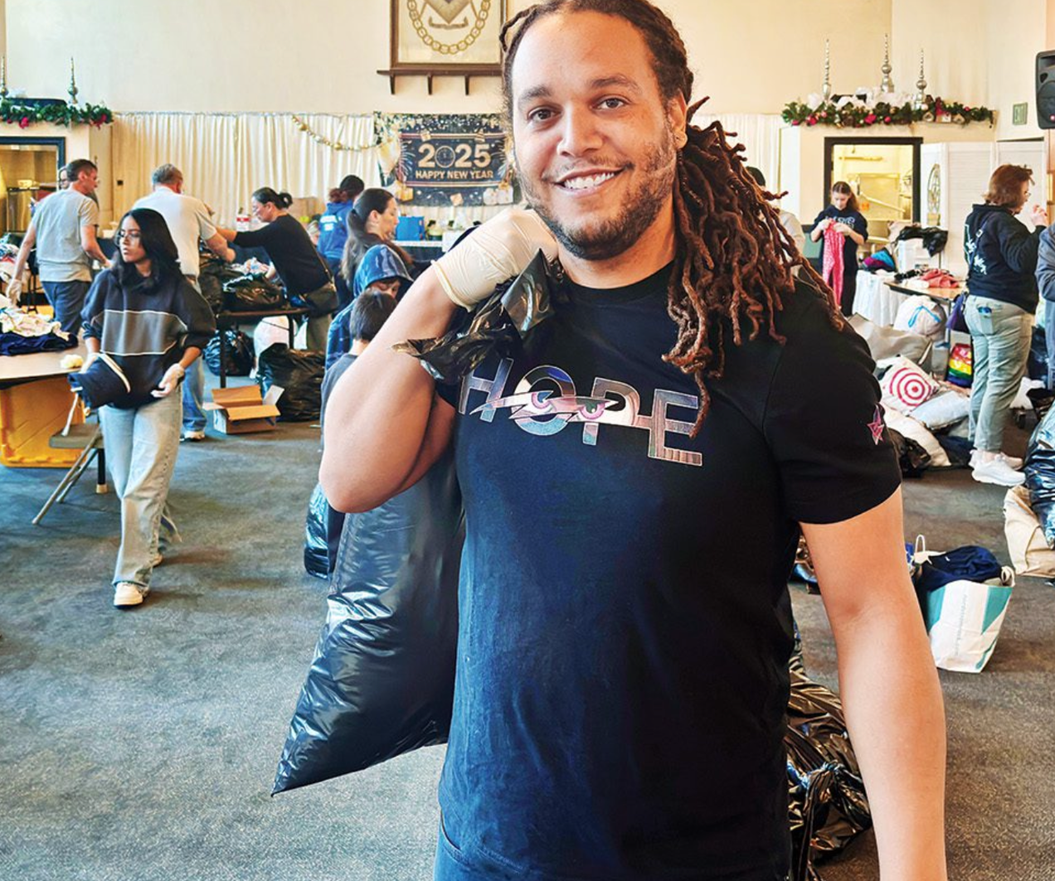
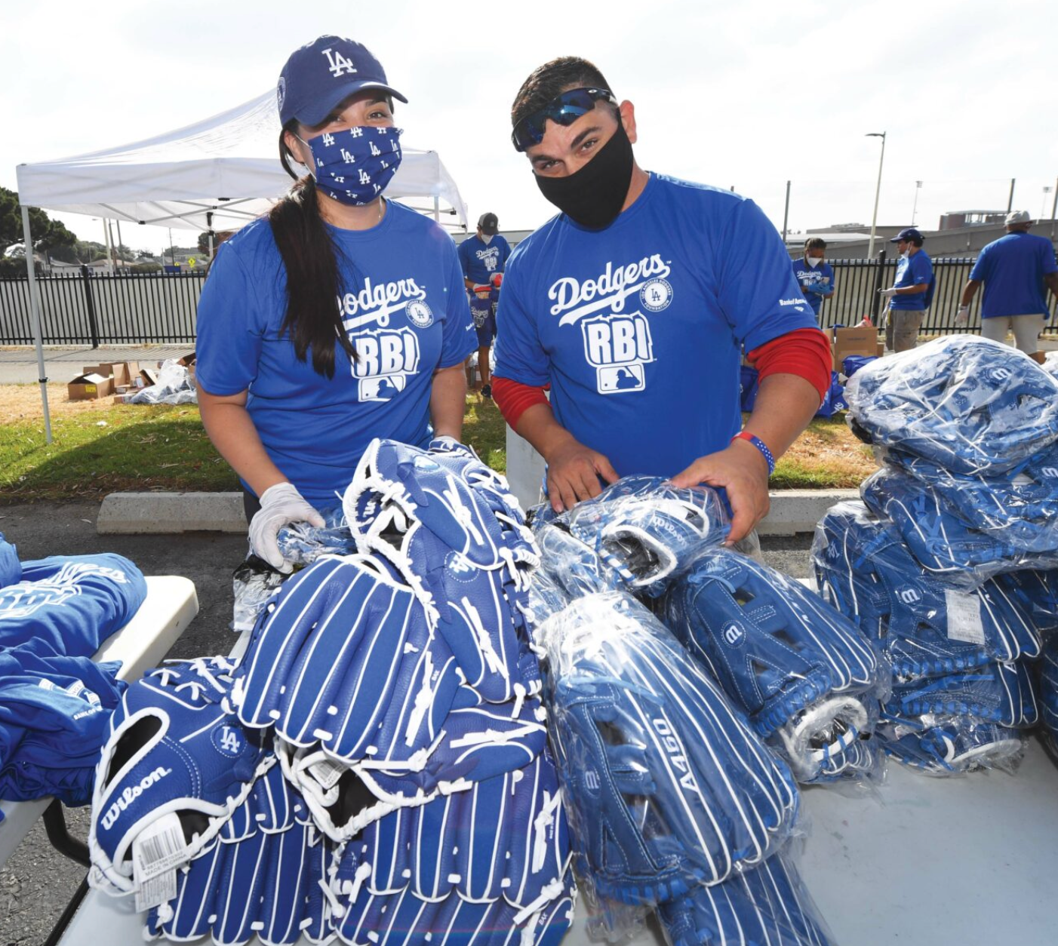
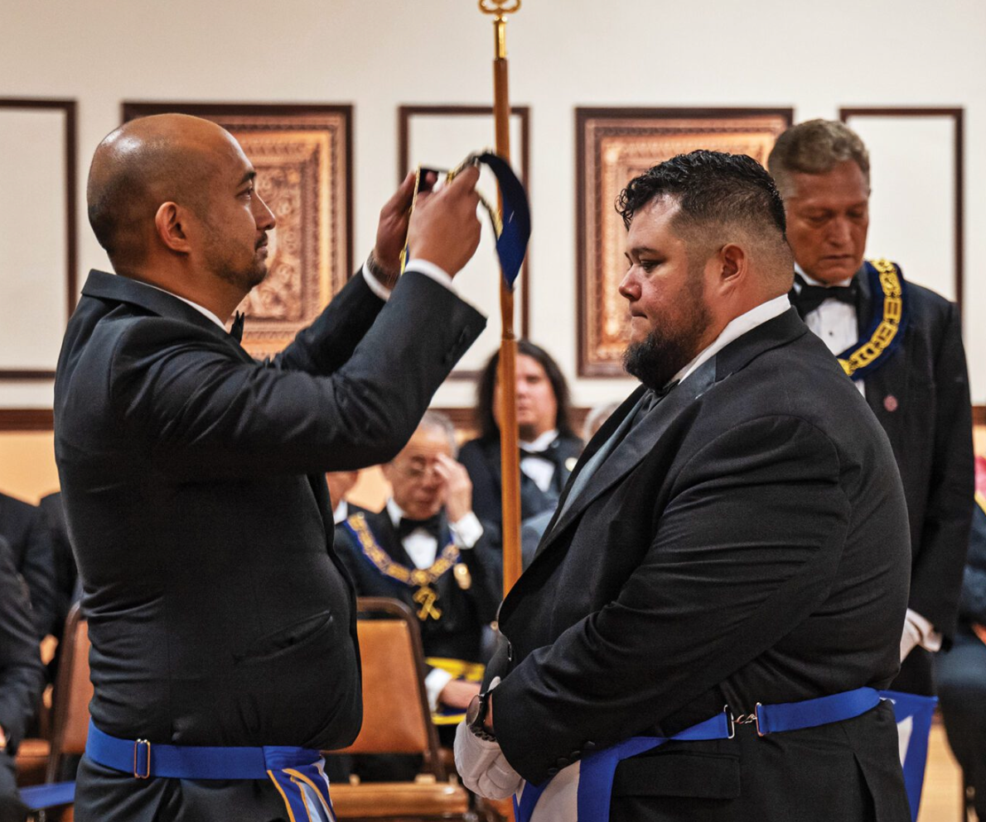

Slide 6
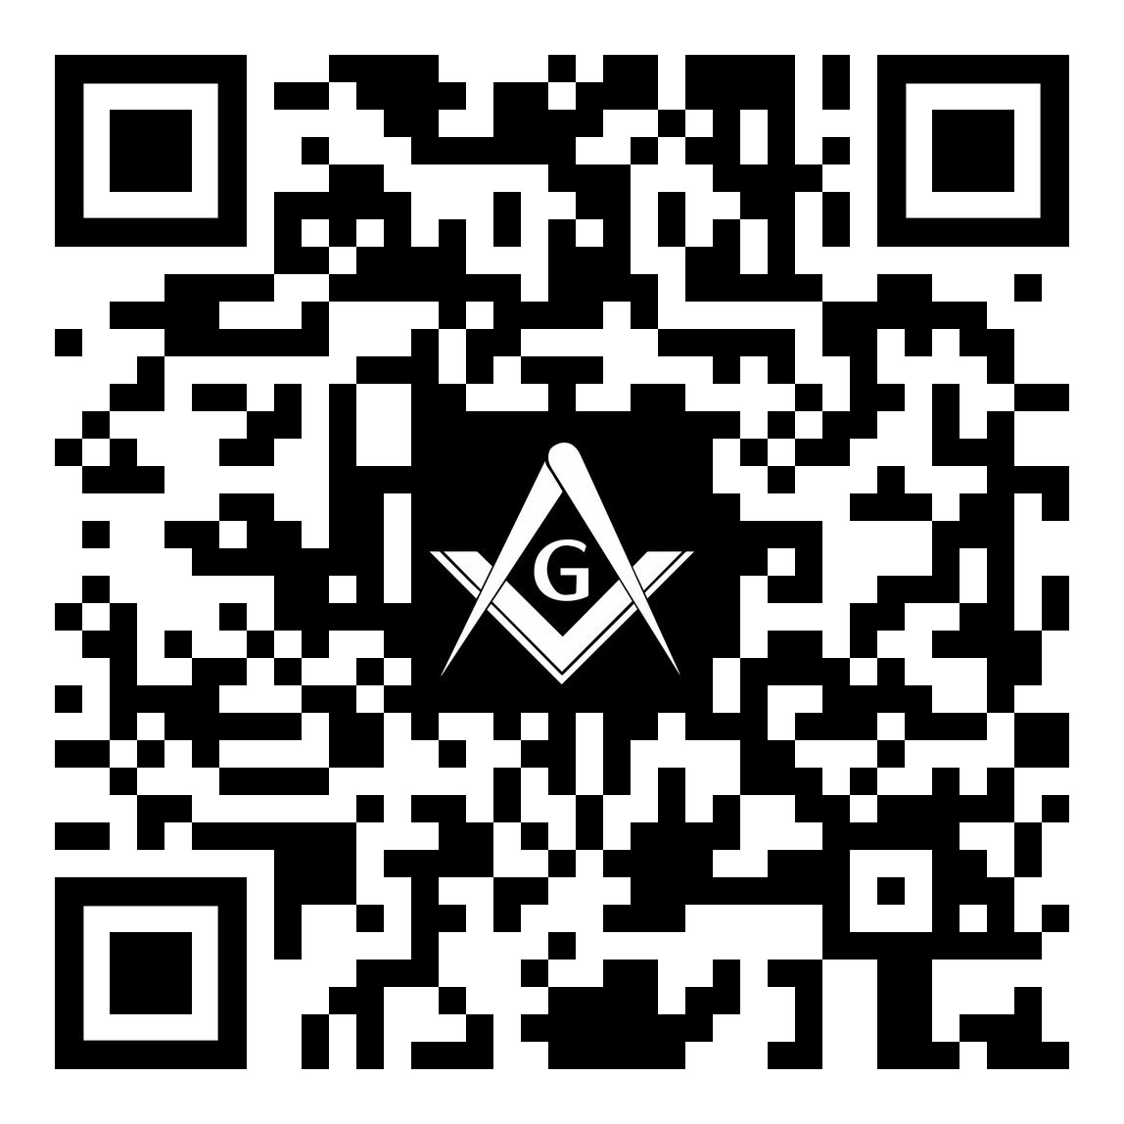
Your Opinion Matters Talking About Masonry (Part 3)
Please complete a 5-Question Survey. This should take less than 3 minutes to complete.
Survey Link: https://forms.gle/KnoUmQbWyVACh3e4A

