Slide 1
HOW DO WE TALK ABOUT OURSELVES?
Talking About Freemasonry:
Part II
Emily Limón Chief Communications Officer

Slide 2
The Caregiver/Hero
A.K.A.
The Mason

Slide 3
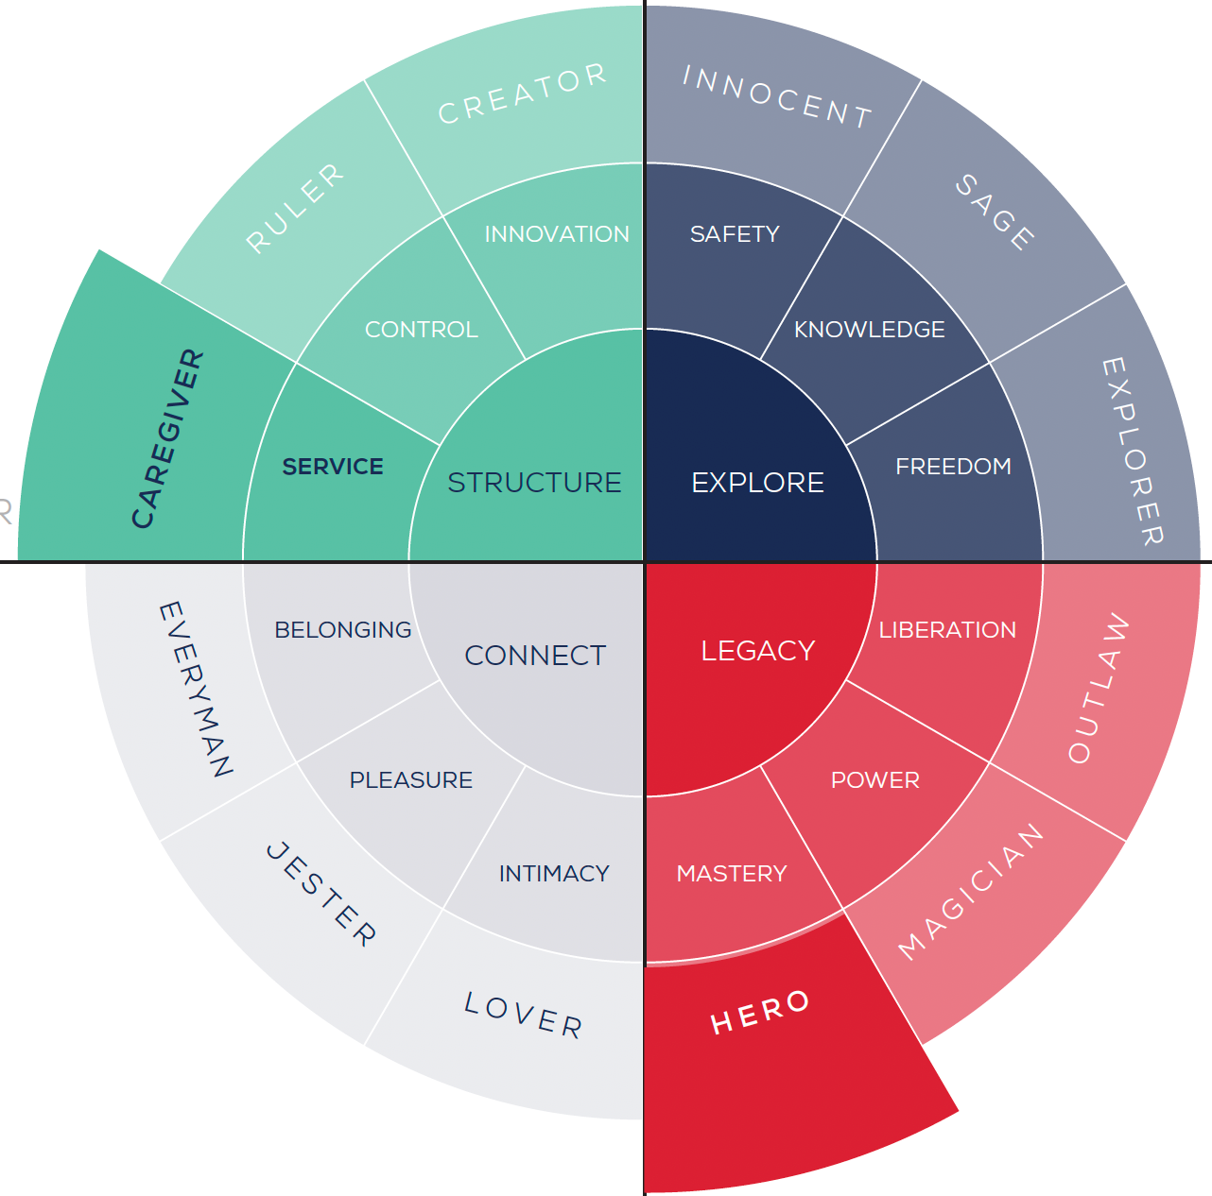
The Caregiver/Hero
"Be the change you want to see in the world."
Brand Message
There's no greater satisfaction than helping someone. Together we can improve our world and make a difference.
Brand Voice
Caring, Inclusive, Bold, Ambitious
Drivers
Service, Stability, Inspiration, Growth
Fears
Selfishness, Neglect, Weakness, Incompetence

Slide 4
THE WHAT, THE WHY, THE WAY
OUR WHAT (Mission)
We build strong communities through friendship, service and self-improvement.
OUR WHY (Vision, Purpose)
To inspire a world in harmony.
OUR WAY (Impact, Values)
We build in our members a foundation of values focused on service, integrity and a sense of belonging. By strengthening our moral character, we are able to affect positive change in the wider world.

Slide 5
Our Brand Message

Slide 6
Masons are builders.
Where once we built magnificent structures, today we build character. Steeped in tradition and ceremony, our values are based on a bedrock of friendship and philanthropy.
We believe that harmony between diverse individuals is a powerful force for good.
And just as ancient stonemasons perfected their craft, we employ timeless lessons that create meaningful change in ourselves, stronger communities around us, and a better world for all.

Slide 7
THREE QUESTIONS
What word or phrase jumps out at you most?
2. How does The Caregiver show up?
3. How does The Hero show up?

Slide 8
Masons are builders.
Where once we built magnificent structures, today we build character. Steeped in tradition and ceremony, our values are based on a bedrock of friendship and philanthropy.
We believe that harmony between diverse individuals is a powerful force for good.
And just as ancient stonemasons perfected their craft, we employ timeless lessons that create meaningful change in ourselves, stronger communities around us, and a better world for all.

Slide 9
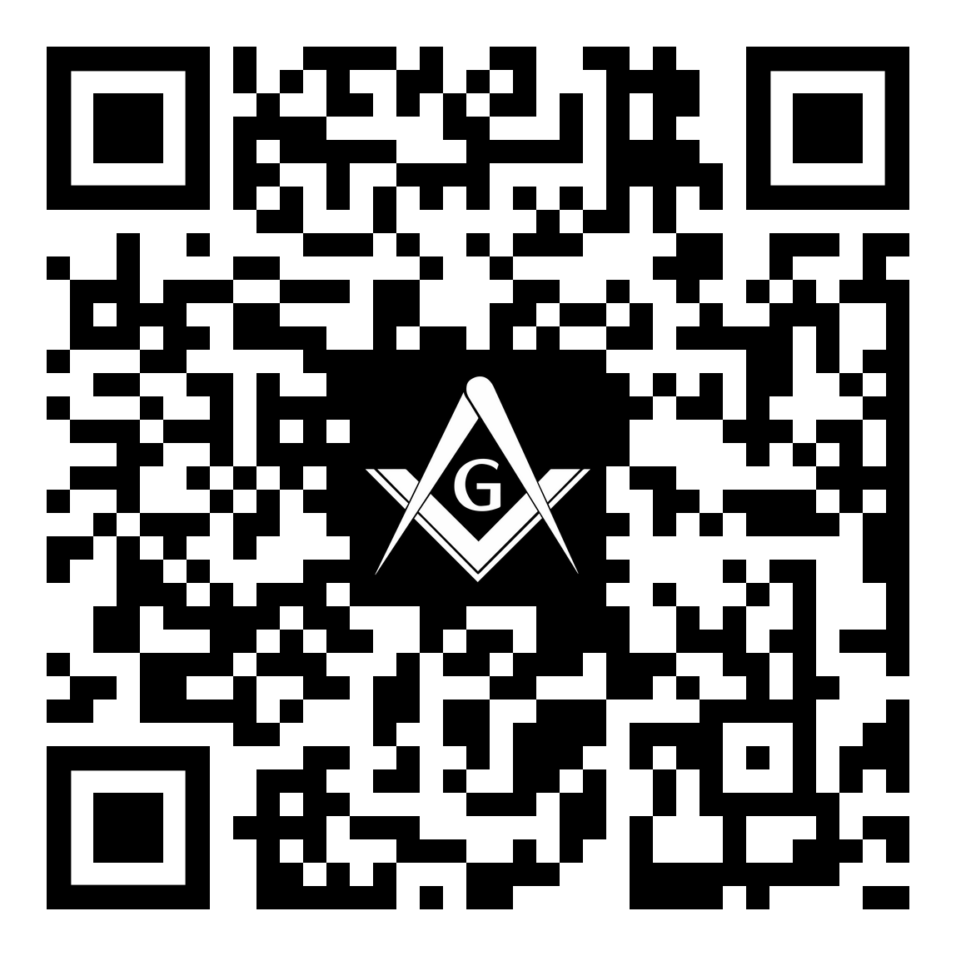
Your Opinion Matters
Talking About Masonry (Part 2)
Please complete a 2-Question Survey. This should take less than 1 minute to complete.
Survey Link: https://forms.gle/DwAbDhUzQdgkD12f6

