Slide 2
Rylin Gamble
Miss California Job's Daughter 2024-2025
Past Honored Queen of Bethel#65 Merced and Outer Guard of Bethel UD Turlock
Peter Thompson Master Councilor for Northern California DeMolay
Jairo Gomez, PM
AGL Division 4 Morning Star Lodge No. 19

Slide 3
Right Worshipful Ara Maloyan, PM
Senior Grand Warden

Slide 4
MY JOURNEY
PRESENTED BY
ARA MALOYAN, PM
Senior Grand Warden

Slide 5
DISCLAIMER
THE VIEWS AND OPINIONS EXPRESSED HERE ARE THOSE OF (ARA MALOYAN) ONLY AND IN NO WAY REPRESENT THE VIEWS, POSITIONS OR OPINIONS – EXPRESSED OR IMPLIED – OF GRAND LODGE OF CA OR ANYONE ELSE.
NO ANIMALS WERE HARMMED DURING MAKING OF THIS PRESENTATION.

Slide 6
OPENING MEDITATION

Slide 7
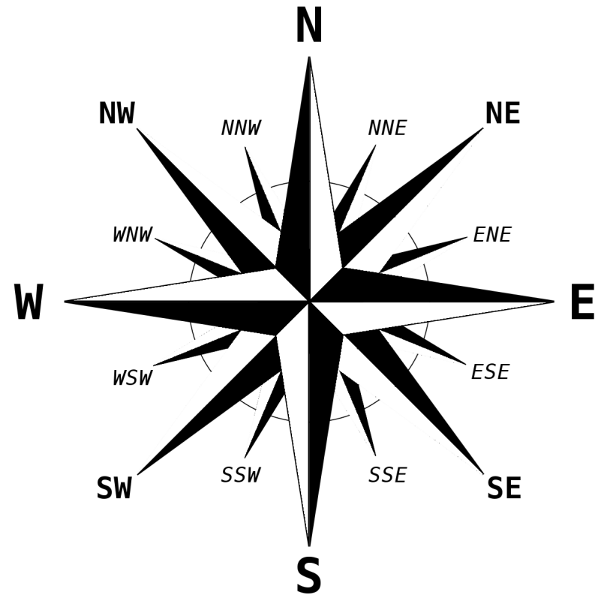
CARDINAL POINTS
HINGE POINT - CARDO;
Etymology: Middle English cardinal "high church official," from Latin cardinalis (same meaning), from cardinalis (adjective) "principal, most important, of a hinge," from cardo "hinge"

Slide 8
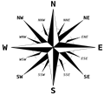
PRE - UNIVERSITY PERIOD
HOBBIES
PLASTIC MODELS
MODEL PLANES
COLLECTING STAMPS
SUPER 8 MOVIES
O LEVELS
HIGH SCHOOL
SCOUTING
SPORTS
FAMILY ILLNESS

Slide 9
UNIVERSITY PERIOD (1978 – 1983)
CALIFORNIA STATE UNIVERSITY – LOS ANGELS
DEGREE IN CIVIL ENGINEERING – EMPHASIS IN STRUCTURES
PHOTOGRAHY
PHOTO LAB MANGER
FENCING TEAM
ROCK CLIMBING – FIRST VISIT TO YOSEMITE NATIONAL PARK
VICE PRESIDENT OF ASCE
CREATED THE ARMENIAN STUDENT ASSOCIATION
PLACEMENT TEST / INTERVIEW WITH CITY OF LOS ANGELES

Slide 10
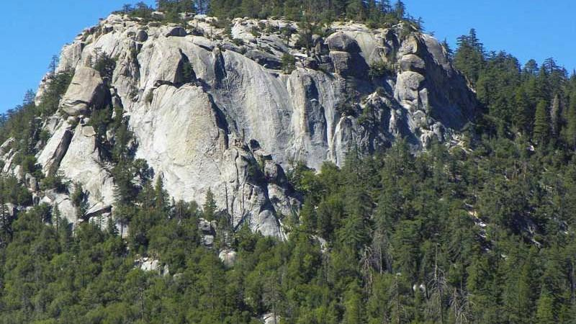
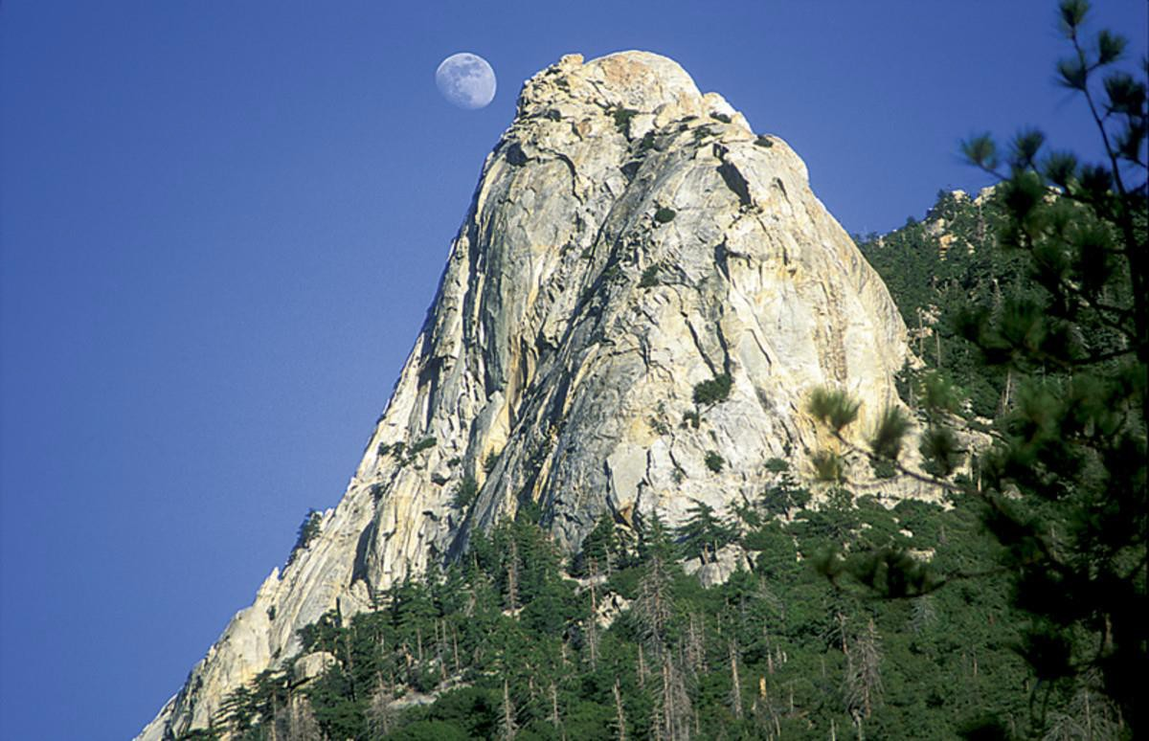
UNIVERSITY PERIOD (1978 – 1983)
SUICIDE ROCK
TAHQUITZ ROCK

Slide 11
CITY OF LOS ANGELES (1984 – 1989)
CITY OF BEVERLY HILLS (1989 – 2012) CITY OF LONG BEACH (2012 – 2015) CITY OF PASADENA (2015 – 2021)
PRIVATE DEVELOPMENT CO. (2021 – 20XX)

Slide 12
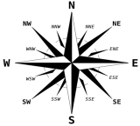
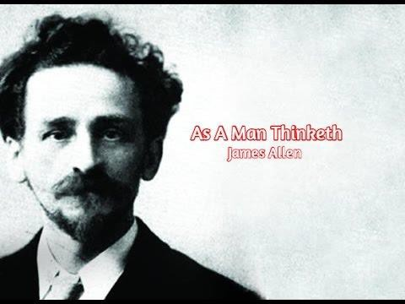
WRITERS THAT HAD A PROFOUND INFLUENCE ON MY LIFE
WRITER JAMES ALLEN (1864 – 1912)

Slide 13
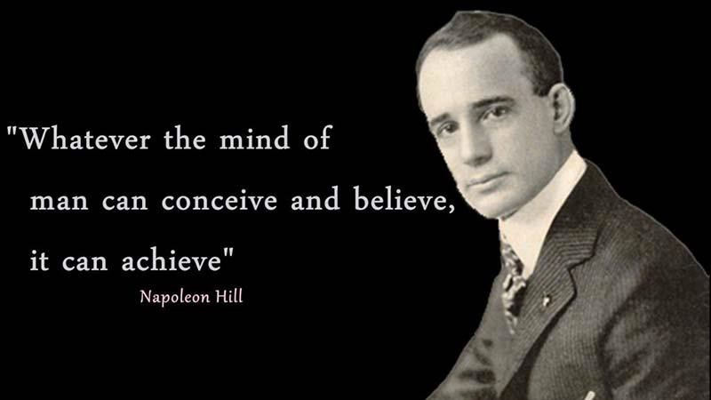
WRITERS THAT HAD A PROFOUND INFLUENCE ON MY LIFE
WRITER NAPOLEON HILL (1883 – 1970)

Slide 14
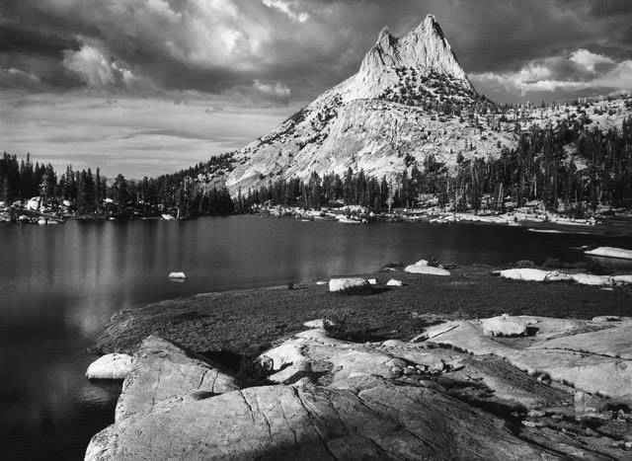
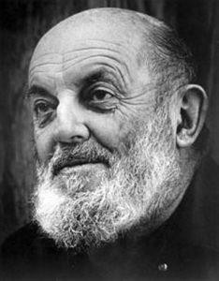
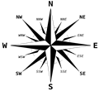
ARTISTS THAT HAD A PROFOUND INFLUENCE ON MY LIFE
PHOTOGRAPHER
ANSEL ADAMS (1902-1984)

Slide 15
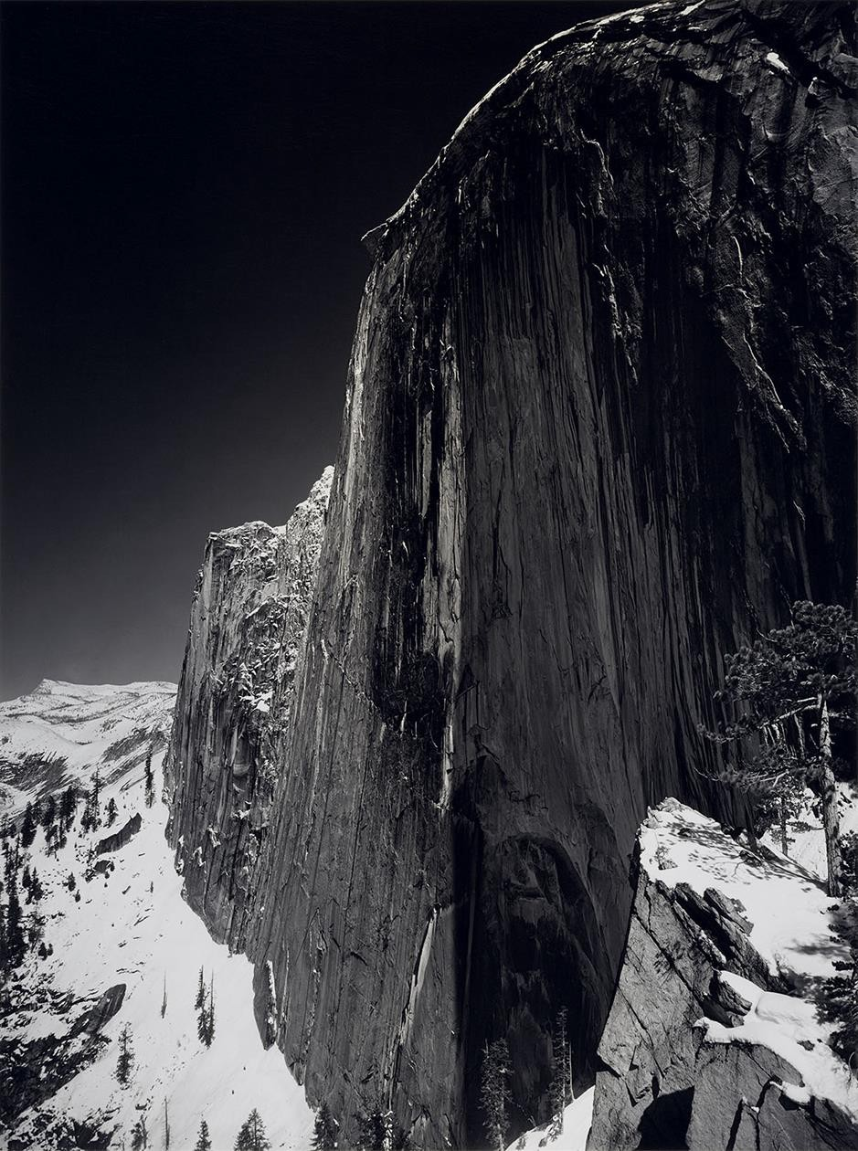
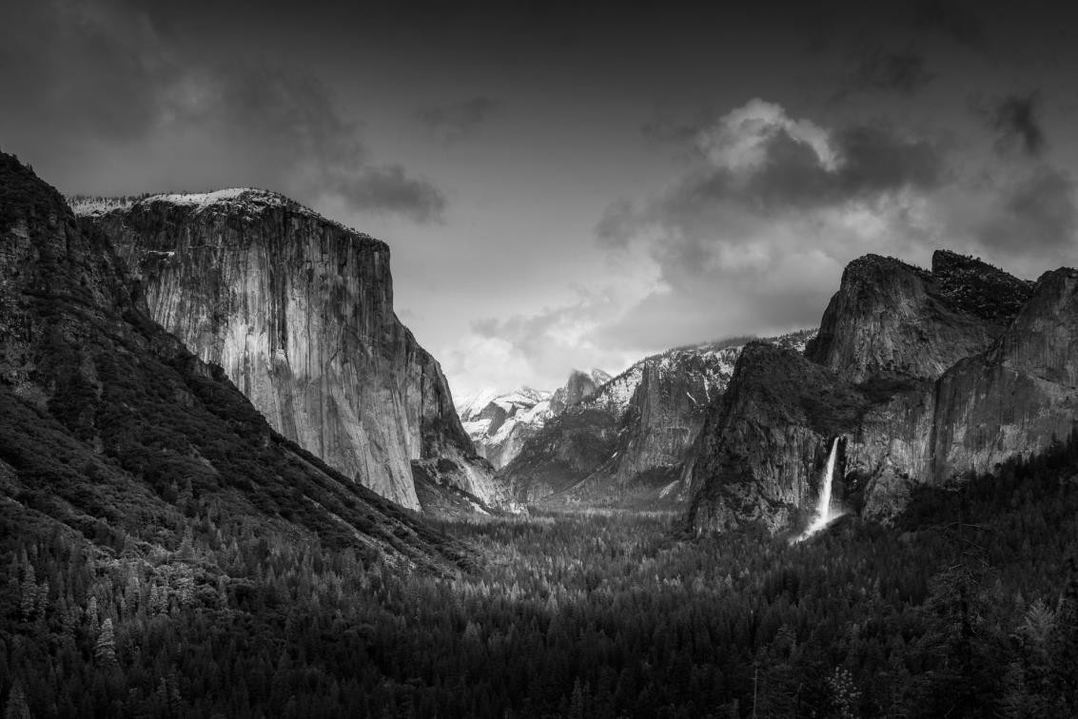
ARTISTS THAT HAD A PROFOUND INFLUENCE ON MY LIFE

Slide 16
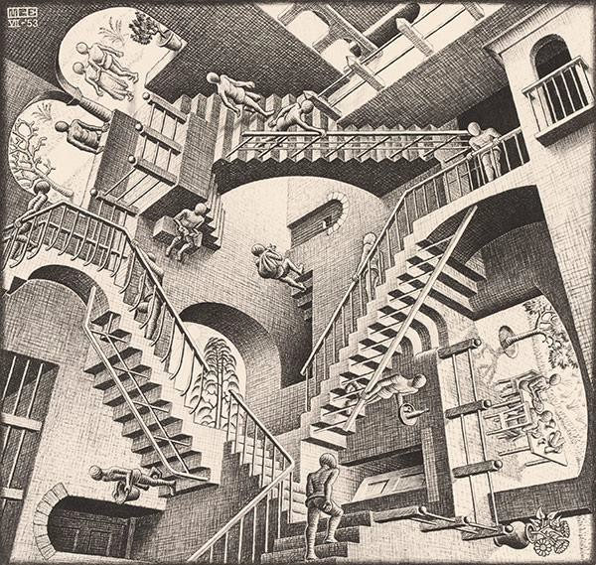
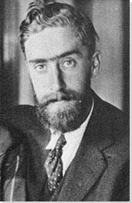
ARTISTS THAT HAD A PROFOUND INFLUENCE ON MY LIFE
GRAPHIC ARTIST
M. C. ESHER (1898 – 1972)

Slide 17
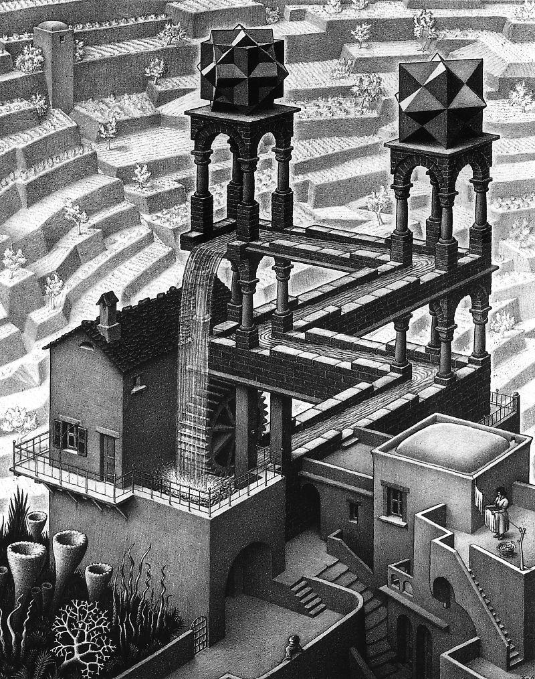
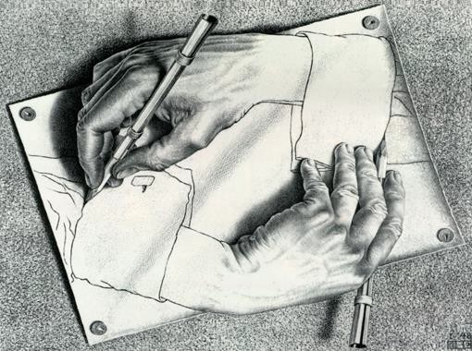
ARTISTS THAT HAD A PROFOUND INFLUENCE ON MY LIFE

Slide 18
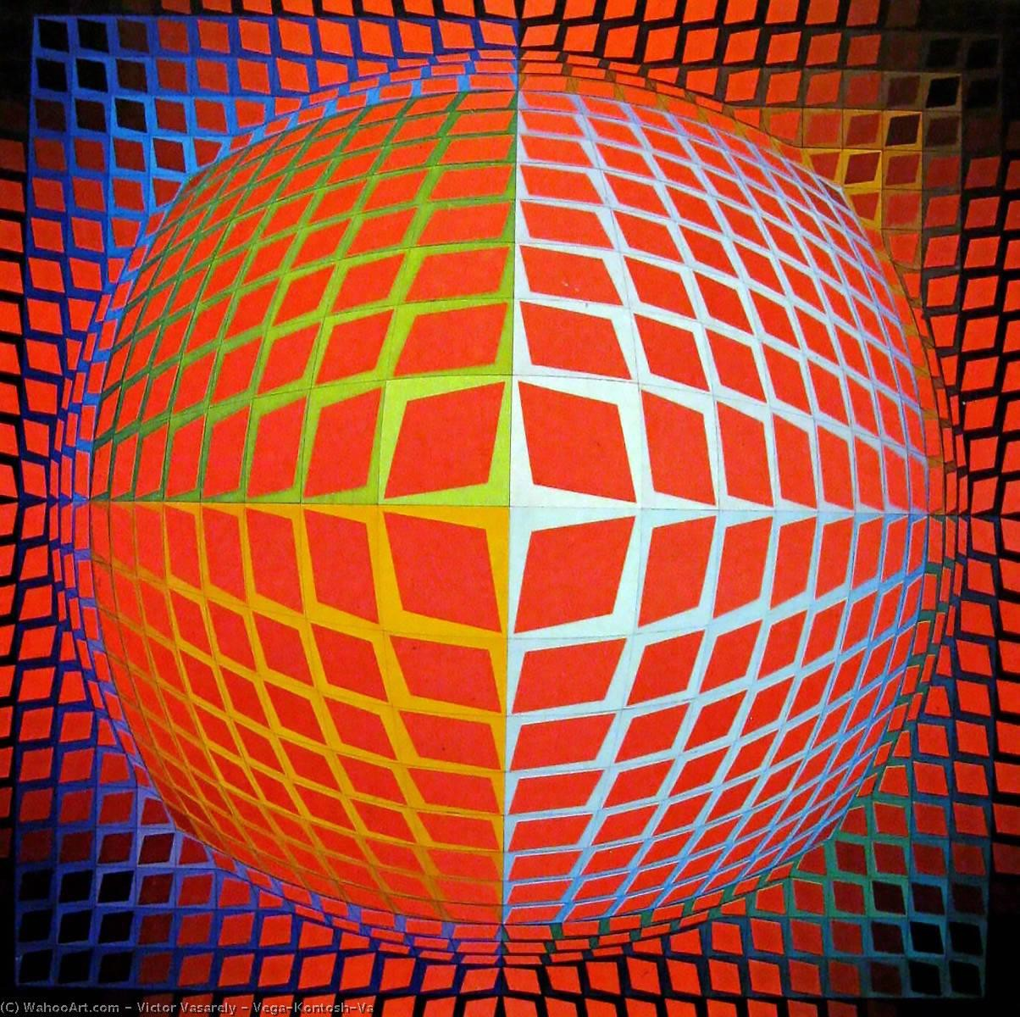
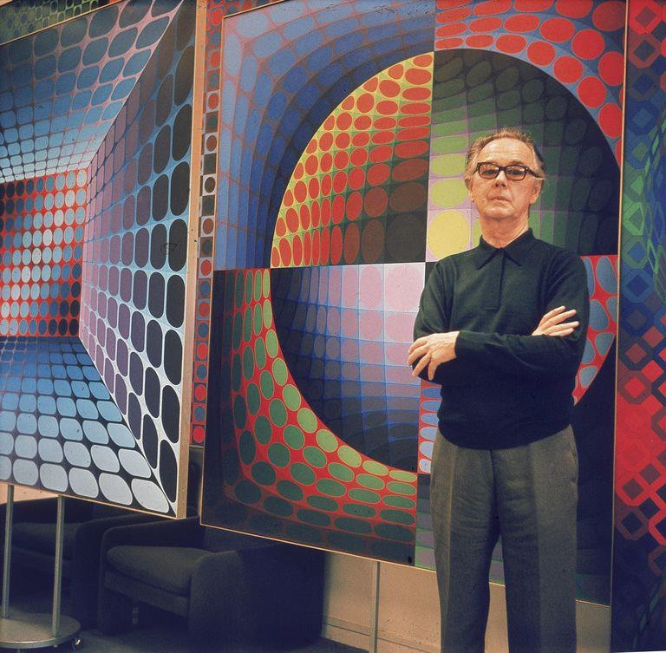
ARTISTS THAT HAD A PROFOUND INFLUENCE ON MY LIFE
ARTIST VICTOR VASARELY
(1902- 1997)

Slide 19
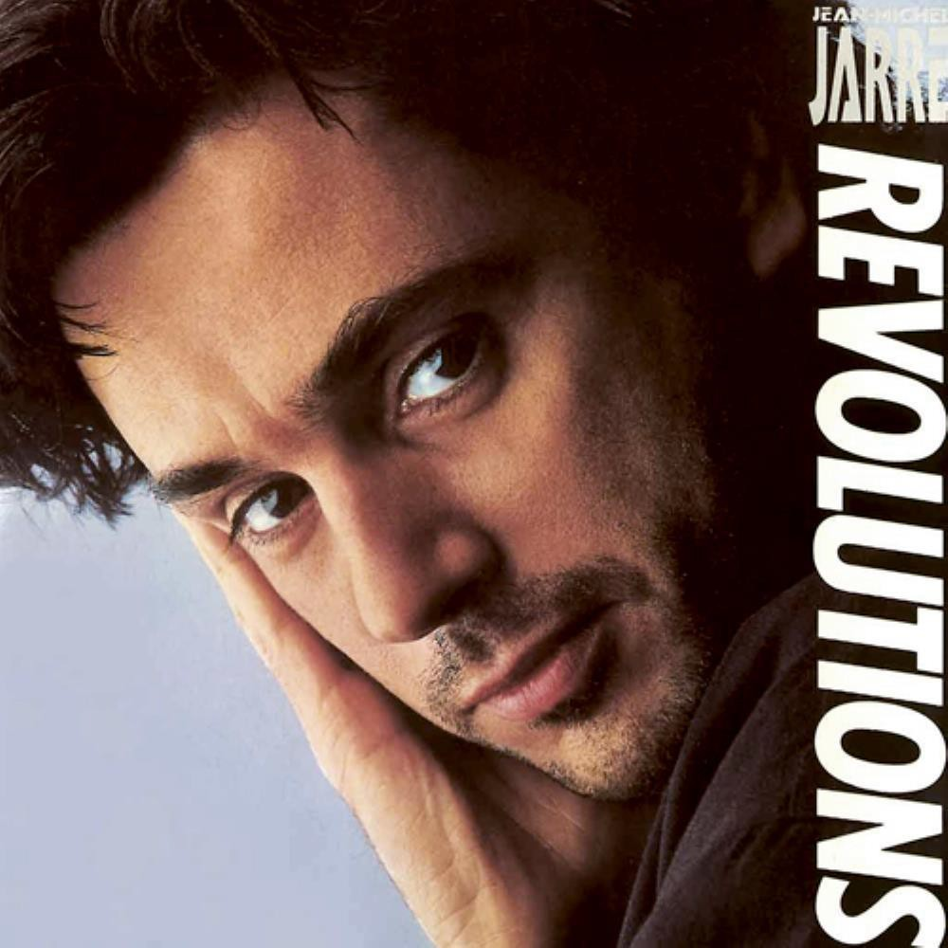
MUSICIANS THAT HAD A PROFOUND INFLUENCE ON MY LIFE
JEAN MICHEL JARRE

Slide 20
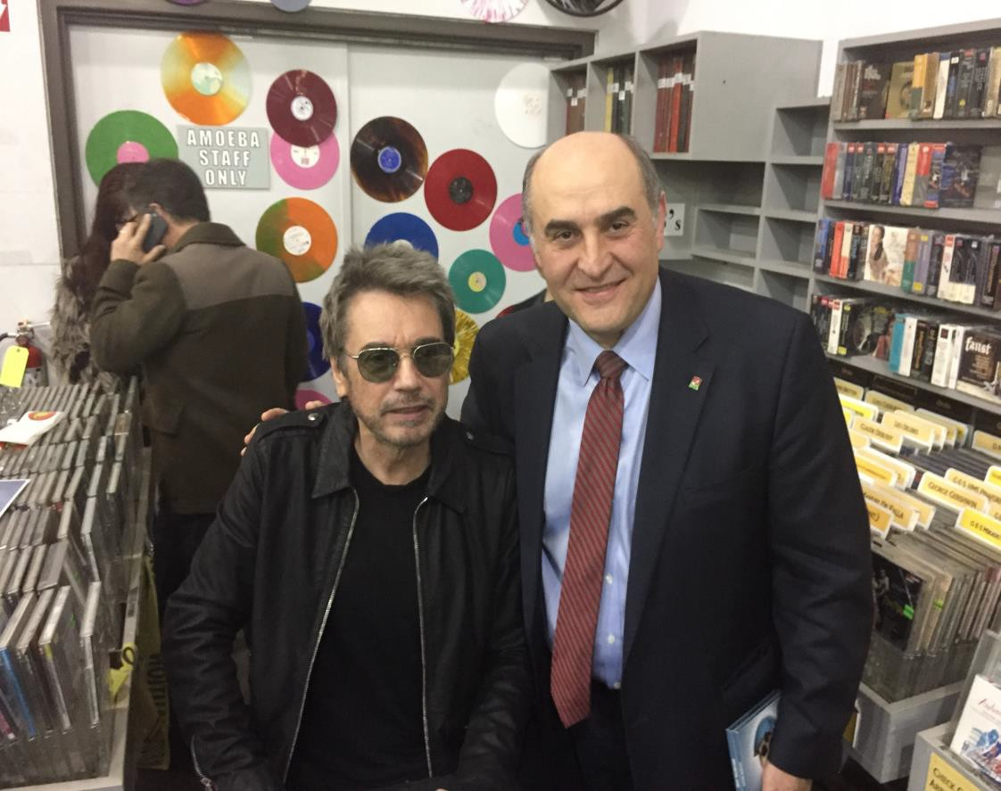
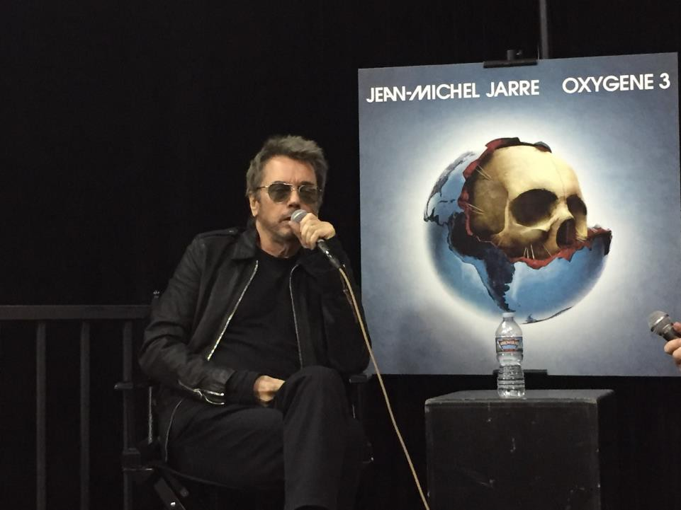
MUSICIANS THAT HAD A PROFOUND INFLUENCE ON MY LIFE
JEAN MICHEL JARRE

Slide 21
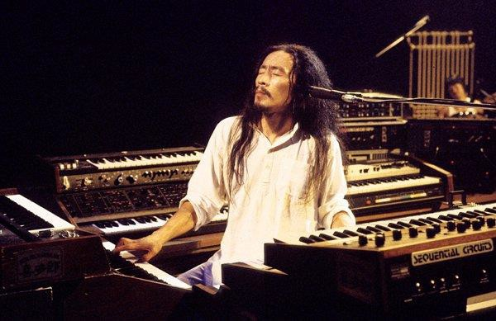
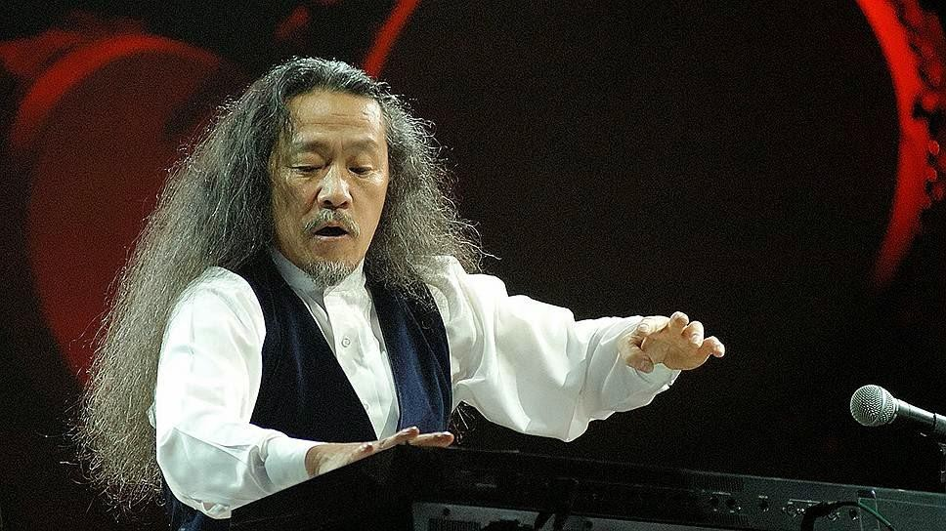
MUSICIANS THAT HAD A PROFOUND INFLUENCE ON MY LIFE
KITARO

Slide 22
WORK PHILOSOPHY
CHARACTER COUNTS
BE THE BEST IN YOUR FIELD
DO MORE THAN YOU HAVE BEEN ASKED TO DO
BE PASSIONATE ABOUT YOUR JOB
DO THE BEST YOU CAN – BE A PERFECTIONIST
NO ONE IS GOING TO TAKE CARE OF YOU EXCEPT YOURSELF
BE A TEAM PLAYER
DO WHAT IS RIGHT
BE TRUTHFUL

Slide 23
WORK PHILOSOPHY
BE FLEXIBLE
RESPECT EVERYONE
NO ONE IS MORE IMPORTANT THAN THE OTHER
THERE ARE DIFFERENT PATHS TO THE SAME GOAL
MODEL THE WAY – WALK THE TALK
DON’T TAKE YOURSELF TOO SERIOUSLY
GENTLE PRESSURE, RELENTLESSLY APPLIED.
HAVE FUN

Slide 24
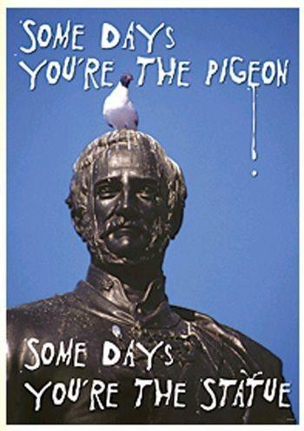
PERSONAL PHILOSOPHY ARAISMS
LIFE

Slide 25
PERSONAL PHILOSOPHY ARAISMS
KNOW THYSELF (γνῶθι σεαυτόν), transliterated: gnōthi seauton
THE GOLDEN RULE
NO REGRETS
CONTINUOUS SELF IMPROVEMENT
IT’S THE JOURNEY AND NOT THE DESTINATION
BALANCING ACT - STOP AND SMELL THE ROSES
CARE MOST FOR THOSE THAT WILL CRY AT YOUR FUNERAL
MOST POWERFUL FORCE IN THE UNIVERSE IS …….

Slide 27
CLOSING MEDITATION

Slide 28
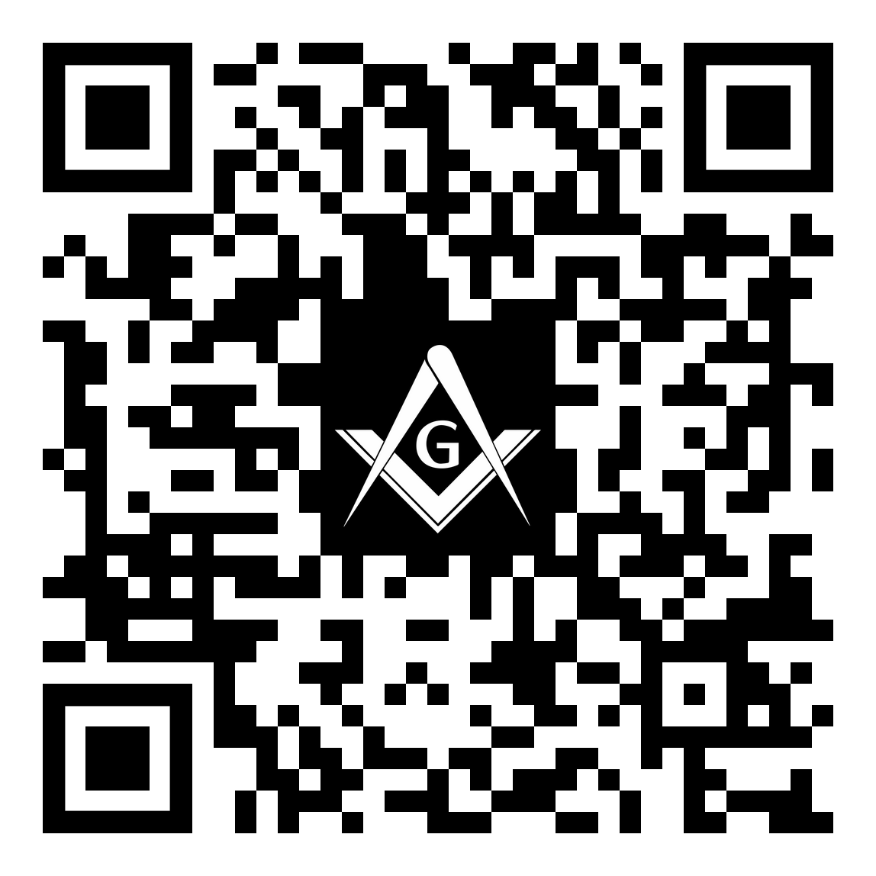
Your Opinion Matters
Lunch & Keynote
Please complete a 2-Question Survey. This should take less than 1 minute to complete.
Survey Link: https://forms.gle/2Qz8WjsmNEUY4Dhe8

