Slide 1
The Executive Committee: The Heart of Planning for the Lodge
Carlos M. Diez Jr., PM
Inspector 905th District Solomon’s Staircase Lodge No. 357

Slide 2
THE COMPOSITION OF AN EXECUTIVE COMMITTEE
EDUCATION
Senior Warden
Candidates - Coaches
Programming – Junior
Deacon
MEMBERSHIP
Junior Warden
Welcome Committee - Marshal
Prospects – Senior Deacon
Member Engagement - Chaplain
RITUAL
Officer’s Coach
Degrees & Ceremonies
Officer Qualifications
Regalia/Paraphernalia - Tiler
Music - Organist
EXECUTIVE
Master
Oversight
Planning & Delegation
Charity – w/Wardens
Hall Association – w/Senior Warden
SOCIAL
Stewards
Dinners and Parties
Outings & Gatherings
Family Engagement
FINANCE
Treasurer
Financial Accounts
Budget/Forecasting
Insurance
ADMINISTRATION
Secretary
Records/Documents
Required Filings
Minutes/Bylaws
Dues

Slide 3
MEETINGS OF AN EXECUTIVE COMMITTEE
SCHEDULED, MONTHLY MEETINGS
The lodge office
A boardroom
A conference call
A virtual meeting

Slide 4
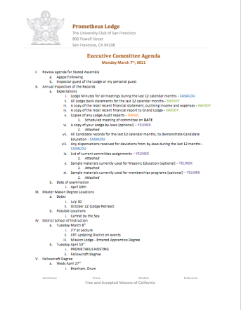
AN AGENDA
Review of MINUTES and set the AGENDA for the stated meeting
Check CANDIDATE advancement
Establish DEGREES and practices needed and the CALENDAR
PLAN and MONITOR lodge programs and PLANNING
Review lodge FINANCES
Review LODGE & HALL ASSOCIATION issues
Review progress of APPOINTMENTS

Slide 5
THE PURPOSE OF AN EXECUTIVE COMMITTEE
PREPARE for upcoming months’ meetings and activities and PLAN for and UPDATE one another on critical issues facing the lodge
SHARE the work of LEADERSHIP, support each other to make the lodge work, and INVOLVE OTHERS
PROVIDE CONTINUITY of vision and direction

Slide 6
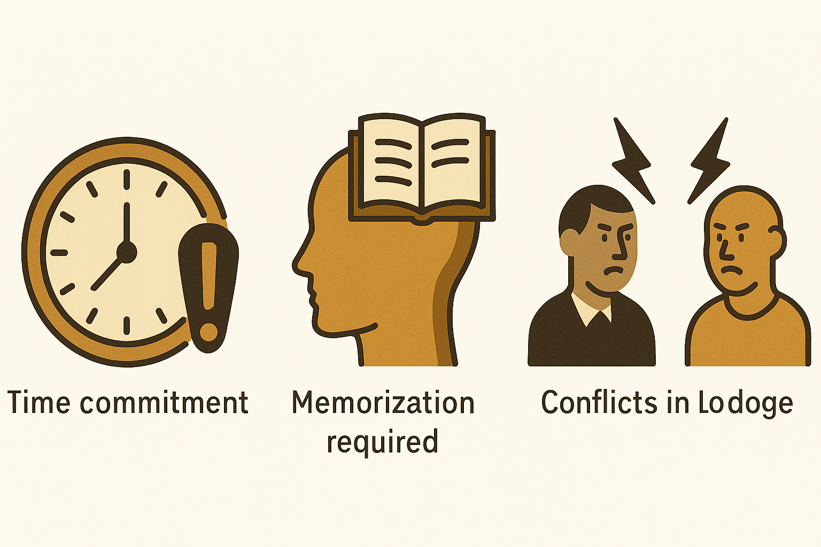
EXERCISE: HOW CAN YOUR LODGE ADDRESS THE TOP REASONS MASONS AVOID OFFICER POSITIONS?

Slide 7
HOW CAN YOUR EXECUTIVE COMMITTEE…
Use lodge time wisely and efficiently.
Provide clear expectations and support on ritual memorization requirements.
Focus on harmony in the lodge. A lodge space is a sacred space. What does it mean to be the leader of a sacred space?

Slide 8
Your Opinion Matters
Executive Committee: Heart of Planning for the Lodge
Please complete a 2-Question Survey. This should take less than 1 minute to complete.
Survey Link: https://forms.gle/LFxUfC4PrN7ux4jEA

