Slide 1
Let’s Start The Day.
Carlos M. Diez Jr., PM
Inspector 905th District Solomon’s Staircase Lodge No. 357
Expand Your Social Circle.
Hit The Ground Running.
What’s Next…

Slide 2
WHO ARE WE?
Talking About Freemasonry:
Part I
Emily Limón Chief Communications Officer

Slide 3
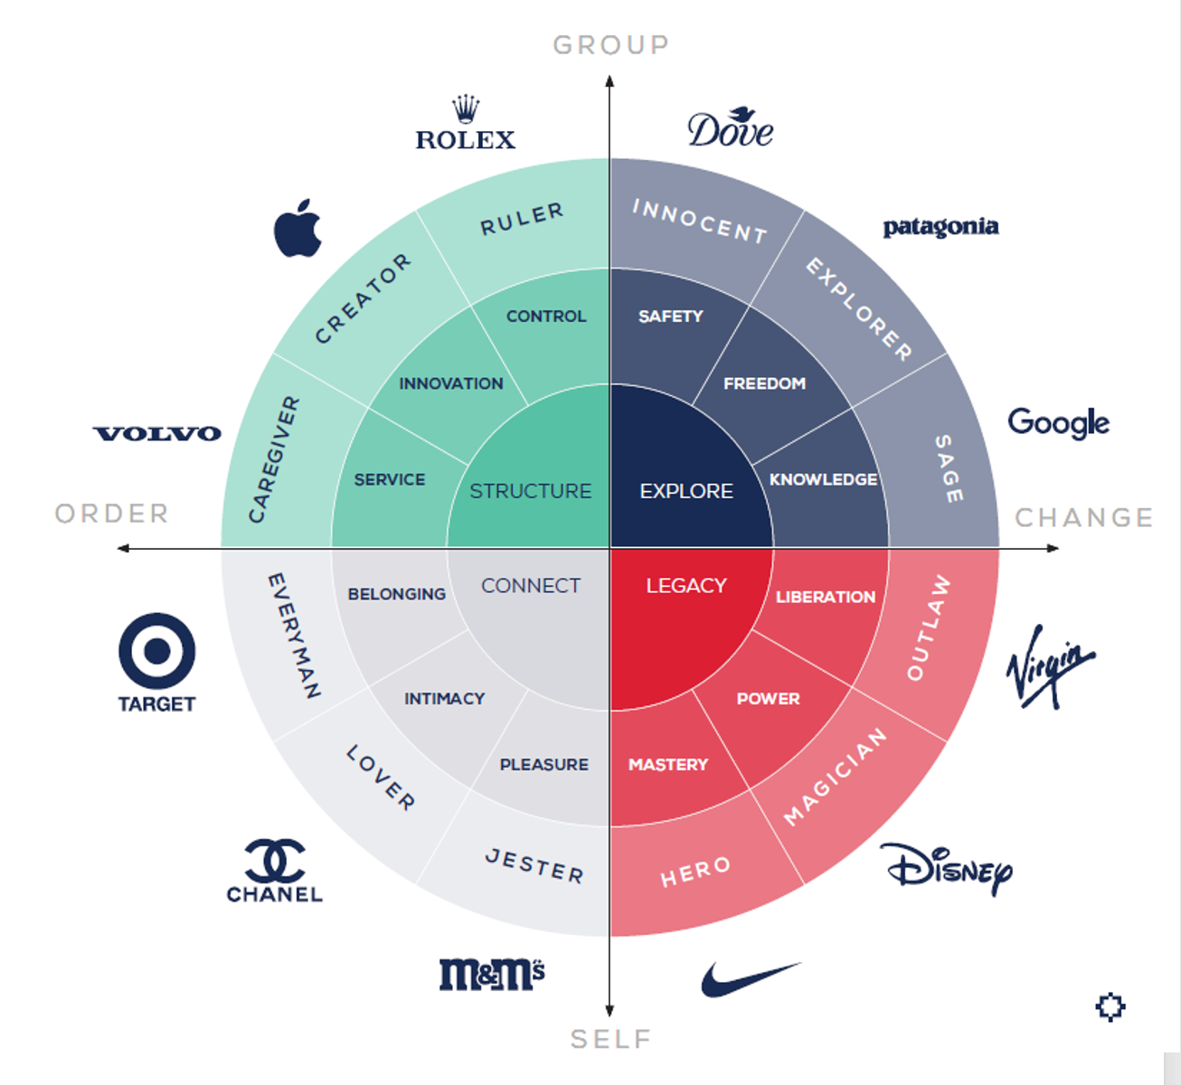
Brand Archetypes
A tool to help create an emotional connection with our members and prospects.

Slide 4
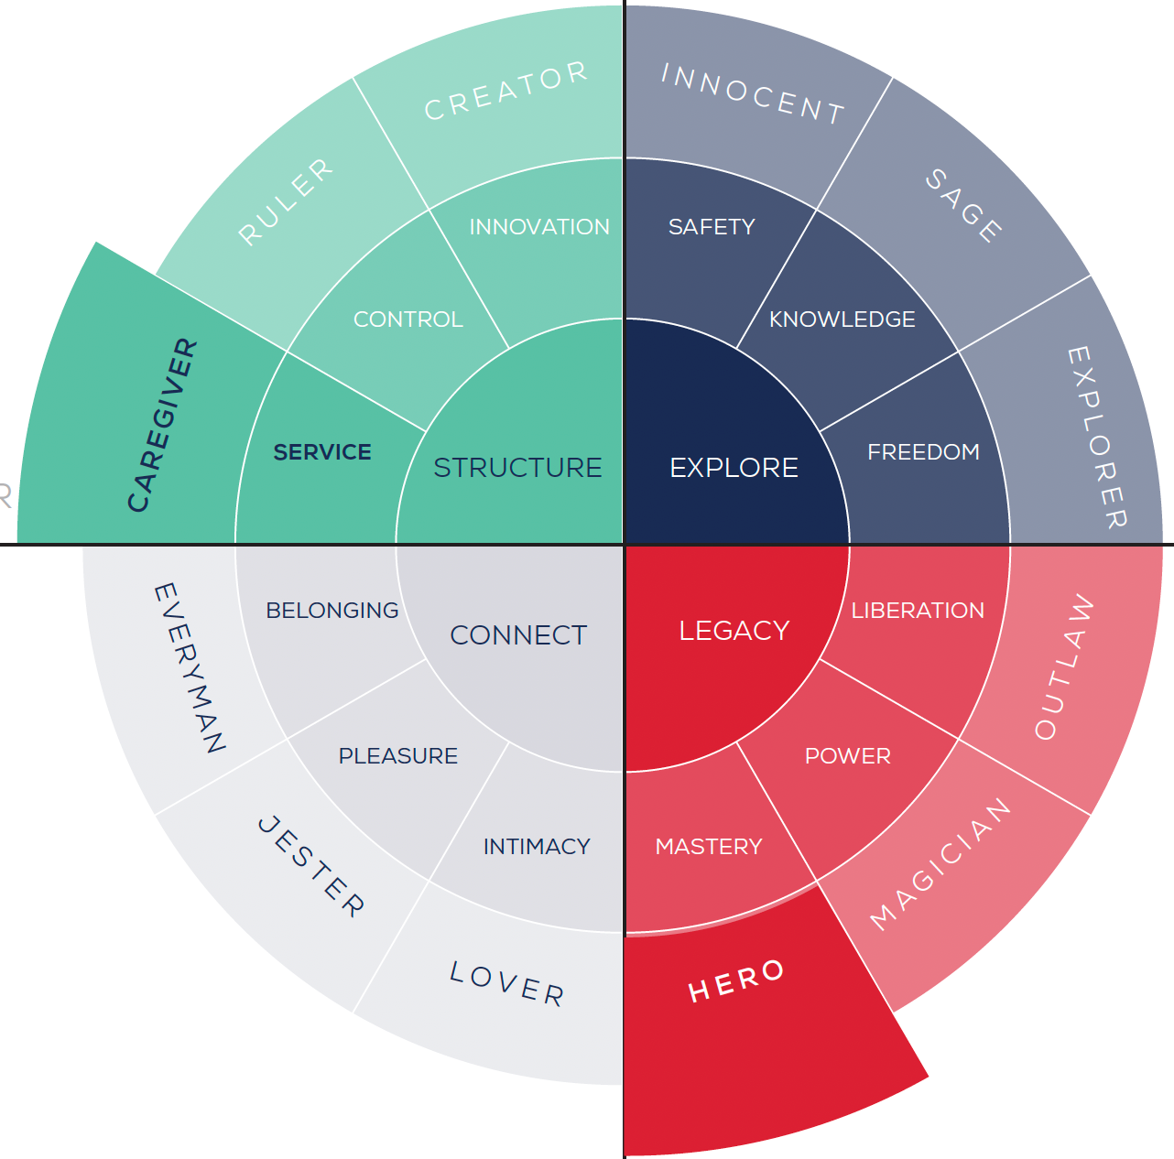
The Caregiver/Hero

Slide 5
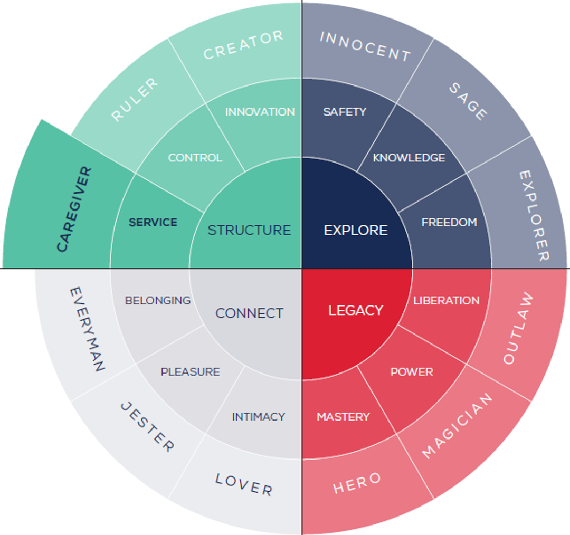
The Caregiver
(Primary)
"How can we help?"
Brand Message
There's no greater satisfaction than helping someone. Treat your neighbor as yourself.
Brand Voice
Caring, Supportive, Reassuring, Inclusive
Drivers
Service, Recognition, Stability, Gratitude
Fears
Selfishness, Neglect, Blame, Instability

Slide 6
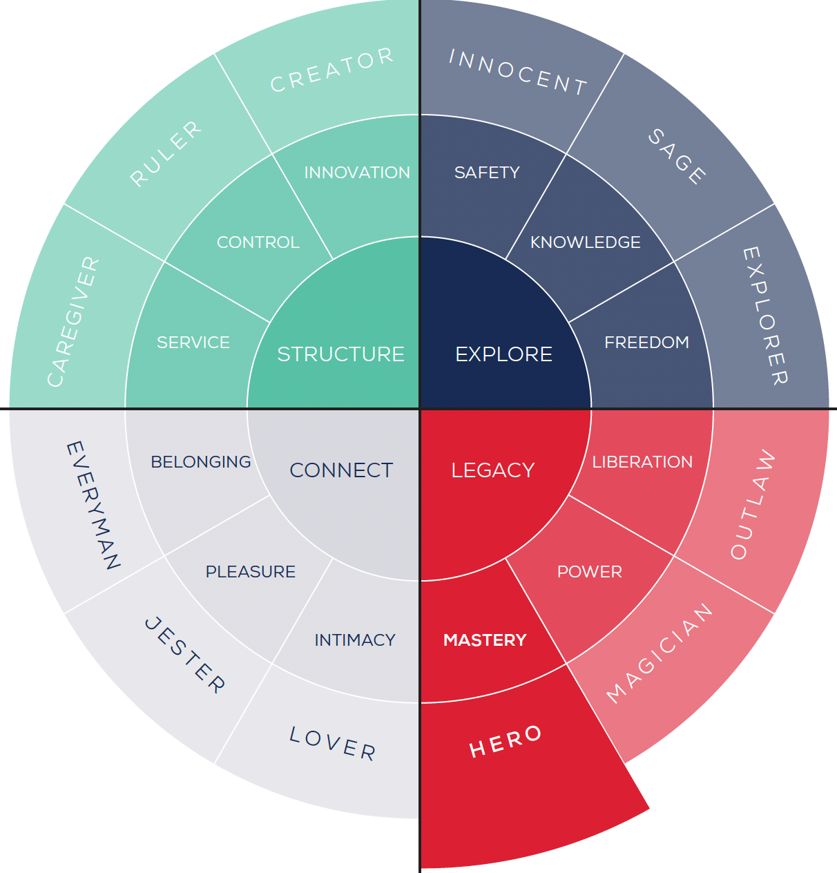
The Hero
(Secondary)
"Where there's a will there's a way."
Brand Message
Embrace challenges, dream big, dig in. Together we can improve our world and make a difference.
Brand Voice
Bold, Encouraging, Brave, Ambitious
Drivers
Honor, Courage, Inspiration, Growth
Fears
Weakness, Vulnerability, Failure, Incompetence

Slide 7
The Caregiver/Hero
"Be the change you want to see in the world."
Brand Message
There's no greater satisfaction than helping someone. Together we can improve our world and make a difference.
Brand Voice
Caring, Inclusive, Bold, Ambitious
Drivers
Service, Stability, Inspiration, Growth
Fears
Selfishness, Neglect, Weakness, Incompetence

Slide 8
The Caregiver/Hero
A.K.A.
The Mason

Slide 9
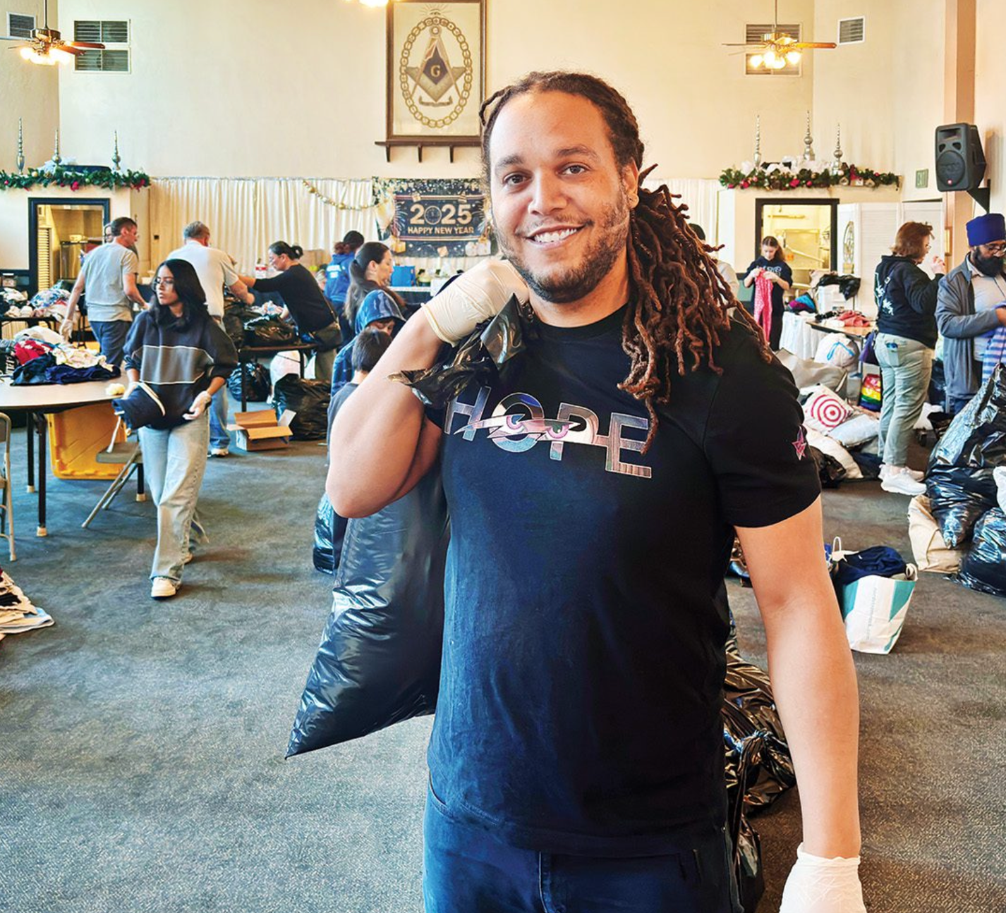
The Caregiver/ Hero
A.K.A.
The Mason

Slide 10
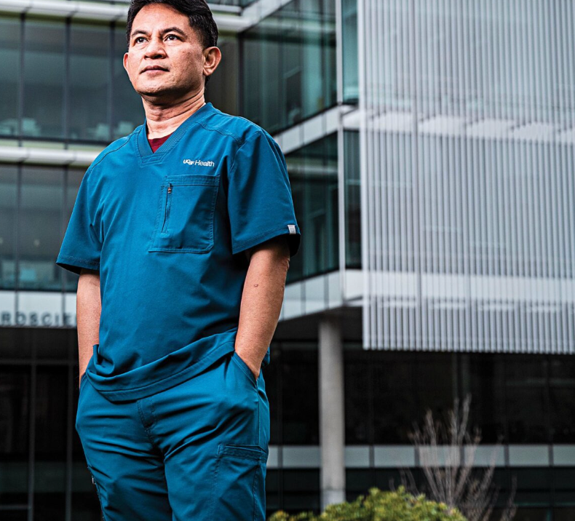
The Caregiver/ Hero
A.K.A.
The Mason

Slide 11
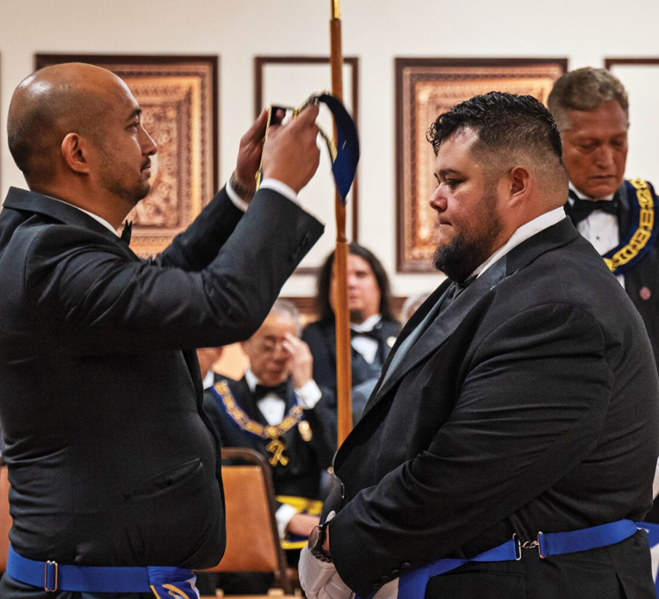
The Caregiver/ Hero
A.K.A.
The Mason

Slide 12
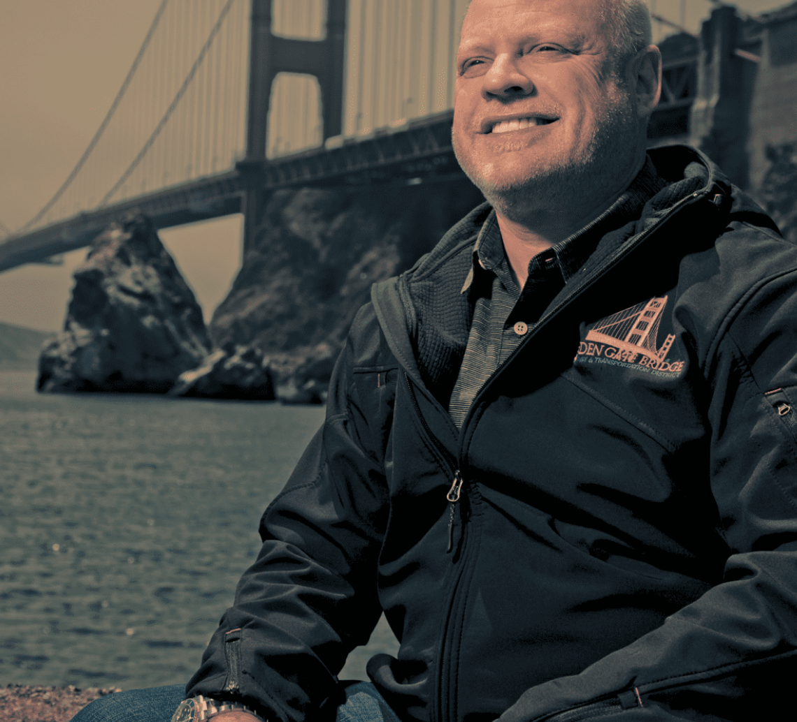
The Caregiver/ Hero
A.K.A.
The Mason

Slide 13
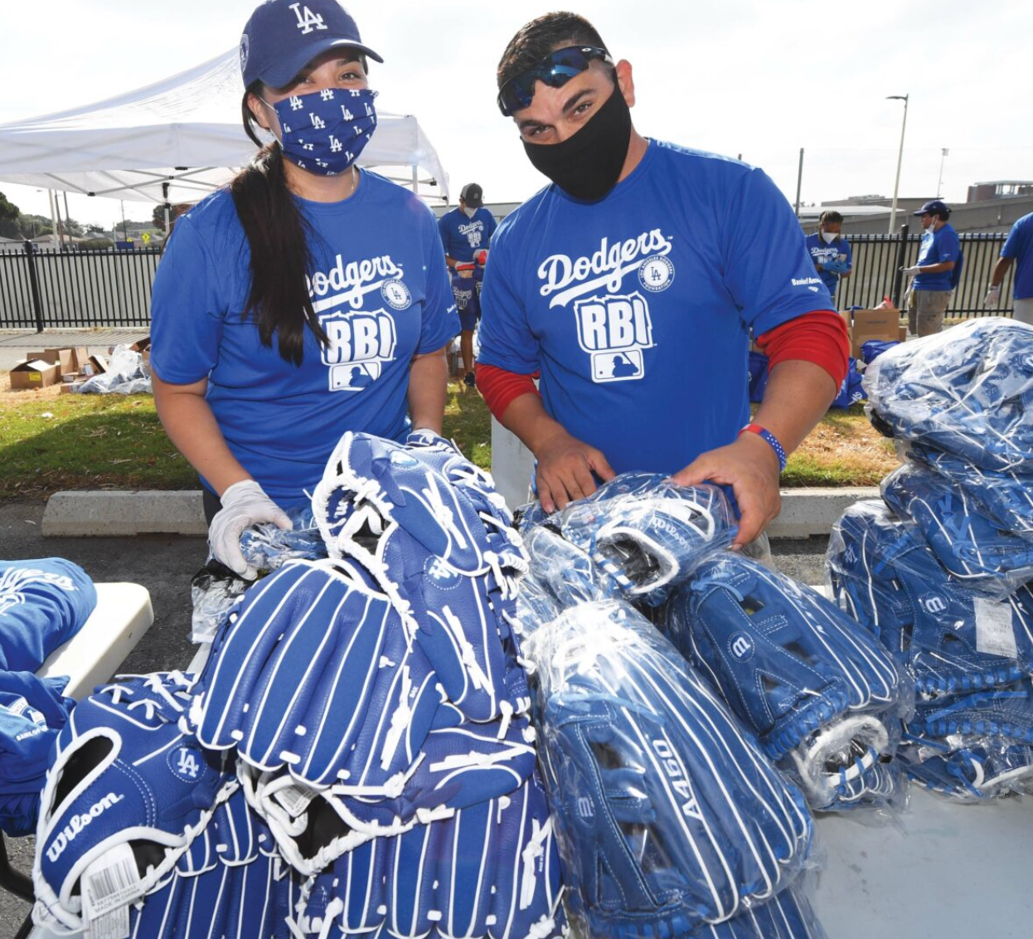
The Caregiver/ Hero
A.K.A.
The Mason

Slide 14
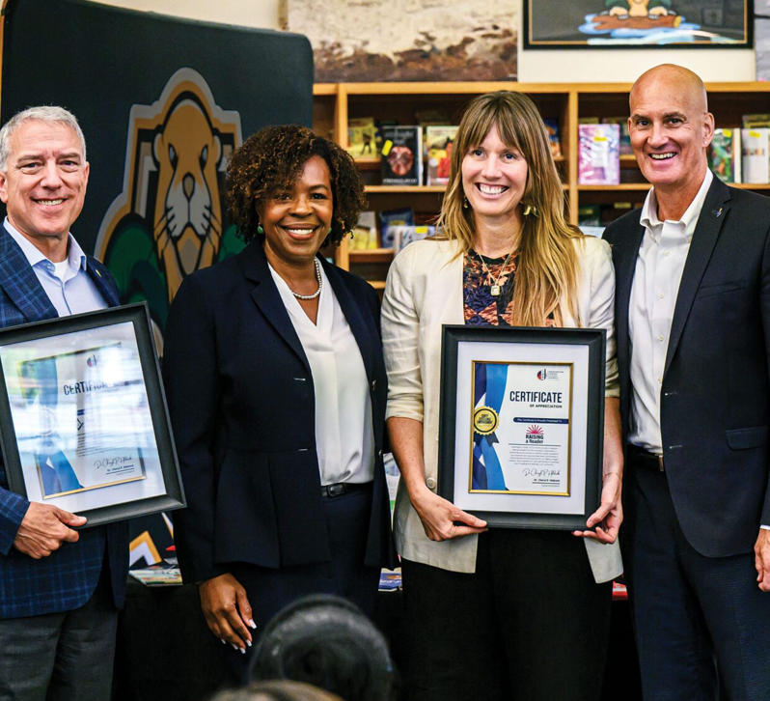
The Caregiver/ Hero
A.K.A.
The Mason

Slide 15
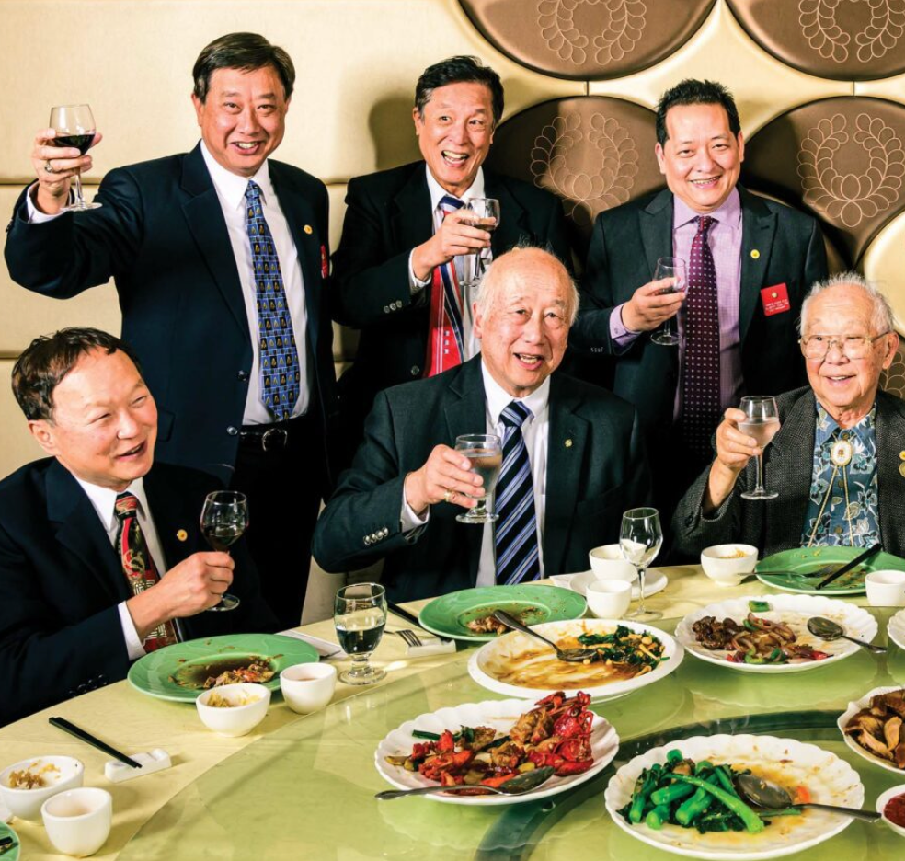
The Caregiver/ Hero
A.K.A.
The Mason

Slide 16
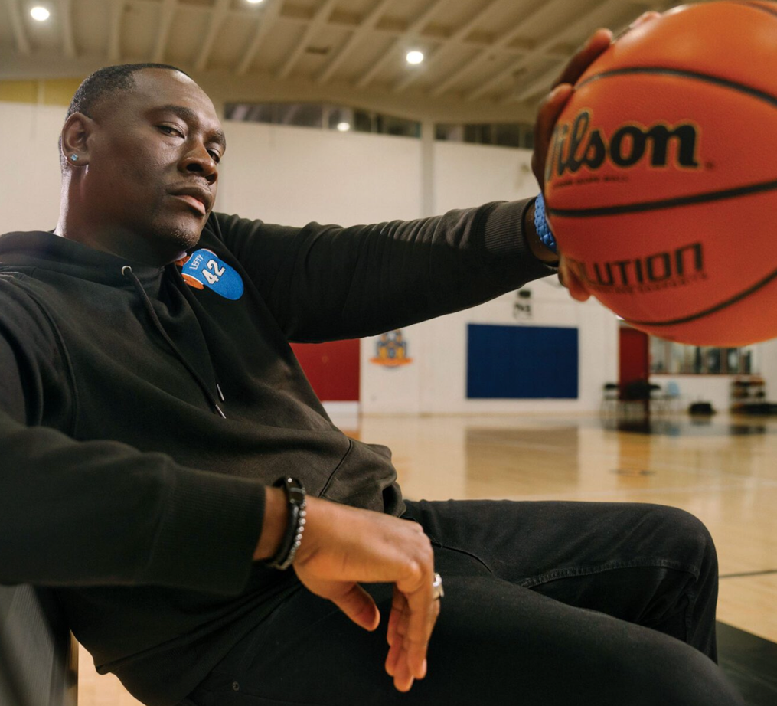
The Caregiver/ Hero
A.K.A.
The Mason

Slide 17
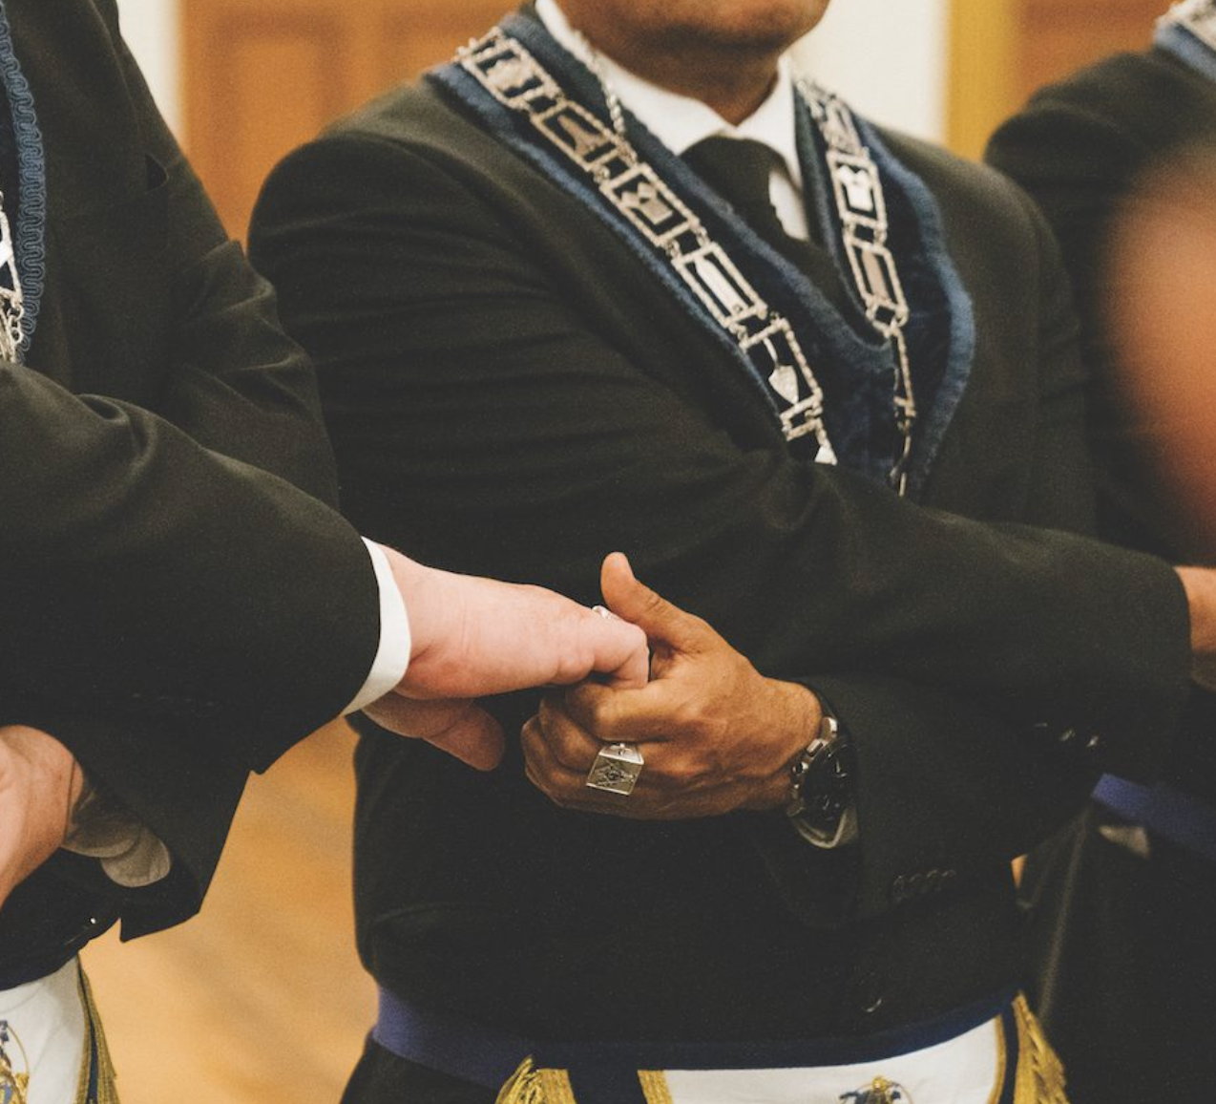
The Caregiver/ Hero
A.K.A.
The Mason

Slide 18
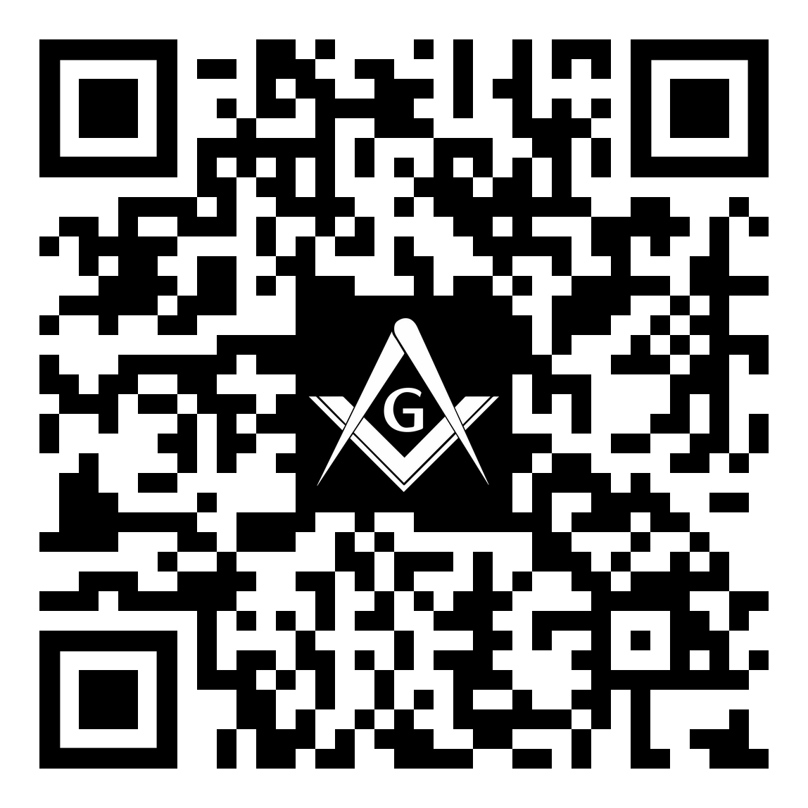
Your Opinion Matters
Talking About Masonry (Part 1)
Please complete a 2-Question Survey. This should take less than 1 minute to complete.
Survey Link: https://forms.gle/mBueGH9eg6zBNJXy5

