Slide 1
Freemasonry & the Hero’s Journey
Doug Ismail, PM
California Lodge No. 1

Slide 2
The Masonic Hero’s Journey
Leadership Retreats 2024
Notes:
Heroism can be found every day – in all parts of our lives. What does the idea of being a Hero mean to you? It becomes harder and harder to define who I am as a person without talking about freemasonry… and yet the idea of being a “Hero” feels a bit odd!

Slide 3
One of the great heroic stories of modern times…
Notes:
George Lucas admitted to borrowing freely from the great heroic myths for his Luke Skywalker character.

Slide 4
Notes:
Here’s where we talk about being a HERO. According to one the of most influential American writers of our time, Joseph Campbell – author of The Hero of a Thousand faces (1949) - “Our life’s journeys often share a fundamental structure.” although there is no STANDARD hero… he can take many forms… THOUSANDS, in fact! He calls this the monomyth. The Hero’s Journey..,” Campbell looked at ALL the stories from the world. Native American, Eastern, Western, Greek, Nordic… and found an undeniable theme emerging. He called it “The Hero’s Journey”

Slide 5
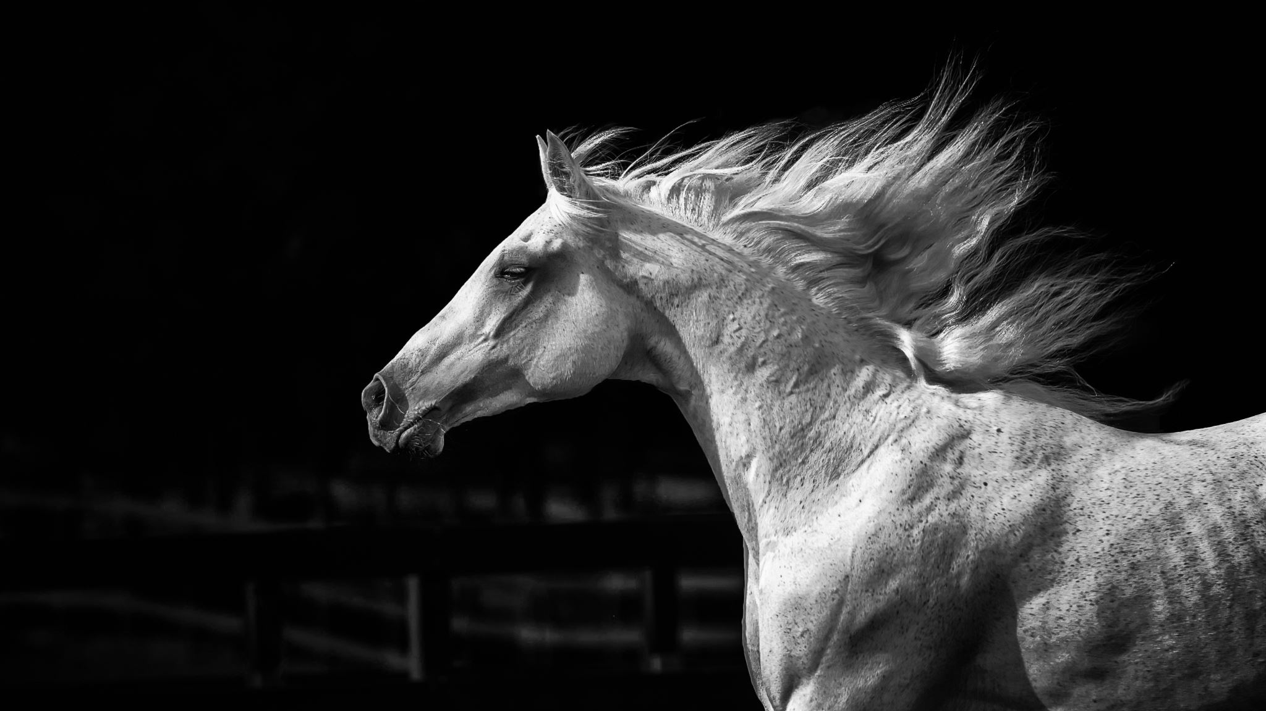
We’ve All Begun A Journey
Notes:
I knew something in my life would be different forever. I wasn’t sure then – as I am still on my own masonic journey… I’m eager to see where it takes me. Masonry gives us a vocabulary to talk about our stories. It gives us guard rails… It provides structure and support. It’s an important part of our OWN life’s journey. You had several options – clubs, groups, etc. BUT… you chose to become a mason. YOU ARE HERE! It’s important to you too…

Slide 6
The Calling: The Known to the Unknown
Notes:
It starts with the call to adventure. We are SEEKING SOMETHING. The HERO is found “Needing More” - Usually coming from an antsy-ness … a dissatisfaction. A sense that there is more to learn, more to do, more to know – and more to contribute to the World – So OFF HE GOES!

Slide 7
The Return: Rebirth and Growth
Notes:
Ahhhh…. We have seen the mountain! Wisdom! Now, we cycle back into our journeys that much better for it… and share our knowledge with the world! We have begun exploring our truer selves. We learn more about life, truth and draw closer to our sense of the ideal self. We emerge as more complete. More complex. We have a desire to make a difference. To share what we’ve learned! We are reborn.

Slide 8
The Journey: Life’s Challenges, Trials and a Transformation
Notes:
Here is the first of the real work. Our Hero faces personal demons, uncertainty, experiences growth and accepts challenges. These are the challenges that life hands us. The reality of living in a complex world. The commitment to the struggle, the journey, the challenges – always with an idea that there is real value to the effort! AND something important to learn and gain!

Slide 9
Remember That Night?
Notes:
How many remember the nights of graduations, promotions at work, even the birth of children? How many recall “that night… “ The night I was made a Mason. It meant that we were about to begin an amazing journey. I hoped it would be profound… and important.

Slide 10
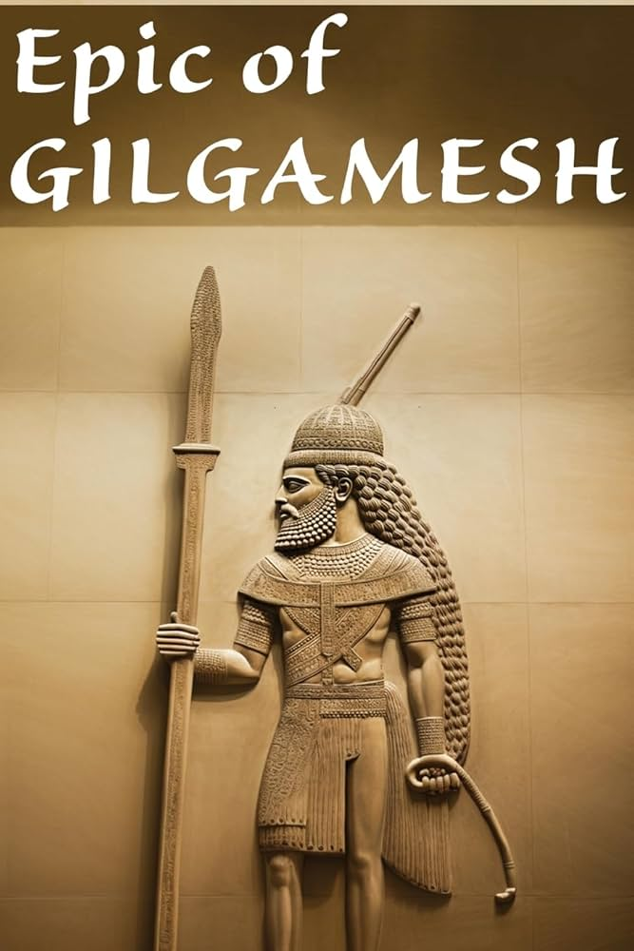
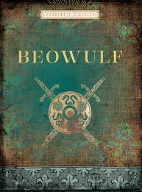
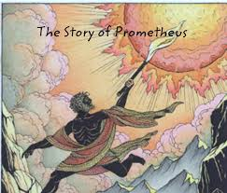
Notes:
Old epic poems, myths and stories…All rooted in the Heroic Myth.

Slide 11
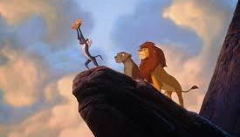
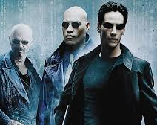
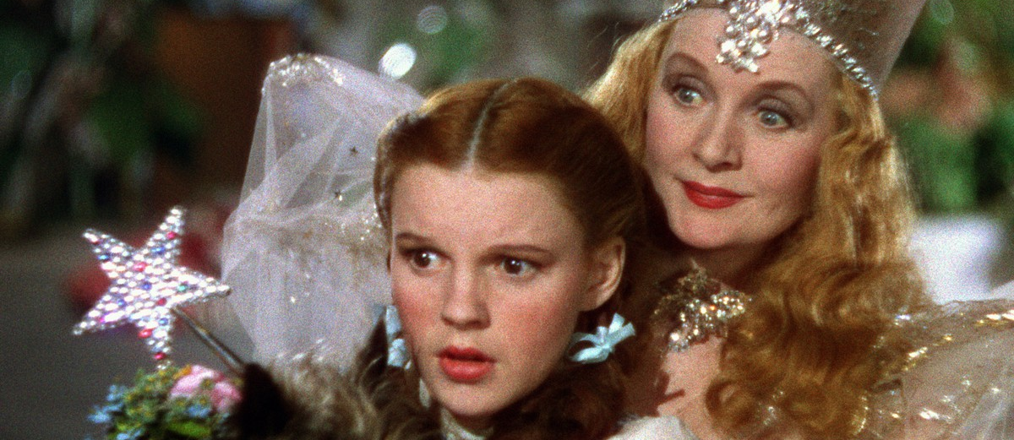
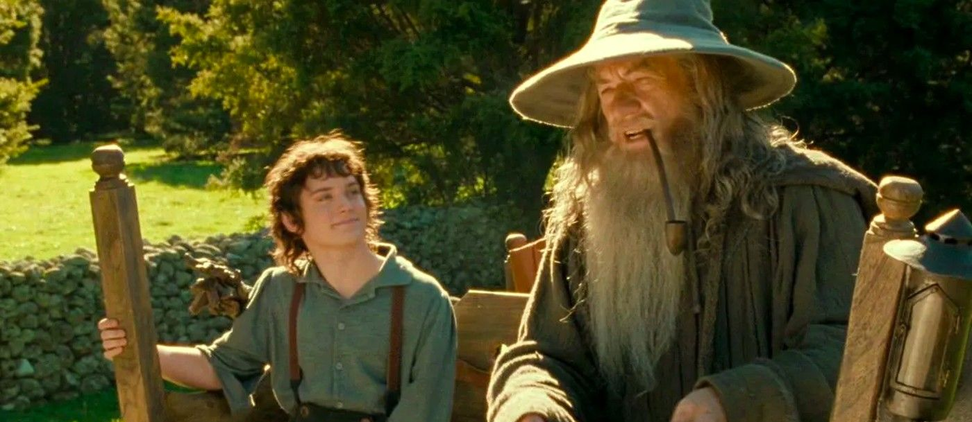
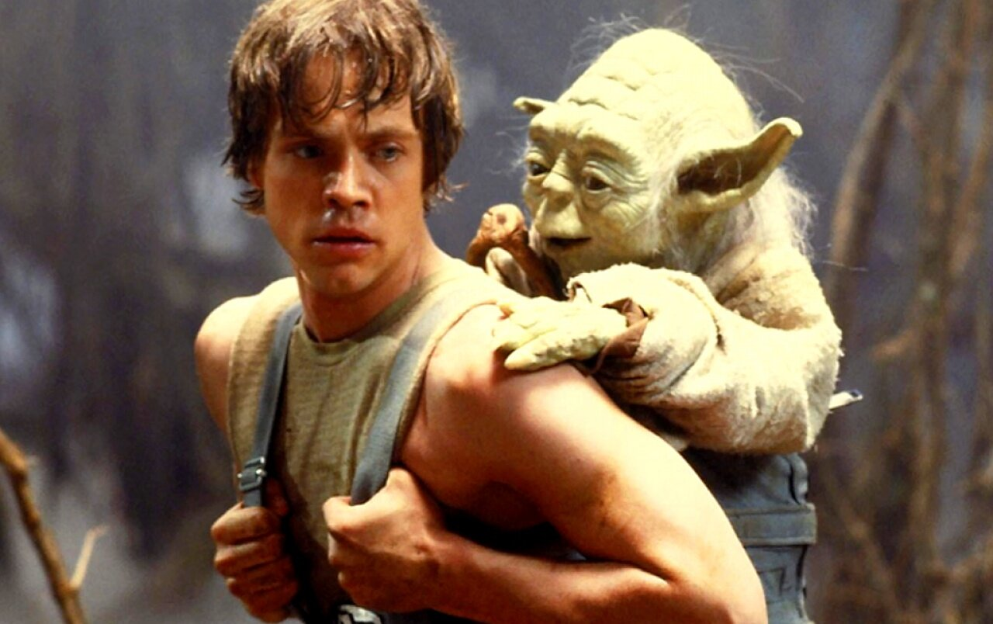
Notes:
You know these stories! Even familiar, modern stories have used the Heroic Archetype. Think about Luke Skywalker – Frodo in the Lord of the Rings. These authors borrowed extensively from Campbell’s work.

Slide 12
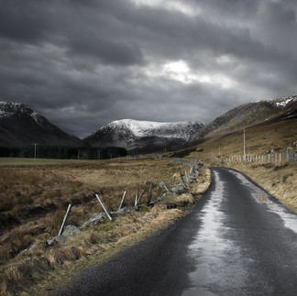
Seeking Wisdom and Truth
This Photo by Unknown Author is licensed under CC BY-SA
Notes:
So… How does freemasonry fit in? What do we offer as part of the Hero’s Journey? Why do men seek us out? What can we offer? Each of us is on our own Heroic Journey… and I think Freemasonry provides the perfect context for this experience.

Slide 13
The Departure
Leaving the Familiar World…
Notes:
As a prospect, candidate, officer, leader… We are all in a cycle of a journey. Why did he come? Don’t we often hear that candidates are SEEKING something? Isn’t a feeling that “there must be more” an important part of what men find attractive about our lodges?

Slide 14
This is where Your Lodge’s Work Begins…
Notes:
Now! The Journey matters! This is where you need to spring into action as a lodge. He’s knocked on the door – and you have answered and let him enter. You are curating his Journey! You are there to manage his experience within the guardrails of Freemasonry – He has many paths in life – how important can you make this one for him? DON’T RUSH! This is important!

Slide 15
The Initiation
Learning from Mentors, Facing Trials and Tests
Notes:
“When the lodge – and prospect say YES! The journey begins… Engage the unknown! Work with a Mentor. Face challenges, grow, learn – even facing things that make you uncomfortable. Trials, test and becoming more “proficient” Think about the whole initiatic process!~

Slide 16
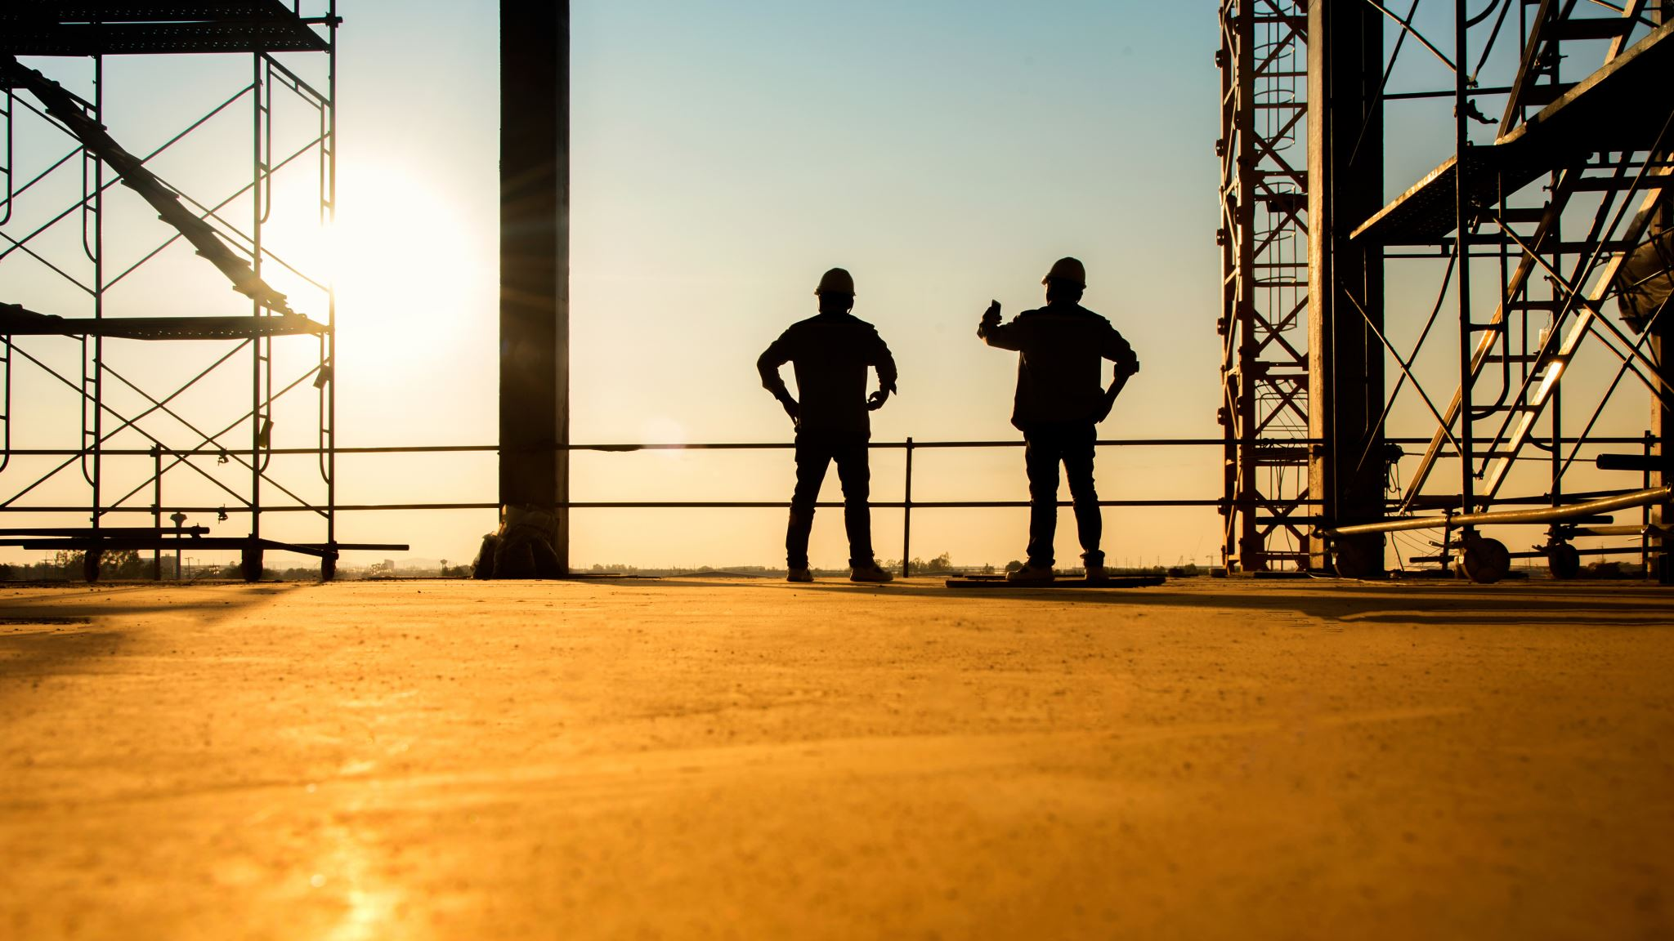
We Have a Team: Our Candidates are not alone on this Journey…
Brothers
Mentors
Officers
Coaches
Notes:
We are ALL helping the candidate on this journey. Not just the candidate coach. The entire lodge! Our lodges are places where each candidate should experience the key elements of the Hero’s Journey

Slide 17
“The Aid and Support of a Mentor.” – The Candidate Coach
Notes:
SO IMPORTANT. The Candidate Coach is a KEY figure here. How many Candidates Coaches are there in this room? Please raise your hands! He needs to see himself as the teacher, mentor, friend, even one who challenges! Do you take this role seriously in your lodge? Do Candidates Coaches embrace this important role? How will you manage this part? Do you provide a series of lessons? What trials? What must he overcome?

Slide 18
Our Tools and Our Wisdom…
Brotherly Love
Relief
Truth
Temperance
Fortitude
Prudence
Justice
24-Inch Gauge
The Level
The Plumb
The Gavel
Notes:
We have ASSETS What do we draw from? What can we teach? What can we learn? These are the tools that we can use to support the Hero’s Journey! We have a unique history… drawn from centuries of ideas, wisdom and study. It is our secret ingredient to becoming a better man.

Slide 19
Light and Truth…
Empathy
Compassion
Trust
Patience
Strength
Fairness
Teamwork
Confidence
All Part of Becoming a Better Man
Notes:
We also have the expectations that society has placed on leaders and men. Does Freemasonry today teach this? When you emerge from our work, is this a fair expectation? Do we expect this from every member? Every candidate?

Slide 20
ACTION: Curating and Managing Your Candidate’s Heroic Journeys?
Who are his Mentors?
Where will he receive Wisdom?
Are there Opportunities for Reflection?
What will be his Lessons?
Notes:
So – think about prospects, candidates and officers… Do you USE these tools to allow them to grow? If not, how can you arrange your lodge leadership to ensure that the support is there?

Slide 21
Remember… We Each Have Our Own Masonic Hero’s Journey
Notes:
In truth… we are ALL on a journey. We are all HEROS in our own stories. You get to decide how the of your life narrative unfolds. You can both star in AND direct your own story.

Slide 22
How Will You Craft YOUR Masonic and Life Journey?
Worshipful Master
Wardens
Deacons, Stewards and Secretaries and Treasurers
Chaplains, Marshals and Tilers
Past Masters and Lodge Leaders
Sideliners and Regular Attendees
Notes:
Who will these officers reach out to? How will they grow and learn? Can you imagine a lodge where VERY member is committed to advancing his own story? If the officers lead, imagine what can happen. What does your journey look like? What are YOUR trials? What will you do when you RETURN? Breath more life into your lodge!~

Slide 23
The Return
Rebirth. Impart Wisdom and Knowledge. Share the Light.
All of us!
Notes:
This is SUCH an important component of being a leader. This is where you emerge from Luke Skywalker to Obi Won Kanobi. You have a responsibility! The WISE Past Master. This makes us special. This is our most important role – “Go Into the World…” We are ALL the heroes of our own life stories. Like the search for the PERFECT ASHLAR – the journey never ends.

Slide 24
Sharing Light and Truth To the Worshipful Master Elect: Please Stand!
“… it is your province to spread and communicate light and instruction to the brethren of your lodge.”
“Charge them to practice out of the lodge those duties which they have been taught in it.”
Notes:
If you are a WM – Please STAND. Remember the WM’s charge…. Remember this? This is YOUR charge! Your Role!

Slide 25
And the Cycle Begins Once Again
Notes:
This is why we are more than 300 years old. This is the critical gift of our Craft. This makes us unique – and special. We ALL work together to guide and navigate our own Heroic Journey.

Slide 26
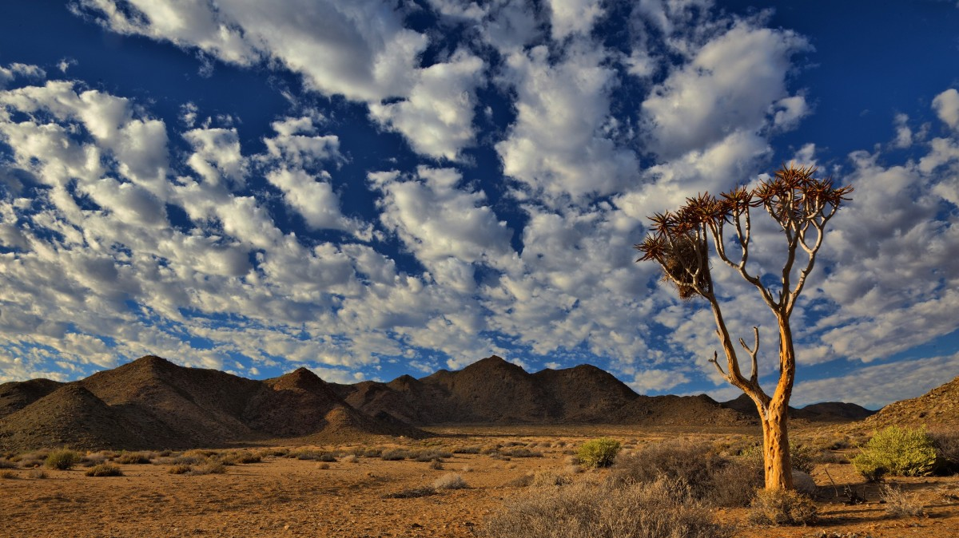
“Go into the World, My Brothers…”
The World Needs Us. Remember: You are all heroes.

Slide 27
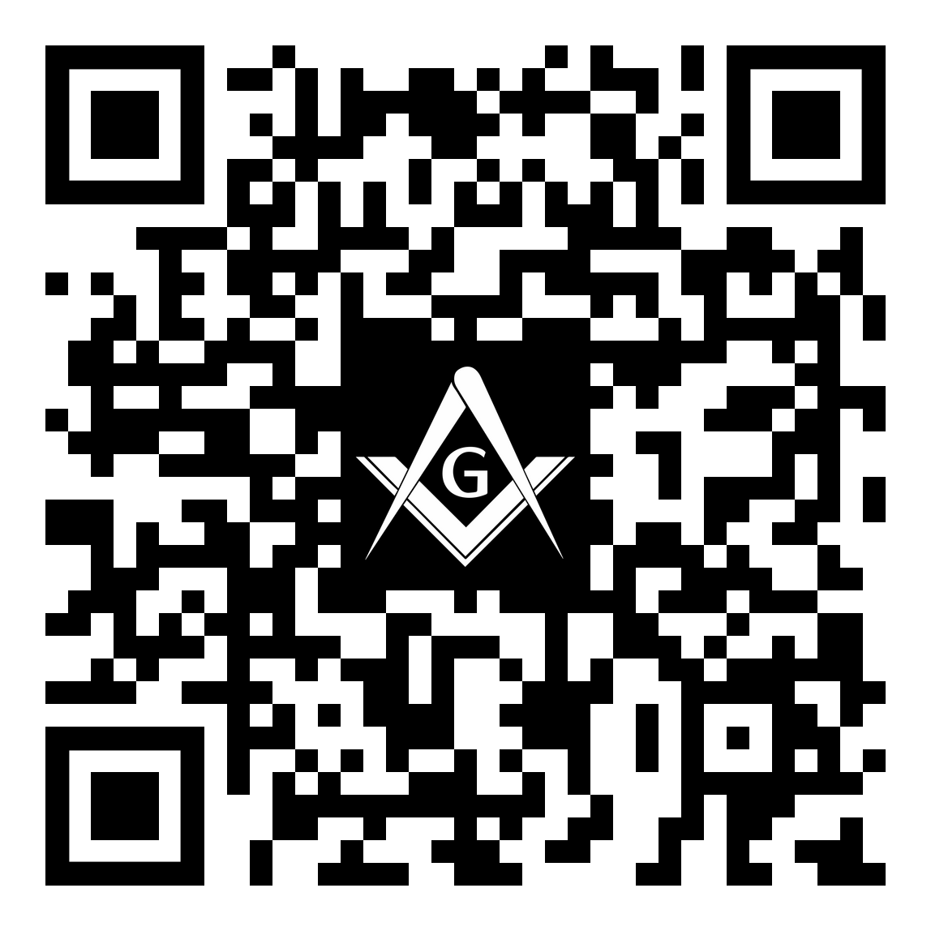
Your Opinion Matters
Freemasonry and the Hero’s Journey
Please complete a 5-Question Survey. This should take less than 3 minutes to complete.
Survey Link: https://forms.gle/Wmt35XLFrgi8h8hj9

Slide 29
Reflecting on the Sessions.
Refer to the participant workbooks.
What will you share with your lodge? Share notes at your tables.
Share your thoughts on the graffiti wall.

