Slide 1
LODGE OFFICERS
BUILDING A LODGE TOGETHER

Slide 2
How is Freemasonry transmitted, unimpaired, from generation to generation?

Slide 3
How is Freemasonry transmitted, unimpaired, from generation to generation?
Through the presence and
effectiveness of
LODGE OFFICERS.

Slide 4
TRADITIONS
TEACHINGS
FELLOWSHIP

Slide 5
Objectives
Understand the motivations behind why people seek, or avoid, lodge officer positions.
Introduce a new tool to clarify the functions and duties of each lodge officer.
Discuss three imperatives that will help guide your leadership into the future.

Slide 6
Why are you an officer?

Slide 7
TOP REASONS FOR BEING A LODGE OFFICER
Supports the health of my lodge.
Supports the growth of my lodge.
Improves the morale of my lodge.

Slide 8
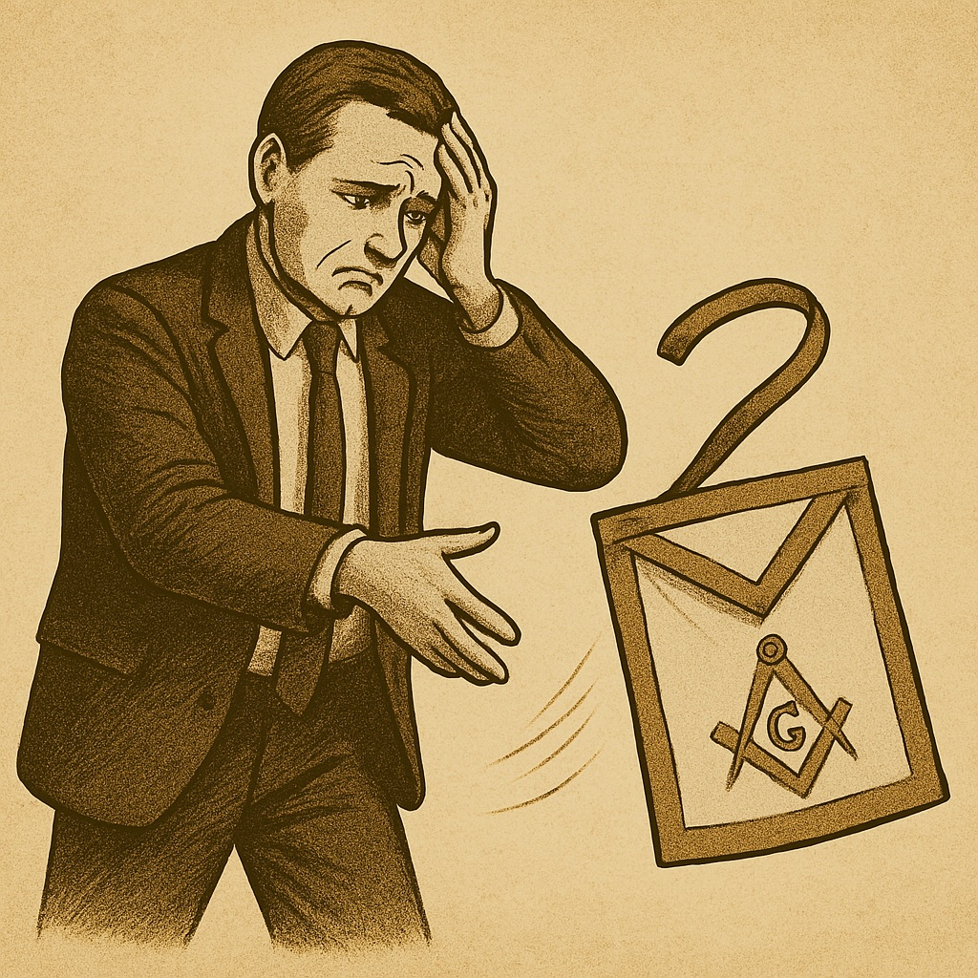
Why do Masons avoid or give up lodge officer positions?

Slide 9
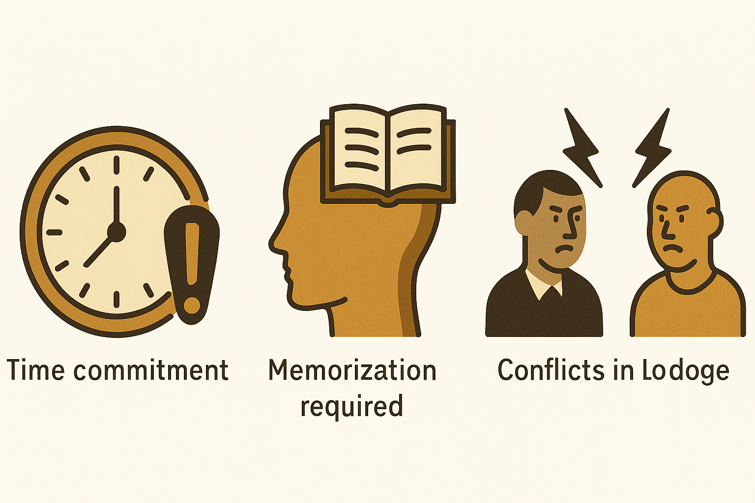
TOP REASONS
MASONS AVOID OFFICER POSITIONS

Slide 10
HOW TO AVOID OFFICER AVOIDANCE
Use time wisely and efficiently.
Provide clear expectations and support on ritual memorization requirements.
Focus on harmony in the lodge. A lodge space is a sacred space. What does it mean to be the leader of a sacred space?

Slide 11
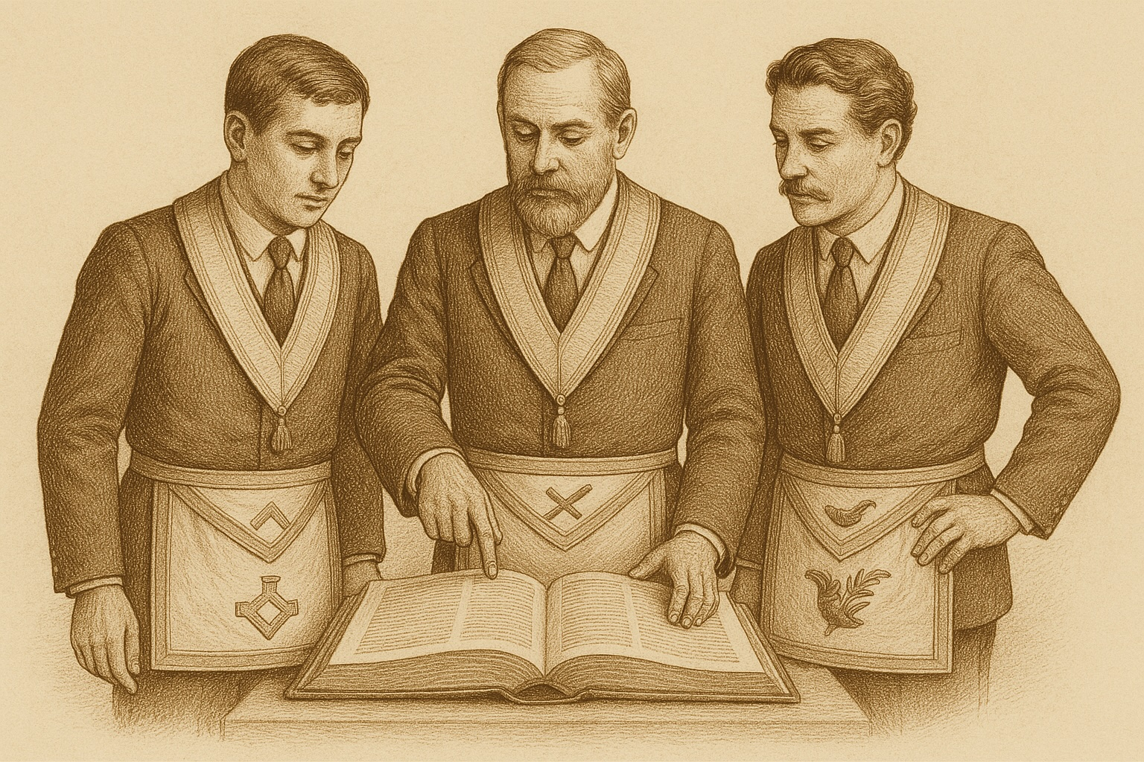
CLARIFYING LODGE FUNCTIONSS
AND OFFICER ROLES

Slide 12
EXERCISE

Slide 14
EDUCATION
RITUAL
MEMBERSHIP
EXECUTIVE
SOCIAL
FINANCE
ADMINISTRATION

Slide 15
EDUCATION
Candidates
Programming
MEMBERSHIP
Welcome Committee
Prospects
Member Engagement
RITUAL
Degrees & Ceremonies
Officer Qualifications
Regalia/Paraphrenalia
Music
EXECUTIVE
Oversight
Planning & Delegation
Charity
Hall Association
SOCIAL
Dinners and Parties
Outings & Gatherings
Family Engagement
FINANCE
Financial Accounts
Budget/Forecasting
Insurance
ADMINISTRATION
Records/Documents
Required Filings
Minutes/Bylaws
Dues

Slide 16
Success comes when every officer contributes

Slide 17
EDUCATION
Senior Warden
Candidates - Coaches
Programming – Junior
Deacon
MEMBERSHIP
Junior Warden
Welcome Committee - Marshal
Prospects – Senior Deacon
Member Engagement - Chaplain
RITUAL
Officer’s Coach
Degrees & Ceremonies
Officer Qualifications
Regalia/Paraphrenalia - Tiler
Music - Organist
EXECUTIVE
Master
Oversight
Planning & Delegation
Charity – w/Wardens
Hall Association – w/Senior Warden
SOCIAL
Stewards
Dinners and Parties
Outings & Gatherings
Family Engagement
FINANCE
Treasurer
Financial Accounts
Budget/Forecasting
Insurance
ADMINISTRATION
Secretary
Records/Documents
Required Filings
Minutes/Bylaws
Dues

Slide 18
BEEHIVE IMPERATIVES
Show up!
Prioritize!
Culture
Effectiveness
Succession
Be the example!

Slide 19
Masons show their leadership is not just administrative, but moral and inspirational.

Slide 20
LODGE OFFICERS
BUILDING A LODGE TOGETHER

