Slide 2
WELCOME!
Carlos M. Diez Jr., PM
Solomon’s Staircase Lodge No. 357
A Moment To Reflect.
You’re Already A Leader.
Engagement.

Slide 3
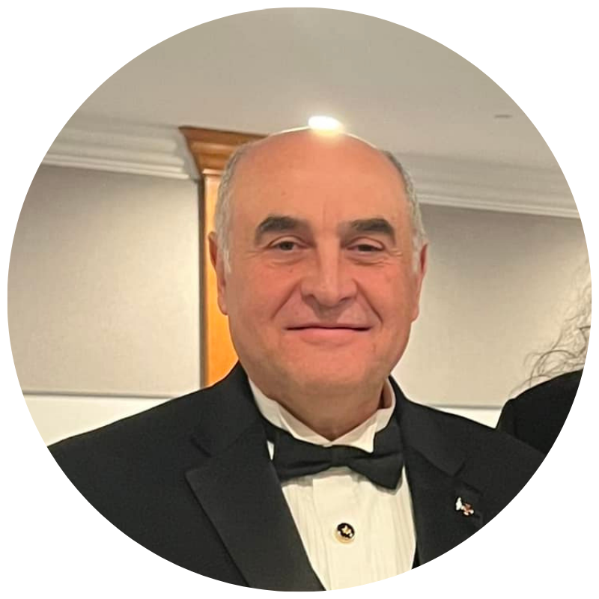
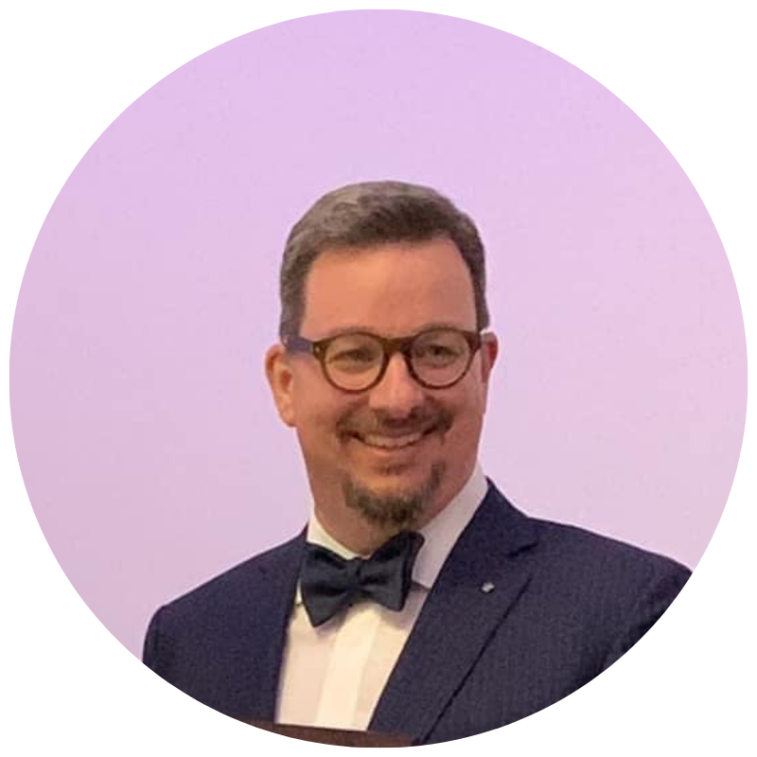
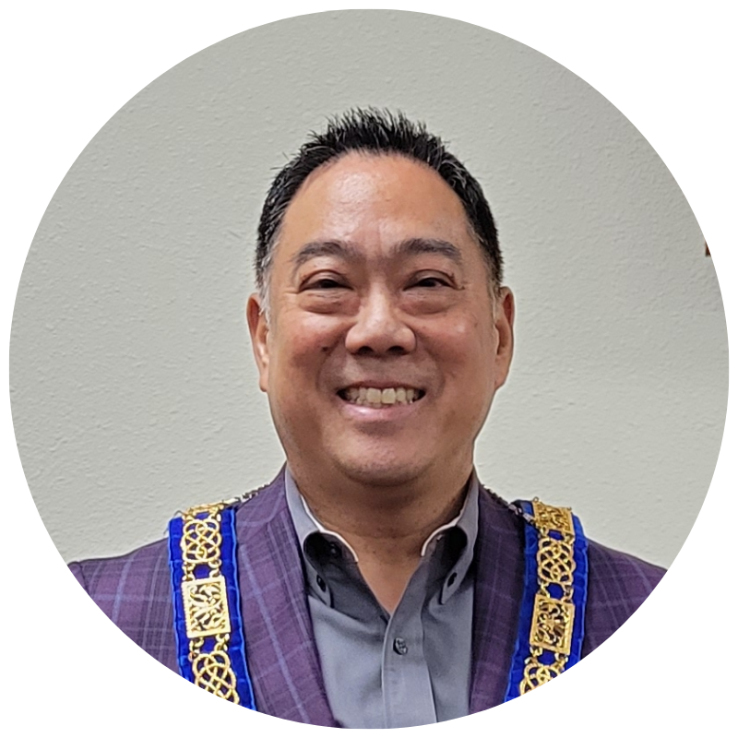
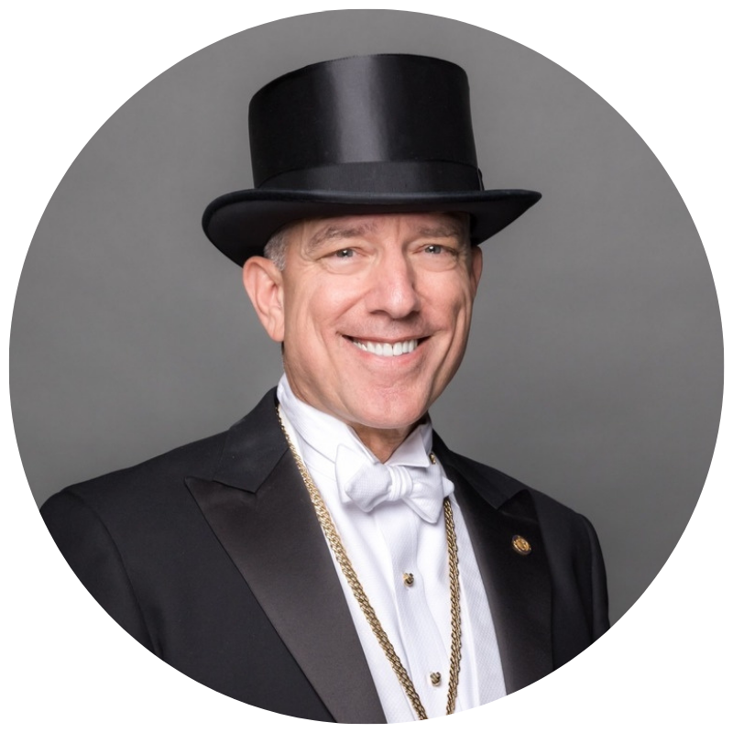
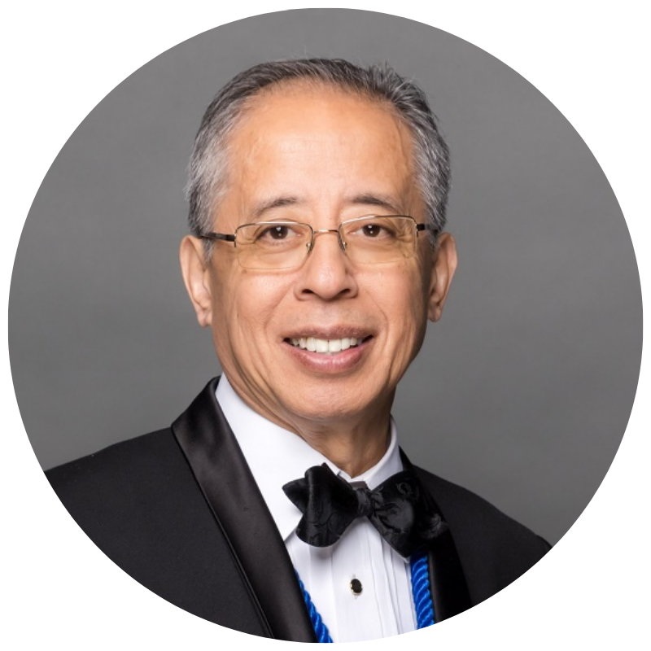
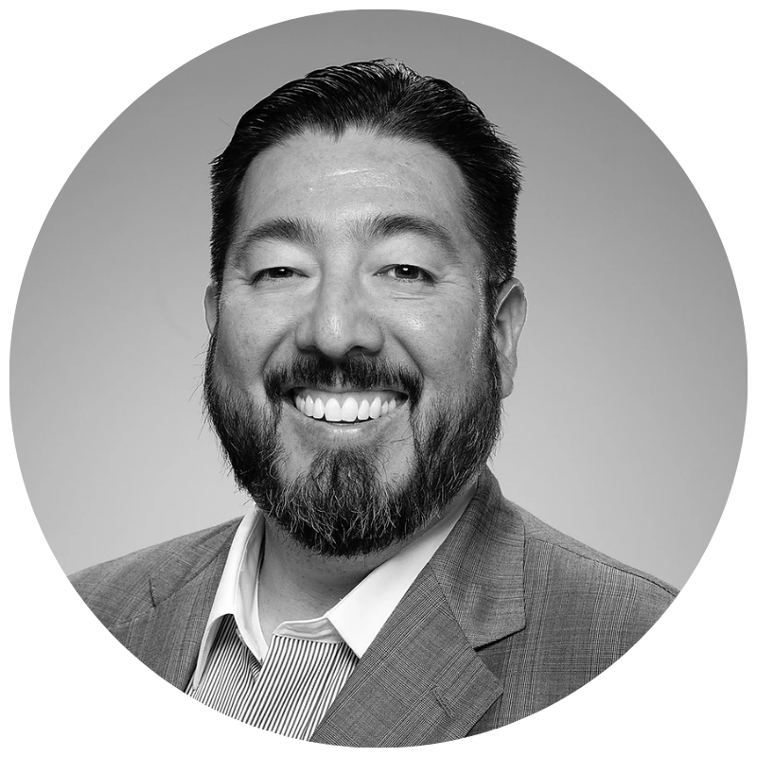
GRAND LODGE
EXECUTIVE COMMITTEE

Slide 4
Matt Vander Horck, PM Long Beach Lodge No. 327
Grand Lecturer

Slide 5
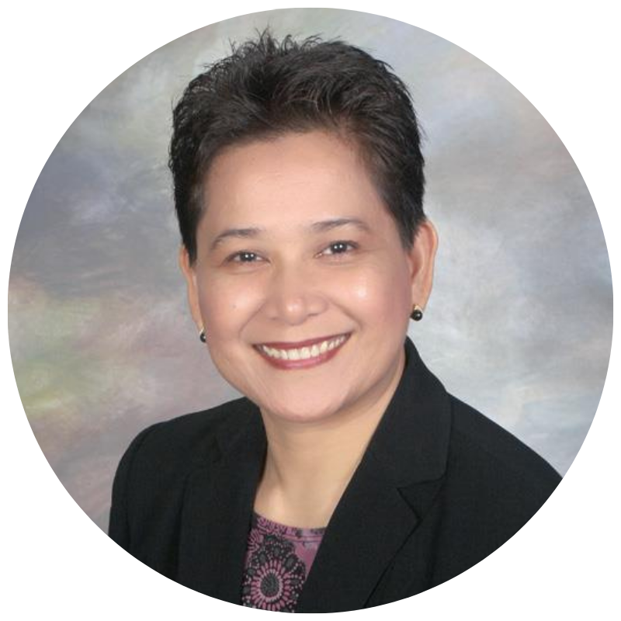
GRAND LODGE
EXECUTIVE COMMITTEE
Very Worshipful Allan L. Casalou, PM
Acalanes Fellowship Lodge No. 480
Grand Secretary

Slide 6
Very Worshipful Charles P. Cross, PM Sandra Cross
Metropolitan Lodge No. 352
Grand Treasurer & Jr. Grand Warden Recommendee

Slide 7
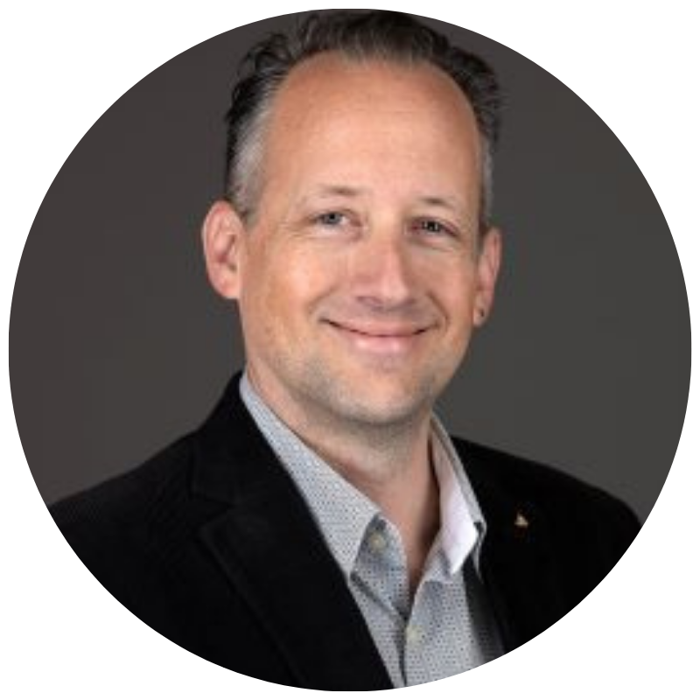
Right Worshipful
Chris Smith, PM Peninsula Lodge No. 168
Junior Grand Warden

Slide 8
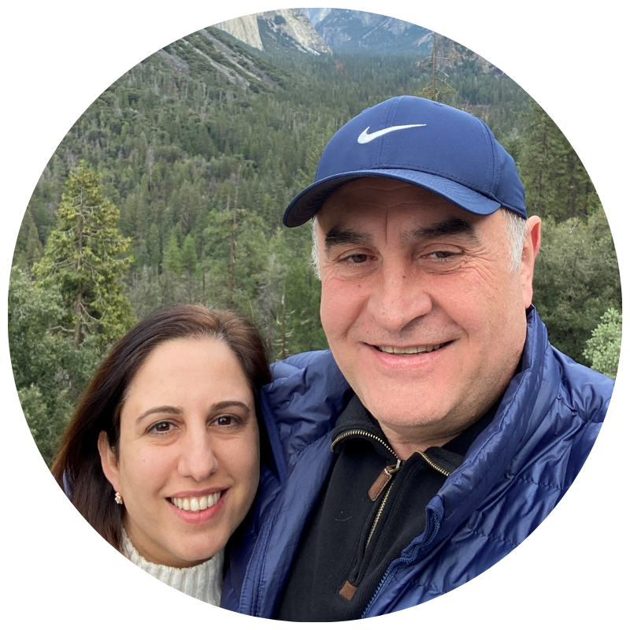
Right Worshipful Ara Maloyan, PM Soseh Yegyan
Santa Monica - Palisades Lodge No. 307
Senior Grand Warden

Slide 9
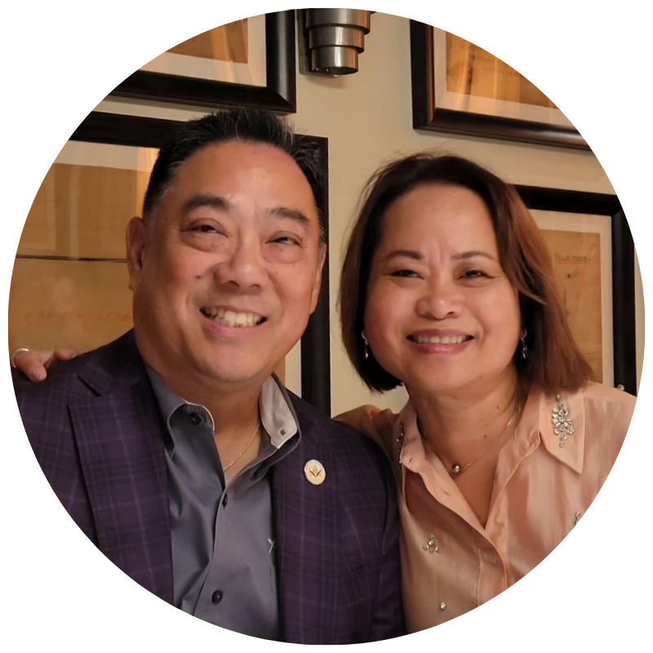
Right Worshipful Garrett S. Chan, PM JoMay Chan
California Lodge No. 1
Deputy Grand Master

Slide 10
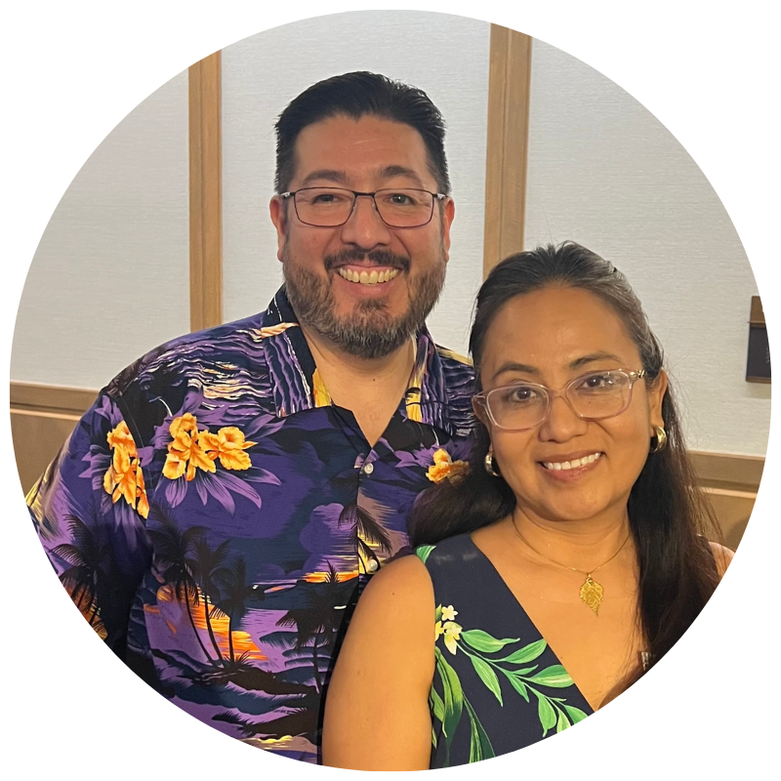
Most Worshipful Arthur L. Salazar, Jr., PM Laura Salazar
Irvine Valley Lodge No. 671
Grand Master of Grand Lodge of California

Slide 11
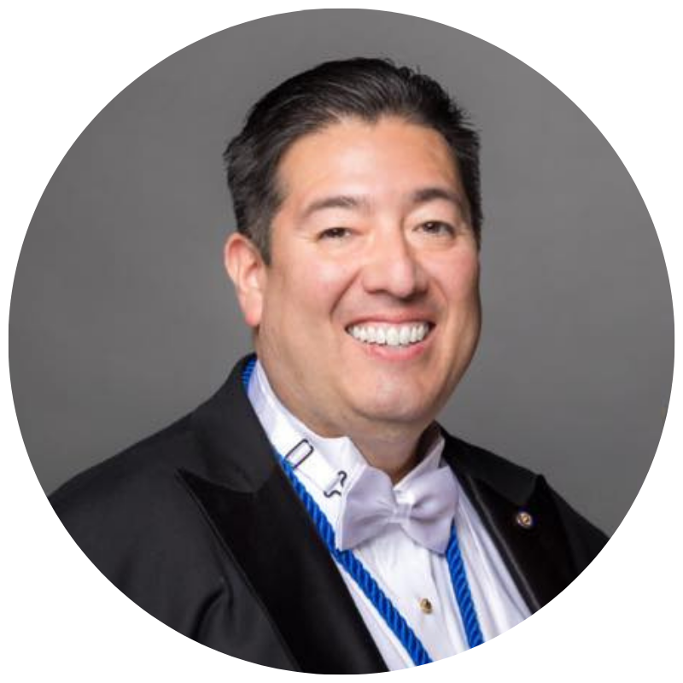
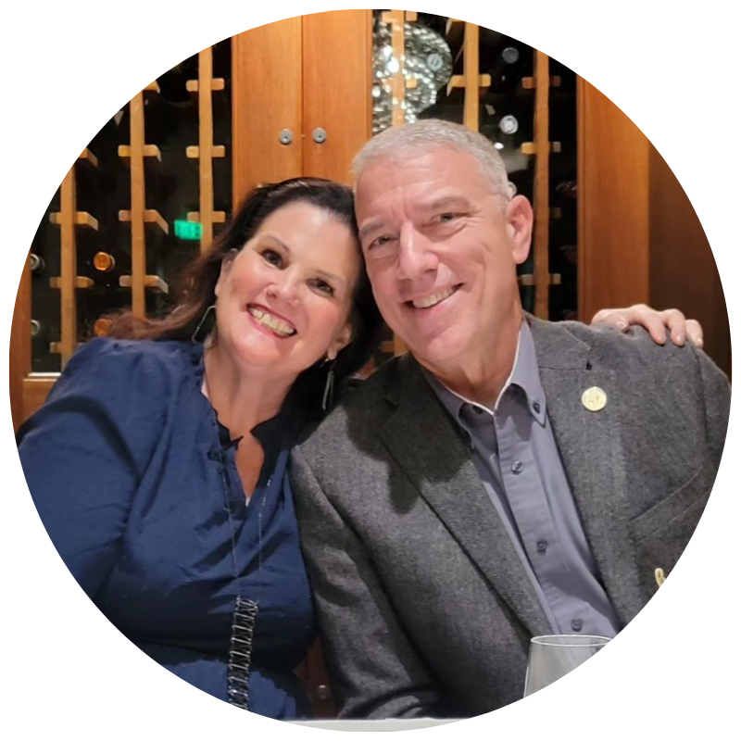
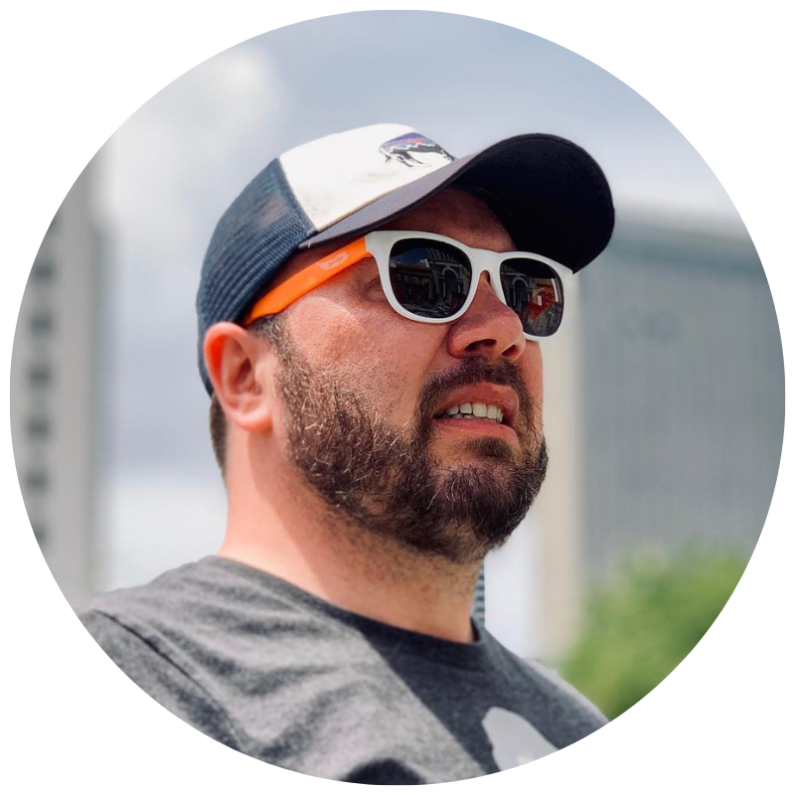
Most Worshipful Arthur L. Salazar, PM Grand Master of Grand Lodge of California

Slide 12
Tracks
EXECUTIVE Master
EDUCATION Senior Warden
Junior Deacon
MEMBERSHIP Junior Warden
FINANCE Treasurer
Assistant Treasurer
ADMIN Secretary
RITUAL Officers Coach
SOCIAL Stewards
Tiler
Organist
Marshal
Assistant
Senior Deacon
Chaplain
Secretary

