Slide 1
Introduction to Grand View Accounting System
Maribel Pasamic Controller
2025 Leadership Retreats

Slide 2
What is Grand View Accounting System
The Grand View accounting system is an accounting system within iMember specifically designed and created for Masonic lodges. It provides the essential accounting functions tailored for Masonic lodges

Slide 3
Benefit of Using The Grand View Accounting System
Succession planning and transition from one treasurer to the next will be seamless.
All lodge financial records are stored in a single location within a cloud-based system, preventing data loss.
Centralized financial accounting system. There is an audit trail of transactions.
No need to complete the lodge annual financial statements
Less work for the lodge to provide the required information to the Grand Lodge for completing the annual tax returns (Form 990 and 199).
No annual or monthly subscription fees, which saves $100,000 each year
The Grand Lodge financial services team is available to help.
Provides unlimited training and support
Updates lodge records - book investment transactions, reconcile checking and/or investment account, upload budget, create and run reports, among others, as needed.
415-292-9170
financialservices@freemason.org

Slide 4
Difference between Sage Intacct and Grand View Accounting System
Grand View Accounting System | Sage Intacct or other accounting System
TAILORED FOR LODGES – ACCOUNTANTS OR NON- ACCOUNTANTS | TAILORED FOR ACCOUNTANTS
EASE OF USE – FEWER NAVIGATION – VERY USER- FRIENDLY | VARIOUS FEATURES/ APPLICATIONS AND MAY REQUIRE ACCOUNTING KNOWLEDGE
BUILT WITHIN IMEMBER 2.0 – NO NEED FOR SEPARATE LOGIN | SEPARATE LOGIN INFORMATION
DUES RECEIPTS ARE AUTOMATICALLY POSTED NO NEED TO ENTER IN THE ACCOUNTING SYSTEM | DUES RECEIPTS NEED TO BE BOOKED`AND ENTERED IN THE SYSTEM

Slide 5
Grand View Accounting Functionality/Features
Lodge accounting provided the following features
Charge members for dues and assessments
Charge members for other financial transactions such as stated meeting dinner
Receive payments from members
Receive charitable donations from members and non-members
Manage multiple accounts and sub-accounts
Transfer funds between accounts
Disburse funds from an account
Pay and track bills
Track monies received by the secretary and paid over to the treasurer.
Cashbook of transactions to track bank accounts.
Bank Reconciliation process.

Slide 6
Chart of Accounts INCOME/RECEIPTS
INCOME |  | Income Category / Code
1 | Membership Dues | 4015
 | Life Membership Dues | 4016
2 | Fees (membership, degrees, etc.) | 4020
3 | Income from Life Membership (less investment fees)
4 | Income from other Investments (less investment fees)
5 | Subtotal
6 | Gifts & Bequests Received | 4110
7 | Income from Donor Restricted Gifts and Trusts | 4120
8 | Transfer from Hall Association in Trust - Dividends/Surplus | 4210
 | Transfer from Hall Association in Trust - Restricted | 4220
9 | Contributions Received Unrestricted | 4140
10 | Contributions Received for other Masonic Programs | 4144
11 | Other Income / Program Revenue | 4310
12 | Total Income

Slide 7
Chart of Accounts INVESTMENT
INVESTMENT | Income Category / Code
Interest Income | 5300
Investment dividend Income | 5400
Capital Gains/Losses | 5500
Realized Gains | 5600
Unrealized Gains/Loses - Changed in Market Value | 5700
Investment Fees | 5800
Other Investment transactions | 5900

Slide 8
Chart of Accounts EXPENDITURES
Required and Necessary Expenditures (CMC 809.540) | Income Category / Code
13 Per Capita/Degree Fees/Return Dues & Fees | 7010
14 Taxes or other Government Charges | 7020
15 Relief to Master Masons, widows or orphans | 7030
16 Funeral and Burial Expenses of a member | 7040
17 Subtotal

Slide 9
Chart of Accounts EXPENDITURES
Discretionary Expenditures (CMC 809.550)
Employment | Income Category / Code
18 Wages and Salaries - Secretary (805.230) | 60050
19 Wages and Salaries - Asst. Secretary (805.320) | 60051
20 Wages and Salaries - Tiler (805.330) | 60052
21 Wages and Salaries - Organist | 60053
22 Employment Taxes | 61100
23 Other Employment Expenses | 61300
24 Subtotal - Employment

Slide 10
Chart of Accounts EXPENDITURES
Discretionary Expenditures (CMC 809.550)
Lodge Programs | Income Category / Code
25 Grand Lodge Annual Communication | 6210
26 District Officers Meetings | 6220
27 Secretaries Association Meetings | 6230
28 Public Schools Observance (805.120) | 6240
29 Constitution Observance (805.120) | 6250
30 Youth Orders Observance | 6260
31 Membership Development | 6270
32 Widows/Sweethearts | 6280
33 Scholarship Program | 6290
34 Other Lodge Programs | 6295
35 Subtotal - Lodge Programs

Slide 11
Chart of Accounts EXPENDITURES
Discretionary Expenditures (CMC 809.550)
Communications and Operations | Income Category / Code
36 Trestleboard Expenses | 6310
37 Postage | 6320
38 Telephone & Internet Expenses | 6330
39 Fees (Banking, Accounting, Legal, etc.) | 6340
40 Building Rent | 6350
41 Other Communications and Operations | 6360
42 Subtotal - Communications and Operations

Slide 12
Chart of Accounts EXPENDITURES
Discretionary Expenditures (CMC 809.550)
Degrees and Candidates | Income Category / Code
43 Candidate Regalia (aprons, trowels, etc.) | 6410
44 Other Candidate Expenses | 6420
Supplies and Equipment
46 Secretaries Revolving Fund (809.120)
47 Office Supplies | 6510
48 Lodge Supplies and Regalia | 6520
49 Printing | 6530
50 Equipment (rental, repairs, etc.) | 6540
51 Other Supplies and Equipment | 6550

Slide 13
Chart of Accounts EXPENDITURES
Discretionary Expenditures (CMC 809.550)
Education and Training | Income Category / Code
53 Candidate Education | 6610
54 Masonic Publications | 6620
55 Wardens' Leadership Retreats | 6630
56 Secretaries Administrative Seminars/ Secretary and Treasurer Retreats | 6640
57 Officers Management Workshops | 6650
58 Other Education and Training | 6670
59 Subtotal - Education and Training
Honors and Awards
60 Retiring Master Testimonial and Regalia | 6710
61 Other Honors and Awards | 6740

Slide 14
Chart of Accounts EXPENDITURES
Discretionary Expenditures (CMC 809.550)
Relief | Income Category / Code
63 Masonic Homes Residents | 6810
64 Contributions to the Masonic Homes | 6820
65 Other Masonic Charitable Programs | 6830
66 Other Masonic Relief (including Mason. Serv. Bur.) | 6840
Other
68 Transfers to the Hall Association | 6910
69 Other Discretionary Expenditures | 6920

Slide 15
Chart of Accounts EXPENDITURES
Social and Fraternal Expenditures (CMC 809.560) | Income Category / Code
71 Community Improvement | 8010
a. Community Association Dues | 8010-01
b. Other Community Improvement | 8010-02
72 Charitable Activity | 8020
73 Refreshment Fund (809.120) | 8030
74 Installation Expenses | 8040
a. Reception/Dinner | 8040
b. Invitations, Flowers, etc. | 8040
75 Other Social and Fraternal Expenditures | 8050

Slide 16
GRAND VIEW ACCOUNTING SYSTEM
Who has access to the system? -
Secretary
Treasurer
How to access? -
Log into your iMember account
Click on “Lodge” on the top right corner of the screen
Click on the "$" icon on the left-side menu bar

Slide 17
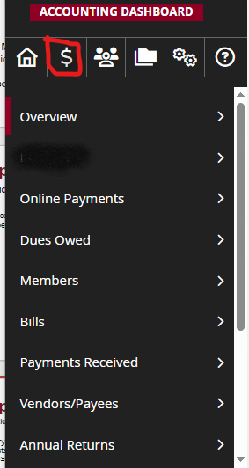
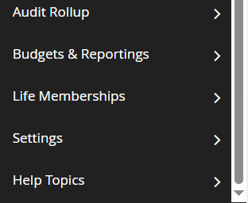
GRAND VIEW ACCOUNTING SYSTEM
Grand View Accounting System Applications

Slide 18
GRAND VIEW ACCOUNTING SYSTEM
Grand View Accounting System Application – OVERVIEW
BANK ACCOUNTS OVERVIEW
SECRETARY TOOLS
TREASURER TOOLS

Slide 19
GRAND VIEW ACCOUNTING SYSTEM
Grand View Accounting System Application – OVERVIEW

Slide 20
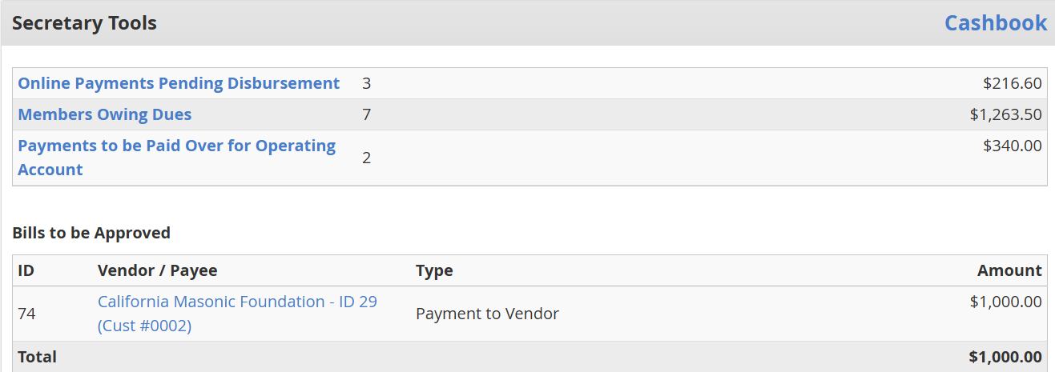
GRAND VIEW ACCOUNTING SYSTEM
Grand View Accounting System Application – OVERVIEW
SECRETARY TOOLS

Slide 21
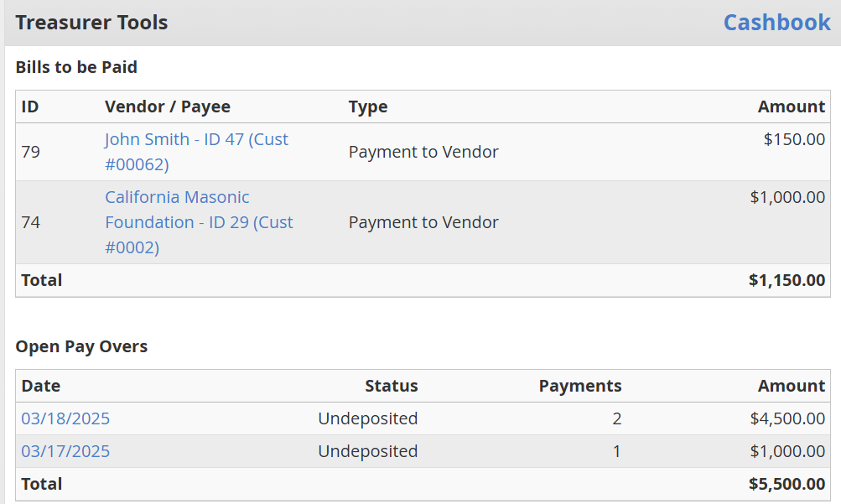
GRAND VIEW ACCOUNTING SYSTEM
Grand View Accounting System Application – OVERVIEW
TREASURER TOOLS

Slide 22
GRAND VIEW ACCOUNTING SYSTEM
Grand View Accounting System Application – BILLS
Secretary’s Tasks | Treasurer’s Tasks
Create Bills for payment
Pay Bills – Select Bills to be Paid
Click “ Print Check”
Click on the selected Vendor name
Enter Bills information
YES
Click “Mark Bill as paid”
Need to print check?
Approve Bills
END
NO

Slide 23
GRAND VIEW ACCOUNTING SYSTEM
Grand View Accounting System Application –
PAYMENTS RECEIVED
Secretary’s Tasks | Treasurer’s Tasks
Other receipts (Donation, Stated Meeting etc)
Dues payments
Once deposited, Go to “Open Pay Overs”
Click “Add Manual Receipt”
Click “Pay Selected payments over to Treasurer”
Select one of the deposited pay over receipts
Enter the Manual Receipt information
Click “Create payover receipt for treasurer”
Change status to Deposited - click “Mark Payover as Deposited”
Print the payover receipt for treasurer’s signature/acknowledgement
END

Slide 24
GRAND VIEW ACCOUNTING SYSTEM
Grand View Accounting System Application – BANK RECONCILIATION
Treasurer’s Tasks
Click “Cashbook”
Enter Bank Statement date and Ending balance amount
Zero Difference?
No
Yes
Select the bank account to be reconciled
Click “Start Reconciling Cashbook”
Click ‘Save Draft’ (to save and continue working later)
Click “Finish Now”
Click “Reconcile Cashbook”
Mark √ reconciled transaction
END

Slide 25
Questions
Answers
Notes:
At this time Jordan and I are happy to answer questions.

Slide 26
Let’s Keep in Touch
Financial Services
✉️ financialservices@freemason.org
415-292-9170

