Slide 1
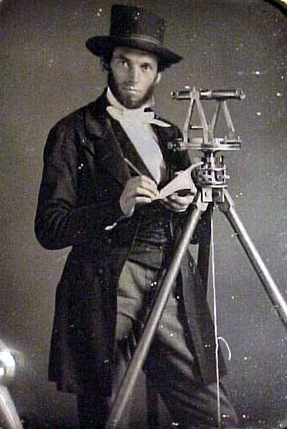
The View From Here: The Masonic World Through North American Based Eyes
Dr. Susan Mitchell Sommers
Professor of History, Saint Vincent College
Academic Chair
Notes:
It is so very good to be here, and to be with you, here at UC Berkeley, one of our nation’s justly famous institutions of higher learning. I could elaborate at some length about how right this feels, but after the past two years, I think that probably is not necessary. Still, I have missed the energy in the room that comes with the live, in-person exchange of ideas. Nothing can take the place of this…an authentic colloquium, in the truest old sense—a meeting or assembly for formal discussion. A colloquium is a fundamental academic form—dating back to the Greek philosophers. In practice, it is very like a symposium—but for that to be authentic we would need a jug of wine on each table, and I fear few of us would make it much past lunch without the need for a nap, and that would disadvantage our afternoon speakers, which would never do.
Many things in my life have changed over the past two years—my mother died, my elderly father moved across the country to live with my family, and keep us on our toes, “Zoom” became a thing, and I taught via its little “Brady Bunch” style boxes for two years. While I was busy with all that, the world changed. Some good things fell away—we all seem to have become a bit less civil and less genuinely civilized. It will take many, many people of good will coming together as we are here, to begin to heal that tear in our cultural fabric. Other things sprang up—and I would be remiss if I did not point to how many international freemasonry rose to the occasion, adapting and adopting to the wider societal changes around them, replying to the sad and broken with extended virtual handshakes, and new ways of meeting via the ether. I’ve participated in two new masonic lecture series, Open Lectures on Freemasonry, based mostly in Turkey but also everywhere, and the lectures hosted in Athens by the Philotecton Society—but there are so very many others—and this has been very good indeed.

Slide 2
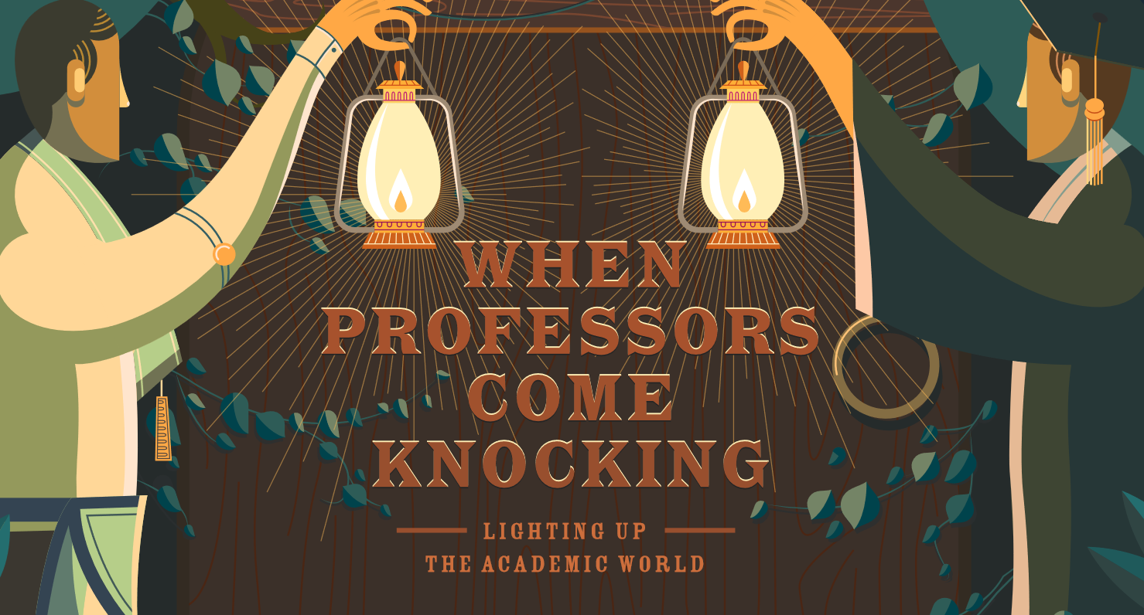
And that of Freemasonry!
Notes:
So, here we are again, in person, after a hiatus of two years. Last year, of course, we met virtually, and were treated to a full house of masonic scholars from all over North America and Europe. Because we were streaming online, hundreds more masons and academics were able to join us, again from all over, and that was a fantastic experience for those of us on the hosting side, as well as for the audience. The conference is different this time around—a new venue and some fresh academic faces. Before I introduce our speakers, I’d like to refresh everyone’s memory about when this event began, and what its intended purpose was, and is.
Quoting from REHMLAC Special Issue UCLA - Grand Lodge of California, “In 2009 an unprecedented partnership between the academic and Masonic worlds in the United States emerged. Under the leadership of Professor Margaret Jacob, UCLA’s Department of History and the Grand Lodge of California—through its Institute for Masonic Studies—joined forces to establish” a series of ventures, including the International Conference on Freemasonry, of which today’s is the tenth. The vision throughout has remained constant: Bring masons and scholars together in an academic setting, to share ideas, conversation and research. There is a mutual benefit, as well as a wider social import: You share your libraries, museums and archives with us, and we share both our findings, and importantly, our craft secrets to you. And together, we face the world with the many aspects of freemasonry most people could never even imagine otherwise—beyond National Treasure.

Slide 3
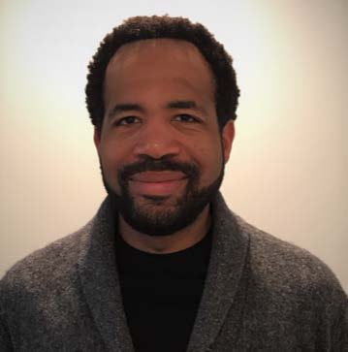
Dr. Chernoh Sesay, Jr.
Associate Professor, Religious Studies, DePaul University
“Emancipation, Citizenship, and Prince Hall Freemasonry during the Revolutionary Era”
Notes:
The conference theme for 2022 is “The View from Here: The Masonic World through North American Eyes.” I am delighted to welcome a combination of long-time and new friends to the conference, each of whom will share their latest projects—some of which are still in manuscript or development. And, while each one has “North American Eyes” with which to view their subjects, their studies vary widely in time and place. In addition, I have asked each to include a methodological “reveal” in his or her presentation—to help make the scientific apparatus used in each of their disciplines more transparent. Academics really do research differently, and it is good practice to share our approaches and methods not only with our students, but also with fellow researchers outside of the academy.
Chernoh M. Sesay, Jr. is an associate professor of religion at DePaul University in Chicago. He is an historian of the Black Atlantic and of colonial North American and antebellum United States history whose research focuses on the intersection of religion, black political thought, identity, and community formation. He is currently completing a book manuscript entitled Black Boston and the Making of African-American Freemasonry: Leadership, Religion, and Community in Early America. In this study, the early development of black Freemasonry, from its founder, Prince Hall, to its prominent antebellum member, David Walker, becomes a prism through which to consider various relationships between religion, gender, community, and interracial and black politics. He is also exploring how different forms of nineteenth and twentieth-century African American historicism were comprised of aligned and competing theological and secular concerns.

Slide 4
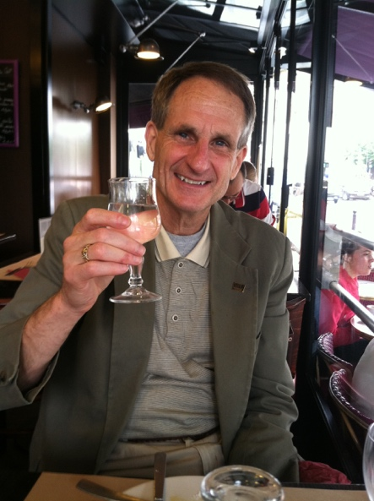
Dr. James Smith Allen
Southern Illinois University, Carbondale: Professor Emeritus of History
“Women in the Judeo-Masonic Conspiracy: A French Cultural Fixation”
Notes:
Jim is a long-time friend, and a treasured mentor. He is an emeritus professor and former university administrator, who now has the time to devote himself to our shared craft—history! His presentation today traces the cultural origins of the role of women in the Judeo-Masonic conspiracy theory in France, from 1789 to at least the early 20th century. Delineation of this distinctly French “imaginary” is the product of the cultural history of Freemasonry as written by recent American scholars raising new questions and using new sources. It has in fact redefined our understanding of Masonry in modern France and elsewhere. The better we are able to understand the belief structures of the past—however erroneous they may have been—the better able we are to understand what many people were thinking about Freemasons and their place in civil society, whatever may actually have been on the minds of the brethren and their sisters on the margins of the Craft when anti-Semitism, anti-Masonry, and anti-feminism were widespread social and cultural phenomena

Slide 5
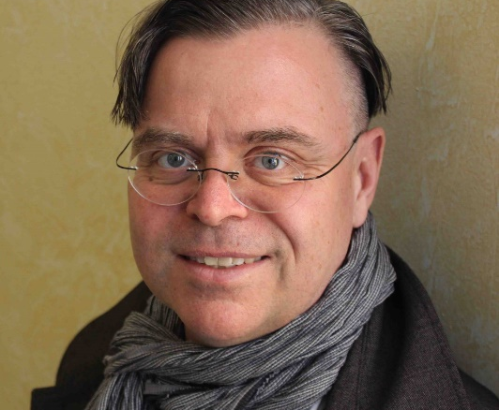
Dr. Andreas Önnerfors Professor of Intellectual
History
Fulbright Scholar, UC
Berkeley
“Transatlantic Perspectives
on Freemasonry:
German Immigrant
Lodges in the USA”
Notes:
How to introduce a colleague who needs no introduction? We are very fortunate that Andreas is currently in possession of North-American based eyes, thanks to the folks at the Fulbright Scholar Program and UCBerkeley.
Andreas will share his latest archival findings with us, in his discussion of German immigrant lodges after revolutions swept Europe in 1848. In the aftermath, waves of European émigrés, many of them Germans, settled in the United States. These ‘Forty-Eighters’ faced challenging choices in their relationship to American society, oscillating around assimilation, adaptation, alienation and open antagonism. The arrival of thousands of refugees from revolutions repositioned US politics within a transatlantic world, one increasingly shaped by multiple intersections and exchanges. Through the activities of German-speaking lodges in the US, this paper analyses ideological tensions between Masonic universalism as espoused by émigrés and US Masonic practices. Persistent prejudices and significant differences in organizational culture led to escalating transatlantic Masonic tensions, pointing to deeper divergences in worldviews and self-perceptions.

Slide 6
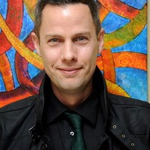
Dr. Rob Collis:
Visiting Assistant Professor of History, Drake University
Research Fellow, Helsinki Collegium of Advanced Studies at the University of Helsinki
“The Avignon Society and Masonic Networks in Europe, 1779-1807”
Notes:
I met Rob when he and I were much younger, and I have watched his scholarship blossom with joy and a bit of pride usually reserved for aunties. Rob is from the UK, but for the past several years he and his spouse, Natalie Bayer, have made their home in Iowa, where both are associated with Drake University.
Rob is giving us a bit of a reprise of our theme from last year, “Hidden Meanings: Esotericism and Masonic Connection,” A great deal of conjecture and erroneous information has been written about the Avignon Society, much of which has centered on its links to Freemasonry. The Avignon Society was able to develop a unique identity as an initiatory group in Europe for over a quarter of a century at a time of monumental upheaval across the Continent. Yet, throughout its existence, this paper will demonstrate that the society leaned heavily on pre-existing networks of High-Degree Freemasonry across Europe in order to establish foundations in specific locations, such as Valence, Avignon and St. Petersburg. Moreover, leaders within the society also actively utilized the Masonic credentials and links of pivotal members of the group in order to promote it more broadly via Masonic channels that traversed much of the European Continent.

Slide 7
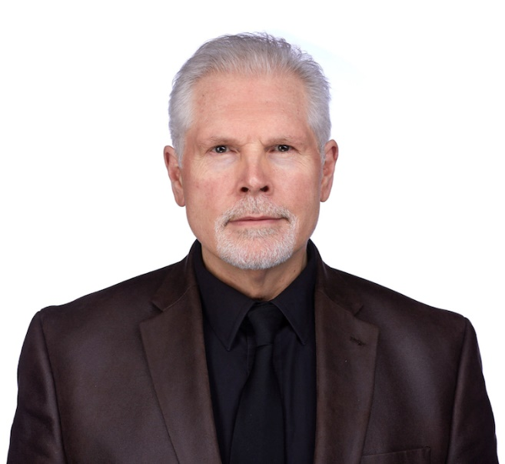
Dr. Kevin Quarmby
Associate Professor and Rose Warner Professor of English, School of Arts and Letters, The College of St. Scholastica
“The Masonic Detective: Freemasonry and the Founding of Emory University”
Notes:
Kevin is a new friend, an actor and professor of Early Modern English literature, and I hope to prod him into pursuing more masonic topics in the future. Be careful, Kevin, it is a slippery slope! You find one interesting little project, and soon you find yourself down the rabbit hole along with Alice. Another Brit with North-American based eyes, Kevin, along with Chernoh and myself, teaches at a Catholic institution……surely something to discuss over a glass this evening?
Here is how Dr. Quarmby’s tale begins:
On the morning of April 4, 2013, a massive tree uprooted on the quadrangle of Oxford College of Emory University, the site in rural Georgia of Emory College, forebear of today’s Emory University. Crashing to the ground, the tree narrowly missed demolishing the Few Memorial, dedicated in 1849 to the first president of Emory College, Ignatius A. Few, and adorned with a prominent masonic square and compasses emblazoned on its column. The memorial’s capstone was dislodged, while its Victorian wrought iron railings suffered irreparable damage. Having stood proudly as a symbol for Emory College and then Oxford College for over 160 years, the Few Memorial survived its ordeal relatively unscathed. Stay tuned for the rest of the story.

Slide 8
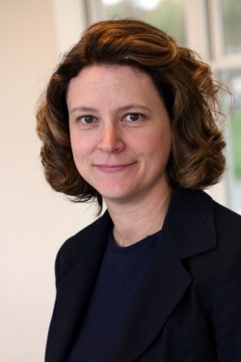
Dr. Heather K. Calloway
Executive Director, University Collections, Indiana University Director, Center for Fraternal Collections & Research, Indiana University
“Paraphernalia of the Lodge: Preserving the Material Culture of Fraternal Organizations”
Notes:
I think I am the last person in masonic scholarship circles to meet Heather, but her reputation is well-known. Her extensive experience and education in all-things-museum has brought her to directorship of the Center for Fraternal Collections & Research at Indiana University. Her talk deals with a topic that is undoubtedly of keen interest to every mason in this room: Masonic stuff!
“While cleaning out a closet filled with old lockers and boxes, a janitor took out a brown envelope, about 12 by 14 inches in size. The envelope was open and looked like it contained an American flag. It appeared to be of some importance, so he took it to the museum curator for inspection. She looked inside and found a flag and a letter which read, “These will occupy permanent places in our museum as memorabilia with appropriate credit to you.” The thank you letter was written to Lt. Col. Richard C. Delsi from Sovereign Grand Commander Clausen, of the Southern Jurisdiction of the Scottish Rite of Freemasonry, USA in 1985, but was seemingly lost until its discovery in a closet in 2002.” What to do? Dr. Calloway will make some suggestions…..

Slide 9
Scholars’ Roundtable: Research in Plague Year(s)
Notes:
Oh my goodness. This has been a wild time, hasn’t it? Fingers crossed, I’m going to Aberdeen in June, to do some essential archival work I intended to do in 2020. It has been interesting for me—my book on James Anderson, author of the Book of Constitutions, has been badly delayed, and I will not have it published in time for the 300th anniversary of the publication of the book. Spoiler alert: I do not argue that 1723 was NOT the year of publication. But my pandemic story is not uniformly glum, and I suspect my colleagues will echo that—more time to think, greater access to electronic resources as some institutions have relaxed paywalls and given grace periods for expired membership….please stay for more!

