Slide 1
Documenting Fears: The Illuminés d’Avignon and the Conspiratorial Mindset of European Authorities, 1790-1821
Robert Collis, Phd, FRHistS,
Drake University (Des Moines, IA)

Slide 2
Talk Outline
1. Brief overview of the key features and individuals of the Illuminés d’Avignon (1779-1820s)
NB: also known as The Avignon Society; The Union; The New Israel Society
2. Brief summary of the key Masonic archives that help to shed light on the activities of the Illuminés d’Avignon
KEY FOCUS
3. The persecution of the authorities against members of the Illuminés d’Avignon:
The Holy Office in Rome against Ottavio Cappelli (1790-1791)
The arrest of Cappelli in Rome in 1799 by the Giunta di Stato and the subsequent collection of belongings and trial papers
The arrest of Tadeusz Grabianka by the Russian authorities in February 1807
The French police surveillance of Madame Thérése Bouche and Joseph Ferrier (1810-1822)

Slide 3
Distinctive features of the Avignon Society
Use of arithmancy: an oracular Holy Word (Sainte Parole) which could be consulted. Brumore, who instigated the use of the Holy Word, referred to it as “the science of numbers” and “the true cabalistic art.”
The development of an elaborate 9-day consecration ritual (that had to be sanctioned via a response from the Holy Word).
This consecration culminated in a theurgic ceremony in which initiates came into contact with their guardian angel.
Until around 1788 many members of the society were preoccupied with the search for the philosophers’ stone
From 1780 until 1789 the group was heavily influenced by Swedenborg.
From 1780 the society embraced a distinct millenarian outlook
The society was open to women and children

Slide 4
The three pivotal figures behind the foundation of the Illuminés society in Berlin in 1779
Antoine-Joseph Pernety: The librarian to King Friedrich II of Prussia in 1779; previously a Benedictine monk in Paris until 1765.
Tadeusz Grabianka: A Polish aristocrat raised in Podolia (in modern-day Ukraine).
Louis-Joseph-Bernard-Philbert Guyton de Morveau, known as Brumore (1738-1787): cleric, poet and playwright. Patronised by Prince Heinrich of Prussia from 1778. Brumore was the key figure behind the use of the oracular “Holy Word” (Sainte Parole) by the society.
Portrait of Tadeusz Grabianka (1740-1807)
Silhouette of Antoine-Joseph Pernety (1716-1796)

Slide 5
Chronological & geographical info about the illuminés d’avignon
1779: The group is established in Berlin
1783-1787: Pernety relocates to Valence in southern France
1785-1787: Grabianka travels to Hamburg, Holland, England, France, and Rome before settling in Avignon.
1787-1791: The “golden” era of activity of the Avignon Society in Avignon.
1791-1799: A rump of the society continues to operate in Avignon
1802-1807: The society relocates to St. Petersburg
1817-1821: Madame Thérèse Bouche comes into contact with Emperor Alexander I of Russia

Slide 6
Two other key personalities in the history of the Illuminés d’Avignon
1) Ottavio Cappelli (1736-1800)
Traveled from Rome to Avignon in 1787
Saw himself as a prophet who could communicate with the archangels Gabriel and Raphael
Stayed in Avignon until 1789 before returning to Rome
Vehemently anti-Swedenborgian
Arrested by the Papal authorities in Sept. 1790
2) Thérèse Bouche (1759-after 1822)
Born in Avignon
Became a member of the Illuminés d’Avignon at some point before 1791 in Avignon.
1813-1814: Wrote letters to Napoleon
1817: Began to write letters to Emperor Alexander I of Russia
1819-1821: Spent two years in St. Petersburg, effectively serving as the Russian emperor’s personal prophetess and spiritual guide

Slide 7
Links between the Avignon Society & Freemasonry
The Seven Brothers of the Avignon Society (1787-1790)
Tadeusz Grabianka (Polish aristocrat)
Antoine-Joseph Pernety (Benedictine monk, royal librarian, Freemason, Berlin (1782))
Antoine-Étienne Bouge (physician, Freemason, Avignon (1774))
Louis-François Bourgeois de la Richardière (physician)
Claude-François Delhomme (physician, Freemason, Valence (1774)
Jean-Agricol Leblond (merchant, Freemason, Avignon (1774))
Joseph Ferrier (lawyer from Arles)

Slide 8
Leading European “Illuminist” freemasons & the Avignon Society

Slide 9
sergei ivanovich pleshcheev, Russian & confidante of Grand Duke (later Emperor) Paul (1752-1802)

Slide 10
Gustaf reuterholm (1756-1813): prominent Swedish statesman & Freemason Consecrated into the Avignon society in dec. 1789
Portraits of Reuterholm by Anton Oechs (1803) housed at the National Museum, Stockholm.

Slide 11
Masonic Archives & the Avignon Society: a) Reuterholm documents
1) Archival collection housed at the Archive of the Swedish Order of Freemasons (Stockholm): documents kindly digitized for me by the head archivist, Ulf Åsén.
2) Reuterholm’s travel journal, which contains his descriptions of being in Avignon in late 1789 and his consecration into the society. Housed at the State Archive of Sweden (Stockholm)
B) The Georg Kloss Archive, housed at the Prince Fredrik Cultural Center (The Hague)

Slide 12
In the shadow of revolution: The illuminati, illuminés & Freemasonry: The case of ottavio cappelli

Slide 13
Jean-Pierre-Louis de Luchet, Essais sur la secte des illuminés (1789)
Luchet conflated the rational, atheistic agenda of the Bavarian Illuminati (established in 1776), with so-called illuminés, who were absorbed in aspects of Western esotericism.
On illuminism (and the confusion that arose between Illuminati and illuminés), see Andreas Önnerfors, “Illuminism,” in The Occult World, ed. Christopher Partridge

Slide 14
The arrest & subsequent inquisition of Cagliostro in Rome (Dec. 27, 1789)
Cardinal François-Joachim-Pierre de Bernis (1790):
“The Tribunal of the Holy Office is still making inquiries with a view to discovering if Cagliostro was not the head of this sect of Illuminati who are beginning to disquiet the authorities here. It is said that a document has been found among Cagliostro’s papers, announcing that Pius VI would be the last Pope and that the Church would be deprived of her territories.”
Source, Constantin Photiadès, Count Cagliostro: An Authentic Story of a Mysterious Life (London: Routledge, 2005), 256.

Slide 15
The arrest of Ottavio Cappelli (Sept. 27, 1790) & the initial reaction in Rome
Luigi Gaetano Marini (natural philosopher), Oct. 9 1790: “[Cappelli is] said to be the leader of a society like the Illuminati and plotted great things.”
Source: Lettere Inedite di Gaetano Marini, vol. 2 (Vatican City: Biblioteca Apostolica Vaticana, 1938), 326-327.
Count Girolamo Astorri (Hapsburg Empire’s Director of Post in Milan, but living in Rome): “He is credited with having attributed himself as an agent of the Illuminati and Freemasons, who supported him with a lot of money.”
Source: A. Ademollo, “Cagliostro e i Liberi Muratori,” in Nuova Antologia di Scienze, Lettere ed Arti (1881), 629.
An invaluable document produced by the Holy Office in 1790 is entitled “Brief Details of the Society discovered on the Arrest of Ottavio Cappelli, taken from the papers searched from the above”
This document contains a summary and analysis of Cappelli’s correspondence with fellow members of the Avignon Society in 1789-1790.

Slide 16
The official Notificazione published by Tommaso Vincenzo Pani of the holy office in nov. 1791 against cappelli
Pani’s official statement accurately outlined some of the distinctive feature of the initiatic society in Avignon and Rome:
Cappelli was involved in a society that had “been destine by heaven to reform the world.”
Open to both sexes and all nationalities
Made use of numerical identification and conducted cabalistic operations
Promoted fabulous apparitions and communications with angels
The heretical sect held “secret and illicit assemblies.”
Conclusion: “The society had a perverse and criminal object.”

Slide 17
Trial papers against cappelli by the Giunta di stato, State Archives of Rome (1799-1800)
Cappelli was arrested in Rome in Nov. 1799, shortly after the fall of the Roman Republic.
Executed in January 1800.

Slide 18
Eighteenth-Century Conspiracy theorists Augustin Barruel (1741-1820) & John Robison (1739-1805)
Proofs of a Conspiracy (1797)
Memoirs Illustrating the History of Jacobinism (1797-1798)

Slide 19
Barruel on the Illuminés d’avignon
“These new or compound adepts styled themselves Illuminees. Notwithstanding the Atheism and Materialism of their master, they, after his example, perpetually talked of God and of spirits […] Their head quarters was at Avignon.”
“The Illuminees of Sweden, Avignon and Lyons, there united in the most secret and most monstrous of Lodges, and form the most terrible tribunal for Kings; that, in short, which pointed out the Sovereign that was to fall, named the assassin, prepared the poisons, or sharpened the dagger.”
Augustin Barruel, Memoirs Illustrating the History of Jacobinism, part IV, vol. IV (London: T. Burton, 1798), 143, 487

Slide 20
Influence of Barruel & Robison on the Russian authorities
Barruel’s work was translated (see right) into Russian in 1805; Robison in 1806.

Slide 21
Tadeusz Grabianka (1740-1807), a Polish aristocrat (born in what is now Ukraine); the foremost figure in the Illuminés d’Avignon. He died in the notorious Peter and Paul Fortress Prison in St. Petersburg in October 1807.
Grabianka arrived in St. Petersburg in August 1805 and quickly succeeded in attracting many of the city’s leading Freemasons into what was now called The New Israel Society.
Grabianka was arrested by the Russian authorities in February 1807.

Slide 22
Аleksandr fyodorovich labzin (1766-1825) & the Dying Sphinx Lodge in St. Petersburg
Leading Members of the Lodge who joined Grabianka’s New Israel Society between 1805-1806:
A. F. Labzin
A. E. Labzina* (Honorary Member)
V. L. Borovikovskii
D. G. Levitskii
I. A. Petrov
P. I. Timofeev
A. G. Cherevin
I. A. Turchilo
P. I. Rusanovskii

Slide 23
The Russian Authorities Fear of Grabianka’s influence in st. Petersburg
Jan. 1807: The Committee for the Preservation of General Security was established.
The 1st article of the statute accompanying the edict that established the committee emphasized that “secret societies under the name of Illuminati and Martinists” were sponsored by the French and were seeking to undermine Russia.
The head of the Committee, Nikolai Novosil’tsev, wrote to Emperor Alexander I in early 1807 and complained that government chancelleries were “full of Martinists, Israelites, illuminés and scoundrels of all shades.”

Slide 24
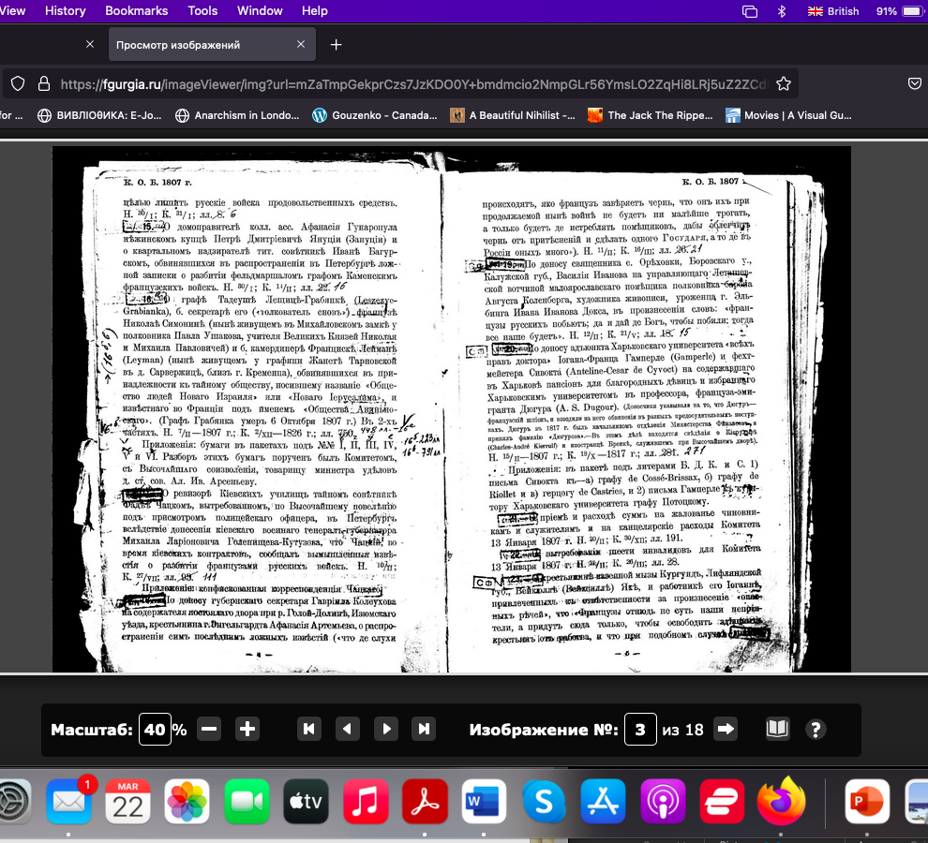
Online Opis’ (Catalogue) of a pre-Soviet publication of the collections of the Russian StatE HISTORICAL ARCHIVE
Archives of the Committee for the Preservation of General Security (established in 1807), during Napoleonic Wars.
Housed at the Russian State Historical Archive in St. Petersburg (Russia).
I visited this archive on two occasions in 2012 and 2014

Slide 25
Grabianka Archive at RGIA
Interrogations of Grabianka and associates about the nature of the society.
Extensive examination of utterances from the Holy Word concerning Russia, including prophecies that seemed to predict harm falling upon Catherine the Great
Descriptions of the society’s notebooks that were in the possession of Grabianka

Slide 26
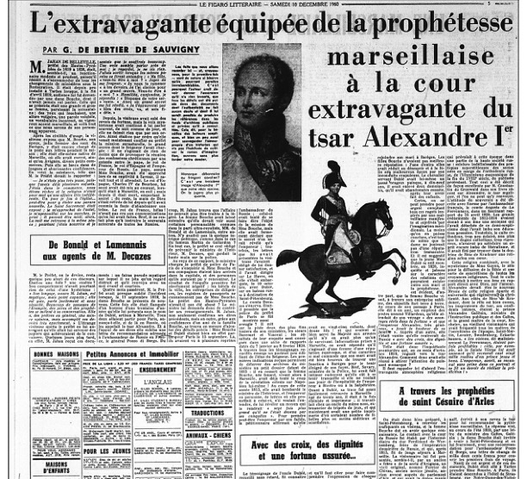
The Prophetess Madame Bouche: G. De Bertier de Sauvigny, Le figaro litteraire (Dec. 10,1960)
The historian-detective in the digital age

Slide 27
Archives Nationales (France), online search catalogue: “Surveillance of Madame Bouche, née Isnard,
“a schemer who became a member of the sect of Illuminés.”

Slide 28
Contents of the Police Dossier
Copies of letters Bouche wrote to Napoleon in 1813
Suggestions by the police that Bouche had written to Emperor Alexander as early as 1817
Interrogations of acquaintances of Bouche in Marseille and Avignon
Police surveillance reports on Bouche in France
Reports of Bouche’s activities in France based on letters she sent to her husband and to the Prefect of the Hautes-Pyrénées Region (Armand Jahan de Belleville)
Also contained police reports on Joseph Ferrier, one of the 7 leaders of the Avignon Society between 1787-1791, and a close acquaintance of Bouche
Key Findings
Bouche traveled to St. Petersburg and acted as the personal prophetess to Emperor Alexander I between 1819-1821.
Many of her acquaintances who were interrogated testified that she was a member of the Illuminés d’Avignon.

Slide 29
Local Avignon archives for info to confirm her acquaintance with the Illuminés D’Avignon
Baptism records of the St. Agricol parish of Avignon, April 18, 1791.
Source: Archives départementales de Vaucluse, GG37, St. Agricol. N. M. D., 1791-1792, 7.

Slide 30
Tracking down bouche’s letter to Emperor Alexander I from 1817-1818 and later letters to Prince Alexander Golitsyn
The police dossier specifically indicated that the Duke of Richelieu, Armand-Emmanuel du Plessis (1766-1822), the prime minister of France, had closely supervised the surveillance operation of Bouche.
I became aware that the Fonds Richelieu were housed at the Bibliothèque interuniversitaire de la Sorbonne in Paris.
An online search of the library’s catalogue revealed a series of letters written by Bouche to the Russian Emperor (from March 1817) and Prince Golitsyn.
The library then sent me digitized copies of the letters.
Besides the letters to the Russian Emperor and Golitsyn, the collection also contained a series of questions and answers posed to the Holy Word by Bouche on behalf of others.

