Slide 1
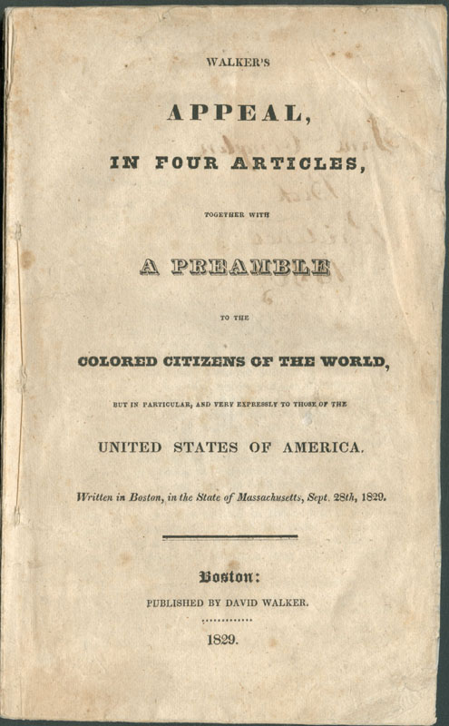
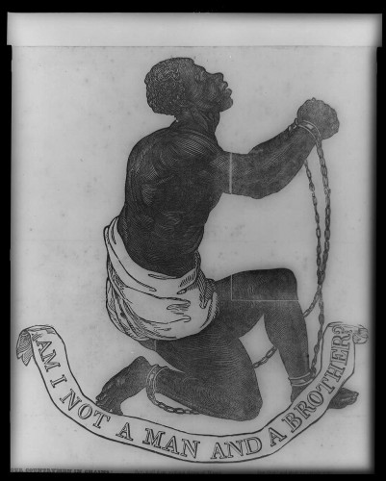
Emancipation, citizenship, and prince hall freemasonary during the revolutionary era

Slide 2

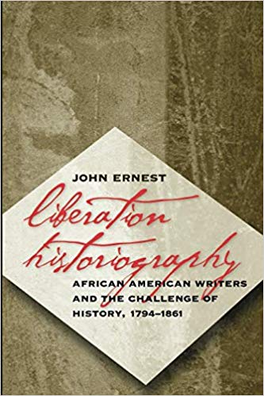

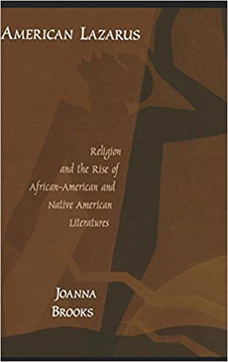

Slide 3
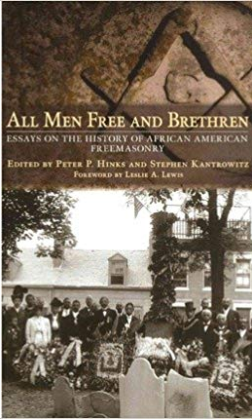
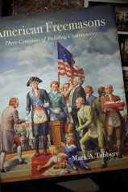
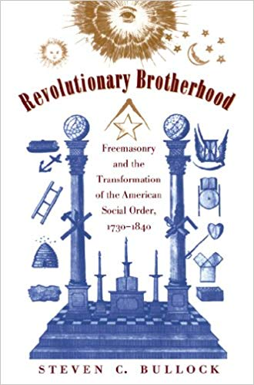
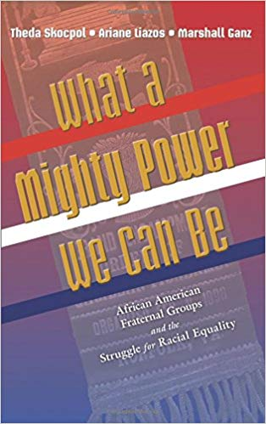


Slide 4
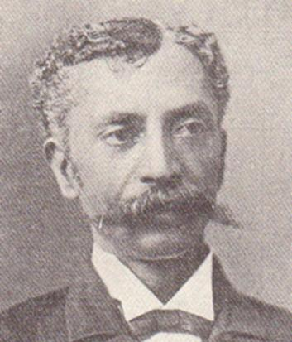
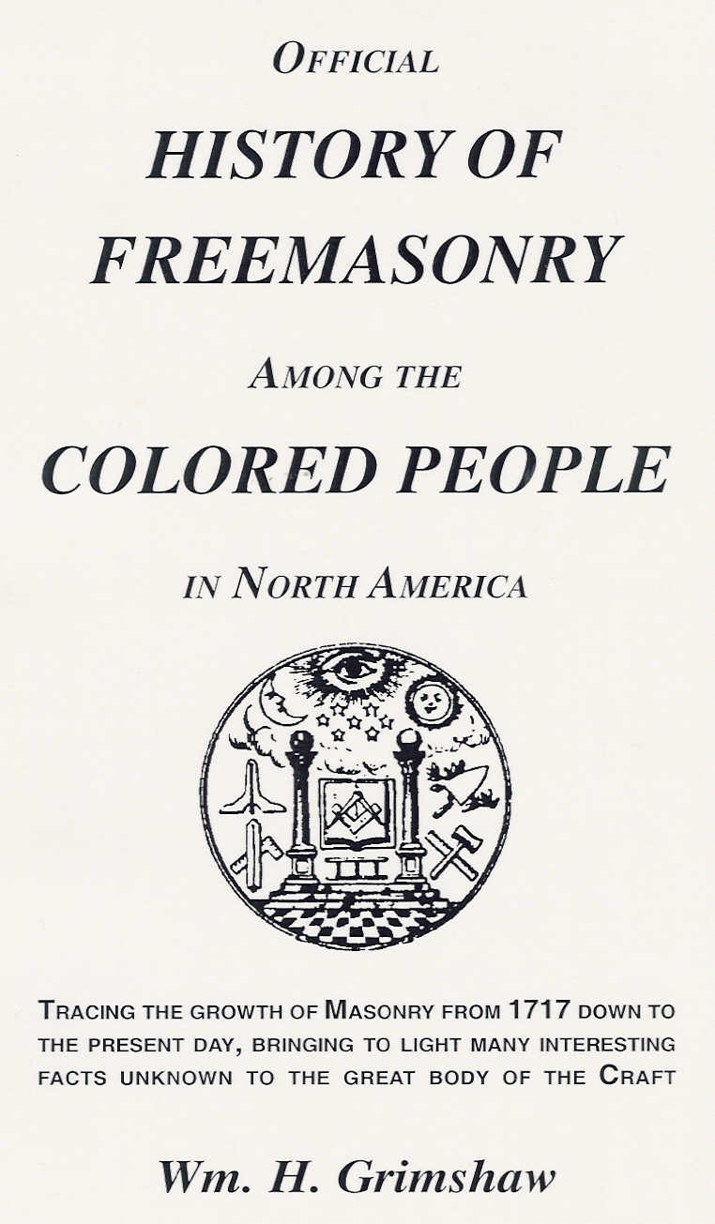
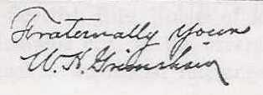

Slide 5
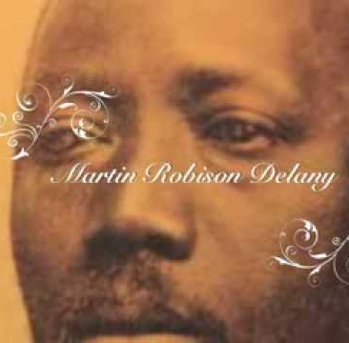
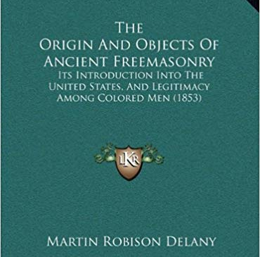

Slide 6
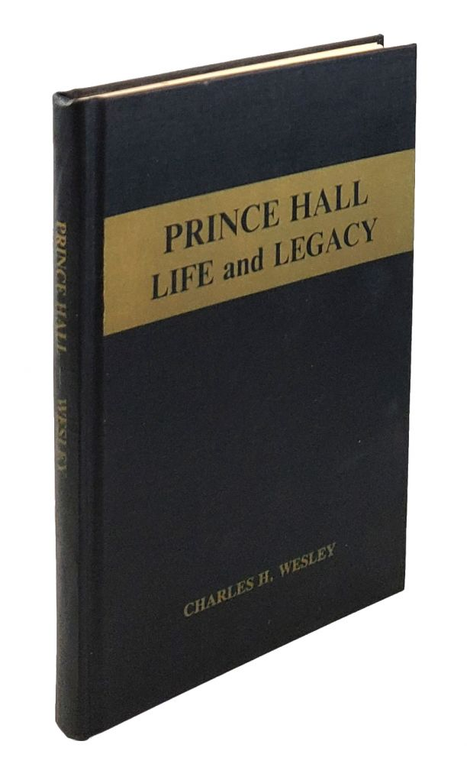
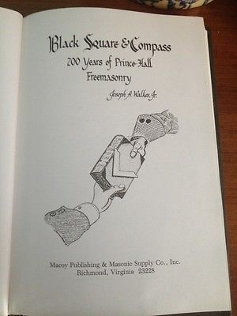
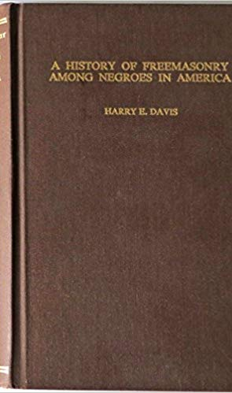
Masonic History

Slide 7
“…Life, Liberty and the pursuit of Happiness.”
-The Declaration of Independence, 1776
“…LIBERTÉ, ÉGALITÉ, FRATERNITÉ.”
-Maximilien Robespierre, 1790

Slide 8
We presume not to dictate to your Excellency and Honors…
We have no Property. We have no Wives. No Children. We have no City. No Country. But we have a Father in Heaven, and we are determined, as far as his Grace shall enable us, and as far as our degraded contemptuous Life will admit, to keep all his Commandments: Especially will we be obedient to our Masters, so long as God in his sovereign Providence shall suffer us to be holden in Bondage.
The Appendix Or, Some Observations on the Expediency of the Petition of the Africans, living in Boston, &c. lately presented to the General Assembly of this Province. To which is annexed the Petition referred to. Likewise, Thoughts on Slavery. With a Useful Extract from the Massachusetts Spy of January 28, 1773, by way of an Address to the Members of the Assembly (Boston, ca. 1773).

Slide 9
To the Honorable Counsel & House of [Representa-]
tives for the State of Massachusette Bay in General
Court assembled, Jan 13 1777 --
The petition of A Great Number of Blackes detained in a
State of Slavery in the Bowels of a free & christian Country
Humbly shuwith that your Petitioners Apprehend that
Thay have in Common with all other men a Natural and
Unaliable Right to that freedom which the Grat [Great] -
Parent of the Unavese [Universe] hath Bestowed equalley on
all menkind [mankind] and which they have Never forfuted [forfeited] by Any Compact or Agreement whatever -- but thay [they] wher [were] Unjustly Dragged by the hand of cruel Power from their
Derest frinds [friends] and sum of them Even torn from the
Embraces of their tender Parents…
MHS Collections Online: Petition for freedom (manuscript copy) to the Massachusetts Council and the House of Representatives, [13] January 1777.
Massachusetts Historical Society, https://www.masshist.org/database/viewer.php?item_id=55

Slide 10
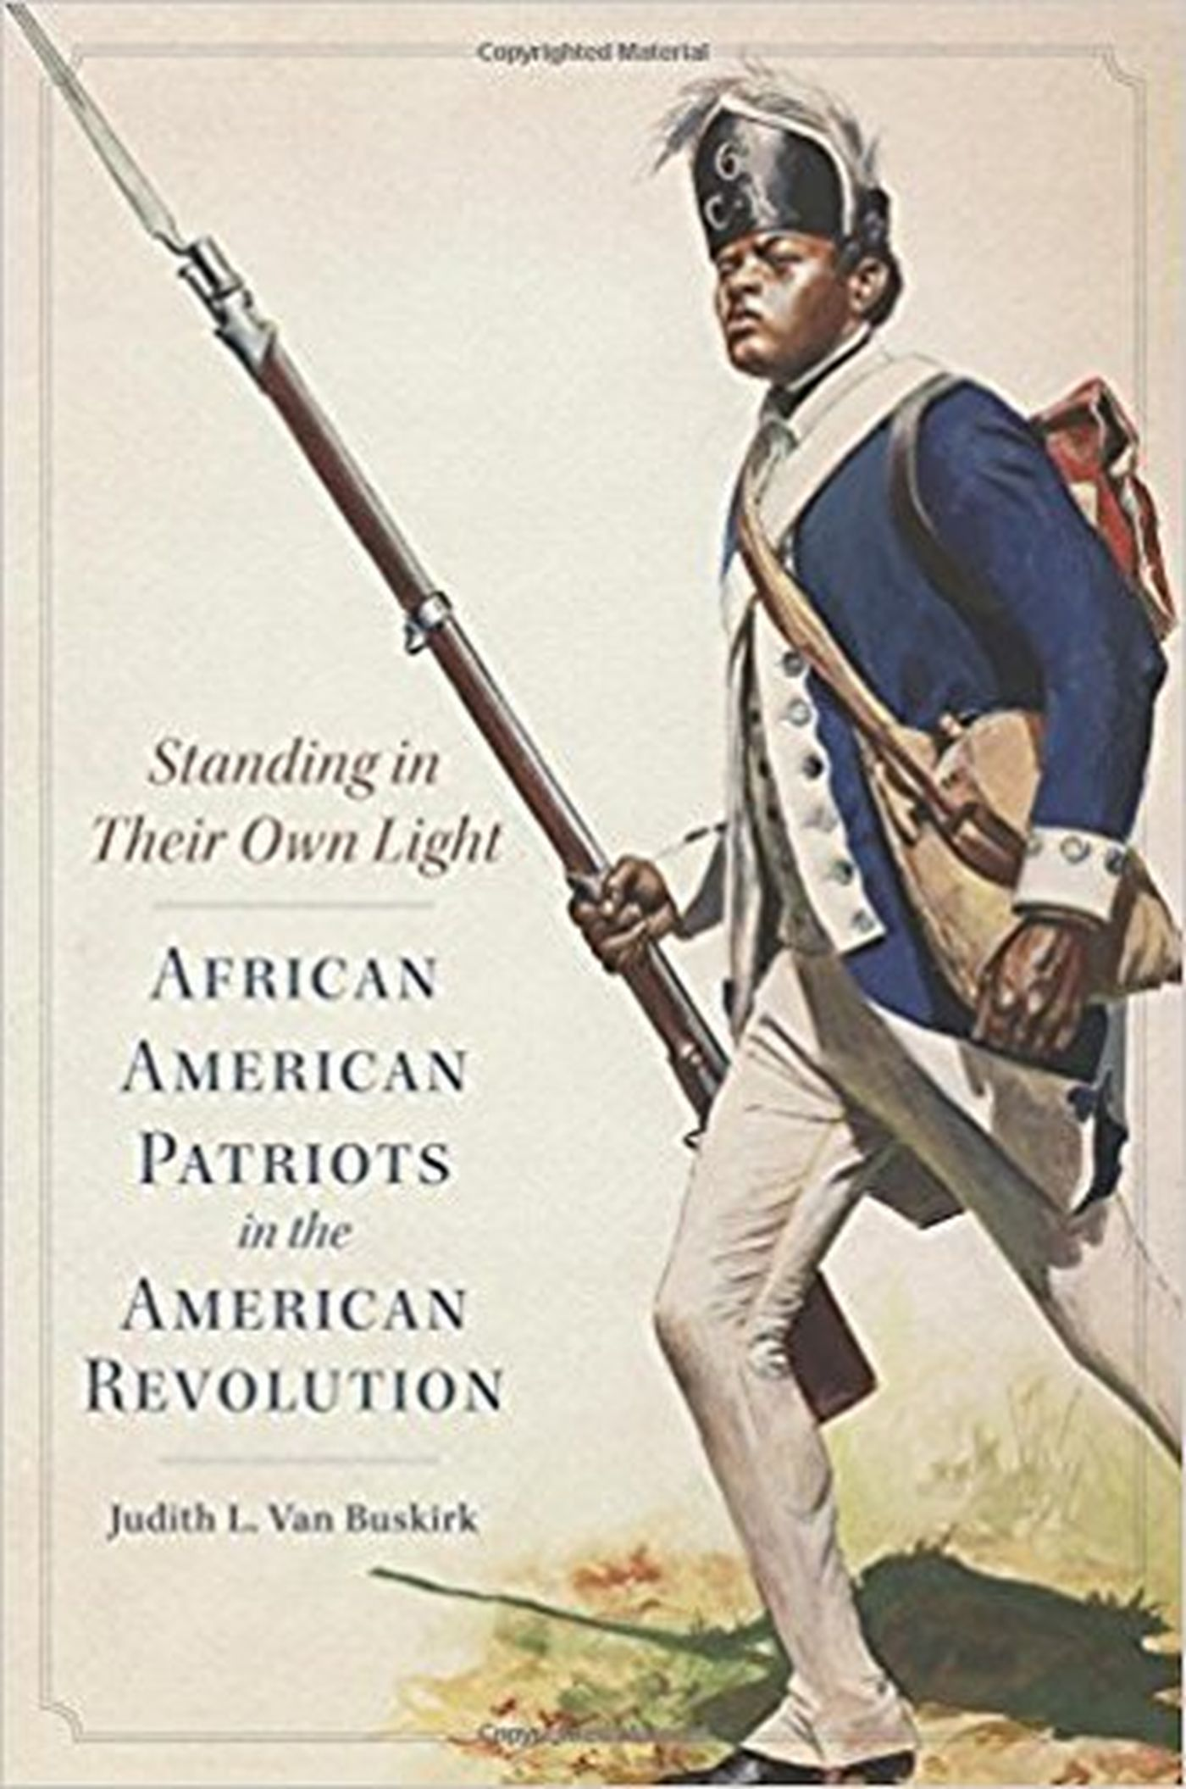
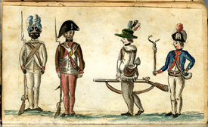

Slide 13
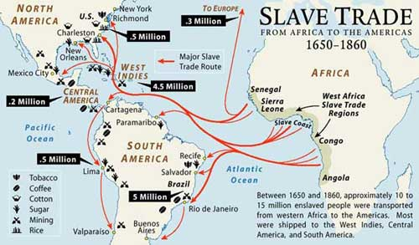

Slide 14
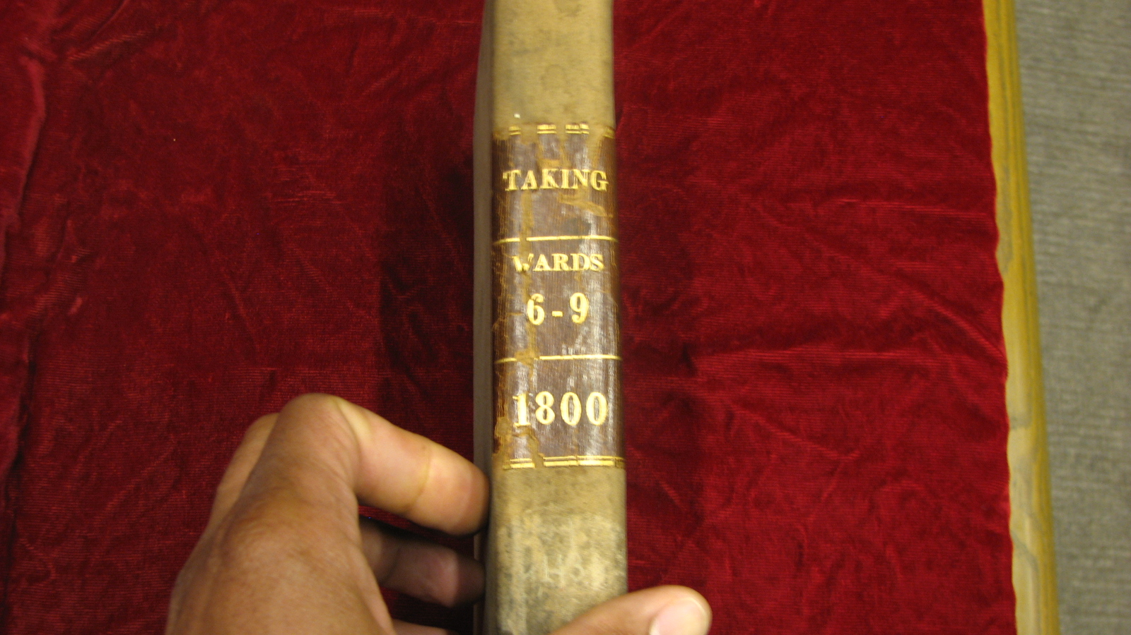

Slide 15
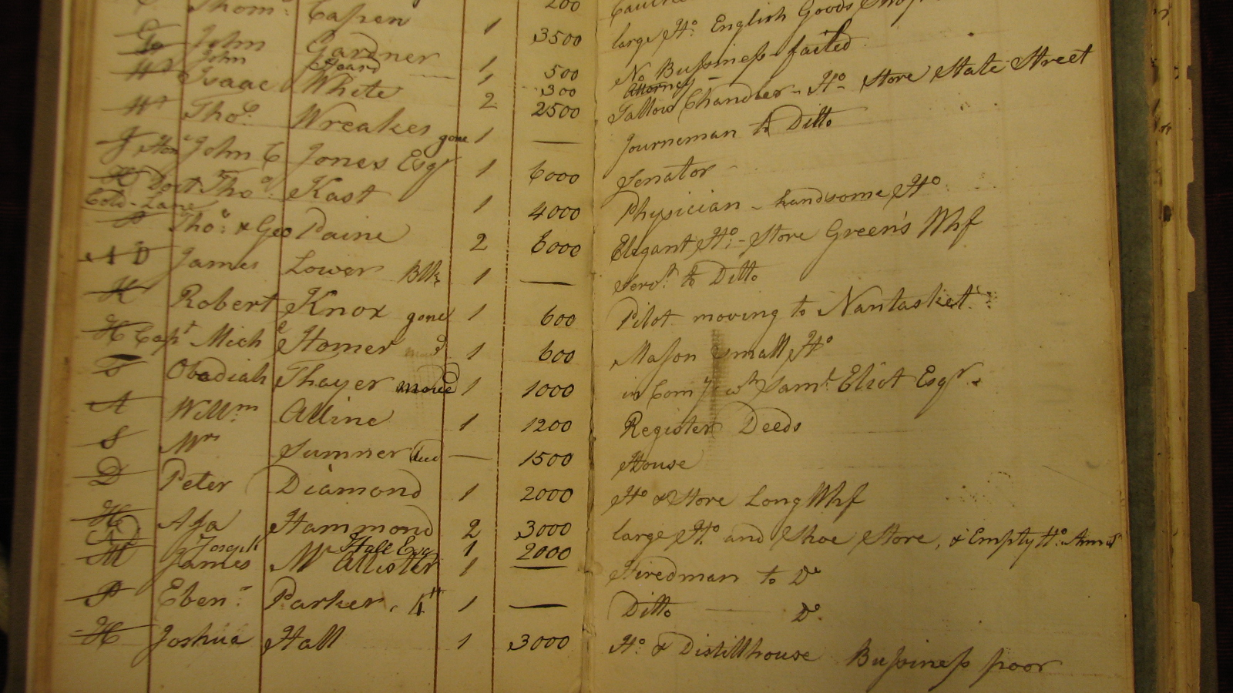

Slide 16
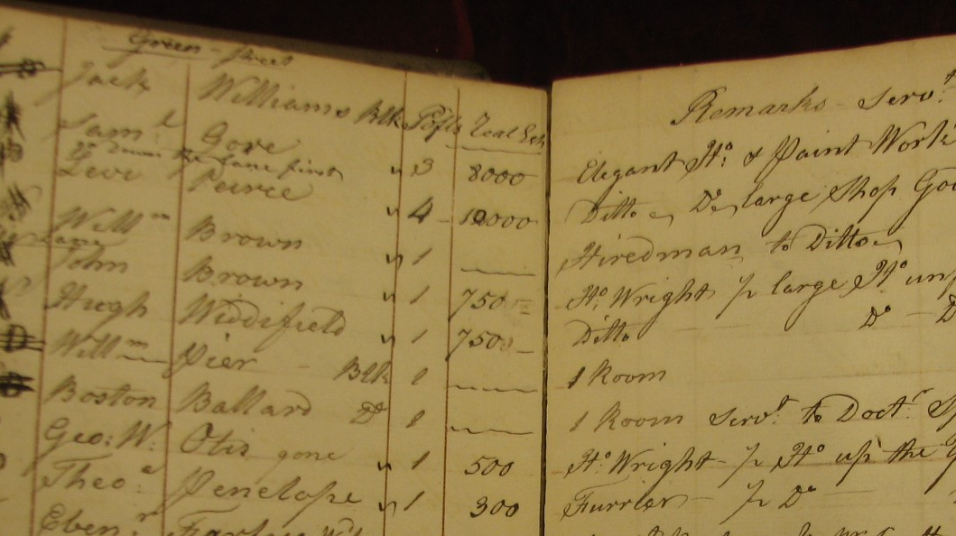

Slide 18
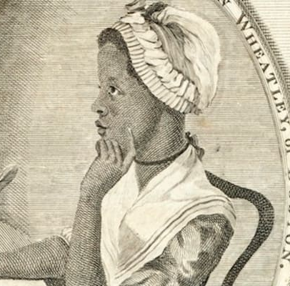
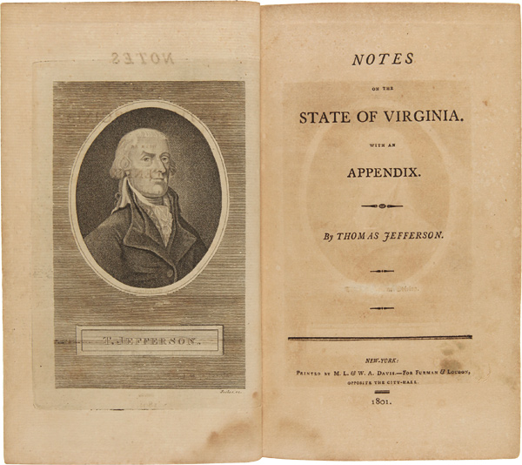

Slide 19
Religion indeed has produced a Phyllis Whately; but it could not produce a poet. The compositions published under her name are below the dignity of criticism. The heroes of the Dunciad are to her, as Hercules to the author of that poem. Ignatius Sancho has approached nearer to merit in composition; yet his letters do more honour to the heart than the head.
-Thomas Jefferson, Notes on the State of Virginia,1785, 1787

Slide 20

Indiana University Press; 2nd Edition (November 22, 1987).

Slide 21
“Declaration of Independence Proclaimed by the AFRICAN GRAND LODGE in the City of Boston Commonwealth of Massachusetts and United States of America through her Officers. Be it known to all whom it may concern That we the undersigned Past Masters of the A.G.L. being regularly made so under a Charter given to our Worthy Brothers Prince Hall, Boston Smith and Thomas Saunderson (colored brethren) by Lord Howard Earl of Effingham acting Grand Master under the authority of his Royal Highness, Henry Frederick Duke of Cumberland &c, &c, &c Grand Master of the most Ancient and Honorable Society of free and accepted Masons. We assume and take upon ourselves the responsibility of declaring ourselves free from the government and control of our Mother the Grand Lodge of England, by whom our Charter dated the twenty-ninth day of September AL 5784 AD 1784 bearing the Grand Seal of London was given _ or, any other Lodge or Lodges whatsoever_Allowing ourselves to be bound however to the most excellent principles and solemnities of Ancient Free Masonry….”
(Records of African Lodge, microfilm, Massachusetts Grand Lodge, Boston, Massachusetts)

