Slide 1
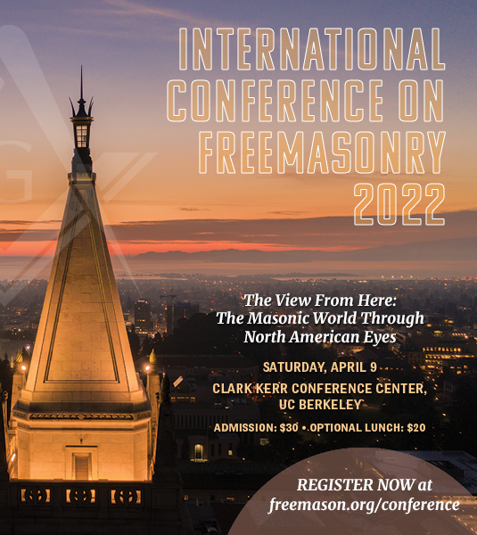
Trans-Atlantic Perspectives on Freemasonry: German Immigrant Lodges in the USA
Dr. Andreas Önnerfors
hyperhelikon@gmail.com

Slide 2
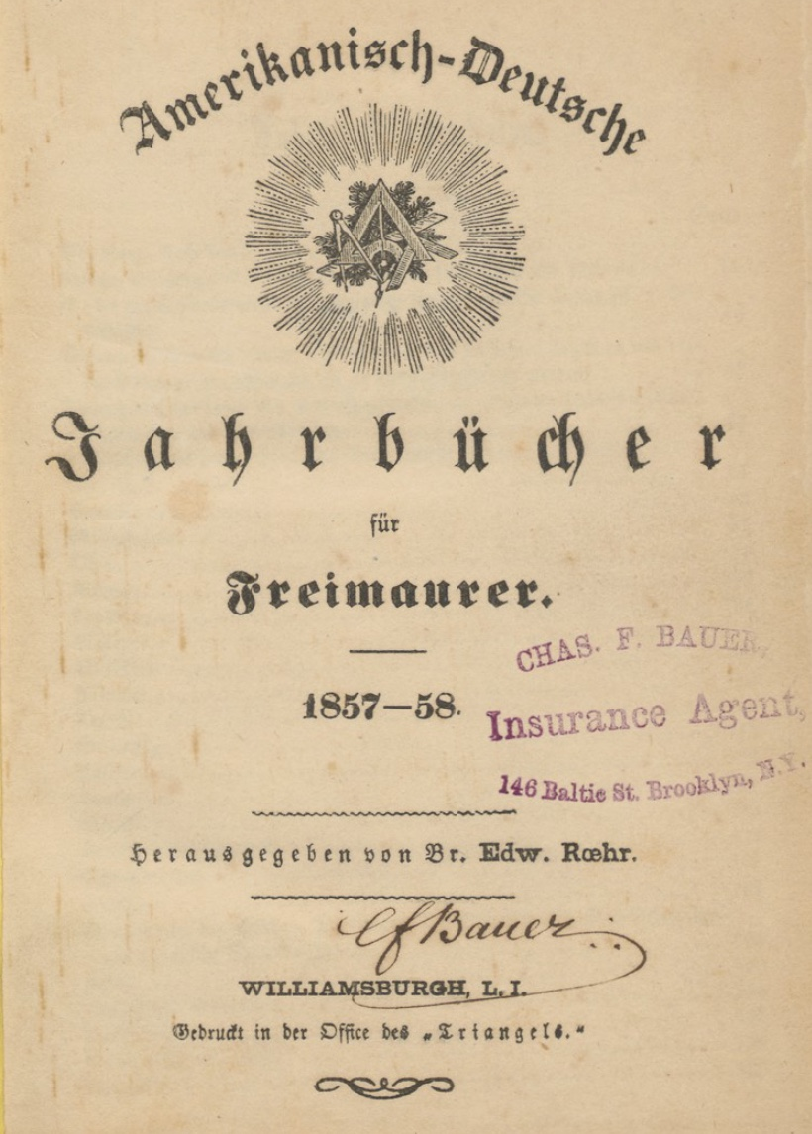
Scope
(I) Trans-Atlantic entanglements in Freemasonry
(II) German immigration and Freemasonry in the USA
(III) The intersection of immigration and identity-formation exemplified by Freemasonry

Slide 3
(I) Trans-Atlantic Entanglements
Consecration of lodge Pythagoras No. 1 in Brooklyn 2 May 1851
”to facilitate this more intimate union between our German and American brothers, in order to further the best of freemasonry in general” and
“become the binding force of the Arch uniting the basic pillars, the Grand lodges on this and that side of the Atlantic, or the chain of union, through which the life-giving spark flows from the one to the other.”
But what was behind the rhetoric?

Slide 4
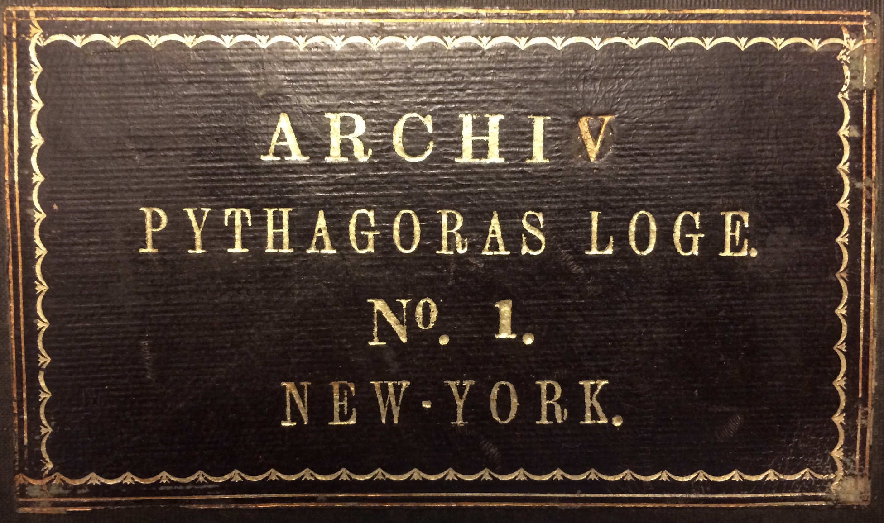
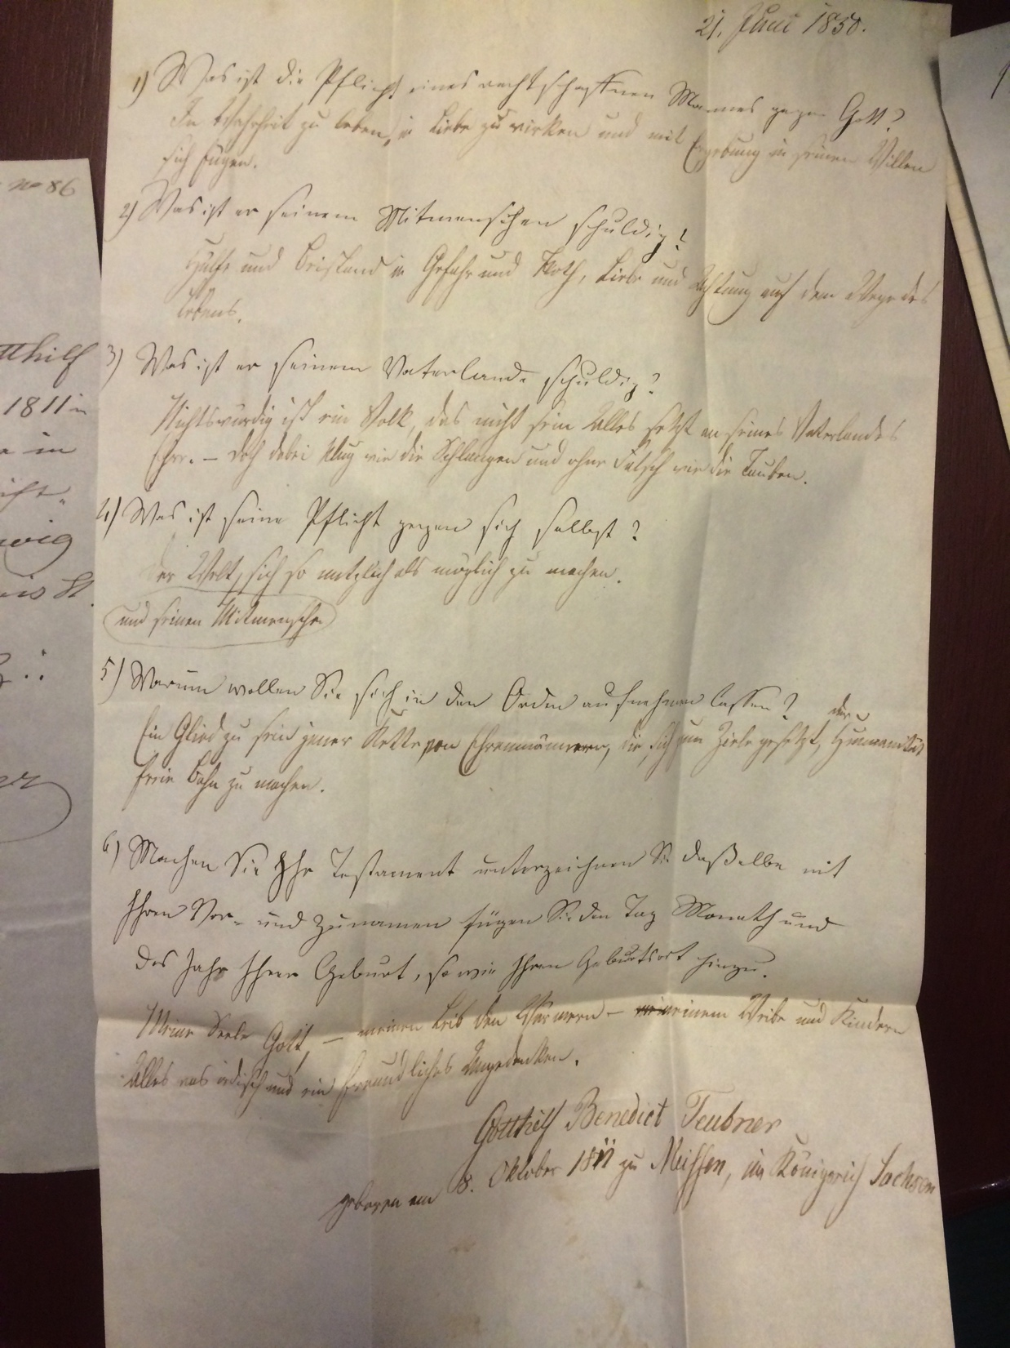
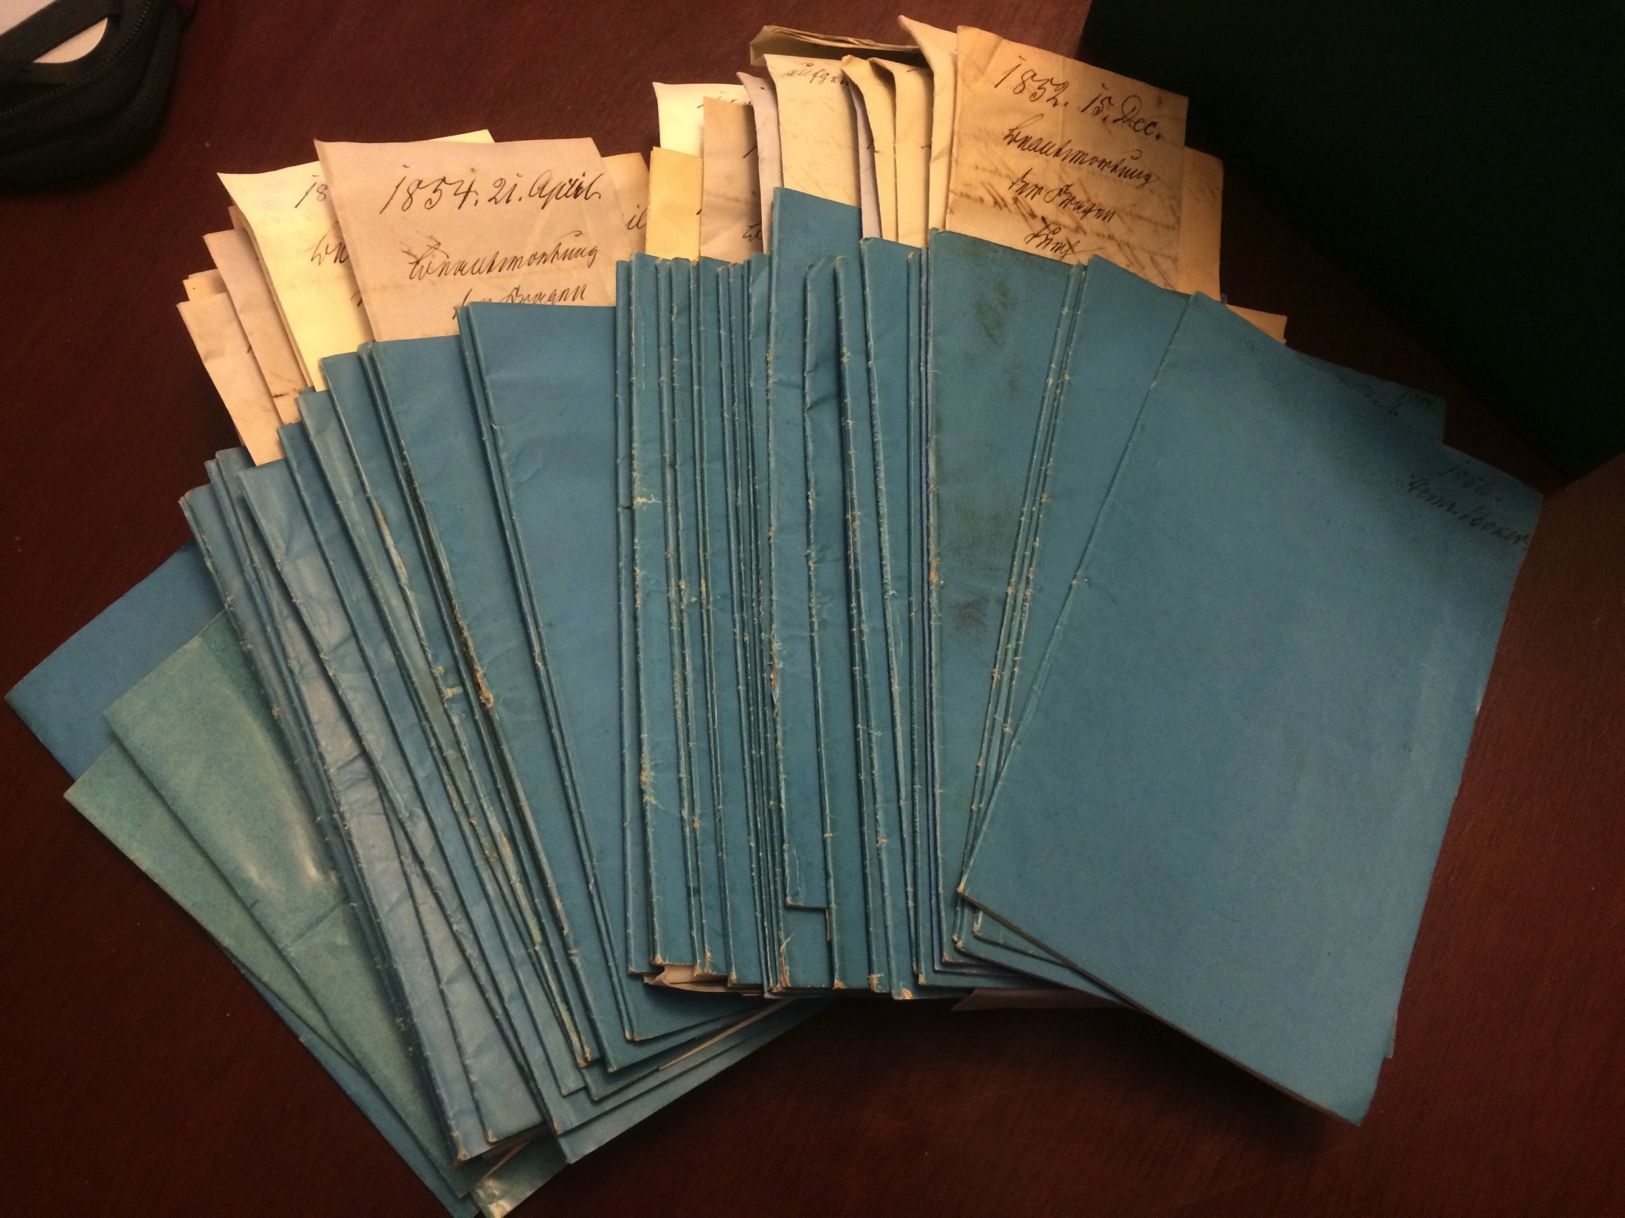
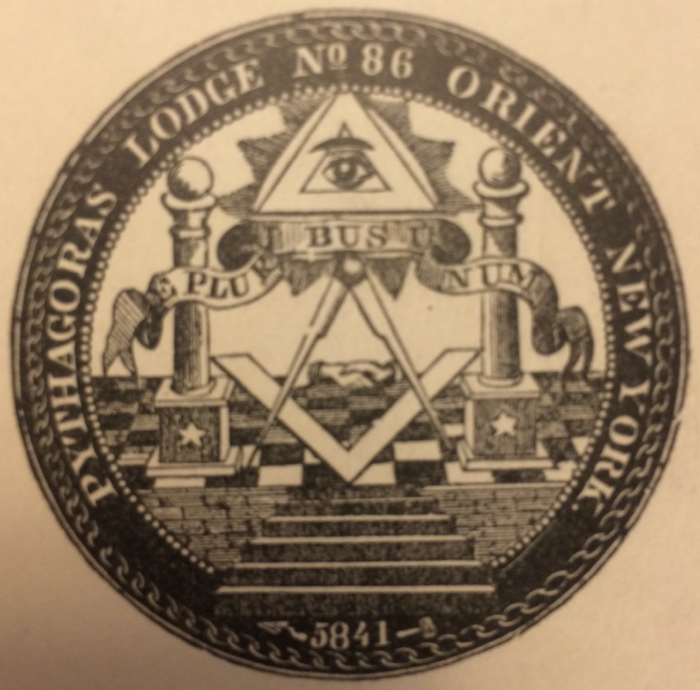
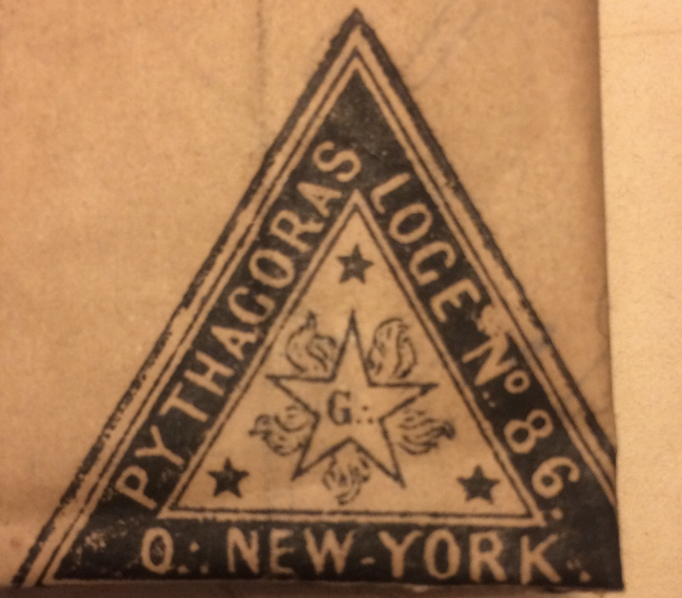
(II) German immigration and Freemasonry in the USA

Slide 5
Timeline NY Freemasonry
PGL NY (Antients) 1781 => 1784 GLNY
1822 – 1827: split between country and city GL
Morgan-affair 1826: decrease from 480 to 79 lodges in 1840 in NYC and NY state
1837 – 1859, four GL: St. John’s Grand Lodge (1837-1850), Phillips Grand Lodge (1849-1858), St. John’s Grand Lodge (revived, 1853-1859), Willards (1837 – 1859)
Trinity No. 10 (1790s), L’Union française No. 17 (1797), German Union No. 322 => Pythagoras No. 86 (1841)

Slide 6
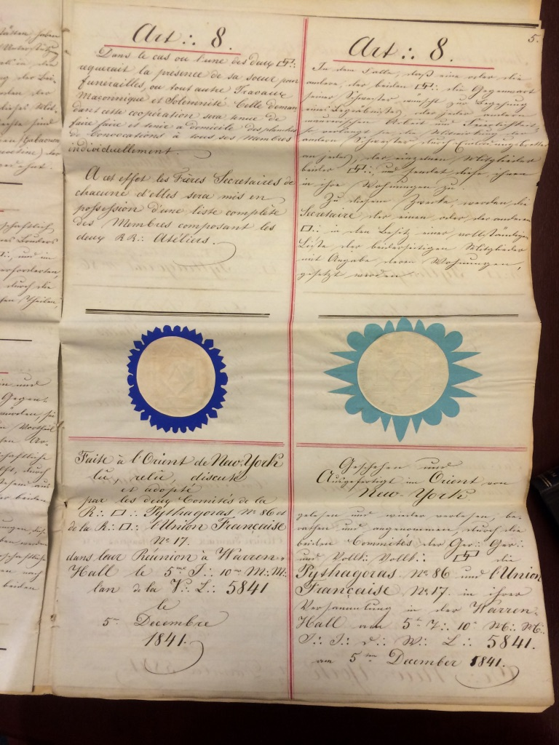
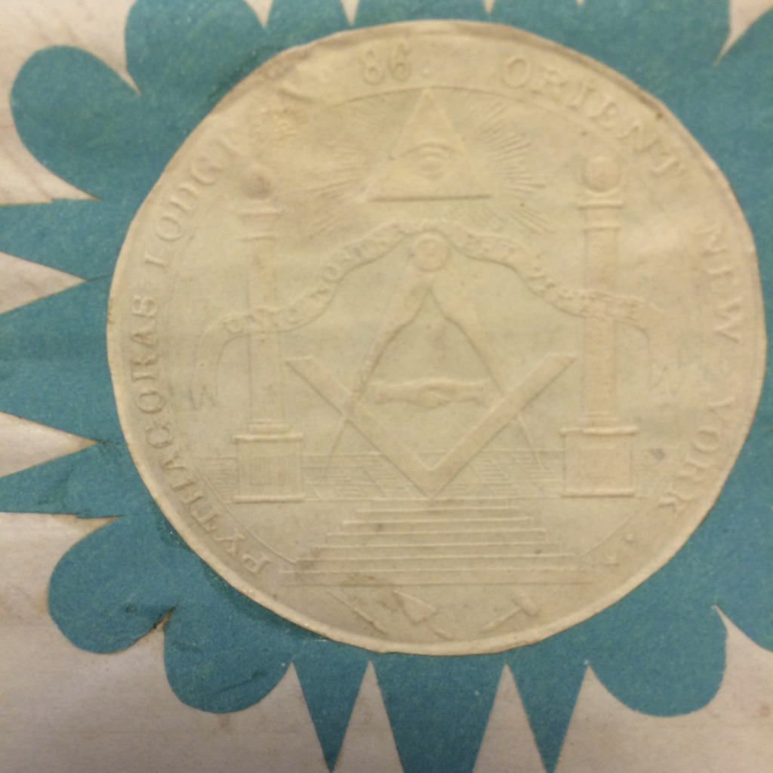
1841: Mutual affiliation between L’Union française No. 17 and Pythagoras No. 86

Slide 7
Timeline lodge(s) ‘Pythagoras’ in NY
1841-1851: Lodge Pythagoras No. 86 in GLNY (Willard?)
1851-1854: Lodge Pythagoras No. 1 in Grand Lodge of Hamburg (GLH)
1854: a split in Pythagoras No. 1 leads to re-establishment of No. 86 under GLNY (Willard?)
1854-(1884/1902): Pythagoras No. 1 in GLH
1853: Franklin No. 2 (GLH) established in Tremont in 1853.
1871: Zeton zum Licht No. 3 (GLH) etablished in Hoboken
1854-(1993): Pythagoras No. 86 in GLNY, united with Trinity No. 12 in 1993
GLH-lodges cease to exist in NY and U.S. at the end of the 19C

Slide 8
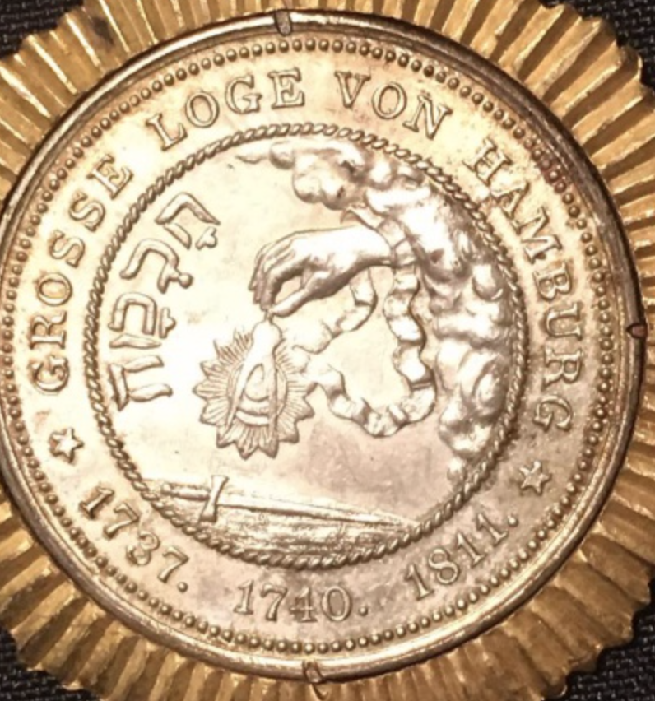
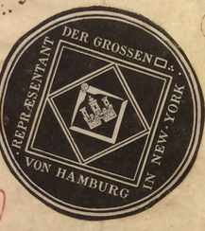
Conflict lines
‘Heart’ vs ‘Form’ of Freemasonry: GLNCY voting rights; territory and authority, territorial jurisdiction
Racial segregation of American Freemasonry: borders of Masonic cosmopolitanism (Monrovia – Hamburg – London – New York)
What does ‘Germanness’ mean in the context of exile/migration? The ‘German mission’ vs adaptation to US-values
=> Is lodge Pythagoras representative?

Slide 9
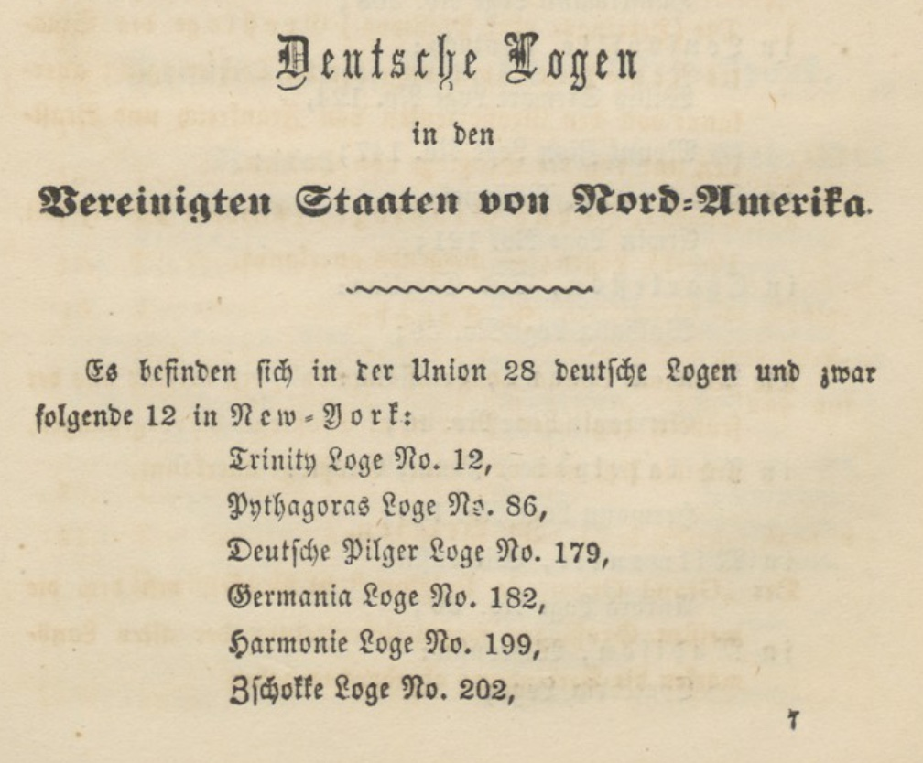
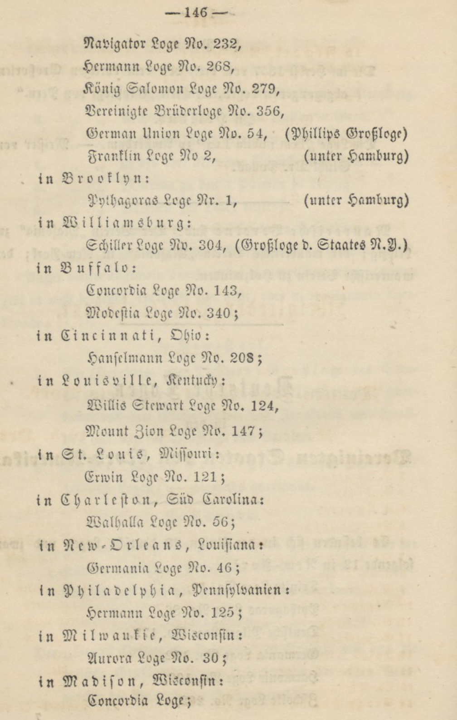
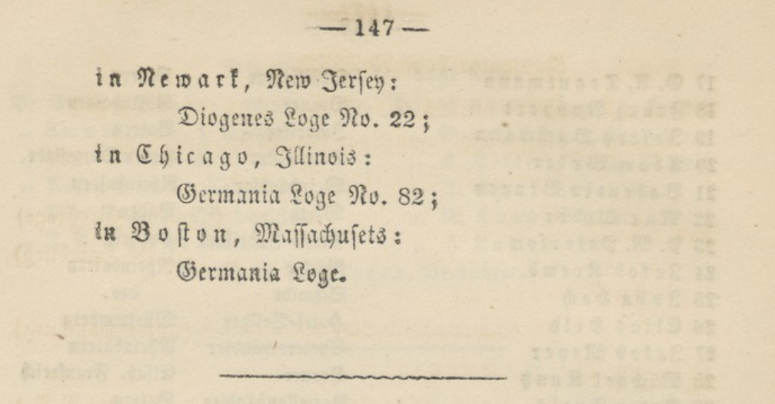
What about California?
1858 – 28 German lodges in the USA:
12 in New York
1 in Brooklyn
1 in Williamsburg
2 in Buffalo
1 in Cincinnati
2 in Louisville
1 in St. Louis
1 in Charleston
1 in New Orleans
1 in Philadelphia
1 in Milwaukee
1 in Madison
1 in Newark
1 in Chicago
1 in Boston

Slide 10
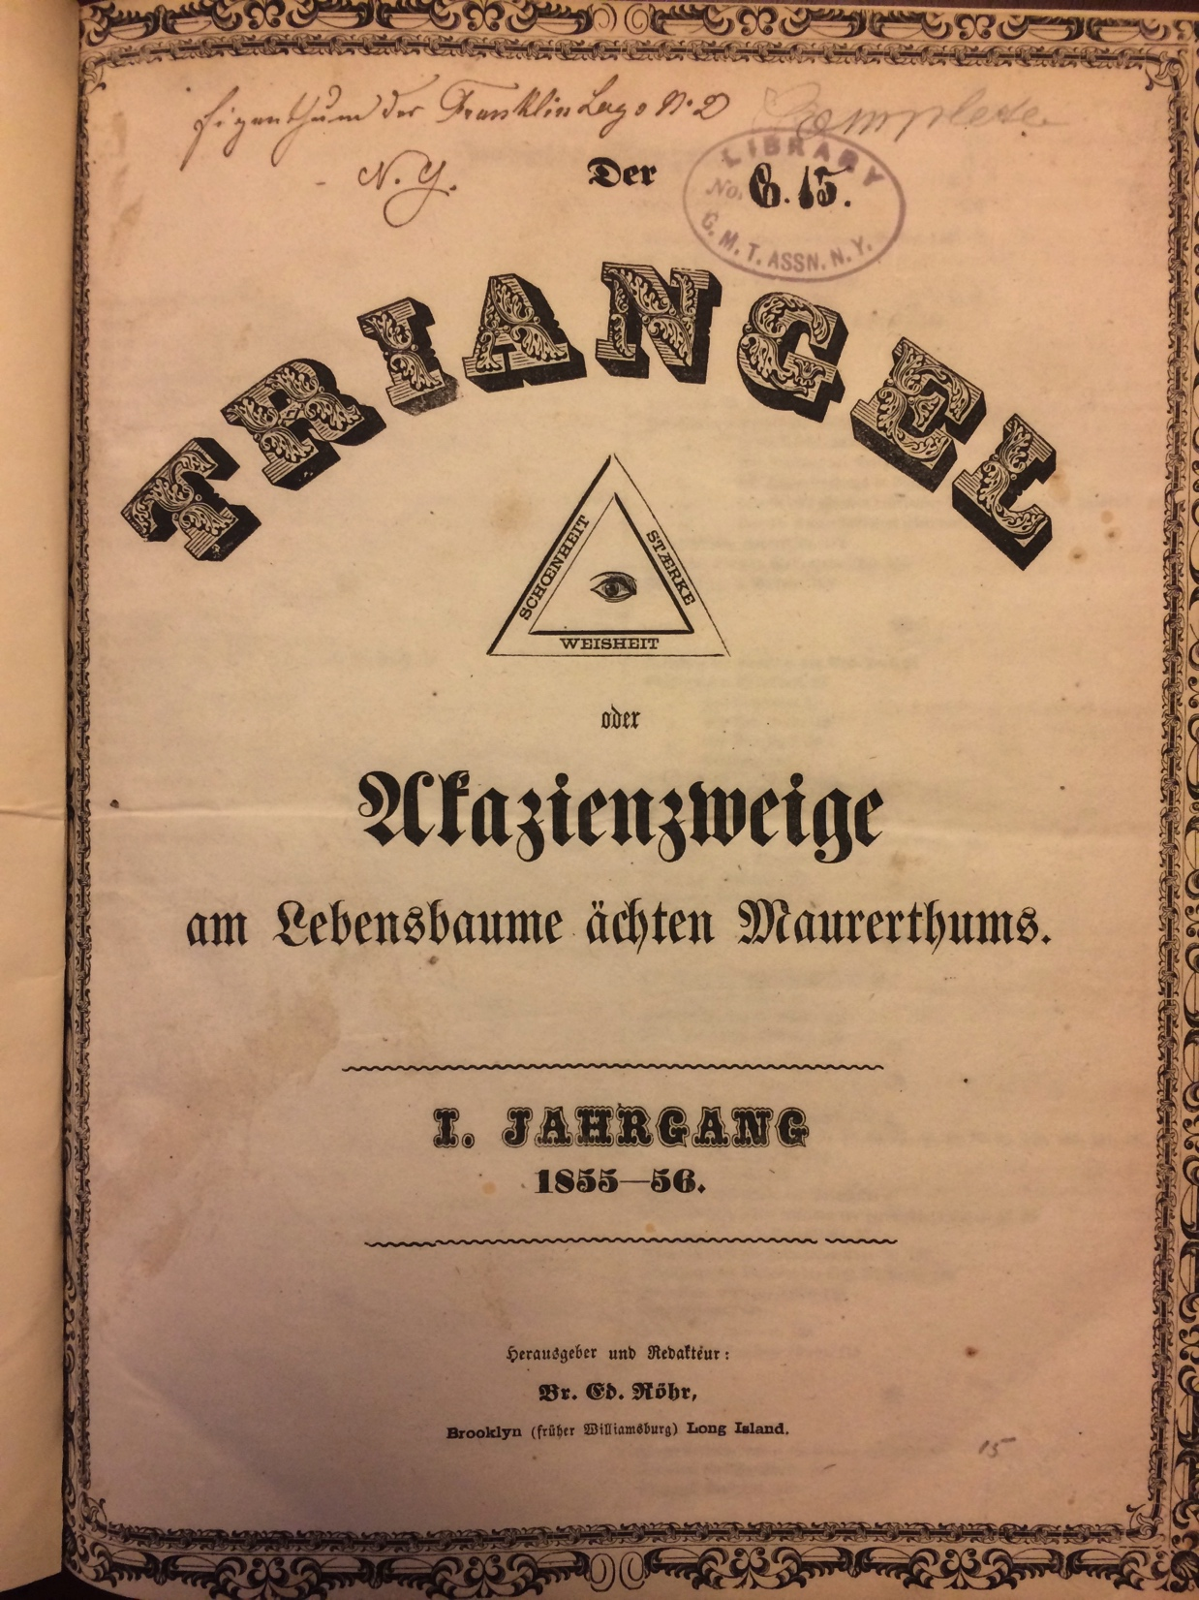
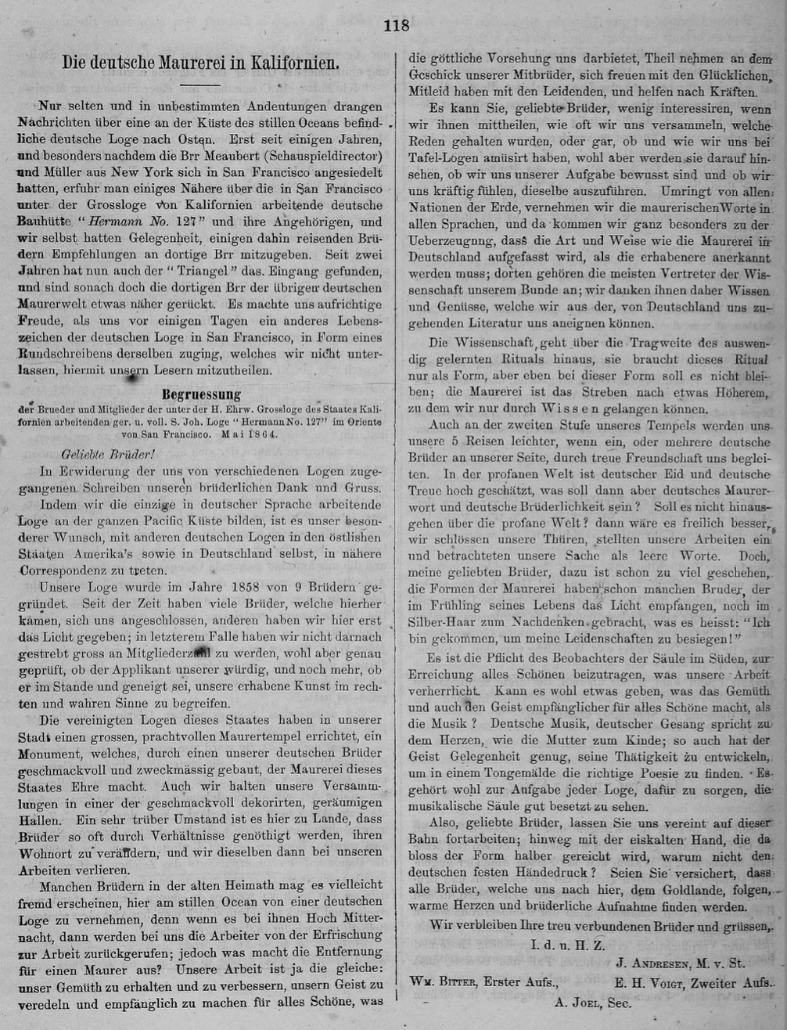
Der Triangel
1864:
First notice of lodge Hermann No. 127 under GLoC
Est. 1858

Slide 11
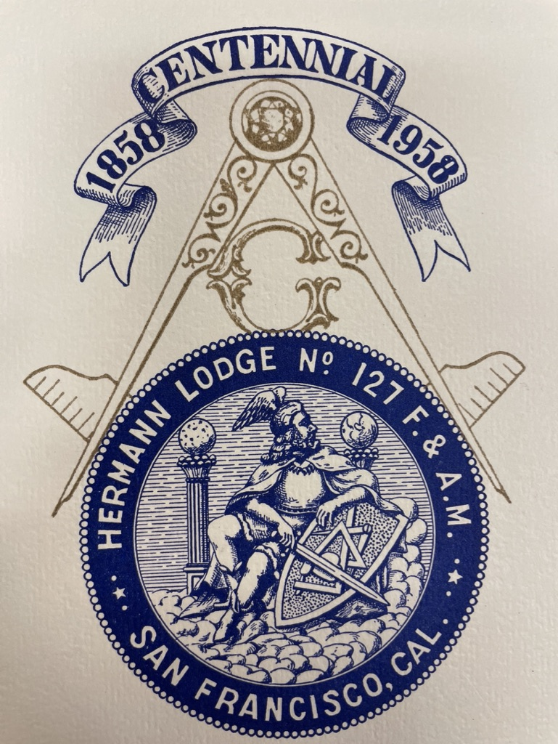
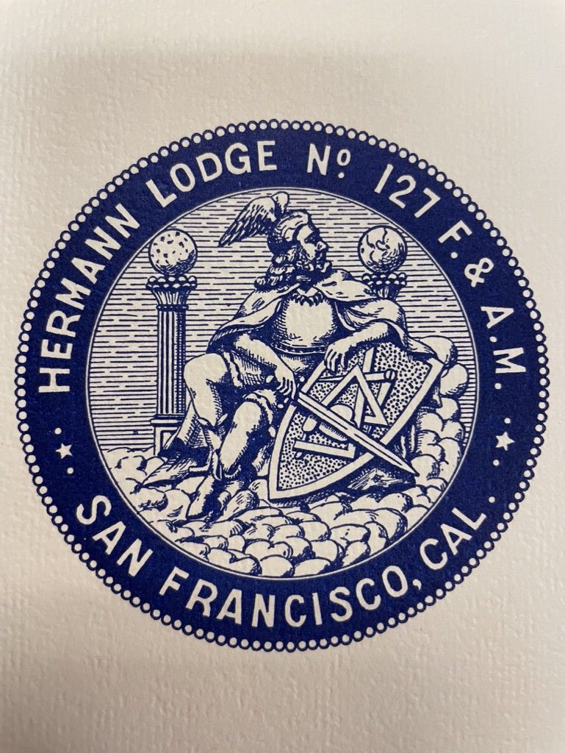
1858
–
1958

Slide 12
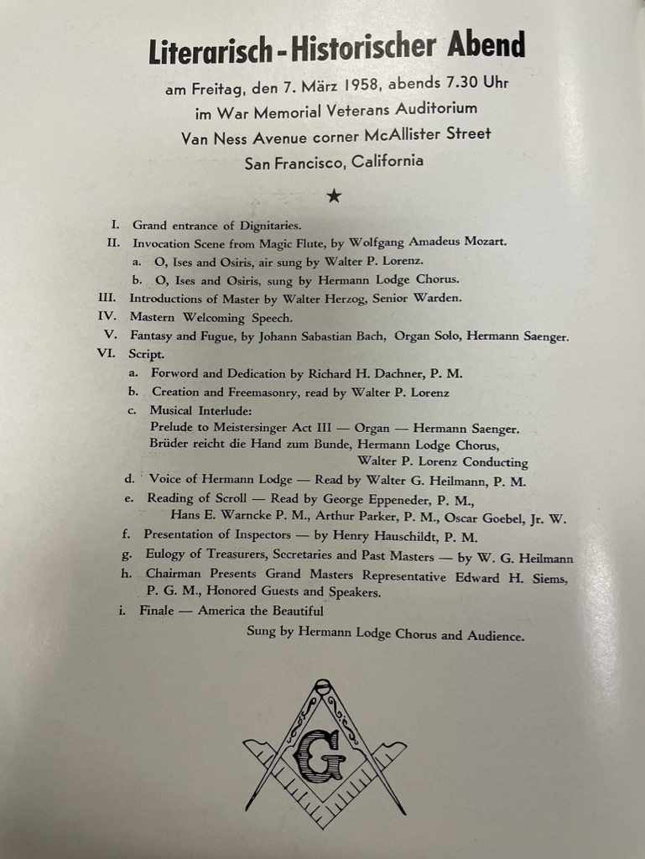
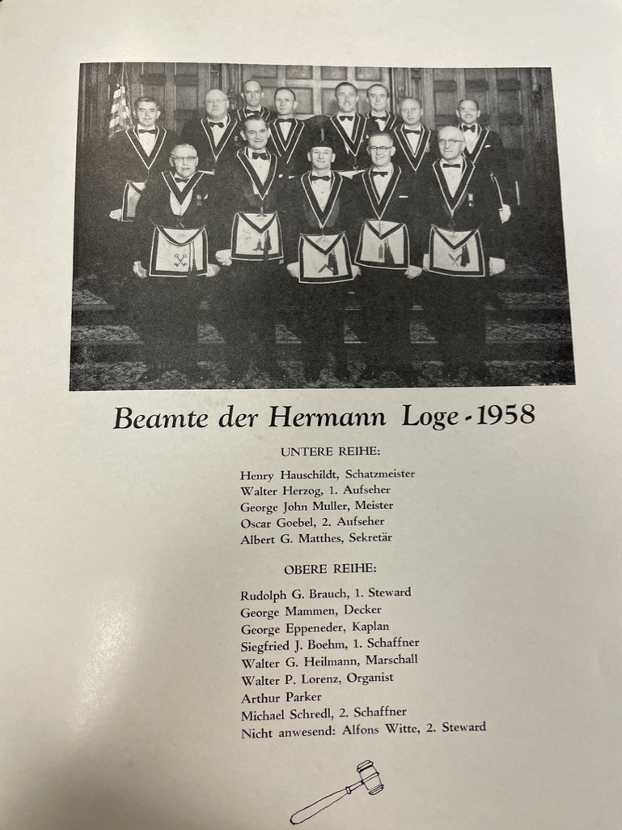

Slide 13
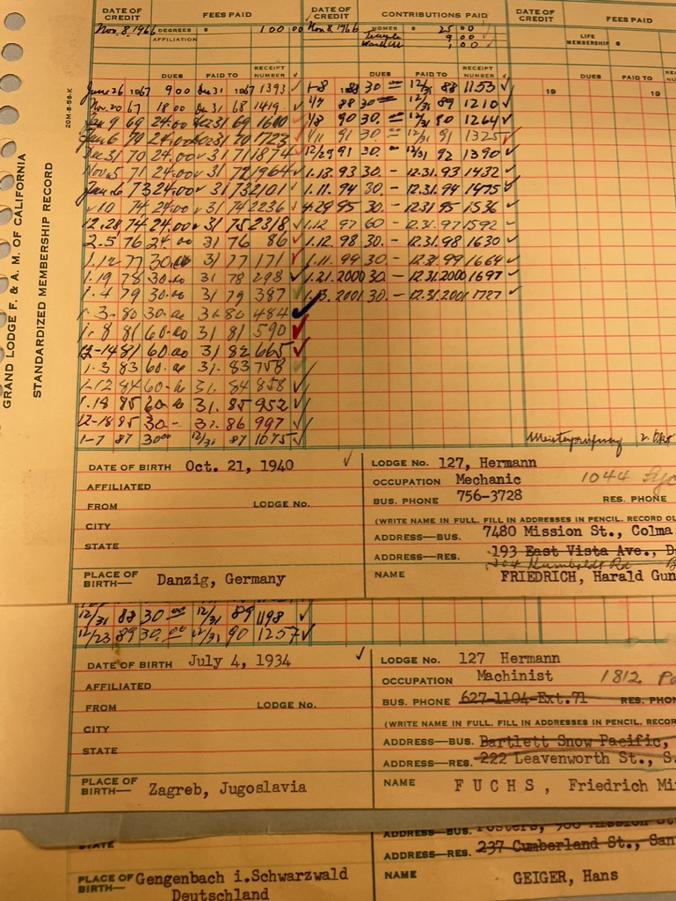
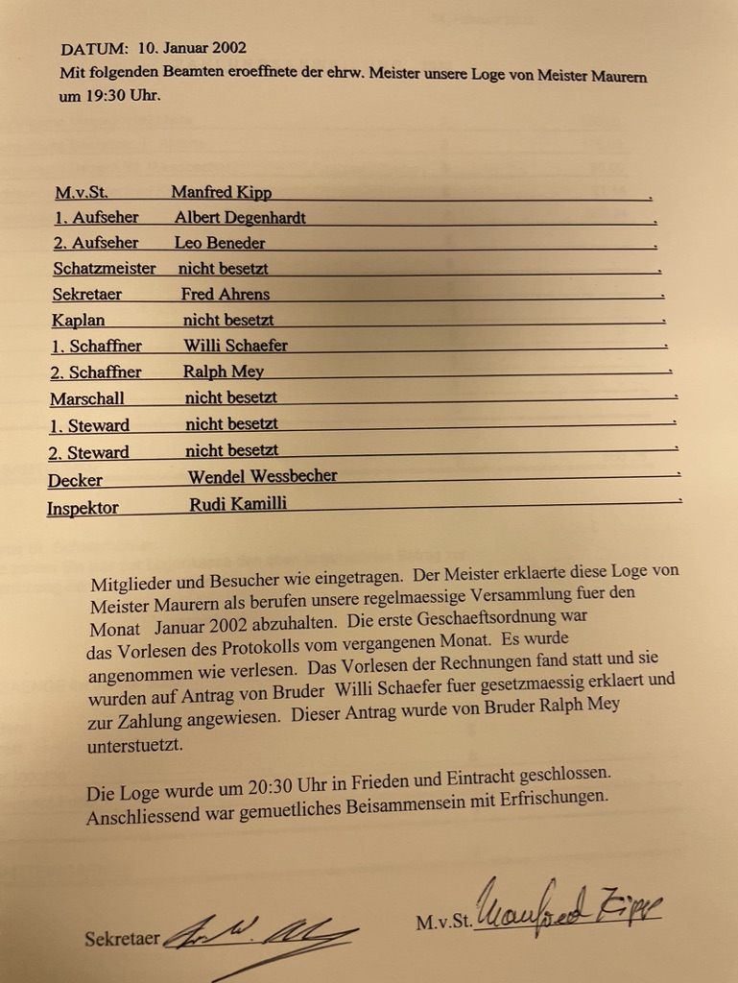

Slide 14
(III) The intersection of immigration and identity-formation exemplified by Freemasonry
Freemasonry: global circulation of people, practices and philosophies
≈ 30 – 40 German-speaking lodges in the US
How many other ‘foreign’ lodges?
Immigration implies identity choices between assimilation, adaptation and exceptionalism
The German lodges were placed in this tension between exclusionary definitions of ‘Germanness’ and integration into a larger vision of what it implies to be American or as members of lodge Hermann No. 127 put it in 1958:

Slide 15
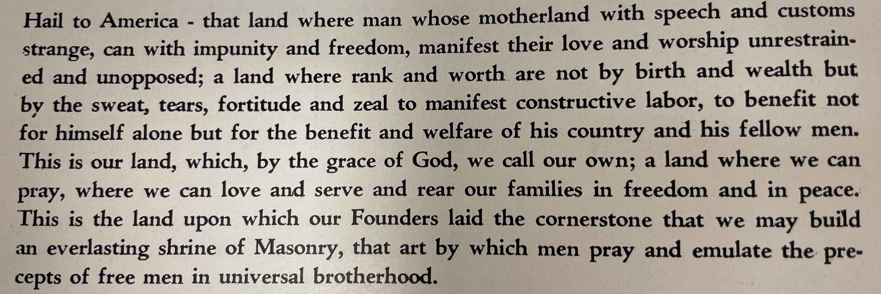
Lodge Hermann No. 127, 1958

Slide 16
Research agenda for a pilot project
Extraction of lodge membership from Amerikanisch-Deutsche Jahrhbücher and Der Triangel
Systematic mapping of archival sources related to the German lodges in the USA together with book collections and artefacts
Inclusion into FactGrid database
More research into contributions of German freemasons to American freemasonry
Implications for studies into other immigrant communities
Qualitative studies

Slide 17
Further reading
”Atlantic antagonism: revolution and race in German-American masonic relations 1848-1861” in Jan Jensen and Jessica Harland-Jacobs, The Fraternal Atlantic, 1770–1930, special issue of Atlantic Studies (Taylor and Francis), Volume 16, Issue 3, 2019, 386–404
“Freedom in Fraternity? The German lodge Pythagoras No.1/86 in New York/Brooklyn and its trans-Atlantic connections in the antebellum U.S.” in Masonic Lodges and their Impact in North and South America, eds. Frank Jacob and Helmut Reinalter, Globalhistorische Komparativstudien, Vol.7, Würzburg: Königshausen & Neumann 2019, 47–69
“The Borders of Masonic Cosmopolitanism: Revolution and Race in German-American Freemasonry”, in Ars Quatuor Coronatorum, Vol 133, 2020, 13–24
“Der Triangel: A German Masonic Newspaper in the USA”, in Freemasonry on the Frontier (Ed. John Wade), London: Lewis Masonic, 2021, 115–132

